Slide 1
HTTP
Lovász Kristóf
CONFIDENTIAL | © 2020 EPAM Systems, Inc.

Slide 2

Kristóf Lovász
Software Engineer at EPAM
Current Project Role: Software Engineer
Primary Skill: Scala Backend Development
Secondary Skill: Java Backend Development
Experience in backend application development
Used Spring Framework
Currently using AWS serverless architecture (Java)
Other interest:
React development
Contact:
Kristof_Lovasz@epam.com

Slide 3

Agenda
1
Client Server architecture
2
HTTP
3
demo

Slide 4
Client Server architecture

Slide 5

Client-Server Architecture

Slide 6
Basic building stones of the web
HTTP as protocol
HTML as document format
CSS as formatting language
JavaScript to run code inside the browser

Slide 7
HTTP Client

Slide 8

HTTP Server
Apache HTTP Server
Nginx
Apache Tomcat
Jetty
...

Slide 9
HTTP

Slide 10
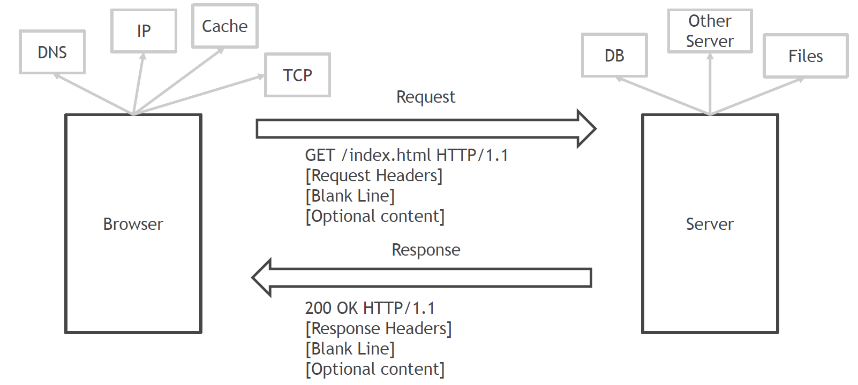
HTTP

Slide 11
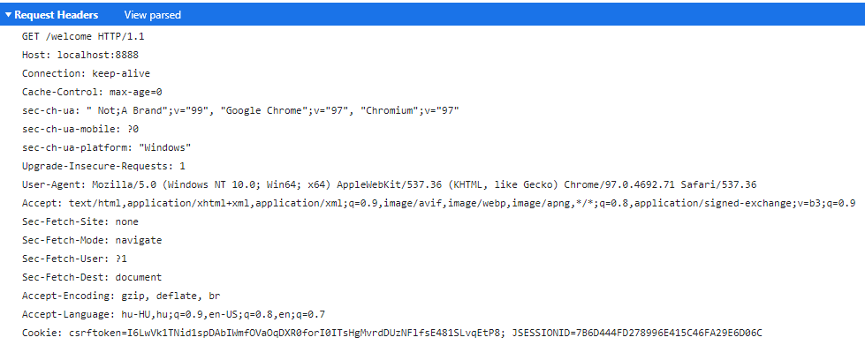
HTTP Request - GET

Slide 12
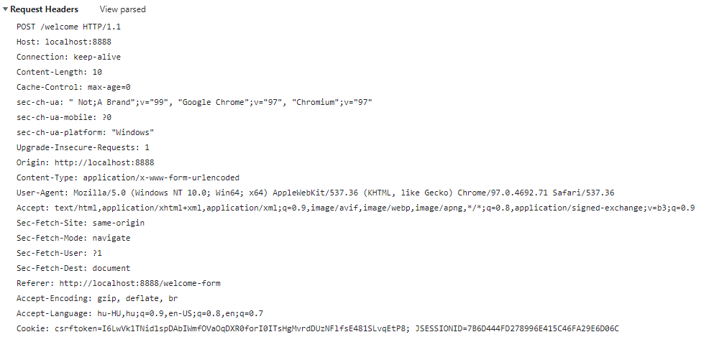

HTTP Request - POST

Slide 13
HTTP Methods
Get: The GET method requests a representation of the specified resource. Requests using GET should only retrieve data.
Head: The HEAD method asks for a response identical to a GET request, but without the response body.
Post: The POST method submits an entity to the specified resource, often causing a change in state or side effects on the server.
Put: The PUT method replaces all current representations of the target resource with the request payload.
Delete: The DELETE method deletes the specified resource.
Connect: The CONNECT method establishes a tunnel to the server identified by the target resource.
Options: The OPTIONS method describes the communication options for the target resource.
Trace: The TRACE method performs a message loop-back test along the path to the target resource.
Patch: The PATCH method applies partial modifications to a resource.

Slide 14
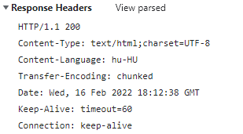
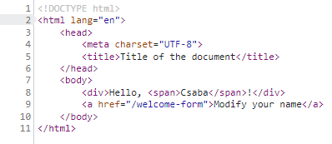
HTTP Response

Slide 15

HTTP Status Codes
Informational responses (100 – 199): An informational response indicates that the request was received and understood.
Successful responses (200 – 299): This class of status codes indicates the action requested by the client was received, understood, and accepted.
HTTP 200 OK
Redirection messages (300 – 399): This class of status code indicates the client must take additional action to complete the request.
Client error responses (400 – 499): This class of status code is intended for situations in which the error seems to have been caused by the client.
HTTP 404 Not Found
HTTP 418 I’m a teapot
Server error responses (500 – 599): The server failed to fulfil a request.
HTTP 500 Internal Server Error

Slide 16
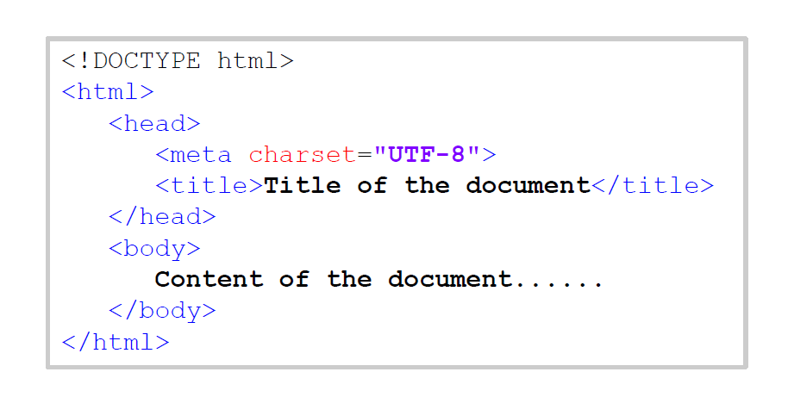
HTML

Slide 17
demo

