Slide 1

Single Page Application & React.js
MARCH 2025

Slide 2
Single Page Application (SPA)
Loads a single HTML page
Dynamically updates content using JavaScript
Pros: faster user experience, reduced server load
Cons: SEO challenges, bigger initial bundle

Slide 3
React.js
Also known as ReactJS or React
Declarative, component-based
JavaScript library for building interactive Uis
JSX: Merging HTML and JavaScript within a single code file
Not a full framework – often requires additional tools
Maintained by Facebook (Meta), open-source project

Slide 4
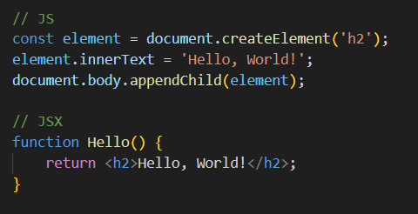
Practice
Vanilla JS vs. JSX

Slide 5
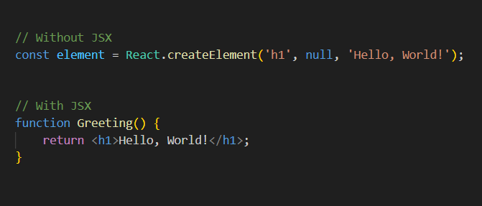
Practice
Components and JSX

Slide 6
Class vs. Function Components
Legacy: class-based
Modern approach: function + hooks
Shorter, more intuitive code

Slide 7
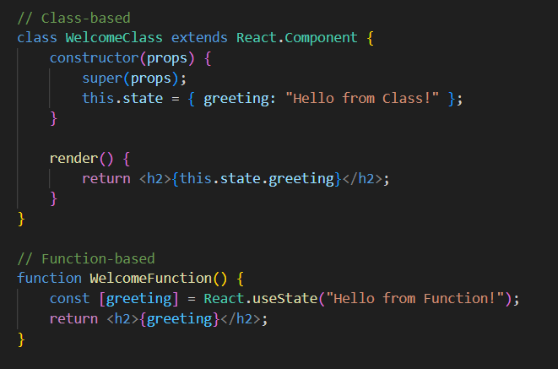
Practice
Class vs. Function Components

Slide 8
Fragments in React
Avoid extra wrappers like <div>
React.Fragment or <> syntax
Clean, minimal HTML structure
Typical use cases: lists, tables

Slide 9
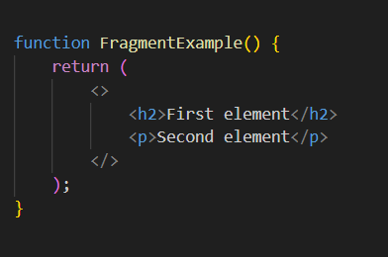
Practice
Fragments in React

Slide 10
Virtual DOM and Rendering
Memory-based representation of the DOM
Diffing algorithm for minimal real DOM updates

Slide 11
State and Props
State: internal component data (useState)
Props: data passed from parent
Unidirectional data flow

Slide 12
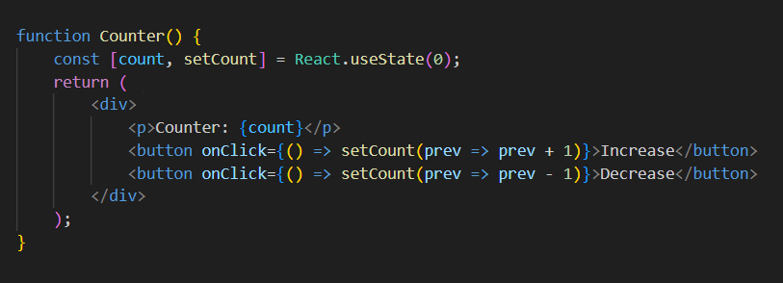
Practice
State and Props

Slide 13
useEffect and Side Effects
Manages lifecycle events (API calls, timers)
Cleanup functions

Slide 14
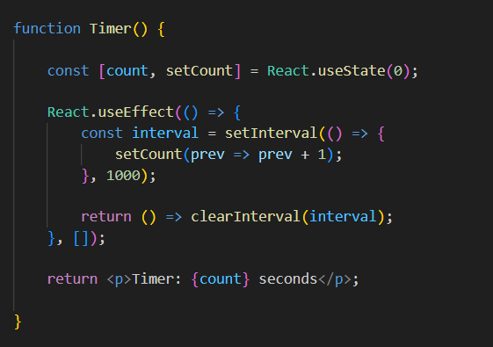
Practice
useEffect and Side Effects

Slide 15
Event Handling
Synthetic Events in React
Common event handlers: onClick, onChange, onSubmit
Real-time form updates
Keys for list items

Slide 16
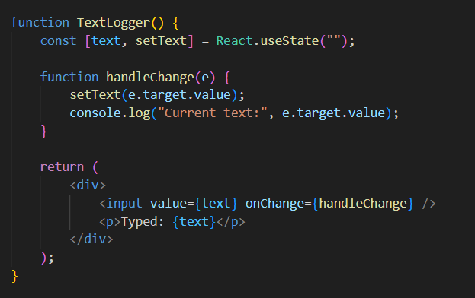
Practice
Event Handling

Slide 17
Pure Functions & Memoization
Pure function - same input, same output
Avoid redundant computations with useMemo, React.memo
Example: heavy calculation
Memoization basics

Slide 18
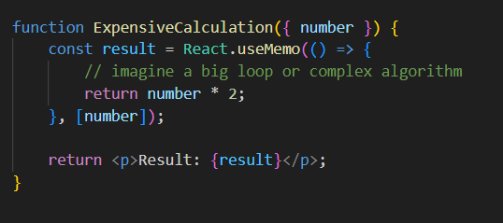
Practice
Pure Functions & Memoization

Slide 19
Rendering Lists (and Arrays)
Using map() to display lists
Keys for efficient updates

Slide 20
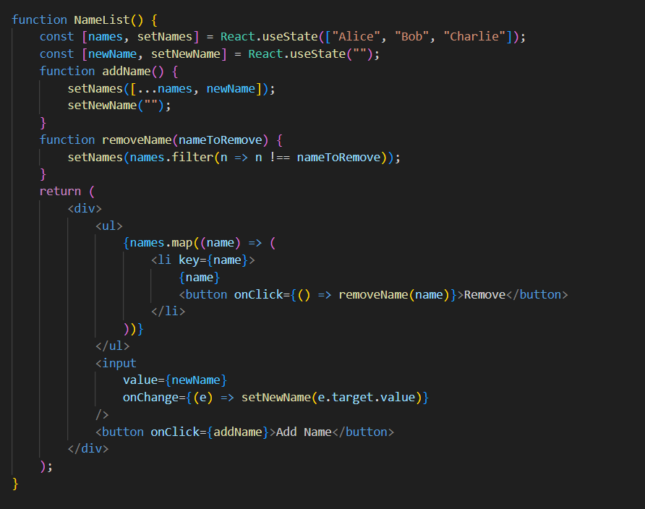
Practice
Rendering Lists

Slide 21
React DevTools
Inspect component tree
Check state, props, performance
Profiler tab for optimizing

Slide 22

Thank you!
For more information, contact
Forray Mihály
Lead Software Engineer
Mihaly_Forray@epam.com

