Slide 1

CI/CD and other useful concepts
MAY 2025

Slide 2
Contents
1
Unit testing
2
CI/CD
3
Deploying to Vercel
4
Tooling / monitoring / logging ...

Slide 3
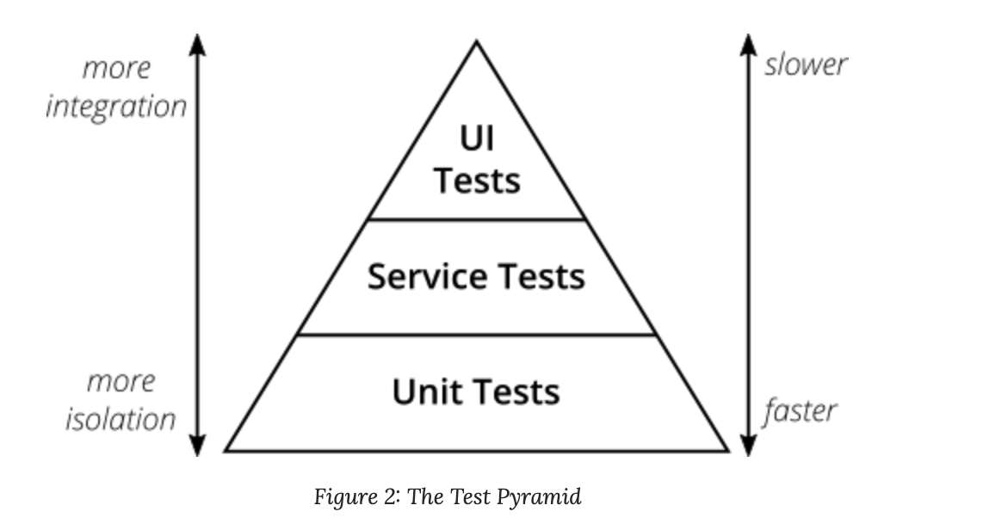
Unit Testing
https://martinfowler.com/articles/practical-test-pyramid.html

Slide 4
Unit Testing
Fast 20ms
Isolated can/should run on its own
Repeatable the same result always
Self-verifying makes sense
Timely written before prod

Slide 5
Unit Testing
Arrange – Act - Assert

Slide 6
Unit Testing
jest / mocha / vitest / ...
Apply common sense!
Always commenting `// Arrange` before arrangements and having 1 complex expect could be wrong too
Follow project conventions
One `it` should cover 1 case if your sentence contains „and” or „or” it’s usually a separate `it`
Components (JSX) can/should be unit tested too!
Sometimes integration-like tests could be better
For coverage
For minimal amount of mocks
For common sense

Slide 7
Unit Testing
Continuous
Integration
Deployment

Slide 8
CI/CD
Integration
automatic building and testing what gets merged to master (even before), so it’s always ”in a good shape”
Deployment
what gets pused to end users automatically
Continuous Delivery ---> ready to go, but might require manual steps

Slide 9
CI/CD
Usually comes with defining a pipeline of steps e.g.
checkout repository
build
test
generate test report
static code analysis (e.g. SonarQube)
generate package to be published
publish package
create docker image
...
send email about the run
...
Steps in the pipeline usually generate „artifacts"

Slide 10
Vercel
Vercel provides the developer tools and cloud infrastructure to build, scale, and secure a faster, more personalized web ~ https://vercel.com/home

Slide 11
Vercel
Simple interface
Many templates
CRA
Vite
Next.js
Many services
DB
Monitoring/tooling
...
Community support
Local development support
Integration with GitHub
Has free tier :)

Slide 12
Vercel + Tooling
See during live coding...

Slide 13

Thank you!
..and now some live coding...
Jordan Szalontai
Lead Software Engineer
Jordan_Szalontai@epam.com

