Slide 1

React.js Routing & Store & Optimization
MARCH 2025

Slide 2
Before React Router: History API
What is the History API?:
Part of the browser's built-in Web APIs.
Used to manipulate and observe the browser's session history.
Methods in the History API:
`history.pushState()`: Adds a new entry to the session history
`history.replaceState()`: Modifies the current history entry
`window.onpopstate`: Handles back/forward navigation events.
‘history.back()’ / ‘history.forward()’
‘history.go(-1)’: move back one page
https://developer.mozilla.org/en-US/docs/Web/API/History_API

Slide 3
History API: The Drawbacks
You would have to manually update the UI based on the current URL, which gets complicated for apps with many views.
Managing state and navigation logic separately often leads to duplication and errors.
This approach works well for small use cases but doesn't scale well for modern SPAs.

Slide 4
React Router Builds on History API
React Router is built on top of the browser's History API.
Enhancements:
Automates UI updates based on route changes.
Integrates routing directly with React’s component-based architecture
Why React Router is Better:
Adds abstraction for nested routes, dynamic routing and protected routes.
Simplifies navigation logic with declarative components.

Slide 5
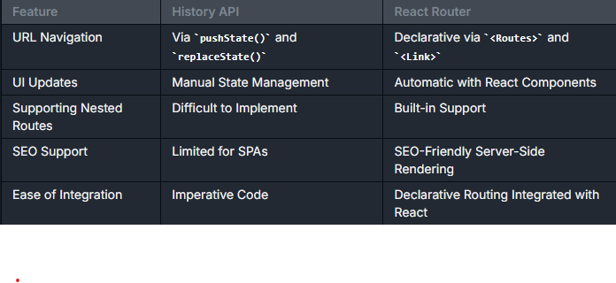
Practice
History API vs React Router

Slide 6
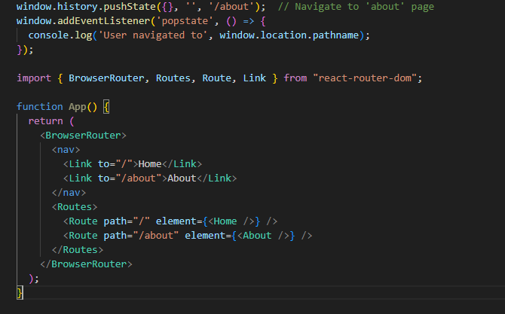
Practice
History API vs React Router

Slide 7
What is React Router?
React Router is a library for handling navigation in React applications.
Key Features:
Declarative syntax for defining routes.
Components like ‘<Routes> ‘ and ‘<Route>’ map URLs to views.
‘<Link>’ for navigation without page reloads
Nested, dynamic and protected routes

Slide 8
Core Concepts of React Router
Main Components:
‘<BrowserRouter>’: The routing provider.
‘<Routes>’: Contains all defined routes.
‘<Route>’: Maps a URL to a component
‘<Link>’: Enables navigation without reloading.

Slide 9
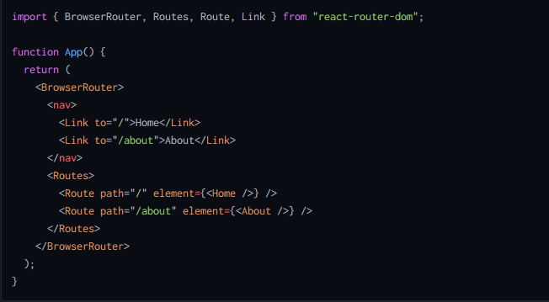
Practice
Core Concepts of React Router

Slide 10
Advanced Routing Features
Nested Routes:
Routes that share layouts or parent components
Dynamic Routes:
Pass parameters like IDs in the URL (e.g. ‘/user/:id’)

Slide 11
Protected Routes
What Are Protected Routes?
Certain routes should only be accessed by authenticated users (e.g., ‘/dashboard’)

Slide 12
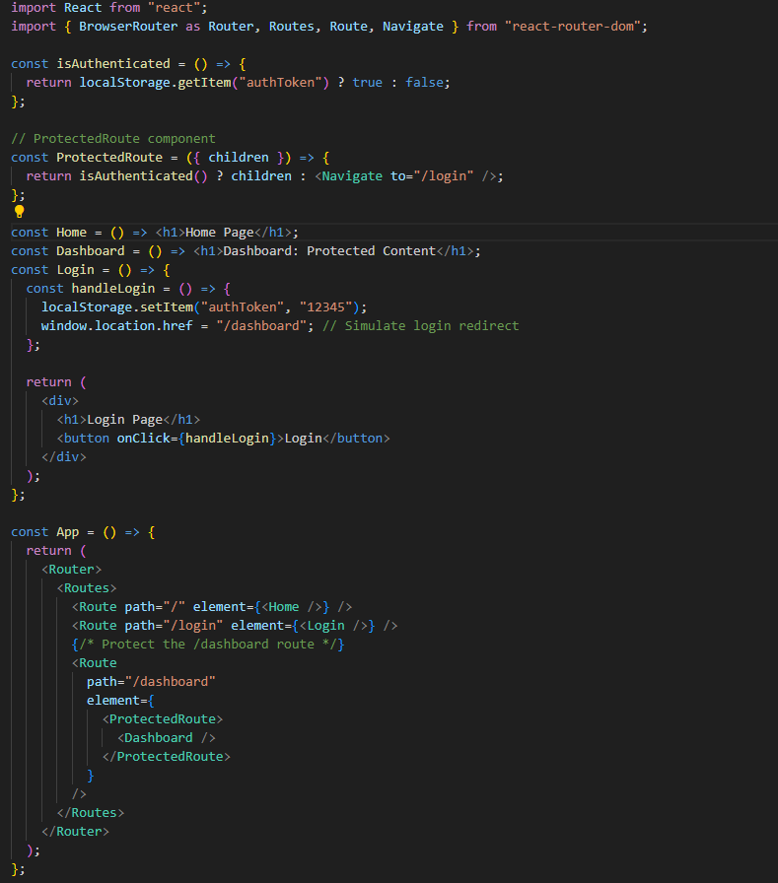
Practice
Protected Routes

Slide 13
React redux

Slide 14
Why Do We Need Redux?
React’s Built-In State Management:
State in functional components: ‘useState’, ‘useReducer’.
Sharing state requires lifting it to a common parent.
Problems with Prop Drilling:
Passing state through multiple layers of components.
Solution Redux:
Centralized state management.
A “Single Source of Truth”

Slide 15
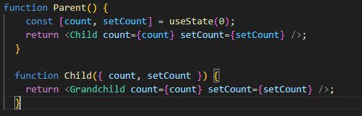
Practice
Why Redux

Slide 16
What is Redux
Redux is a predictable state management library for JavaScript apps.
Core Concepts:
Store: The centralized state.
Actions: Descriptions of state changes.
Reducers: Functions that compute new state.
Benefits:
Single Source of Truth.
Easy debugging with predictable state updates.

Slide 17
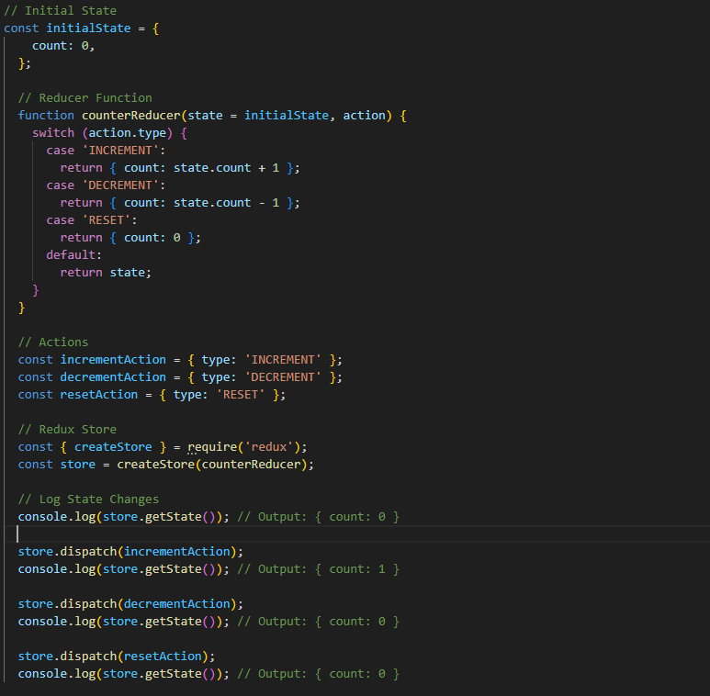
Practice
What is Redux

Slide 18
Redux Toolkit
Why Redux Toolkit?
Reduces Boilerplate Code.
Combines Actions, Reducers, and Store Setup.
Includes best practices for scalability and maintainability.
Fixing Common Redux Pitfalls:
Tedious configuration.
Manually writing repetitive boilerplate.
Complex debugging workflows.
Key Features:
‘createSlice’: Simplifies reducer and action creation.
‘configureStore’: Sets up the store with built-in middleware.

Slide 19
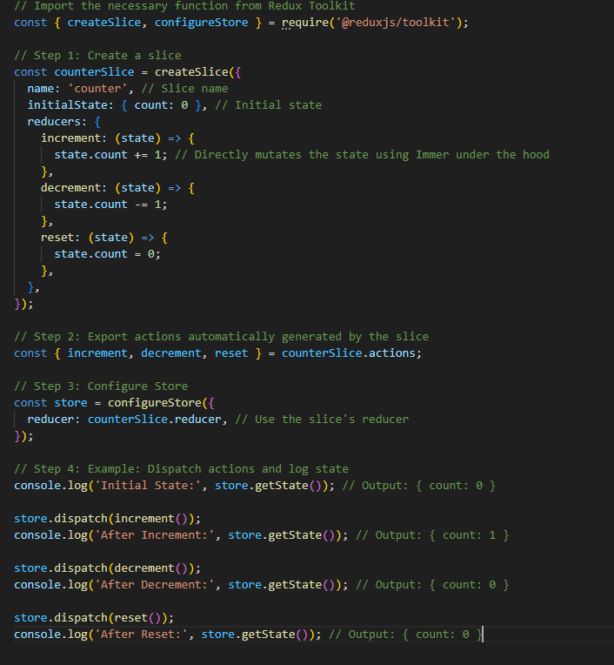
Practice
Redux Toolkit

Slide 20
Redux Thunks
What is a Thunk?
A middleware that enables writing async logic for Redux actions.
Allows action creators to return functions instead of plain objects
Includes best practices for scalability and maintainability.
Thunk use cases?
Moving complex logic out of components
Making async request or other async logic
Writing logic that needs to dispatch multiple actions in a row or over time
Writing logic that needs access to ‘getState’ to make decisions or include other state values in an action

Slide 21
React Context
What is React Context?
A way to manage and share state without prop drilling.
Provides global state accessible to any child component
Key Components:
‘createContext’, ‘Provider’, and ‘useContext

Slide 22
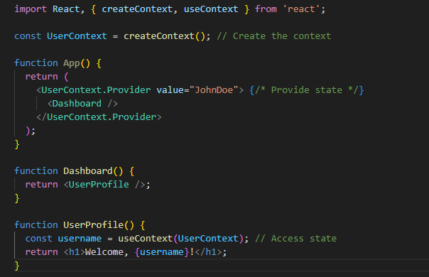
Practice
React Context

Slide 23
React Optimization
useCallback
useMemo
Memo

Slide 24
useMemo
Why useMemo?
Optimizes performance by caching expensive computations.
Key Concept
Prevents re-computation unless dependencies change.
It only recomputes the value if its dependencies change, helping prevent unnecessary computations during renders.
Real – Word Use Case
Calculations for large datasets (e.g., filtering, sorting) in a table/grid.

Slide 25
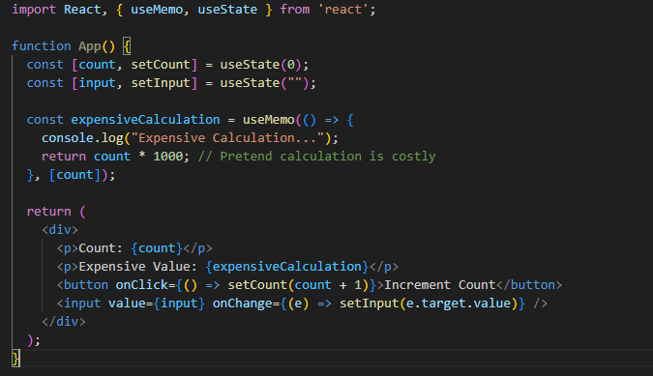
Practice
React useMemo

Slide 26
useCallback
Why useCallback?
Optimizes performance by memorizing functions.
Key Concept:
Prevents function re-creation unless dependencies change.
Real – Word Use Case:
Ensures no unnecessary rendering occurs in child components.

Slide 27
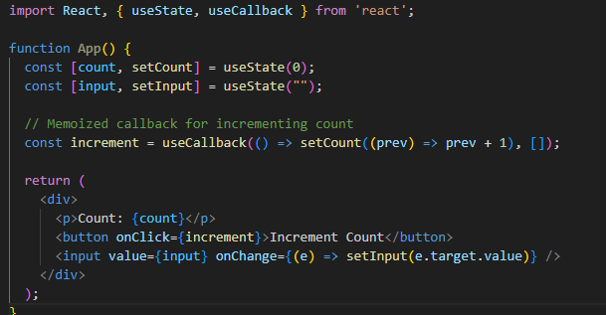
Practice
React useCallback

Slide 28
memo
Why memo?
Prevents unnecessary re-renders of functional components.
Key Concept:
Skips rendering if props haven’t changed.
Real – Word Use Case:
Use memoization for components that don’t need to update frequently, such as headers, buttons, toolbars, and static UI elements.

Slide 29
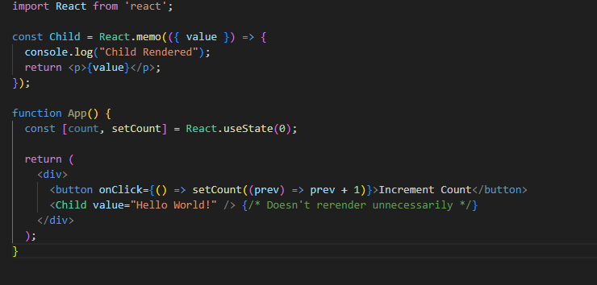
Practice
React memo

Slide 30

Thank you!
For more information, contact
Peter Toth
Software Engineer
Peter_Toth9@epam.com

