Slide 1
Building a REST API with Spring Boot
David Veres

Slide 2
What do we know so far?
Git
Maven
HTTP
Spring
Spring Data
Spring Boot

Slide 3
HTTP recap
Client, server
Request, response
Headers, body
Methods
GET, POST, PUT, DELETE (and some other)
Status codes
1xx, 2xx, 3xx, 4xx, 5xx

Slide 4
Spring recap
Java Framework
Core parts
IoC container (to support dependency injection)
Beans
Annotations
Spring Data
Spring Boot

Slide 5
What are we going to build?
A service that handles movies
Backend
REST API
Spring Boot
Can be called by others
Any client
Frontend

Slide 6
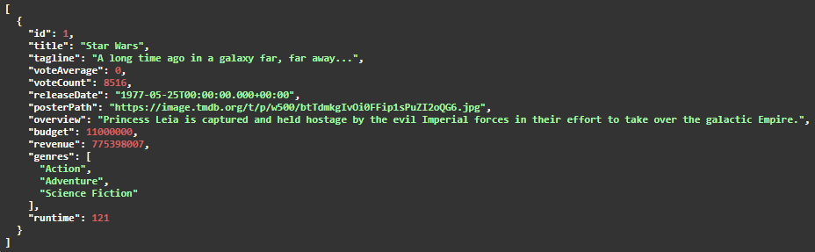
Example response from the service

Slide 7
What is REST?
Representational State Transfer
Architectural style for web services
Provides guidelines for us
If our service fulfills them: RESTful
REST over HTTP
REST contains the guidelines
HTTP is the protocol for communication

Slide 8
REST over HTTP
Objects are resources
HTTP methods
GET – retrieve
POST – create
PUT – update
DELETE – remove
Well chosen HTTP status codes
Stateless communication
Representation
Often JSON or XML
But can be anything

Slide 9
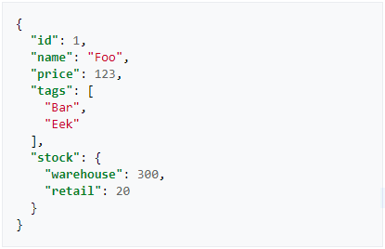
JSON example
https://json.org/example.html

Slide 10
REST example - GET
Request
GET /movies
Response
HTTP 200

Slide 11
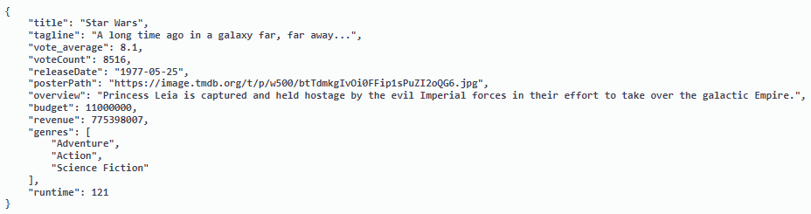
REST example - POST
Request
POST /movies
Response
HTTP 201
(The created resource)

Slide 12
The reference API
Movies API in JS
GitHub: https://github.com/VarvaraZadnepriak/MoviesAPI.ReactJS
We are going to re-implement this with Java and Spring Boot

Slide 13
REST API documentation
Swagger UI
Tells us about
Endpoints
HTTP methods
Expected request/response
HTTP status code
https://editor.swagger.io/
https://github.com/VarvaraZadnepriak/MoviesAPI.ReactJS/blob/master/swagger.yaml

Slide 14
Short demo

Slide 15
Let’s start coding!
https://github.com/epam-nye-cooperation/epam-nye-webapp

Slide 16
Feel free to ask!

Slide 17
Thank you for your attention!

