Slide 1
Short introduction to JavaScript
Jozsef Gal
Nyíregyháza – 2022/03/16

Slide 2
Agenda
01
JavaScript
02
DOM
03
Asynchronous model
04
Callbacks, Promises
05
AJAX, Fetch API
06
Exercises

Slide 3
JavaScript
What is JavaScript?
Basics: types, functions, classes

Slide 4









What is JavaScript?
JavaScript
High level interpreted programming / scripting language
Prototye based
Functional oriented with possibility of OO usage
Synchronous
Loosely / dinamically typed
Originally designed for browsers, but now it’s used in many other aspects
Standard: ECMAScript
Widely used version: ES2015 / ES6
Current version: ES2020 / v11
ES.Next: dynamic name for the next version under development

Slide 5
JavaScript – types
JavaScript
The language is pretty similar to C
Basic types:
undefined
Boolean
Number
BigInt
String
Symbol
Structural types:
Object
Array, Map, Set, WeakMap, WeakSet
Function
Structural root primitive:
null
Variables
var: old-fashioned way of create a function scoped variable
let: block scope variable, the value can be changed
const: block scope variable, cannot be changed
Globals: window or global (environment dependent)
Functions
Anonymous function
Named function
Inner function
Immediately Invoked Function Expression
Arrow function
Objects
Key-value pairs
Prototype (and constructor)
JSON
https://developer.mozilla.org/en-US/docs/Web/JavaScript/Data_structures

Slide 6

JSON
JavaScript
JavaScript Object Notation
A lightweight data interchange format
Readable to humans
Easily processed by programs
Subset of JavaScript
MIME type: application/json
Can contain:
Number
String
Boolean
Array
Null
Object
{
"id": 1,
"name": "Json Statham",
"hasGun": true, "movies": [
"Crank",
"The Transporter"
],
"killedBy": null
}

Slide 7
Variables and scopes
JavaScript
Variable scope: a block of code within a variable makes sense
You can interpret scopes as scope of an object (even functions are objects)
Global scope: window (browsers) / global (headless browsers or Node)
Function & Global
Block scope
1.
var a = 42;
try {
var a = 90;
} catch (err) {
console.log(err);
}
console.log(a);
2.
const a = 42;
try {
const a = 90;
} catch (err) {
console.log(err);
}
console.log(a);
3.
const a = 42;
try {
a = 90;
} catch (err) {
console.log(err);
}
console.log(a);
4.
let a = 42;
try {
let a = 90;
} catch (err) {
console.log(err);
}
console.log(a);
5.
let a = 42;
try {
a = 90;
} catch (err) {
console.log(err);
}
console.log(a);
* hoisting

Slide 8
Functions
JavaScript
Function declaration
function myFunction(param1, param2) {...}
Function expression (anonymous, IIFE)
const myFunction = function(param1, param2) {...};
Shorthand method definition
const collection = { myFunction: function(param1, param2) {...}, };
Arrow function
const myFunction = () => {...};
Generator function
Returns a generator object
Can be exited and re-entered
Save context across re-entrances
Function as object instance
const numberA = "numberA"; const numberB = "numberB"; const sumFunction = new Function( numberA,
numberB,
"return numberA + numberB„
); sumFunction(10, 15); // => 25
Functions are first-class citizens of JavaScript – can be:
passed as an argument
returned
assigned to a variable
The number of arguments passed to a function depends on the caller (not the declaration)
Highly depends on context from where it’s called:
„this” does not mean the same thing as in Java
(Re-)Define scope with:
Call
Apply
Bind
https://developer.mozilla.org/en-US/docs/Web/JavaScript/Reference/Functions

Slide 9
Classes
JavaScript
class Computer {
constructor(name) {
this.name = name;
this.portable = false;
}
describe = () => {
console.log(this.name);
return ` It's ${this.name} – ${this.portable ? "portable" : "standard"} computer`;
};
}
class Notebook extends Computer {
constructor(name) {
super(name);
this.portable = true;
}
}
const notebook = new Notebook("HP G8");
notebook.describe();
Template for creating objects
Before ES6: house of horror
ES6: class expression
Constructor
Only „public” elements can be defined (no restriction definition)
Prototype:
JS implements prototype-based inheritance
Mechanism by which JS objects inherit features from one another
Chain: every objects has a prototype, which can also have a (different) one
__proto__ property: how to resolve methods?
https://developer.mozilla.org/en-US/docs/Learn/JavaScript/Objects/Object_prototypes
https://developer.mozilla.org/en-US/docs/Web/JavaScript/Reference/Classes

Slide 10
Document Object Model
HTML, CSS and JavaScript combined

Slide 11
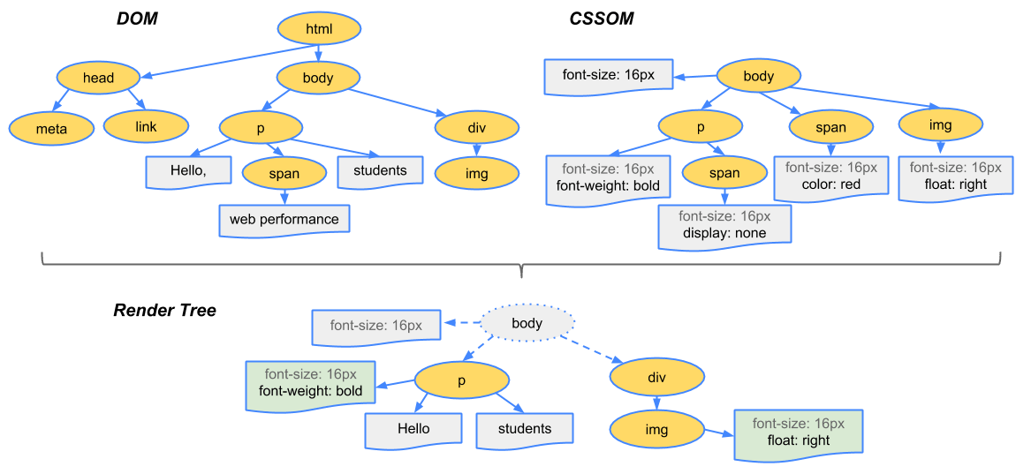
What is DOM?
Document Object Model
Programming interface for HTML and XML documents
Has its own structure
Defacto standard: tree data model
API provides us a way to access and modify the DOM elements
HTML: non-standard XML
Related: CSSOM (CSS Object Model)
Needed for rendering the page
HTML page: combined DOM & CSSOM

Slide 12
JavaScript & DOM
Document Object Model
JS main purpose: add functionality to a website
Add the possibility to react on different events:
Mouse (over, hover)
Keyboard events (key pressed)
Form and Input events (submit data or value changes)
DOM manipulation
Create, remove or update nodes in the DOM dinamically
Access elements and modify attributes
Root element: window.document
And more:
Single Page Applications
Web applications
Access elements:
document.getElementById
document.querySelector
document.querySelectorAll
Events:
element.addEventListener("click", callbackFn)
element.removeEventListener("click", callbackFn)
Content manipulation:
element.innerHtml
document.createElement
document.createTextNode
node.appendChild

Slide 13
SCRIPT tag
Document Object Model
Default loading: synchronous
When browser met a script tag it loads the file and execute it
During this the rendering is stoped
Asynchronous:
Async attribute
Download in the background at a low priority (same in defer)
Can interrupt page rendering to execute
Executes as soon as possible without particular order
Defer attribute
Won’t interrupt page rendering to execute
Executes in sequence just before the DOMContentLoaded event
Suggested method
Move every SCRIPT tag at the end of the BODY
Benefits:
The whole page is rendered when the browser loads the script
Already visible page for the user
Separated logic from display mode

Slide 14
Create HTML with JavaScript
Document Object Model
<main id="app">
<header class="page-head">
<h1>Hello world</h1>
<p>a little description here</p>
</header>
</main>
const app = document.createElement("MAIN");
app.setAttribute("id", "app");
const pageTitle = document.createElement("H1");
pageTitle.innerText = "Hello world";
const description = document.createElement("P");
description.appendChild( document.createTextNode("a little description here") );
const header = document.createElement("HEADER");
header.classList.add("page-head");
header.appendChild(pageTitle);
header.appendChild(description);
app.appendChild(header);
document.body.appendChild(app);
Notes:
Check: 1-create-html-with-js.html

Slide 15
Event handling
Document Object Model
<div id="app">
<input name="content" />
<button class="button">Click here</button>
<ul class="list"></ul>
<p>0</p>
</div>
const list = document.querySelector("#app .list");
const addElement = () => { const input = document.querySelector( "input[name='content']" ); const element = document.createElement("LI");
element.innerText = input.value.trim();
list.appendChild(element);
document.querySelector("#app p").innerText = list.children.length; };
const button = document.querySelector(".button");
button.addEventListener("click", addElement);
Notes:
Check: 2a-event-handling.html & 2b-event-handling.html

Slide 16
Asynchronous model

Slide 17
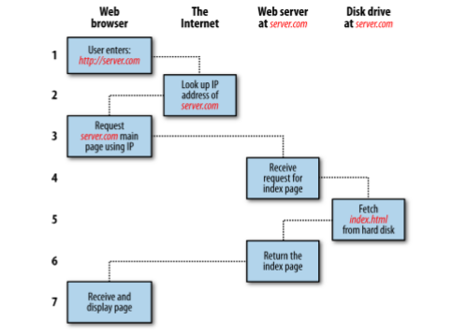
HTTP & How the web works
Asynchronous model
You enter http://server.com into your browser’s address bar.
Your browser looks up the IP address for server.com.
Your browser issues a request for the home page at server.com.
The request crosses the Internet and arrives at the server.com web server.
The web server, having received the request, looks for the web page on its disk.
The web page is retrieved by the server and returned to the browser.
Your browser displays the web page.

Slide 18
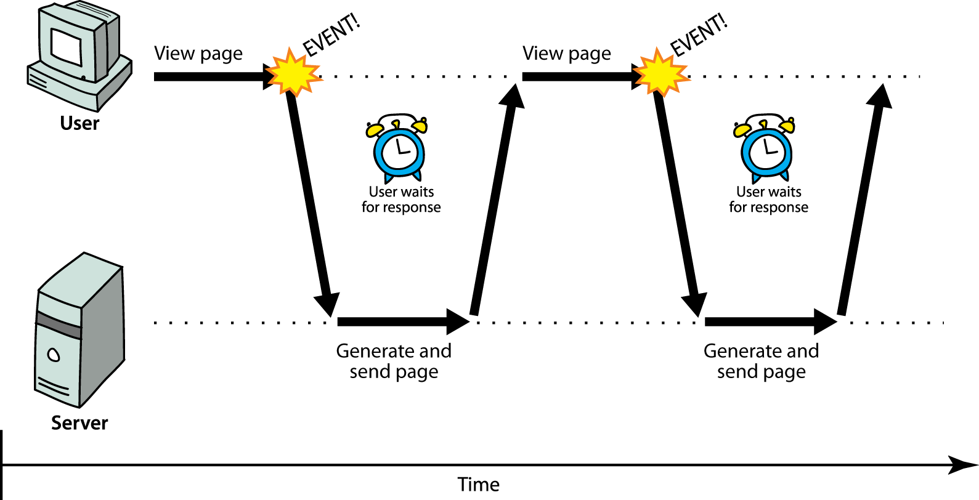
Long ago in a distant land...
Asynchronous model

Slide 19
The synchronous way
Asynchronous Model
The user must wait while full content loads
Standard way of communication in web pages (click – wait – refresh)
Still valid in every cases – one request and one response: but only one at a time
Be careful what you put in your HTML and how: every external resource (image, script or stylesheet) means one request and also a delay in loading
Pros
Easier to program on client side – focus is on server side
Not really dependent on the client itself
Cons
Extremely SLOW
Each page requires fully loaded content – terrible user experience
Server side has to take care of HTML generation as well

Slide 20
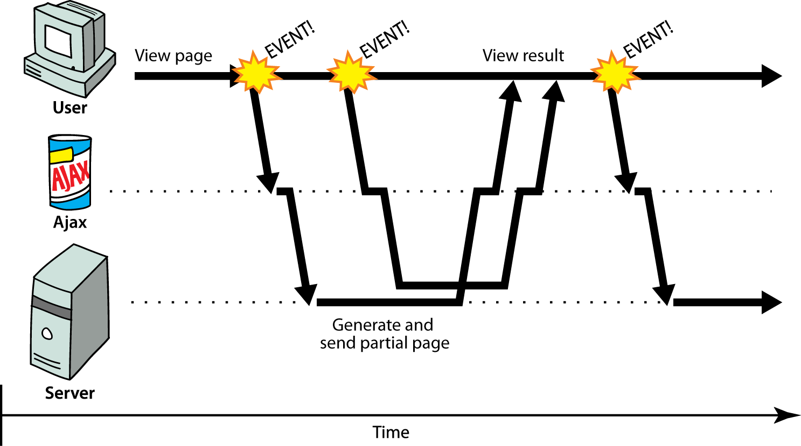
Web 2.0
Asynchronous model

Slide 21
Rich (heavy/fat/thick) Client
Asynchronous model
Client-server communication in the background
Dynamically update page without reloading
Transparent to the user
Content of fetched file can be put into the current web page using DOM manipulation
Pros
Fast – not everything is needed at the first load
User friendly – dynamically added new items (like on Facebook/9gag)
Service Oriented Architecture – independent, reusable services
Cons
Requires different kind of thinking (SOA)
Heavily based on JavaScript – client dependency
Client error might disable a functionality and/or a complete page
Hell of loading indicators
Bunch of limitations to take into consideration

Slide 22
Limitations
Asynchronous model
Same Origin Request Policy - can only load from the same domain via the same protocol
Cross Origin Resource Sharing (CORS)
Hard to handle manually loaded scripts
SEO can cause difficulties
Disabled JavaScript equals disabled functionality

Slide 23
Callbacks & Promises

Slide 24
Asynchronous functions
Callbacks & Promises
const printNumber = (num) => {
setTimeout(() => {
console.log("Your number is: ", num);
}, Math.floor(Math.random() * 100) + 1);
};
const countToThree = () => {
printNumber(1);
printNumber(2);
printNumber(3);
};
countToThree(); // What is the result of this? Why?
Notes:
Check code section: 3a-async-timer.html

Slide 25
JavaScript concurrency model
Callbacks & Promises
JavaScript has a concurrency model based on „event loop”
Three main parts: heap, stack and message queue.
At some time during the event loop, the JS runtime starts processing the messages on the message queue
Event handlers, XMLHttpRequest and timers can push messages to the message queue
Each message has a callback associated with it, which will be invoked upon processing.

Slide 26
Callbacks
Callbacks & Promises
const printNumber = (num, callBackFn) => {
setTimeout(() => {
console.log("Your number is: ", num);
callBackFn();
}, Math.floor(Math.random() * 100) + 1);
};
const countToThree = () => {
printNumber(1, () => {
printNumber(2, () => {
printNumber(3, () => {});
});
});
};
countToThree(); // Is this better?
Functions are first class citizens in JavaScript
That means we can use them as function parameters
A callback is basically a function that is passed to another function
The first function will call the callback
So let’s see our printNumber function with callbacks
Notes:
Check code section: 3b-async-timer.html

Slide 27
The Promise
Callbacks & Promises
A promise is an object representing the eventual completion or failure of an asychronous operation.
A Promise is in one of these states:
pending: initial state, neither fulfilled nor rejected.
resolved: meaning that the operation completed successfully.
rejected: meaning that the operation failed.
Until ES6 JavaScript did not have native implementation for promises
Pre ES6, the concept Promise was more like a design pattern, if you wanted to use it you had to use third-party libraries like jQuery or Q, frameworks that had the implementation (like AngularJS) or implement it yourself.
https://developer.mozilla.org/en-US/docs/Web/JavaScript/Reference/Global_Objects/Promise

Slide 28
The Promise object
Callbacks & Promises
With the standardisation of ECMAScript2015 (more commonly known as ES6), native support for promises was introduced for JavaScript
The promise constructor takes a function with two functions as parameters for happy and sad cases – this function is called the executor
The executor is called immediately (even before creating the new promise object), does some asynchronous work then calls resolve if everything went fine, or reject if some error occured.
The Promise prototype has the well known then, catch and finally methods for handling the result of the Promise
const proxy = new Promise(
(resolve, reject) => {}
);

Slide 29
How to work with promises?
Callbacks & Promises
In async calls you have to work with data you don’t have yet – so: Simple variable assignment is not working!
You have to WAIT until the data arrives – it can be done via the THEN method
It’s also possible an error occurs and it has to be handled too – never forget it, a promise has to be accepted or rejected within a time
You can store data within promises too e.g. no other request has to be sent out which can increase performance
JS Decorator for promise: async + await pairing
const proxy = new Promise(
(resolve, reject) => {}
);
proxy
.then((param) => {
console.log("done", param);
})
.catch((error) => {
console.error("error", error);
});
(async () => {
try {
const param = await proxy;
console.log("done", param);
} catch (error) {
console.error("error", error);
}
})();

Slide 30
Counting with Promises
Callbacks & Promises
const printNumber = (num) =>
new Promise((resolve, reject) => {
setTimeout(() => {
console.log("Your number:", num);
resolve();
}, Math.floor(Math.random() * 100) + 1);
});
const countToThree = () => {
printNumber(1)
.then(() => printNumber(2))
.then(() => printNumber(3));
};
countToThree();
const countToThree = async () => {
await printNumber(1);
await printNumber(2);
await printNumber(3);
};
/** We successfully created a promise chain that will print the numbers in order */
Notes:
3c-async-timer-with-promise.html

Slide 31
AJAX & Fetch API
Asynchronouse JavaScript and XML
Execute requests from client side to a server

Slide 32
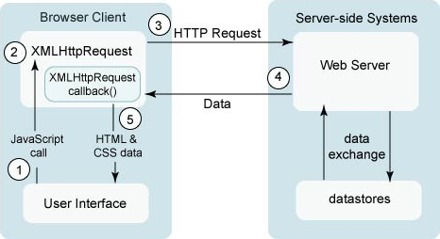
A typical AJAX request
Ajax & Fetch API
Click event handler
Create a request, register callback
Call a service
Server is answering…
Event – answer arrived; run callback function
Remember:
Your callback is what really process the data
Can’t work with a value you don’t have yet
https://developer.mozilla.org/en-US/docs/Web/Guide/AJAX

Slide 33
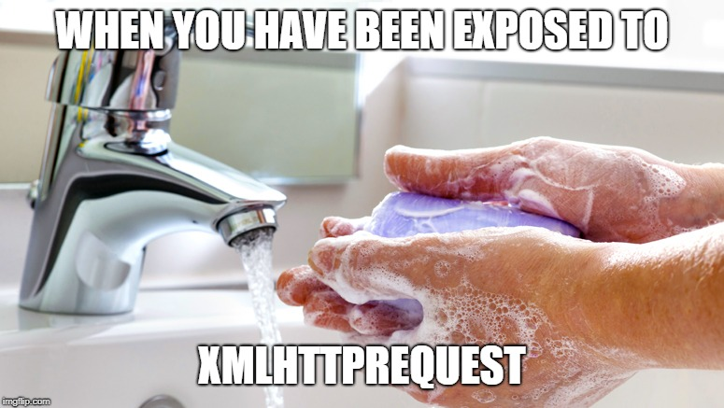
Old-school JS – XMLHttpRequest (XHR)
AJAX & Fetch API
Don’t Panic
and carry a towel
const ajax = new XMLHttpRequest();
ajax.onreadystatechange = () => {
if (ajax.readyState === 4 && ajax.status === 200) {
const response = JSON.parse(ajax.responseText);
ShoppingCart.updateQuantity(response.quantity);
} else if (ajax.status != 200) {
Notification.error("Unexpected error");
}
};
ajax.open("post", "/api/cart", true);
ajax.send(
JSON.stringify({
productId: 5,
quantity: 1,
userId: 1,
})
);
This would be the code if you would like to handle the response only in native JavaScript
Frameworks and JS tools helps a lot in this – so don’t worry, you won’t meet this if you’re using one.

Slide 34
The Fetch API
AJAX & Fetch API
(async () => {
const response = await fetch("/api/cart", {
method: "POST",
headers: {
"Content-Type": "application/json",
},
body: JSON.stringify({
productId: 5,
quantity: 1,
userId: 1,
}),
});
if (response.status === 200) {
const { quantity } = await response.json();
ShoppingCart.updateQuantity(quantity);
} else {
throw new Error("Unexpected error");
}
})();
The Fetch API provides a JavaScript interface to create HTTP requests.
Follows the Promise pattern solution
Standard way to request data from server and handle the responses
Example:
(async function() {
const res = await fetch("https://yesno.wtf/api");
const data = await res.json();
console.dir(data);
return data;
})();
https://developer.mozilla.org/en-US/docs/Web/API/Fetch_API
Notes:
4a-fetch.html

Slide 35
Exercises
Dynamically update HTML page

Slide 36
Create a simple HTML page
Exercises
Title: Was it good enough?
Add a button with text: let’s ask
Add a placeholder for an image (no content yet)
Add a placeholder for an answer
Define 3 CSS classes:
.ok with green color
.no with red color
.dunno with color gray
<!DOCTYPE html>
<html>
<head>
<title>Was it good enough?</title>
<style type="text/css">
body { text-align: center; }
.ok { color: green; }
.no { color: red; }
.dunno { color: gray; }
</style>
</head>
<body>
<h1>Was it good enough?</h1>
<button>Let’s ask</button>
<p>I don’t know yet...</p>
<figure></figure>
</body>
</html>

Slide 37
Let’s code something
Exercises
Add an event-listener to button for click event handler
Create a service MyService with one method: question
When the button is clicked:
Execute a request to "https://yesno.wtf/api"
(the handler should be placed within MyService)
const MyService = (() => {
return {
question: async () => {
const res = await fetch("https://yesno.wtf/api");
return res.json();
}
};
})();
const clickHandler = (event) => {
event.preventDefault();
MyService.question();
};
const button = document.querySelector("button");
button.addEventListener("click", clickHandler);

Slide 38
Still coding...
Exercises
While waiting for response, change the paragraph text to „Wait for it...” and change it to gray color („dunno” class)
Create a function that replace the items; depending on the answer param:
In case of „yes”:
Change paragraph text to „YES”
Change the paragraph’s color to green using the CSS classes (use „ok”)
In case of „no”:
Change the text of paragraph to „NO”
Change the paragraph’s color to red using the CSS classes (use „no”)
const getTextItem = () =>
document.querySelector("p");
const updateText = (answer) => {
const textItem = getTextItem();
textItem.className = "";
textItem.classList.add(
answer === "no" ? "no" : "ok"
);
textItem.innerText = answer;
};
....
const clickHandler = (event) => {
event.preventDefault();
const textItem = getTextItem();
textItem.innerText = "Wait for it...";
if (!textItem.classList.contains("dunno")) {
textItem.classList.add("dunno");
}
....
}

Slide 39
Almost there...
Exercises
Create a function that replace or create the image within the placeholder
If the image already placed, update the source of it
If it has not been added yet, create it and append to the placeholder with set url
const setImage = (url) => {
const container = document.querySelector("figure");
let image = container.querySelector("img");
if (!image) {
image = document.createElement("img");
container.appendChild(image);
}
image.setAttribute("src", url);
};

Slide 40
Finish it
Exercises
Connect the service call with update phase
Update/create image from the response’s „image” field
Set the text based on the response’s „answer” field
const clickHandler = (event) => {
...
MyService.question().then(data => {
updateText(data.answer);
setImage(data.image);
});
};
Notes:
Check exercise.html & exercise.js

Slide 41
Thank you!
For more information, contact
Jozsef Gal
Senior Software Engineer
jozsef_gal@epam.com
EPAM Debrecen
Tüzér street 4.
HU-4028 Debrecen

