Slide 1
Node.JS
Jozsef Gal
Nyíregyháza – 2022/03/30

Slide 2
Agenda
01
Utilities
02
JavaScript on server side: NodeJS

Slide 3
Utilities
Commonly used libraries and development tools

Slide 4
ECMAScript
Utilities
Commonly used for client-side scripting on World Wide Web
JavaScript standard to ensure the interoperability of web pages across different browsers
Always Up-to-date version: ESNext
Make your work much easier if you know the standards for the different browsers
Downgrade is possible between different versions using additional tools and polyfills
Solves most of the problems with browser differencies
Does not replace testing!

Slide 5
Package managers
Utilities
NPM
Worlds largest software registry
Standard usage of JavaScript libraries and utilities
Supported by most of the IDE’s
Online repository for open-source Node.js projects
Command-line utility for interaction with the repo
Aids package installation, version and dependency management
YARN
Also uses the NPM repository
Project management utility
Creates a more lightweight dependency tree than NPM
Usually a bit faster (in large repositories)

Slide 6
Package.json
Utilities
Entry point for each package manager
Store version of the software, depencies for development and for the working application
Describes what is necessary to run the created module
Initialize your project with:
yarn init or
npm init
{
"name": "test",
"version": "0.0.1",
"description": "little bit of description",
"main": "index.js",
"license": "MIT",
"dependencies": {
"express": "4.17.3"
},
"devDependencies": {
"@types/express": "4.17.13"
}
}

Slide 7
TypeScript
Utilities
Pros:
Better readibility
Reduce the number of possible typos
Self-documented results, possible replacement of JSDoc
Clean and simple code results
Cons:
Does not run in browsers (and it is not supposed to)
Hard to configure for beginners
Typed JavaScript at any scale
Superlative for JavaScript
Add ability for static type definitions
Provide a way to describe your application and lets you validate your code during development
Transformed into JavaScript with TypeScript compiler or Babel
@types package usually have support for older/not TS libs

Slide 8
Linting – ESLint
Utilities
Static code analysis tool
Indentify problematic patterns found in ES/JS code
Covers code quality and coding style issues
Makes code more consistent to avoid bugs
Impose the coding standard using a certain set of standalone rules
Lets your project use the same writing style, e.g.:
variable naming conventions
tabs or space usage
Single/double quotes for string
Function styles
limitations

Slide 9
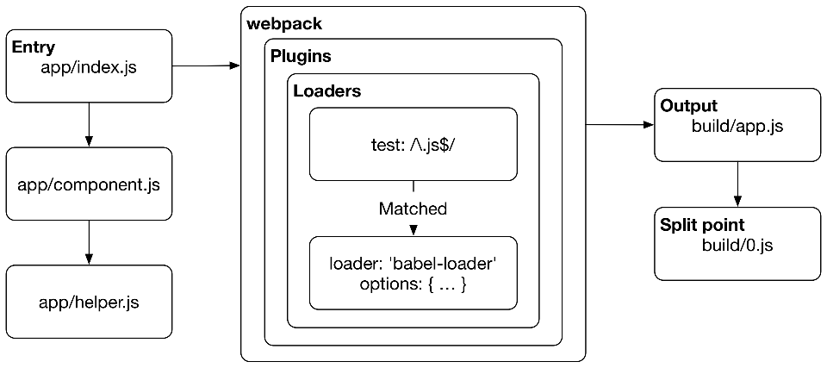
Webpack
Utilities
Webpack is module bundler
Can take care of bundling alongside a separate runner
From an entry point it:
Traverses the module imports (import / require)
Construct a dependency graph of the project
Generates output based on the configuration
Can handle different formats via loaders
TypeScript
(S)CSS
Simple JavaScript
Can be used in other environments as well (e.g Ruby on Rails)

Slide 10

Node.JS
JavaScript runtime environment for backend

Slide 11
What is Node.JS?
Node.JS
Open source server environment
Runs on all major platforms (e.g. Windows, Linux, Unix, Mac OS)
JavaScript on the server side
Node is a single threaded, non-blocking asynchronous server
What it can do in an efficient way:
Display dynamic page content
CRUD operations on server side files
Database communication
Socket handling: direct connection between clients through a server (e.g chats, P2P)
Proxy

Slide 12
Comparison: PHP vs Node.JS
Node.JS
PHP file handling
Sends the task to the computer’s file system
Waits until the file system opens and reads the file
Return the content to the client
Ready to handle next request
Cons:
Multiple, but independent database requests can thake a while
Not enough responsive on many cases
Node request handling
Sends the task the computers’s file system
Ready to handle next request
When the file system finished the operation the server will send the response content to the client (streaming)
Cons:
Not much differences in response time on single operation
Sometimes hard to reconcile the independent queries
Usage of promises / callbacks are essential

Slide 13
Express
Node.JS
Fast and minimalist web framework for Node.js
Let’s you create a RESTful JSON Webservice through HTTP
Flexible and pluggable
Ability to route
Ability to write middlewear
Supports MVC architecture
Supports templating engines
What is a HTTP RESTful API:
Supports CRUD operations through HTTP requests:
(C) POST to push new items
(R) GET requests for request data
(U) PUT to update existing items
(D) DELETE to remove data
Response tells if it was successful or not:
HTTP Status codes (e.g. 200 – OK, 404 – Not found, 500 – error)
Response body contains a JSON object with the result of the operation

Slide 14
Exercises

Slide 15
Installation
Exercises
Install Node.JS (LTS): https://nodejs.org/en/
Install yarn package manager: https://yarnpkg.com/getting-started/install
Clone web-app repository for your local machine: https://epa.ms/nye-webapp
Note: for Windows system you might need to add NPM to the path environment variable:
C:\Users\[your-user]\AppData\Roaming\npm
>: node -v
v14.18.1
>: npm –v
6.14.15
>: npm install –g yarn
>: yarn –v
v1.22.10

Slide 16
How to initialize a new project?
Exercises
{
"name": "example",
"version": "0.0.1",
"main": "index.js",
"license": "MIT",
"dependencies": {
"express": "4.17.3"
},
"devDependencies": {
"typescript": "4.6.3",
"ts-loader": "9.2.8",
"tslib": "2.3.1",
"webpack": "5.70.0",
"webpack-cli": "4.9.2",
"copy-webpack-plugin": "10.2.4",
"create-file-webpack": "1.0.2",
"npm-run-all": "4.1.5",
"cross-env": "7.0.3",
"rimraf": "3.0.2"
}
}
Create your package.json manually or with yarn
yarn init
Answer the upcoming questions
Add the major dependency: Express
yarn add express
Add dev-dependencies one by one:
yarn add name@version -D
Or after manual edit: yarn install

Slide 17
TypeScript configuration
Exercises
{
"extends": "./tsconfig.json",
"compilerOptions": {
"lib": [
"ES2019"
],
"module": "CommonJS",
"noEmit": false,
"outDir": "dist",
"target": "ES6"
},
"include": [
"src/server/**/*.ts"
],
"exclude": [
"node_modules",
"src/server/**/*.spec.ts"
]
}
tsconfig.json & tsconfig.server.json
Defines what will be the target environment
Let’s you use TypeScript in Node.js
Concentrate on serverside code: exlude clientside items and different node modules

Slide 18
Webpack configuration
Exercises
"use strict";
const path = require('path');
const CopyWebpackPlugin = require('copy-webpack-plugin');
const CreateFileWebpack = require('create-file-webpack');
const ROOT_DIR = path.resolve(__dirname);
const DIST_DIR = path.resolve(ROOT_DIR, 'dist');
const DIST_SERVER_DIR = path.resolve(DIST_DIR, 'server');
const PACKAGE = require(path.join(__dirname, 'package.json'));
module.exports = {
entry: {
server: path.resolve(ROOT_DIR, './src/server/server.ts')
},
mode: 'development',
module: {
rules: [
{
test: /\.ts$/,
enforce: 'pre',
use: {
loader: 'ts-loader',
options: {
transpileOnly: true,
configFile: 'tsconfig.server.json'
}
}
}
]
},
output: {
path: DIST_SERVER_DIR,
filename: '[name].js'
},
resolve: {
extensions: ['.ts', '.js']
},
webpack-server.config.js
Defines rules in creating your final applications
TypeScript itself is not a runnable thing on Node: transpile is required (with ts-loader)

Slide 19
Create your Node application
Exercises
import express from "express";
import path from "path";
const DEFAULT_PORT = 5000;
const PORT = process.env.PORT || DEFAULT_PORT;
const app = express();
const appDir = path.resolve(__dirname, "../ui");
app.use("/", express.static(appDir));
app.listen(PORT, "0.0.0.0", () => {
console.log(`Server is running on port ${PORT}`);
});
Create a directory structure: src/server
Create file: server.ts
Import express and create an app
Add static listener to root directory (/)
Start the server

Slide 20
Build the application
Exercises
Add new section to your package.json: scripts
Set a script for each build and start commands
Build and start your application from command line:
yarn build:server
yarn start
Open your browser: http://localhost:5000/
In correct case it will create a dist directory and creates every necessary things
If it loaded then you will see the content of the index.html
{ ...
"scripts": {
"build:server": "cross-env NODE_ENV=development webpack build --config ./webpack-server.config.js",
"start": "cross-env NODE_ENV=development node dist/app.js"
}, ...
}

Slide 21
Create a middleware
Exercises
Make it configurable: what should be the basis is coming from outside
Add listener to root request (/) within basis:
Read a query parameter
Return the value in json format
Add a listener to an additional path, set status to a valid HTTP header (e.g. 404), and return a json object with an error
Add a new listener with an url parameter object and returns that

Slide 22
Handling POST requests
Exercises
router.post( `${rootPath}/login`, (req: Request, res: Response) => {
const { username, password } = req.body;
if (username === "admin" && password === "password") {
return res.json({
status: "logged in"
});
}
res.status(401).json({
error: "invalid username or password"
});
} );
Create a new middleware: Users
Add a new route to configurable base (e.g. /api/user) listening to POST requests: /login
The response should contain the following information:
If the user data was correct return with:
200 status
a message
In case case of incorrect data return with:
401 status code
Error message
Add JSON parser to your application
fetch("/api/user/login", {
method: "POST",
headers: {
"Content-Type": "application/json",
"Accept": "application/json"
},
body: JSON.stringify({
username: "admin",
password: "notreallyastrongone"
})
}).then((res) => res.json())
.then((data) => console.log(data))
app.use(express.json());

Slide 23
Validation
Exercises
const schema = Yup.object().shape({
username: Yup.string().ensure()
.required("Please enter your username")
.max(100, "Too long username"),
password: Yup.string().ensure()
.required("Please enter your password")
.min(8, "Your password is too short")
.max(100, "Too long password")
});
Run a validation before using login information
Use YUP package to validate the incoming requests
Create a singleton service for this purpose
Keep original method and use nextFunction in the new handler
router.post(`${rootPath}/login`, async ( req: Request, res: Response, next: NextFunction ) => {
try {
await schema.validate(req.body as UserLogin);
next();
} catch (error) {
res.status(400).json(error);
}
});

Slide 24
Thank you!
For more information, contact
Jozsef Gal
Senior Software Engineer
jozsef_gal@epam.com
EPAM Debrecen
Tüzér street 4.
HU-4028 Debrecen

