Slide 1
Stateful communication
Jozsef Gal
Nyíregyháza – 2022/04/06

Slide 2
Agenda
01
HTTP Communication
02
Cookies
03
Web Storage API
04
IndexedDB

Slide 3
HTTP Communication
Stateless vs Stateful

Slide 4
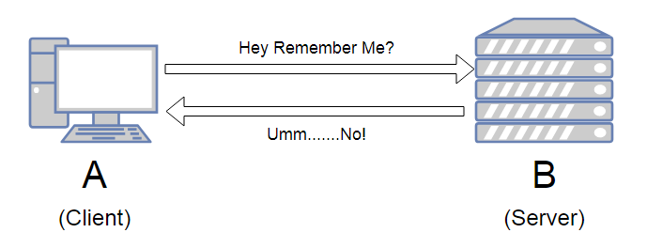
Stateless protocol
HTTP Communication
The receiver must not retain session state from previous requests
Each request is expected to be independent from the other
The request should contain all the necessary information
Typical problems: identificiation, remember data

Slide 5
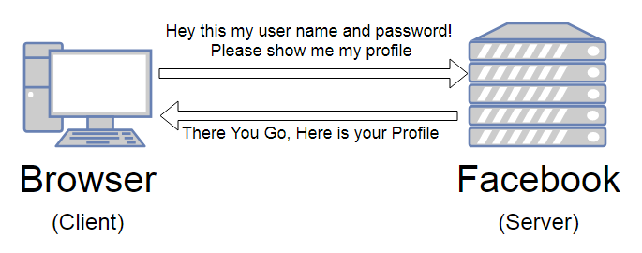
Authentication and authorization over HTTP
HTTP Communication
Authentication: the process of determining whether someone or something is who or what it says it is
Authorization: giving someone permission to do or have something
Attach an identifier to the request
Cookie
Specific header (Authorization)

Slide 6
Session
HTTP Communication
Sequence of HTTP request and response transactions with the same client
Has a unique ID (session id / session token)
Expected to be finished after a defined time or when the connection is „closed”
Problem: how to organize independent requests into a session?
Possible solution: store the ID on client side somehow

Slide 7
Cookies

Slide 8
What are cookies?
Cookies
A small piece of data that a server sends to a user’s web browser
The browser may store the cookie and send it back to the same server with later requests
Used to tell if two requests come from the same browser
Remember stateful information
Key-value pairs
Limited to a specific size
Usages:
Session management
Login, shopping carts, game scores, etc
Personalization
User preferences, themes or other settings to access immediatelly
Tracking
Recording and analyzing user behavior
GDPR

Slide 9
Set-Cookie and Cookie headers
Cookies
Set-Cookie
HTTP response header
Sends cookies from server to the user agent
Tells the client to store a pair of cookies
Cookie
HTTP request header
Sends stored cookies back to the server
Session cookie:
Deleted when the current session ends
End is defined by browser – can last indefinitely
Permanent cookie:
Expires attribute – end date of the cookie
Max-Age attribute – removed after period of time
Set-Cookie: <cookie-name>=<cookie-value>
Host: www.example.org
Cookie: yummy_cookie=choco; tasty_cookie=strawberry

Slide 10
Restrictions attributes and security
Cookies
Domain
Specifies which hosts can receive a cookie
Defaults to the same host that set the cookie excluding subdomains
If specified subdomains are included
Path
Indicates a URL path that must exist in the requested URL in order to send the Cookie header
Directory separator: „/” (%2F)
Valid for subdirectories as well
SameSite
Lets servers specify when cookies are sent with cross-site requests
Minimal protection agains cross-site request forgery attacks (CSRF)
Values
Lax: when the user navigates to the cookie’s origin site (default)
Strict: only where it was originated
None: both originating and cross-site requests, but only when Secure attribute is also set
https://developer.mozilla.org/en-US/docs/Web/HTTP/Cookies

Slide 11
Web Storage API

Slide 12
Concepts and usage
Web Storage API
Useful for storing smaller amounts of data
Maintains a seperate storage area for each given origin
Data is never transfered to the server
sessionStorage
Available for the duration of the page session (while browser is open, including reloads and restores)
Stores data only for a session
Storage limit is larger than a cookie (at most 5MB)
localStorage
Stores data with no expiration date
Gets cleared only through JavaScript or clearing brower cache / locally stored data
Greater storage limit
https://developer.mozilla.org/en-US/docs/Web/API/Web_Storage_API

Slide 13
Storage
Web Storage API
Both sessionStorage and localStorage implements Storage interface
Stores key-value pairs
where both are handled as strings (DOMString object)
Store objects: JSON.stringify & JSON.parse (apply manually)
Allows:
Retrieval (getItem)
Addition (setItem)
Removal (removeItem)
Wipe-out (clear)

Slide 14
IndexedDB

Slide 15
IndexedDB API
IndexDB
Low-level API for client-side storage of significant amounts of structured data (e.g. files)
JavaScript-based object-oriented transactional database system
Operations are done asynchronously
Follows same-origin policy
Usage:
Specify database schema
Open a connection to the database
Retrieve and update data within a series of transactions
https://developer.mozilla.org/en-US/docs/Web/API/IndexedDB_API

Slide 16
Exercises
Create login with protected pages with JavaScript

Slide 17
Let’s start with configuration
Exercises
Clone repository from:
https://epa.ms/nye-webapp
Checkout branch:
9-auth
Open directory with editor:
client/lesson-9/code/begin
Build the server environment:
Minimal support for login and request profile
Default user: admin@local.com / admin123456
Open browser: http://localhost:5000/api/users
Copy webpack configuration (follow instructions)
Add build:client script file to package.json
git clone https://github.com/epam-nye-cooperation/epam-nye-webapp.git
git checkout 9-auth
yarn install yarn build:server yarn start
(async() => {
const res = await fetch("/api/users/login", {
method: "POST",
headers: {
"Content-Type": "application/json",
"accept": "application/json"
},
body: JSON.stringify({
username: "admin@local.com",
password: "admin123456"
})
});
const { authToken } = res.json();
console.log(authToken);
})();

Slide 18
Start with login page
Exercise
Open login-form.html in client/login directory
Create a file next to it: auth-service.ts
Implement AuthService class
Create file: login-form.ts
Implement page changes – take it easy
Add script to login-form.html: js/login.js
Add new line to webpack entry points
The AuthService should handle login and token data
The login-form should communicate with service and redirect to profile page when logged in
<script type="text/javascript" src="js/login.js"></script>
login: path.resolve(ROOT_DIR, './src/client/login/login-form.ts'),

Slide 19
Continue with profile page
Exercise
Open profile.html in client/profile directory
Create a file next to it: profile-page.ts
Implement page changes
Add script to profile.html: js/profile.js
Add new line to webpack entry points
The profile page should redirect to login when opened without a valid token (revalidate)
Should display user data
The AuthService should be extended with profile requests handler
<script type="text/javascript" src="js/profile.js"></script>
profile: path.resolve(ROOT_DIR, './src/client/profile/profile-page.ts'),

Slide 20
Home page
Exercise
Open index.html in client/home directory
Create a file next to it: home-page.ts
Implement page changes
Add script to index.html: js/home.js
Add new line to webpack entry points
The home page should welcome logged in users
Do not request data from server, use only JWT
<script type="text/javascript" src="js/home.js"></script>
profile: path.resolve(ROOT_DIR, './src/client/home/home-page.ts'),

Slide 21
Notes - final version differences
Exercise
Login page:
handles client side validation using the same YUP schema we have on server side
Add / hide error messages depending on result
Display an error message when the login failed
Home page:
Displays a link to profile page and logout for logged in user
Shows a link to login form for unauthorized users

Slide 22
Thank you!
For more information, contact
Jozsef Gal
Senior Software Engineer
jozsef_gal@epam.com
EPAM Debrecen
Tüzér street 4.
HU-4028 Debrecen

