Slide 1
React
Jozsef Gal
Nyíregyháza – 2022/04/20

Slide 2
Agenda
01
Single-page applications
02
React
03
Chakra UI
04
Exercises

Slide 3
Single-page applications
Thick clients

Slide 4
What is an SPA?
Single Page Application
SPA: Single-page application web app implementation that loads only a single HTML document and then updates the body content via JavaScript
Allow users to use websites without loading whole new pages from the server
Thick (heavy/fat/rich) client
The loaded application contains every necessary template and styling (can be also cached)
The server does not have to render HTML, can focus on data only (REST API)
Stateful client, stateless server
Client-side navigation (or routing):
Uses JS History API
Different URL for different pages – same look and feel as a generic website
Requirements:
Usage of modern browsers (the newer the better)
Service Oriented Architecture on server side (properly defined API with endpoints supporting JSON)
Tip: use a JS library or framework to avoid code duplication

Slide 5

React

Slide 6
What is React?
React
AKA: React.JS or ReactJS
Declarative, component-based JavaScript library to build interactive UIs
Seamlessly connects HTML with JavaScript via JSX (syntax extension to JS)
Rendering logic is inherently coupled with other UI logic (event handling, state changes, data-preparation)
Easy templating
Unlike other frameworks (e.g. Angular) requires additional tools to build a whole application
Maintained by Facebook (Meta)
<Box width="full" backgroundColor="background.dark">
<Flex as="nav">
<SortMovies sortType={sorting} onChange={setSorting}/>
</Flex>
<MovieList movies={movies} />
</Box>

Slide 7
Component & Props
React
Components create the UI of an application
Class or functional components
Main purpose: encapsulation and reusability
Modular coding
Separation of concerns:
Each component should focus on one purpose
Easy unit testing
Props (or properties)
Read-only parameters
Static resources for a component
Defines how a component should be rendered
Callbacks: communicate with other components
interface WelcomeProps {
name?: string;
}
class Welcome extends React.Component<WelcomeProps> {
constructor(props: WelcomeProps) {
super({
...props,
name: props.name ?? "World",
});
}
render() {
return <h1>Hello, {this.props.name}</h1>;
}
}
const Welcome: React.VFC<WelcomeProps> = ({ name = "World" }) => (
<h1>Hello, {name}</h1>
);

Slide 8
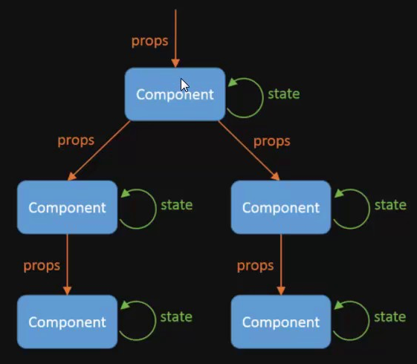
State
React
State represents the current state of a component
Data in the State control what you see in the View
Private and fully controlled by the component
When the state changes (e.g. on an event) the UI is rerendered with only the changed parts
Updating a state is asynchronous

Slide 9
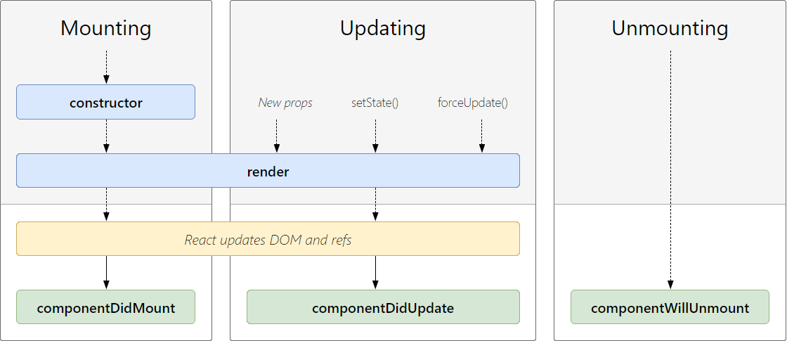
Component lifecycle & Hooks
React
state, setState(...)
useState(...)
componentWillMount
useState(...)
componentDidMount
useEffect(() => {}, [])
componentDidUpdate
useEffect(() => {}, [...dependencies])
shouldComponentUpdate
memo(Component, () => {})
componentWillUnmount
useEffect(() => {return () => {}}, [])

Slide 10

Chakra UI
Accessible React apps with speed

Slide 11
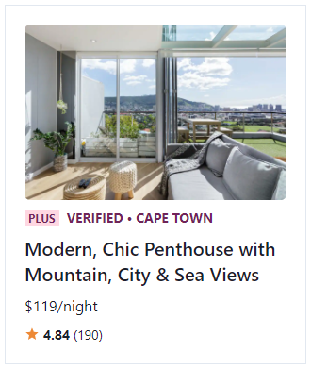
What is Chakra UI?
Chakra UI
Simple, modular and accessible component library
Building blocks to build React applications
Contains most of the possible items you need in a web application
Accessible – WAI-ARIA standards for all components
Themable – customization
Composable – composition instead of inheritance
Supports dark/light mode
import React from "react";
import { Box, Center, Image, Flex, Badge, Text } from "@chakra-ui/react";
import { MdStar } from "react-icons/md";
export const Example = () => (
<Center h="100vh">
<Box p="5" maxW="320px" borderWidth="1px">
<Image borderRadius="md" src="https://bit.ly/2k1H1t6" />
<Flex align="baseline" mt={2}>
<Badge colorScheme="pink">Plus</Badge>
<Text
ml={2}
textTransform="uppercase"
fontSize="sm"
fontWeight="bold"
color="pink.800"
>
Verified &bull; Cape Town
</Text>
</Flex>
<Text mt={2} fontSize="xl" fontWeight="semibold" lineHeight="short">
Modern, Chic Penthouse with Mountain, City & Sea Views
</Text>
<Text mt={2}>$119/night</Text>
<Flex mt={2} align="center">
<Box as={MdStar} color="orange.400" />
<Text ml={1} fontSize="sm">
<b>4.84</b> (190)
</Text>
</Flex>
</Box>
</Center>
);

Slide 12
Exercises

Slide 13
Warm up
Exercises
Checkout lesson-10 resources:
https://epa.ms/nye-webapp
Branch: 10-react
These will be used later
Create a React application with Yarn or NPM
Use chakra-ui template with TypeScript
Suggested app name: netflixroulette
Copy the branchs’ resources in src directory
Start application
Replace default theme with personalized one
Open template: https://epa.ms/nye-webapp-template
git clone https://github.com/epam-nye-cooperation/epam-nye-webapp.git
git checkout 10-react
yarn create react-app netflixroulette --template @chakra-ui/typescript
OR
npx create-react-app netflixroulette --template @chakra-ui/typescript

Slide 14
Create logo
Exercies
File: netflix-roulette-logo.tsx
Component name: NetflixRouletteLogo
Should lead to home page (/)
Chakra components:
Link
Heading
Text
import React, { VFC } from "react";
import { Heading, Link, Text } from "@chakra-ui/react";
export const NetflixRoulletteLogo: VFC = () => (
<Link
href="/"
_hover={{
textDecoration: "none",
}}
>
<Heading fontSize="xl" color="text.highlighted">
<Text as="span" fontWeight="black">netflix</Text>
<Text as="span" fontWeight="medium">roulette</Text>
</Heading>
</Link>);

Slide 15
Create movie list item
Exercises
<LinkBox>
<AspectRatio ratio={322 / 455} marginBottom={7}>
<Image src={movie.poster_path} />
</AspectRatio>
<Flex justifyContent="space-between" opacity={0.5}>
<LinkOverlay href={`/movie/${movie.id}`}>
<Heading
as="header„
flexGrow={1}
gap={2}
display="flex„
flexDirection="column„
>
<Text as="h4" fontSize="lg" fontWeight="medium"> {movie.title}
</Text>
{movie.tagLine && <Text fontSize="sm">{movie.tagLine}</Text>}
</Heading>
</LinkOverlay>
<Text sx={{
border: "solid 1px",
borderColor: "border.default",
borderRadius: 4,
fontSize: "sm",
paddingX: 2,
paddingY: 1,
}}>
{movie.release_date.getFullYear()}
</Text>
</Flex>
</LinkBox>
Responsibility: display one list item
File: movie-list-item.tsx
Component name: MovieListItem
Property:
movie: Movie
Image (poster_path):
Aspect ratio: 322 / 455 (~70%)
Conditional rendering: tagLine

Slide 16
Create list
Exercises
Responsibility: display all passed items
File: movie-list.tsx
Component name: MovieList
Property:
movies: Movie[]
Use grid layout
Template columns: repeat(3, 1fr)
Gap: 12
<Grid
sx={{
gridTemplateColumns: "repeat(3, 1fr)",
gap: 12,
}}
>
{movies.map((movie) => (
<GridItem key={movie.id}>
<MovieListItem movie={movie} />
</GridItem>
))}
</Grid>

Slide 17
Load data and pass it:
Exercises
Responsibility: access list, organize and sort items
File: movie-list-page.tsx
Tip: create own hook to handle this
Component name: MovieListPage
State item:
sorting
Raw data list should be transformed to Movie items
Limit the list (preferred to be a small number, e.g. 6 or 12)
Use hooks: useState, useMemo
const [sorting, setSorting] = useState(MovieSortType.RELEASE_DATE);
const movieList: Movie[] = useMemo(
() => (MovieDB as RawMovie[]).map(movieFactory),
[]
);
const movies: Movie[] = useMemo(() => {
const sorted = movieList.sort(
(a: Movie, b: Movie) => {
if (sorting === MovieSortType.RELEASE_DATE) {
return b.release_date.getTime() - a.release_date.getTime();
} else if (sorting === MovieSortType.RATING) {
return (b.vote_average ?? 0) - (a.vote_average ?? 0);
}
return a.title.localeCompare(b.title);
}
);
return sorted.slice(0, 6);
}, [movieList, sorting]);
<Box width="full" backgroundColor="background.dark">
<MovieList movies={movies} />
</Box>

Slide 18
Create sorting component
Exercises
<Flex alignItems="center" gap="8">
<Text
as="label"
sx={{
fontSize: "md",
letterSpacing: "0.888889px",
textTransform: "uppercase",
opacity: 0.6,
}}
onClick={openMenu}
>
Sort by
</Text>
<Menu
placement="bottom-end„
onClose={closeMenu}
onOpen={openMenu}
isOpen={isOpened}
>
<MenuButton>
{sortType}
<UpDownIcon color="text.highlighted" marginLeft={3} />
</MenuButton>
<MenuList bgColor="background.dark">
<MenuItem onClick={}>{MovieSortType.RELEASE_DATE}</MenuItem>
<MenuItem onClick={}>{MovieSortType.TITLE}</MenuItem>
<MenuItem onClick={}>{MovieSortType.RATING}</MenuItem>
</MenuList>
</Menu>
</Flex>
Responsibility: display available sorting options, show actual sorting state
File: sort-movies.tsx
Component name: SortMovies
Properties:
sortType: MovieSortType
onChange: (sortType: MovieSortType) => void;
When user selects a sorting the onChange should be called
Additional dependency required: @chakra-ui/icons

Slide 19
Update page item
Exercises
Add sorting component to the page
Pass properties
Try it out
<Box width="full" backgroundColor="background.dark">
<Flex as="nav">
<SortMovies onChange={setSorting} sortType={sorting} />
</Flex>
<MovieList movies={movies} />
</Box>

Slide 20
Differences in final solution
Exercises
The theme overrides and ChakraProvider moved to index.tsx from App.tsx
Different styling solution in components: see src/theme/components directory
The components has their own styles collected into one space
You can also define additional styles for your components and use it with useMultiStyleConfig hook
Examples: MovieDescription, MovieListItem
Some new items are introduced, e.g.:
PageHeader – search bar and add movie button, together with the logo
MoviePage – to display a specific movie, will be used in the next lesson
GenreList – display some highlighted genres
New item introduced to handle common layout for each page – NetflixRoulettePage (see: App.tsx)
functional component that already includes the page footer and organizes the other items
content is defined by its children – replace PageHeader component with MoviePage to see the results in App.tsx

Slide 21
Thank you!
For more information, contact
Jozsef Gal
Senior Software Engineer
jozsef_gal@epam.com
EPAM Debrecen
Tüzér street 4.
HU-4028 Debrecen

