Slide 1
Week 10 : Traffic Simulation

Slide 2
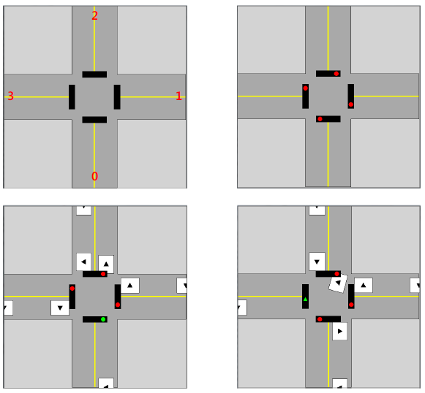
Traffic Simulation
Implement the traffic signal simulation for intersection with car movement

Slide 3
Traffic Simulation
4 python files in traffic simulation
traffic_background.py : for drawing background
functions
draw_background
traffic_signal.py : for signal object
Class
Signal : layer, red, green, left_turn, yellow
Functions
make_signal, make_signals, set_signal
traffic_car.py : for car object
Class
Car : layer, sign, sign_layer, road, road_w, unit_length, is_ready
Functions
make_car, make_cars, move_car, make_straight_sign, go_straight_car, turn_left_car, turn_right_car, find_action_function, car_action
traffic_simulation.py : for simulation
Global variables
canvas_w, road_w, canvas_size, canvas, roads, lights
Functions
get_ready, is_empty, road_action, traffic_simulation1, traffic_simulation2, traffic_simulation3, traffic_simulation4

Slide 4
Some functions need to aware
traffic_car.py
def go_straight_car(car)
Car goes straight further and disappers.
def turn_left_car (car)
Car is turning left and go further and disappers.
def turn_right_car (car)
Car is turning right and go further and disappers.
traffic_simulation.py
def get_ready()
The first car of roads moves to starting position
def is_empty()
Return True if every road has no car, False otherwise.
def road_action()
Send the first car ready if 'traffic_sign' and the sign of the car are met.
If the car was moved, pop it from the road, otherwise just leave it.

Slide 5
set_signal in traffic_signal.py
def set_signal(signal, light)
Input
signal : a signal object
light : one of the strings ‘red’ , ‘yellow’, ‘green’, ‘left’
Changes the signal to display the requested light pattern. Set the right color for ‘light’ and black for others
For example, if you get a light ‘red’, then you need to change the color of signal object’s variable using following instructions
signal.red.setFillColor(‘red’)
signal.yellow.setFillColor(‘black’)
signal.green.setFillColor(‘black’)
signal.left_turn.setFillColor(‘black’)

Slide 6
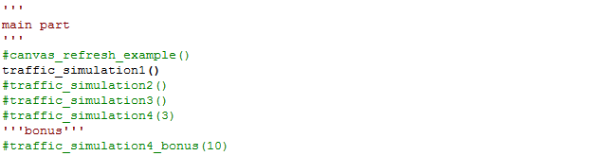
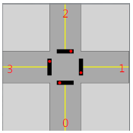
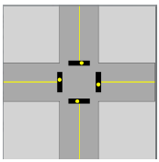
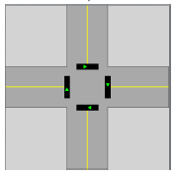
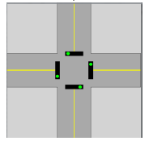
set_signal in traffic_signal.py
After implementing set_signal function, if you modify ends of line in traffic_simulation.py to execute traffic_simulation1 like this
you can get following result

Slide 7
traffic_simulation2 in traffic_simulation.py
The signal order of ‘traffic_simulation1’ is little bit strange
All lights change at the same time
Only the signal of roads should be changed, and the signal order is like following.
After signal of the road 0 changed in above order, that of road 1 start to change to yellow

Slide 8
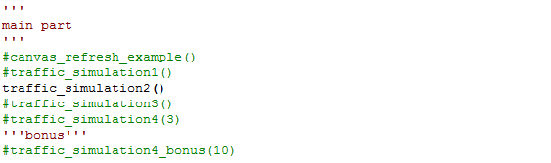
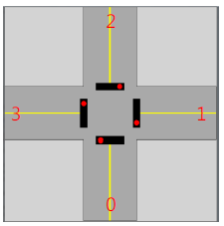
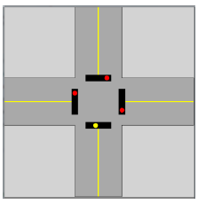
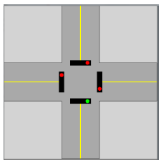
traffic_simulation2 in traffic_simulation.py
if you modify ends of line in traffic_simulation.py to execute traffic_simulation2 like this
you can get following results
but, current traffic_simulation2, left and yellow signal is missing
next road start!

Slide 9
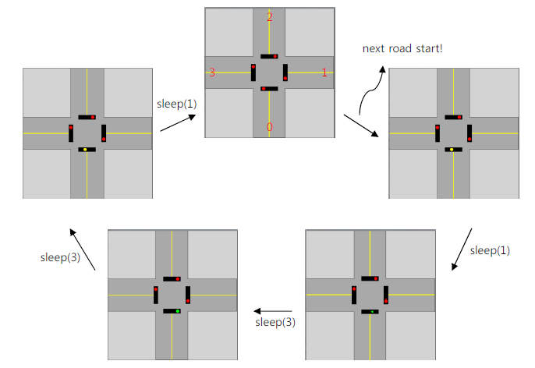
traffic_simulation2 in traffic_simulation.py
By adding left, and yellow signal, change traffic_simulation2 to following this picture. Be aware the sleep time

Slide 10
move_car in traffic_car.py
def move_car (car, times=1)
Input
car: Car object
times: Integer
‘car’ moves car.unit_length*times steps forward.
Each movement of length car.unit_length should be shown on the graphic animation
The meaning ‘forward’ depends on the road number.
For example, if car.road == 0, car must move towards to top (because, ‘forward’ means up on the road 0) using the following instruction
for i in range(times):
car.layer.move(0, -car.unit_length)

Slide 11
find_action_function in traffic_car.py
def find_action_function (car, traffic_sign=‘all’)
Input
car : Car object
traffic_sign : Current signal of traffic light. one of (‘red’, ‘yellow’, ‘left’, ‘ green’)
Output
function: Proper action function depending on car sign and traffic sign. If they didn’t match, return None
Check the sign of ‘car’ and ‘traffic_sign’
If they are met, return appropriate actions_function. Otherwise return None
For example, car.sign == ‘left’ and traffic_sign is ‘left’ or ‘all’, then we can make car turn_left. So we can return the action fuction turn_left_car

Slide 12
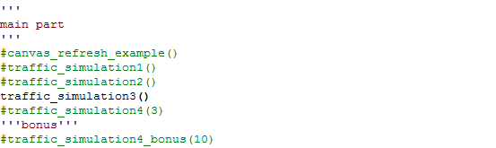
move_car, find_action_function
After implementing move_car, find_action_function function, if you modify ends of line in traffic_simulation.py to execute traffic_simulation3 like this
you can see the results in ‘traffic_simulation3.avi’

Slide 13
traffic_simulation4 in traffic_simulation.py
‘traffic_simulation3’ has the same signal order of ‘traffic_simluation1’
‘traffic_simulation4’ will take the same signal order of ‘traffic_simulation2’,
but you should use sleep(1) only after the yellow signal is turned on
def traffic_simulation4(how_many)
input ‘how_many’ means the number of cars on each road.
After you implement traffic_simulation4, you can see the same results in ‘traffic_simulation4.avi’

Slide 14
Any Questions?

