Slide 1
Data Collection
Read tags.csv
Find n=#games for each tag
25x data collection for floor(n/25) pages
(n mod 25)x data collection for the last page
The web-crawler is written in R.
6
Notes:
So this is the summary of our steam crawler program.

Slide 2
Data Transformation
Indie game1 game2 game3
date1 date2 date3
pos1 pos2 pos3
neg1 neg2 neg3
Action game2 game3 game4
date2 date3 date4…
edges:
Source Target Date Pos Neg
19 21 1984 51 4
19 597 1984 51 4
19 4559 1984 51 4
…
index:
game1 game2 game3 game4 ...
edges_final
edgefilter20:
Source Target Weight
Indie Stealth 621
Indie Action 1025
…
The transformation is done using R and Gephi.
10
Notes:
Managed to do the last two transformations.
It was actually very easy.

Slide 3
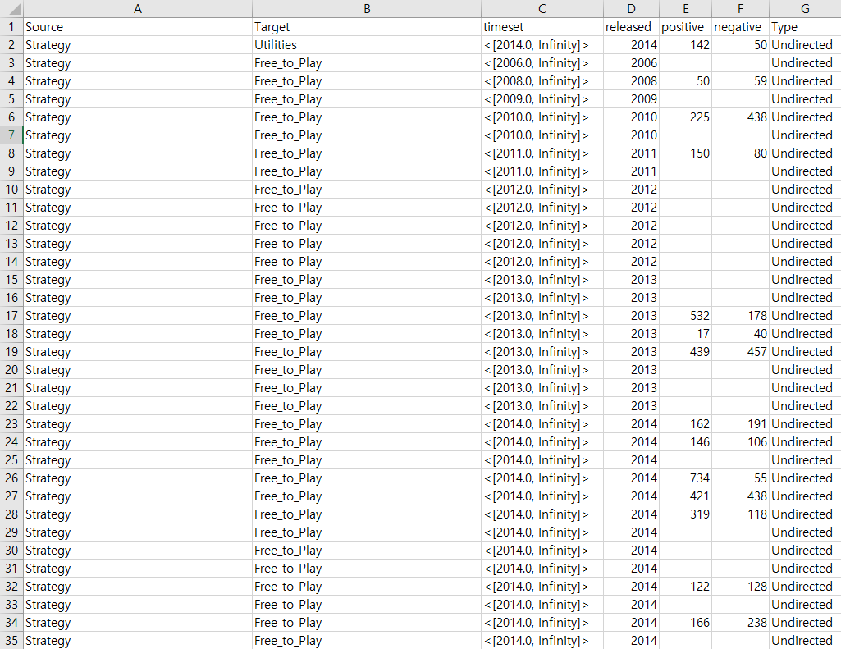
Data Structure
edges_final
9
Notes:
각 데이터 구조

Slide 4
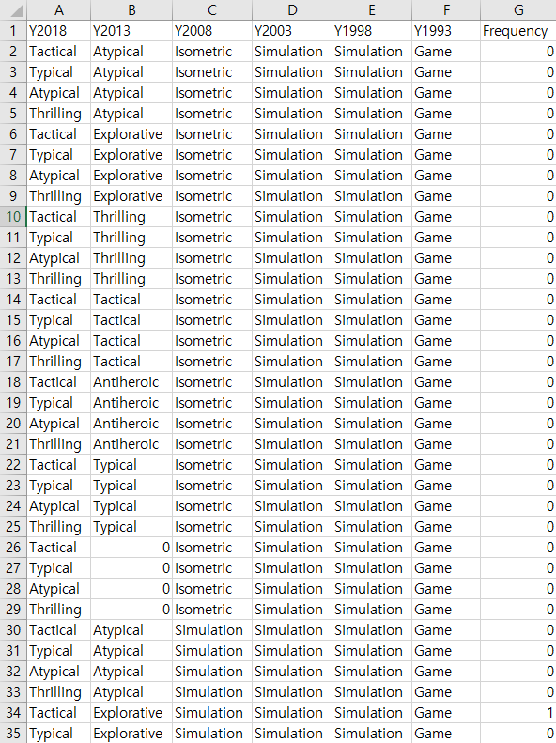
Data Structure
Clustering Table
9
Notes:
각 데이터 구조

