Slide 1
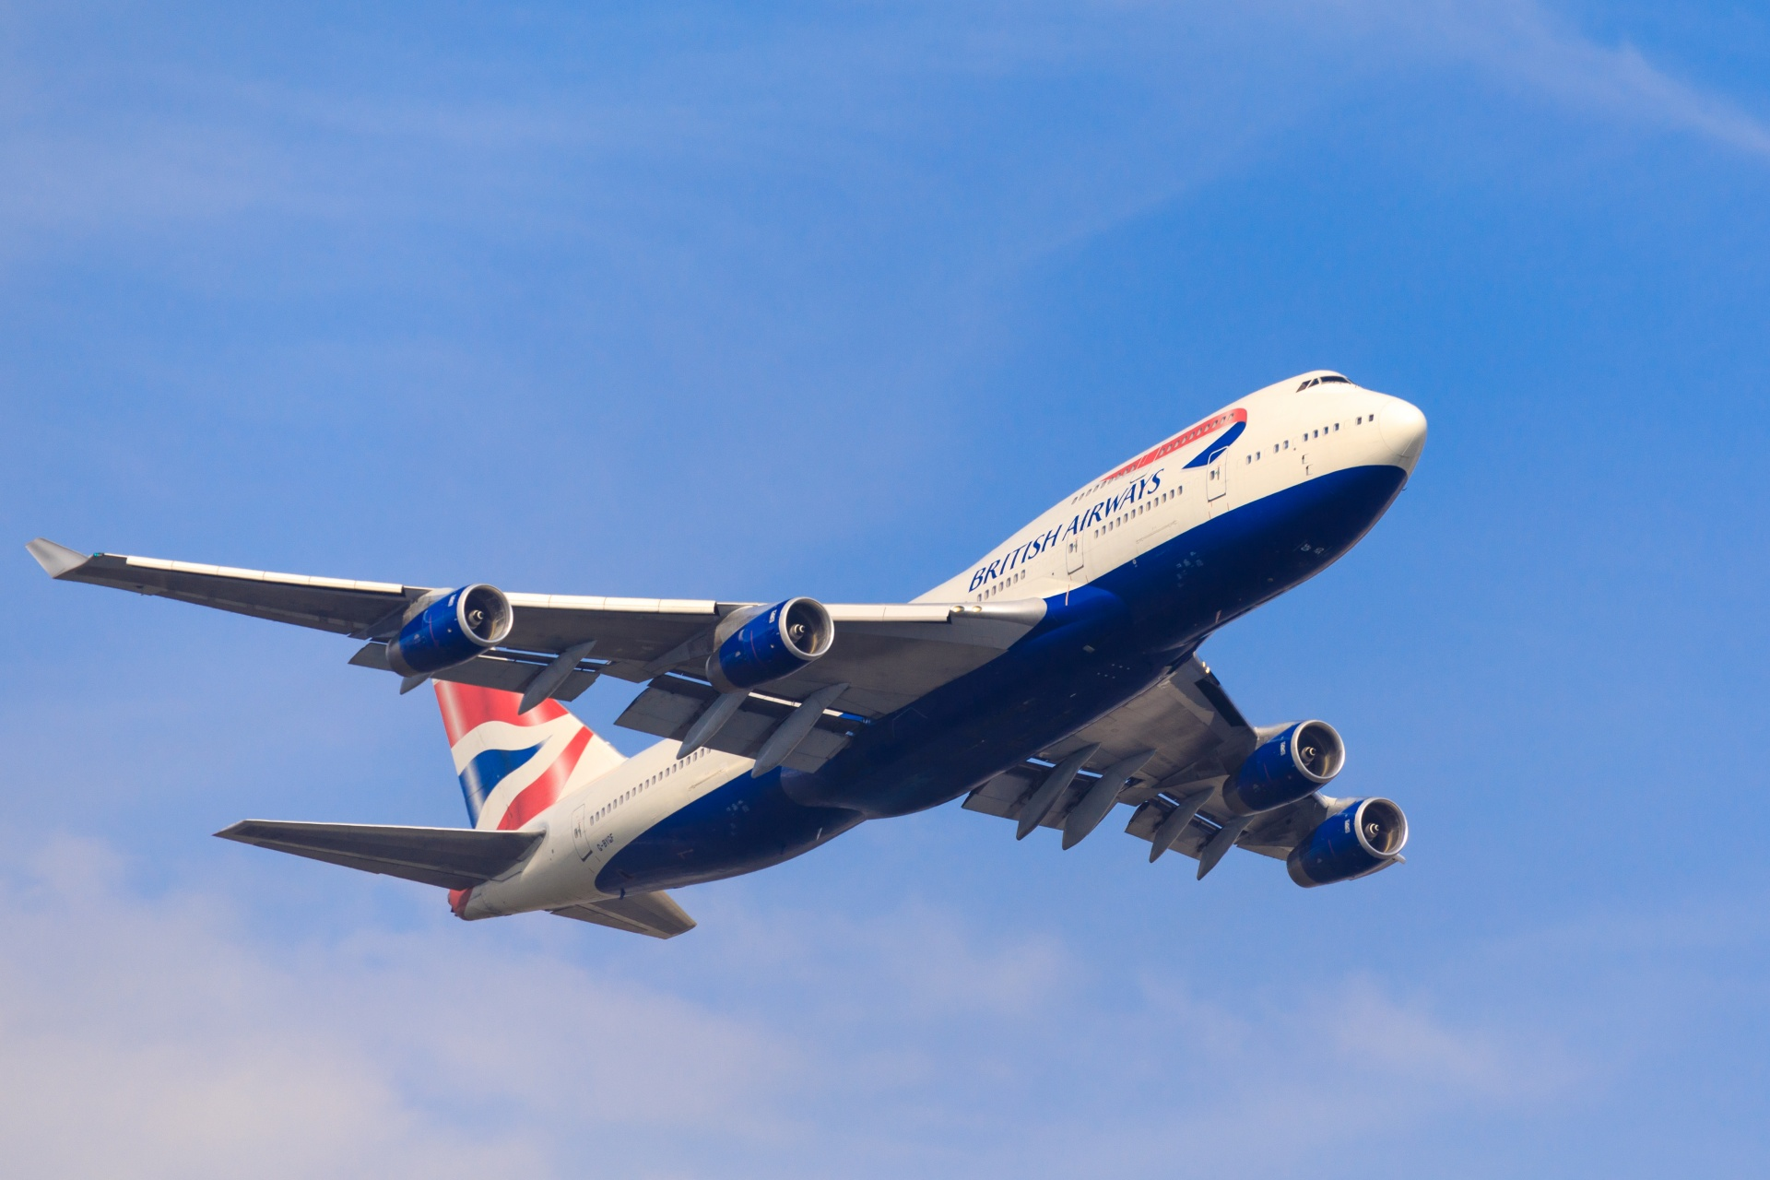
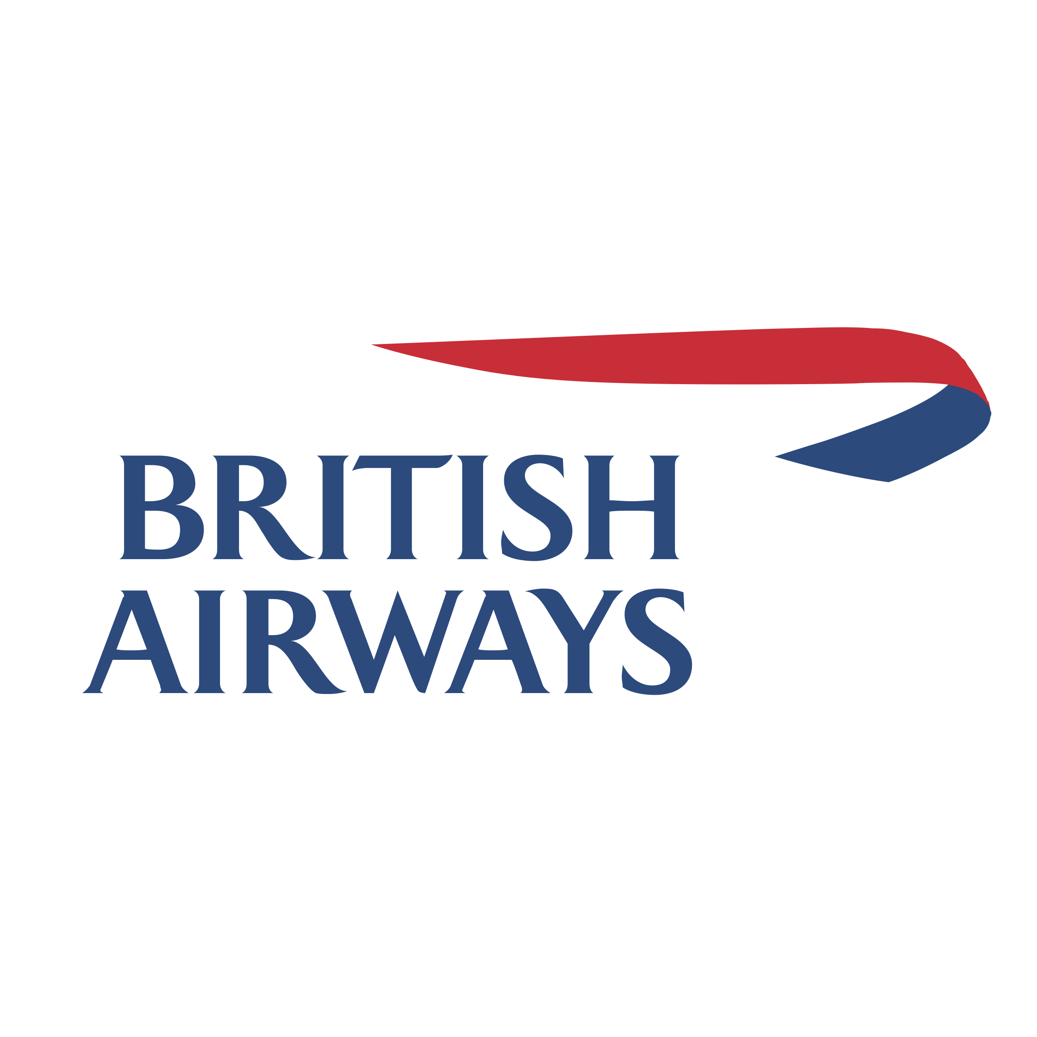
British Airways
Web Scrapping Analysis

Slide 2
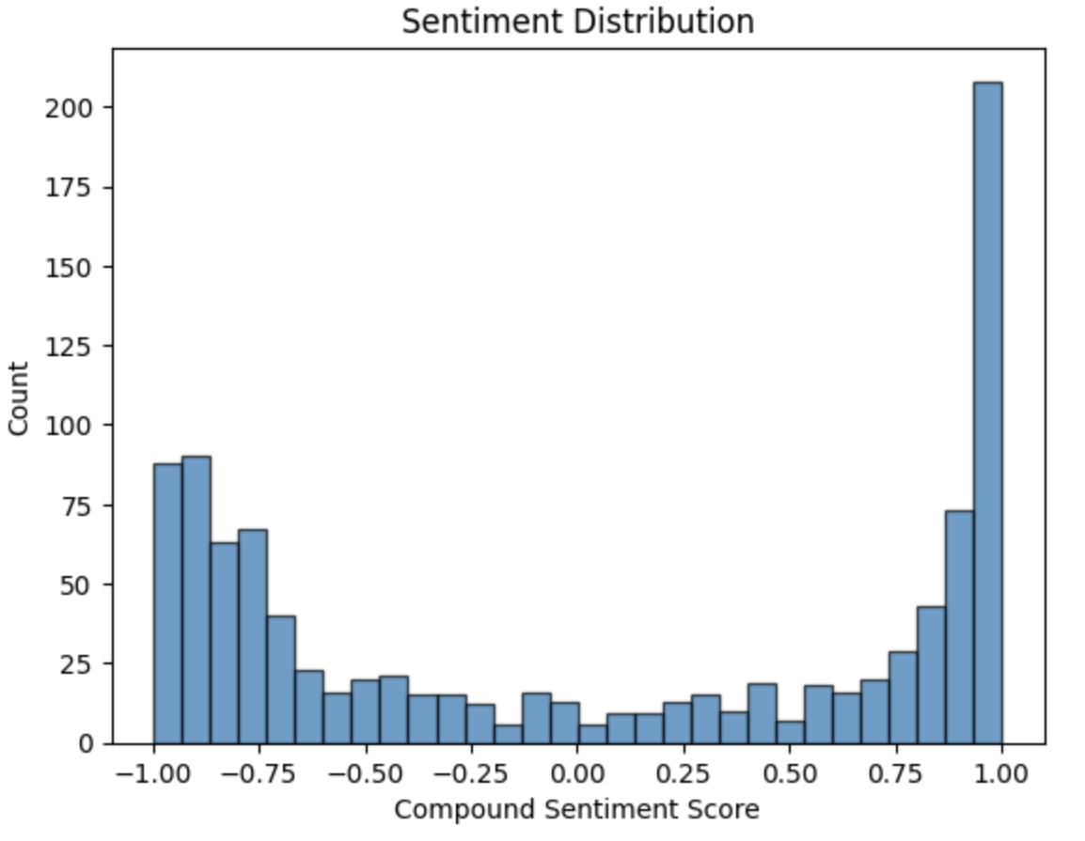
Sentiment Analysis
Positive trend
Reviews larger than 0 show greater customer satisfaction
More than 50% of the reviews are positive

Slide 3
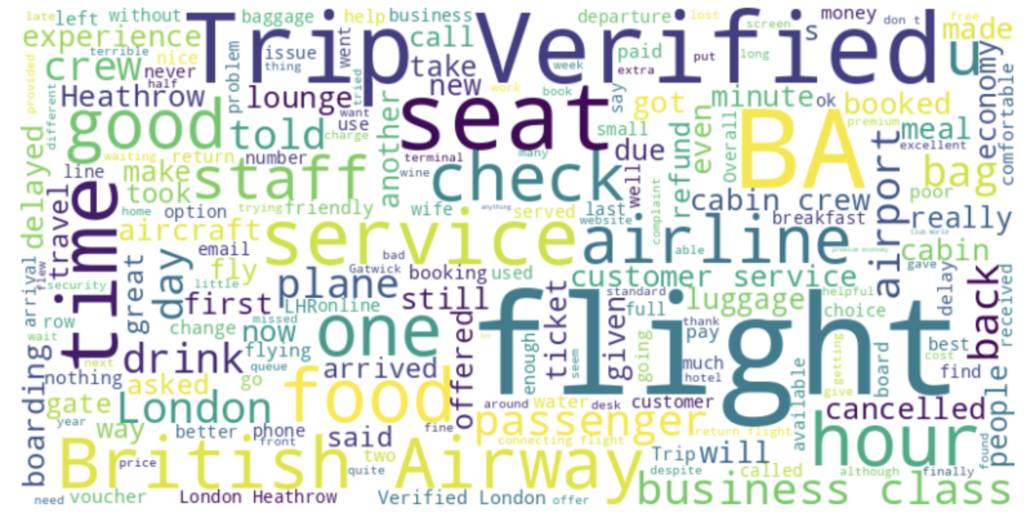
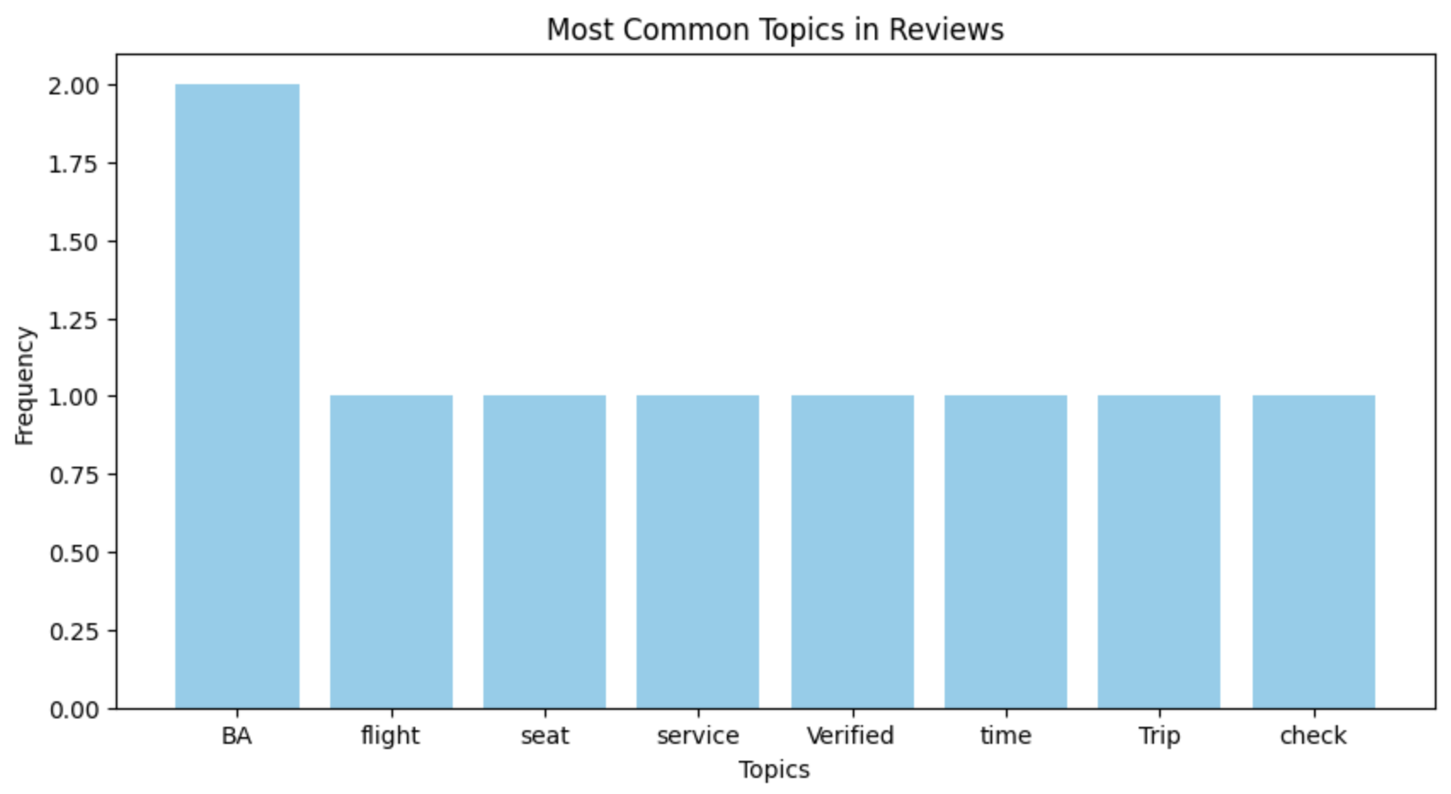
Word Cloud Analysis
The most common words extracted from the customers’ reviews are:
‘Trip’
‘Verified’
‘BA’
‘flight’
‘time’
‘seat’
‘check’
‘service’
Based on the results, passengers care most about the quality of the trip, flight delays, and comfort

Slide 4
Classification Report
The model accurately predicts 85% of instances
When the model predicts a booking (class 1), it is less certain and has a higher chance of false positives
your model is better at capturing instances where there is no booking (class 0) than instances where there is a booking (class 1)
F1 score = 0.92 indicates good performance
The model relies heavily on features like purchase_lead and length_of_stay to make predictions
Classification Report
Accuracy | 0.85
 | Precision | Recall | f1-score | Support
0 | 87% | 98% | 92% | 8,520
1 | 53% | 13% | 21% | 1,480
Accuracy |  |  | 85% | 10,000
Macro Average | 70% | 55% | 56% | 10,000
Weighted Average | 82% | 85% | 81% | 10,000
 | Feauture | Importance
1 | Purchase Lead | 15%
3 | Flight Hour | 12%
2 | Length of Stay | 11%
0 | Number of Passengers | 5%
7 | Flight Duration | 4%

Slide 5

Cross-Validation
Cross-validated Accuracy on Sample: 0.85 (+/- 0.01)
Cross-validated Accuracy on Full Dataset: 0.73 (+/- 0.20)
The sample indicates a higher cross-validated accuracy compared to the full dataset
There is more variability in the full dataset

