Slide 1

Data Science Assessment – Custom NER models for Job Skills
Eleonora Parrag

Slide 2
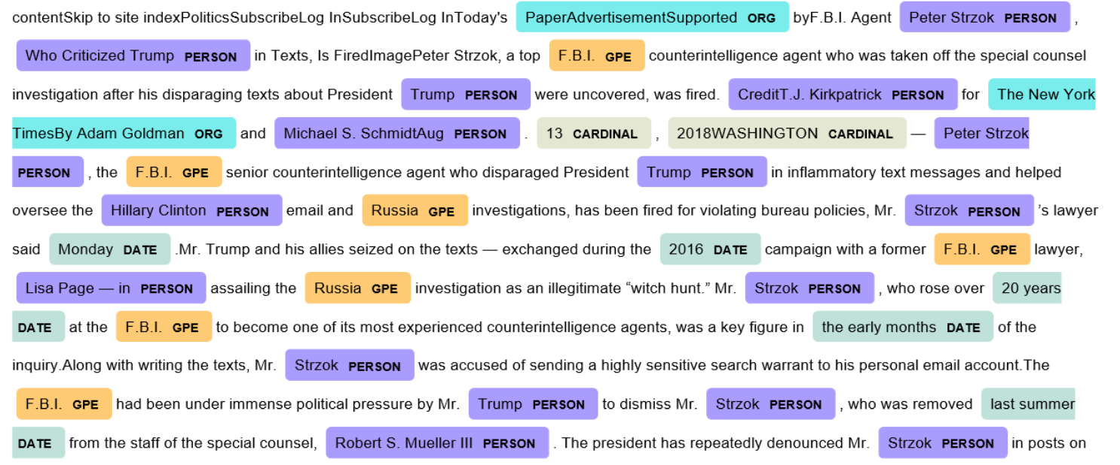
NER Models
Named Entity Recognition

Slide 3
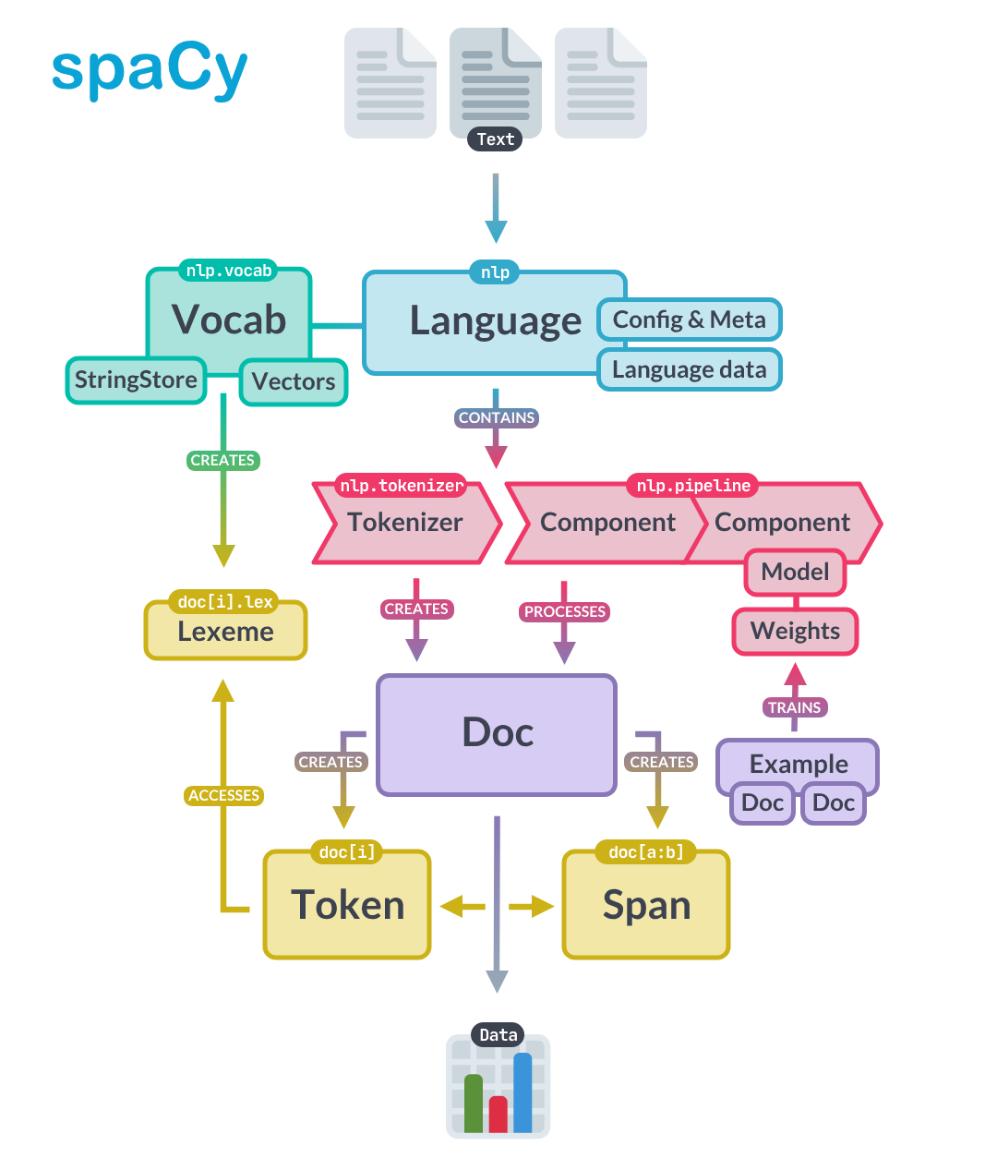
How do they work?
spaCy is popular for NER
It uses word embeddings to identify entities by context
It has many pre-trained models

Slide 4
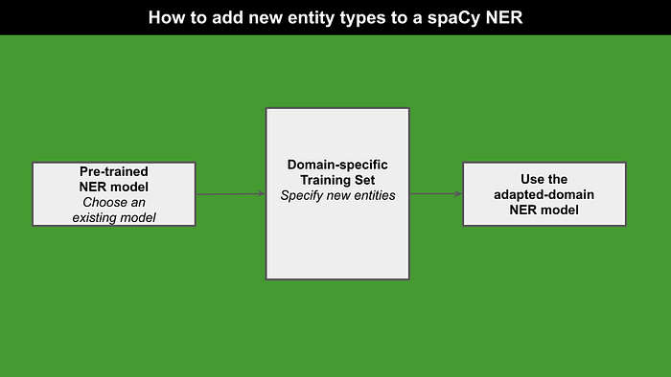
Custom NER Models
Sometimes pre-existing ones cannot do specifics, give examples e.g. medication names, bacteria names, etc.
Need annotated data

Slide 5
To Note…
A tagger will never get everything right! There will always be some missed or misclassified entities
Defining your own categories will require manually classifying many documents

Slide 6
Example Input
[ "My name is Johnny Kolly and I'm a producer. My boss is Jimmy Smith.", { "entities": [ (11,23,"PERSON"), (55,66,"PERSON"), (34,42,"JOB") ] } ]

Slide 7
Pre-processing steps
Before training can begin, the following is needed:
Annotation
Data cleaning - remove meaningless white space (like newlines, leading and trailing spaces) or formatting characters
Other cleaning e.g. lowercasing, punctuation, lemmatizing should not be done as spaCy would also use these to help gauge context
Formatting for spaCy (see previous slide)
Train test split with even distribution of skill tags

Slide 8
Choosing a Dataset
Sources:
Webscraping job sites for CVs/Job descriptions e.g. Indeed
Kaggle is a great source for publically available datasets for training machine learning models
The bigger the better!
Hand-labelled by humans is best
Is the data representative of what it will be used for?
How easy is it to gather/clean/annotate?

Slide 9
Possible Approaches:
Find an existing NER entity-annotated dataset and clean according to my purposes
Find Resume/Job description data and hand-label using an NER annotator [1]
Find Resume/Job description data and label using word search from skills list
[1] https://tecoholic.github.io/ner-annotator/

Slide 10
Possible Datasets:
Kaggle: Employment Skills List
Kaggle: Job Descriptions
Kaggle: Resume dataset
Kaggle: NER-labelled Resumes

Slide 11
Find an existing NER entity-annotated dataset and clean according to my purposes

Slide 12
Sample from Kaggle NER Dataset
{"content":
"Afreen Jamadar\nActive member of IIIT Committee in Third year\n\nSangli, Maharashtra - Email me on Indeed: indeed.com/r/Afreen-Jamadar/8baf379b705e37c6\n\nI wish to use my knowledge, skills and conceptual understanding to create excellent team\nenvironments and work consistently achieving organization objectives believes in taking initiative\nand work to excellence in my work.\n\nWORK EXPERIENCE\n\nActive member of IIIT Committee in Third year\n\nCisco Networking - Kanpur, Uttar Pradesh\n\norganized by Techkriti IIT Kanpur and Azure Skynet.\nPERSONALLITY TRAITS:\n• Quick learning ability\n• hard working\n\nEDUCATION\n\nPG-DAC\n\nCDAC ACTS\n\n2017\n\nBachelor of Engg in Information Technology\n\nShivaji University Kolhapur - Kolhapur, Maharashtra\n\n2016\n\nSKILLS\n\nDatabase (Less than 1 year), HTML (Less than 1 year), Linux. (Less than 1 year), MICROSOFT\nACCESS (Less than 1 year), MICROSOFT WINDOWS (Less than 1 year)\n\nADDITIONAL INFORMATION\n\nTECHNICAL SKILLS:\n\n• Programming Languages: C, C++, Java, .net, php.\n• Web Designing: HTML, XML\n• Operating Systems: Windows […] Windows Server 2003, Linux.\n• Database: MS Access, MS SQL Server 2008, Oracle 10g, MySql.\n\nhttps://www.indeed.com/r/Afreen-Jamadar/8baf379b705e37c6?isid=rex-download&ikw=download-top&co=IN",
"annotation":
[{"label":["Email Address"],"points":[{"start":1155,"end":1198,"text":"indeed.com/r/Afreen-Jamadar/8baf379b705e37c6"}]},
{"label":["Skills"],"points":[{"start":743,"end":1140,"text":"Database (Less than 1 year), HTML (Less than 1 year), Linux. (Less than 1 year), MICROSOFT\nACCESS (Less than 1 year), MICROSOFT WINDOWS (Less than 1 year)\n\nADDITIONAL INFORMATION\n\nTECHNICAL SKILLS:\n\n• Programming Languages: C, C++, Java, .net, php.\n• Web Designing: HTML, XML\n• Operating Systems: Windows […] Windows Server 2003, Linux.\n• Database: MS Access, MS SQL Server 2008, Oracle 10g, MySql."}]},
{"label":["Graduation Year"],"points":[{"start":729,"end":732,"text":"2016"}]},
{"label":["College Name"],"points":[{"start":675,"end":702,"text":"Shivaji University Kolhapur "}]},
{"label":["Degree"],"points":[{"start":631,"end":672,"text":"Bachelor of Engg in Information Technology"}]},
{"label":["Graduation Year"],"points":[{"start":625,"end":629,"text":"2017\n"}]},
{"label":["College Name"],"points":[{"start":614,"end":622,"text":"CDAC ACTS"}]},
{"label":["Degree"],"points":[{"start":606,"end":611,"text":"PG-DAC"}]},
{"label":["Email Address"],"points":[{"start":104,"end":147,"text":"indeed.com/r/Afreen-Jamadar/8baf379b705e37c6"}]},
{"label":["Location"],"points":[{"start":62,"end":67,"text":"Sangli"}]},
{"label":["Name"],"points":[{"start":0,"end":13,"text":"Afreen Jamadar"}]}],"extras":null}
This is horrible. How can I clean this?

Slide 13
[{"label":["Skills"],"points":[{"start":8098,"end":8383,"text":"❖ Operating Environment: […] Windows95/98/XP/NT\n❖ Database Tool: SQL Management Studio (MSSQL), Business\nDevelopment Studio, Visual studio 2005\n❖ Database Language: SQL, PL/SQL\n❖ Ticket Tracking Tool: Service Now\n❖ Reporting Tools: MS Reporting Services, SAS\n❖ Languages: C, C++, PL/SQL"}]},
{"label":["Skills"],"points":[{"start":8008,"end":8049,"text":"Database (3 years), SQL (3 years), Sql Dba"}]},
{"label":["Skills"],"points":[{"start":743,"end":1140,"text":"Database (Less than 1 year), HTML (Less than 1 year), Linux. (Less than 1 year), MICROSOFT\nACCESS (Less than 1 year), MICROSOFT WINDOWS (Less than 1 year)\n\nADDITIONAL INFORMATION\n\nTECHNICAL SKILLS:\n\n• Programming Languages: C, C++, Java, .net, php.\n• Web Designing: HTML, XML\n• Operating Systems: Windows […] Windows Server 2003, Linux.\n• Database: MS Access, MS SQL Server 2008, Oracle 10g, MySql."}]},
[{"label":["Skills"],"points":[{"start":3749,"end":3756,"text":"Teradata"}]},
{"label":["Skills"],"points":[{"start":3709,"end":3717,"text":"Mainframe"}]},
{"label":["Skills"],"points":[{"start":3664,"end":3671,"text":"Teradata"}]},
{"label":["Skills"],"points":[{"start":3636,"end":3644,"text":"Mainframe"}]},
{"label":["Skills"],"points":[{"start":3542,"end":3549,"text":"Teradata"}]},
{"label":["Skills"],"points":[{"start":3526,"end":3529,"text":" Jcl"}]},
{"label":["Skills"],"points":[{"start":3510,"end":3514,"text":"cobol"}]},
It’s worked perfectly for some of them, but I don’t think the above will work with NER so I’d need to find a way to clean it

Slide 14
Possible Approaches:
Find an existing NER entity-annotated dataset and clean according to my purposes
The annotations group all the skills together in one chunk. This does not seem suitable for identifying individual skills, but rather a whole section of a CV
Find Resume/Job description data and hand-label using an NER annotator
Labour-intensive, but can achieve best selection of training data
Find Resume/Job description data and label using word search from skills list
This will have weaknesses as doing it automatically will inevitably make mistakes, it’s best to be checked by a human. Also, skills not on the list will be missed, or some things can be tagged as skills in the incorrect context. However, this can be a good starting point for training an NER model, as it doesn’t need perfect input data to achieve results if the dataset is large enough

Slide 15
Data Cleaning
Suitable formatting – including clean annotations and indices
Remove extra whitespaces, formatting characters \n, \r, etc.
Remove some punctuation? spaCy can use some information for context clues so best not to get rid of everything
Remove bullet points, non-ascii characters

Slide 16
Creating my own Annotations

Slide 17
Word Search
Kaggle List of Employment skills (taken from Linkedin, 36941 skills!)
Split cleaned CV text by spaces, then match words from the skills list
Get the start and end indices of the skill in the text
From skills list: Pandas, Python
Text: I have experience using Pandas and Python

Slide 18
Word Search
But…
What about cases? Skills on linked are capitalised e.g. Pandas. They might not be in the text → make everything lowercase for the search?
What about multiple word skills? E.g. Natural Language Processing?
Could search text string → but inconsistent cases, and what about acronyms, software names? E.g. R could be picked up many times in words

Slide 19
Multiple word skills
I have experience in Pandas, Python, R, and Natural Language Processing
I have experience in pandas python r and natural_language_processing
‘I’, ‘have’, ‘experience’, ‘in’, ‘pandas’, ‘python’, ‘r’, ‘and’, ‘natural_language_processing’
‘I’, ‘have’, ‘experience’, ‘in’, ‘pandas’, ‘python’, ‘r’, ‘and’, ‘natural_language_processing’
I have experience in Pandas, Python, R, and Natural Language Processing
Make lowercase, add underscores to multi-word skills found in text
Split words by spaces
Match lowercase skills, find indices
Return to original format, use same indices to find skills
Ready for training a custom NER model!

Slide 20
Multiple word skills
Match multi-word skills
Cleaned sample text (lowercase)
Replace spaces with underscores in text
Match single word skills and underscored multi-word skills
Split sample text
(lowercase)
Get Indices
Final dataset
Cleaned sample text (original non-lowercased)
Indices of skills (including multi-word skills)

Slide 21
Final Dataset
Contain cleaned text, and annotations of skills included the words and start/end indices in the text
Ready for conversion to input for spaCy
Original Data | Cleaned Data | Indices | Words
Performed sentiment (Positive, Negative & Neutral) and Time series analysis on customer comments across all 4 categories.\r\n* | performed sentiment positive negative & neutral and time_series_analysis on customer comments across all 4 categories. | [2231,2231] | [‘Time series analysis’]

Slide 22
Ways to improve
Is a whole resume as an entry too long? Could split into sentences but then we would lose the context
Include job descriptions as well? –would have to train separately
Find a larger source of data – webscraping off Indeed could be good
Despite the labour-intensive aspect, labelling by humans (using e.g. an NER annotator) would allow for the best training set
Possible fast approach to hand-labelling:
Label a smaller proportion by hand (maybe 10%)
Train the model test on another chunk of your data.
Have a human review, correct mistakes in annotation, then add to training set → this would require less annotating by hand

Slide 23
Ways to improve
Is a whole resume as an entry too long? Could split into sentences but then we would lose the context
Include job descriptions as well? –would have to train separately
Probably best to start with my dataset
Adapt the model and training data depending on my results
Experiment!
Find a larger source of data – webscraping off Indeed could be good
Despite the labour-intensive aspect, labelling by humans (using e.g. an NER annotator) would allow for the best training set
Possible fast approach to hand-labelling:
Label a smaller proportion by hand (maybe 10%)
Train the model test on another chunk of your data.
Have a human review, correct mistakes in annotation, then add to training set → this would require less annotating by hand

Slide 24
Thanks for listening – any questions?

Slide 25
Links
https://www.kaggle.com/datasets/maneeshdisodia/employment-skills Employment Skills List
https://www.kaggle.com/datasets/gauravduttakiit/resume-dataset
https://www.kaggle.com/code/jmartindelasierra/structuring-and-analyzing-job-descriptions/input
https://www.kaggle.com/datasets/dataturks/resume-entities-for-ner/data NER annotated data

