Slide 1

Trade-Off Analysis of Open Source Web
Mobile App Frameworks: The KuDo Project
Master on Libre Software URJC 2013
Author: Esther Parrilla-Endrino
Tutors: Prof. Gregorio Robles, Prof. Daniel Izquierdo
Copyright (c) 2013 Esther Parrilla-Endrino
This work is licensed under the Creative Commons Attribution 3.0 License

Slide 2
Proposed Agenda
Overview
Objectives
Types of Mobile App Frameworks
Possible Candidates
OpenBRR Analysis
Conclusions
Future Work
Resources
Copyright (c) 2013 Esther Parrilla-Endrino
This work is licensed under the Creative Commons Attribution 3.0 License

Slide 3
Overview
Beginning this year I have started working on a personal project called ’KuDo’, the idea is to setup a start-up focused in the development of web-based applications for educational purposes that can be easily run in mobile devices such as smartphones, tablets etc...
This Master Thesis is the baseline activity I have performed for the KuDo project in order to determine which technical solution could fit better for this purpose from the wide range of web mobile app frameworks existing nowadays.
Mobile devices such as smartphones and tablets have become the preferred tools for communicating with each other, for that reason there are lots of technical solutions for implementing applications that can be run under those devices and that offer a clear enhancement in the end-user experience. That is the reason why the KuDo project is focused in this kind of developments, there is a clear niche of new opportunities in this software development field.
Copyright (c) 2013 Esther Parrilla-Endrino
This work is licensed under the Creative Commons Attribution 3.0 License

Slide 4
Objectives
The objectives of this Master Thesis were defined and agreed with my tutors and can be summarized in the following list:
  Select a couple of representative Open Source web-based frameworks for developing mobile apps from the existing solutions currently available in the market.
  Set a checklist of points to be analyzed for each solution in the form of well-defined metrics that can be properly measured.
  Analyze each solution using the OpenBRR methodology, setting dif-ferent weights and scores for each category according to this model. Spreadsheets shall be used for automating this process.
  Summarize pros and contras of each solution.
  Perform a comparison of the results for each solution taking as a baseline the final version of each spreadsheet and also applying a SWOT comparision analysis on top of OpenBRR.
Copyright (c) 2013 Esther Parrilla-Endrino
This work is licensed under the Creative Commons Attribution 3.0 License

Slide 5
Types of Mobile App Frameworks
Native Apps: A native app is an app for a certain mobile device (smartphone, tablet, etc.) They are installed directly in the device. Users typically acquire these apps through an online store or market place such as The Apple Store or Google Play.
Web-based Apps: When we talk about mobile web apps we are re-ferring to Internet-enabled apps (compliant with HTML5, CSS3 and Javascript standards) that allow web developers to quickly and easily create mobile apps that work on Android, iOS and BlackBerry devices and produce a native-app-like experience inside a browser.
Hybrid Apps: An application in which some or all of your UI and business logic is written in HTML, CSS, and JavaScript running within a ”native wrapper” such as a Titanium WebView or PhoneGap container. Hybrid apps have limited access to the device hardware. Hybrid apps offer app store distribution and operation without a network connection.
→ Web-based Apps solutions (pure or hybrid) are the preferred ones!
Copyright (c) 2013 Esther Parrilla-Endrino
This work is licensed under the Creative Commons Attribution 3.0 License

Slide 6
Possible Candidates
There are many web-based frameworks for developing mobile apps nowadays, the first step I performed in this study was to take a deep look in the Internet at the available solutions and select a subset of them that fulfills the requirements of the KuDo project:
  Appspresso
  Sencha Touch
  Appcelerator Titanium
  IPFaces
  MoSync
  jQuery Mobile
  Cordova
  Dojo Mobile
→ Sencha Touch and jQuery Mobile are the selected ones!
Copyright (c) 2013 Esther Parrilla-Endrino
This work is licensed under the Creative Commons Attribution 3.0 License

Slide 7
OpenBRR Analysis
The Business Readiness Rating model (OpenBRR) is intended to help IT managers assess which Open Source software would be most suitable for their needs. The initiative is lead by the Carnegie Mellon West University, Spike Source, Intel and O’Reilly’s Code Zoo and offer proposals for standardizing different types of evaluation data and grouping them into categories.
The model is composed of the following phases:
  Phase 1 - Quick Assessment: defining and ranking of metrics and cat-egories according to their importance within the product that is going to be evaluated.
  Phase 2 - Target usage assessment: Set the necessary category and metric weights according to the project’s goals.
  Phase 3 - Data collection and processing: Gather data for each metric used in each category rating, and calculate the applied weighting for each metric, spreadsheets are used for this purpose.
  Phase 4 - Data translation: Use category ratings and the functional orientation weighting factors to calculate the Business Readiness Rating score and publish the software’s Business Readiness Rating score.
Copyright (c) 2013 Esther Parrilla-Endrino
This work is licensed under the Creative Commons Attribution 3.0 License

Slide 8
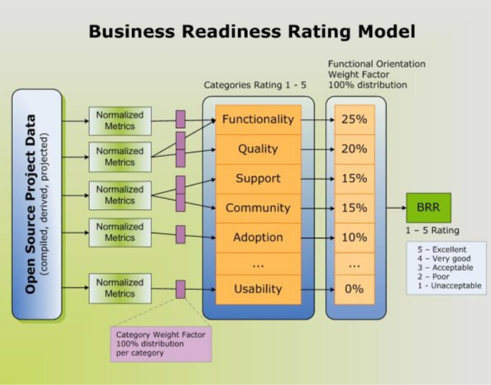
OpenBRR Analysis
Copyright (c) 2013 Esther Parrilla-Endrino
This work is licensed under the Creative Commons Attribution 3.0 License

Slide 9
OpenBRR – Data Sources
The starting point for getting data on the selected solutions are the official websites of each Mobile App framework.
One of the data sources we studied in the MSWL was Ohloh, which provides information about Open Source software projects. Metrics present in Ohloh site are generated by Ohloh specific tools and others are provided by gathering the information on Ohloh users feedback from the projects they are interested in.
In the MSWL we studied other data sources like FLOSSMetrics, FLOSSmole and FLOSShub which provide centralized access to data analysis (charts, tables and other quantitative information) of free/libre/open source projects hosted in forges such as Sourceforge , GForge etc...
Unfortunately because the technologies we are studying in this thesis are quite new, there is no data there, so I had to look for other sources of information:
  Discussion groups/Polls on LinkedIn, Survey Monkey, Quora, Google discussion groups etc...
  Technical articles: IBM Developer Works, Mobile App specific sites...
  Books/Presentations: Amazon, SlideShare...
  Prototype examples available on GitHub
Copyright (c) 2013 Esther Parrilla-Endrino
This work is licensed under the Creative Commons Attribution 3.0 License

Slide 10
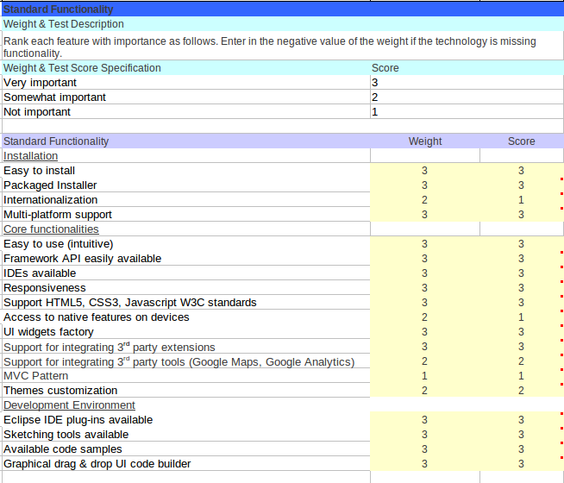
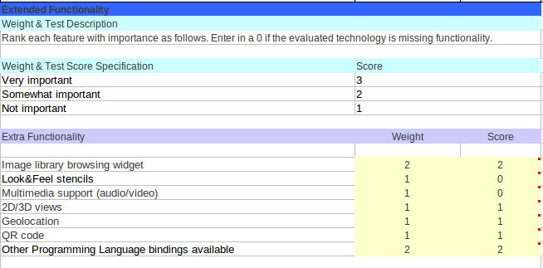
OpenBRR Analysis – Quick Assessment
Focused in setting the number of categories used and the different metrics that shall be evaluated per category. The canonical OpenBRR model recommends to focus in not more than seven categories, but in order to provide a more general overview, I have considered the twelve categories present in the model.
The most important category within this study is the ”Functionality” category, here I have defined a set of very specific criteria to evaluate precisely the selected frameworks:
Copyright (c) 2013 Esther Parrilla-Endrino
This work is licensed under the Creative Commons Attribution 3.0 License

Slide 11
OpenBRR Analysis – Quick Assessment
Regarding the metrics, I have reviewed the list of metrics provided by the canonical OpenBRR model template. If these metrics fit well with the type of tools I have to analyze (mobile web app) I have left them, if not, I have substituted them with new ones that measure better the QA of the products:
  Multiplatform support → Usability
  Is there a dedicated information (web page, wiki, etc) for security? → Security
  Architecture based on design patterns → Scalability
  Are there any repositories of 3rd party UI Plug-ins → Architecture
  Backend Services Support → Architecture
  Enable/disable features through configuration → Architecture
  Programming Languages → Architecture
  Framework web site quality → Documentation
  Longevity → Community
  Cloud Support → Community
  License → Professionalism
Copyright (c) 2013 Esther Parrilla-Endrino
This work is licensed under the Creative Commons Attribution 3.0 License

Slide 12
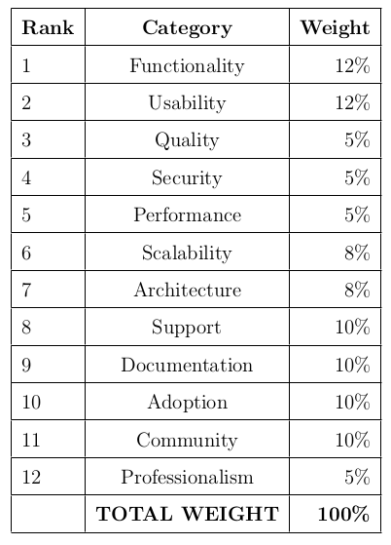
OpenBRR Analysis – Target Usage Assessment
This second phase consists in setting the category and metric weights according to the KuDo project requirements:
Copyright (c) 2013 Esther Parrilla-Endrino
This work is licensed under the Creative Commons Attribution 3.0 License

Slide 13
OpenBRR Analysis – Data Collection
For filling the differents scores assigned to each category defined previously I have used the OpenBRR baseline spreadsheet provided to the students of Master on Libre Software 2011-2012 located at:
http://docencia.etsit.urjc.es/moodle/mod/resource/view.php?id=4350
This spreadsheet has an initial set of metrics for each OpenBRR category, allowing to ponderate each metric and providing a normalized score according to the possible values obtained in measurements.
Category weights have been introduced in the sheets. Each metric within each category should have a weighting factor to differentiate the metric’s importance within that particular category.
Each metric has been measured searching the Internet and getting the needed information from official mailing lists or websites and referencing that link in the corresponding ”Raw score” cell with a ”comment” in the cell. When a reference is not provided, it means that that metric could not be found or the own tool command line help or main website announces that aspect so it is easy to find.
For the unknown data, I have assigned the worst possible normalized score to the corresponding metric, so the results is not biased by unreliable information.
Copyright (c) 2013 Esther Parrilla-Endrino
This work is licensed under the Creative Commons Attribution 3.0 License

Slide 14
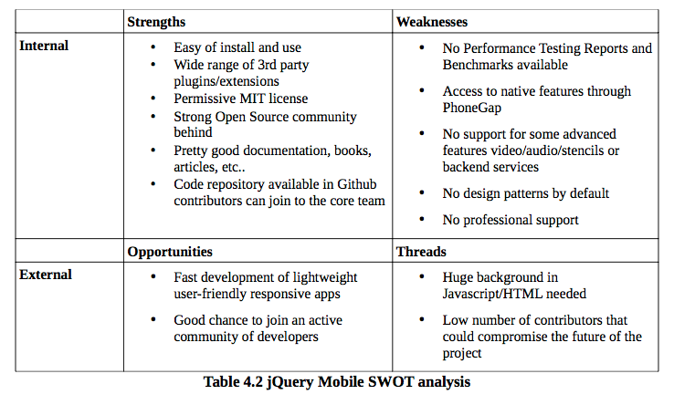
OpenBRR Analysis – Data Translation (I)
For filling the differents scores assigned to each category defined previously I have used the OpenBRR baseline spreadsheet provided to the students of Master on Libre Software 2011-2012.
The final score for jQuery Mobile is 4.0015
https://github.com/eparrillae/eparrillae-mswl-thesis/blob/master/MasterThesis/thesis/OpenBRR_Templates/BRR_Template_jQueryMobile.ods
Copyright (c) 2013 Esther Parrilla-Endrino
This work is licensed under the Creative Commons Attribution 3.0 License

Slide 15
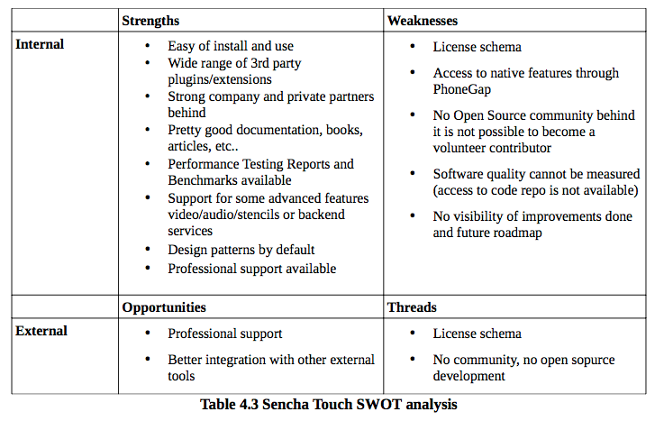
OpenBRR Analysis – Data Translation (II)
For filling the differents scores assigned to each category defined previously I have used the OpenBRR baseline spreadsheet provided to the students of Master on Libre Software 2011-2012.
The final score for Sencha Touch is 3.723
https://github.com/eparrillae/eparrillae-mswl-thesis/blob/master/MasterThesis/thesis/OpenBRR_Templates/BRR_Template_SenchaTouch.ods
Copyright (c) 2013 Esther Parrilla-Endrino
This work is licensed under the Creative Commons Attribution 3.0 License

Slide 16
Conclusions
During this trade-off I have discovered that jQuery Mobile has a simpler design using a relatively small object model that allows you re-use already existing HTML code, which makes it faster and easier to learn. Sencha has a large object model, which provides more features out of the box (DOM manipulation, CRUD Operations, access to SOAP/REST web services etc...), but takes longer to learn.
There is no established architecture, jQuery Mobile is layout-based and this allows you the freedom to do whatever you want. It is true that it extensively uses Javascript and HTML but for me is a challenge to improve my knowledge in those fields. Also it is easier to integrate with other frameworks, targets more devices than Sencha Touch (not dependant on WebKit) and it is not tied to a particular vendor.
Moreover it is licensed under a MIT permissive license which is perfect for my KuDo project. Clearly Sencha Touch bussiness model is quite different from jQuery Mobile in the case of Sencha there is a clear objective of monetization of their products (closed development process right now and a commercial entity controls it, not an Open Source foundation). For that reason they take care of professional support, implementation of comercial tools for development with Secncha, etc.. I am an experienced developer and do not need that kind of support.
As a final conclusion, I would say that if you intend to design business-friendly web apps then probably Sencha is the right option but if your goal is to create a market-friendly apps (like the ones within KuDo project) in a quick time, then you may choose to go with jQuery Mobile.
Copyright (c) 2013 Esther Parrilla-Endrino
This work is licensed under the Creative Commons Attribution 3.0 License

Slide 17
Future Work
Beginning this year I started working on a new personal project that I called ’KuDo’, first time I setup a start-up project from scratch!
The first step was to define the activity I would like to perform and give it a name, after some ”brainstorming”I decided to focus the activity in providing lightweight web-based applications for educational purposes that can be easily run in mobile devices such as smartphones, tablets etc...
The second step was to look in the market which frameworks were available for mobile apps development, if it was better to go for a native, an hybrid or a web-based solution and then perform a deep trade-off. This has been the aim of this Master Thesis, during this process I have learnt a lot in terms of web-based technologies, mobile apps and QA metrics.
As part of the future work on the KuDo project I am planning the following activities:
  Define Business Model → Double Licensing?
  Training → Barcelona Activa, Barcelona Net Activa etc...
  Co-working → MeetBCN, Comunidad Coworking, Mob Barcelona etc...
Crisis -> having a long-term job is not guaranteed -> time to move on and look for new professional opportunities!!!
Copyright (c) 2013 Esther Parrilla-Endrino
This work is licensed under the Creative Commons Attribution 3.0 License

Slide 18
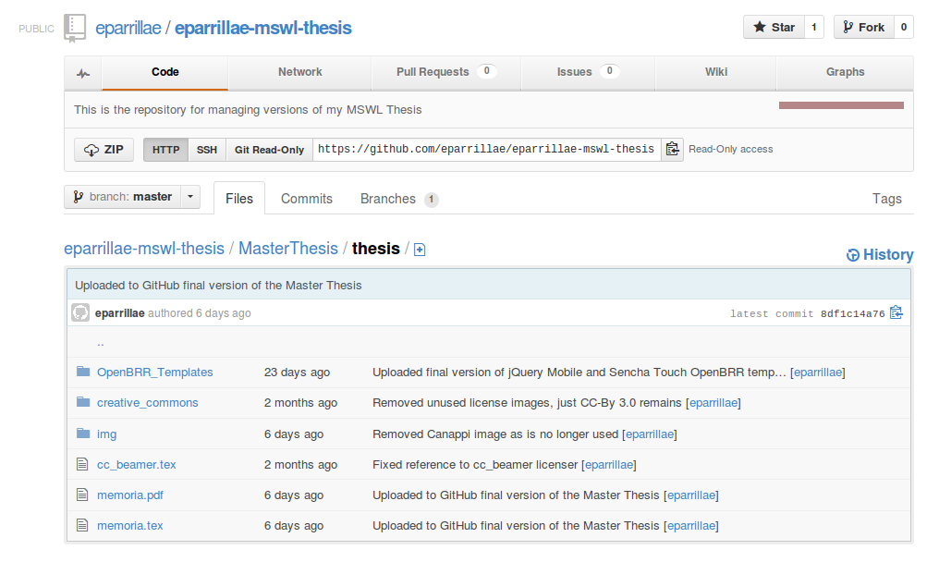
Resources
All material of this Master Thesis can be found in my GitHub project at:
https://github.com/eparrillae/eparrillae-mswl-thesis
Copyright (c) 2013 Esther Parrilla-Endrino
This work is licensed under the Creative Commons Attribution 3.0 License

Slide 19
Thanks! ;-)
Copyright (c) 2013 Esther Parrilla-Endrino
This work is licensed under the Creative Commons Attribution 3.0 License

