Slide 1
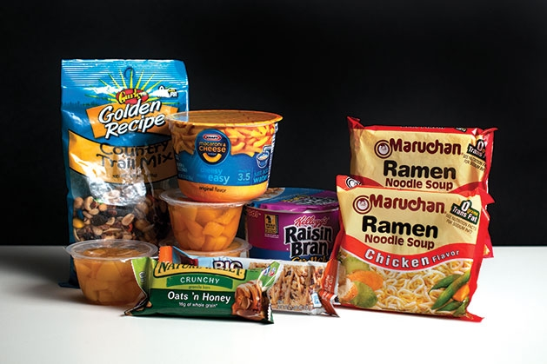
MY Pantry
The College Student Diet
Elisha Parslow
Elizabeth Young
Justice Martinez

Slide 2
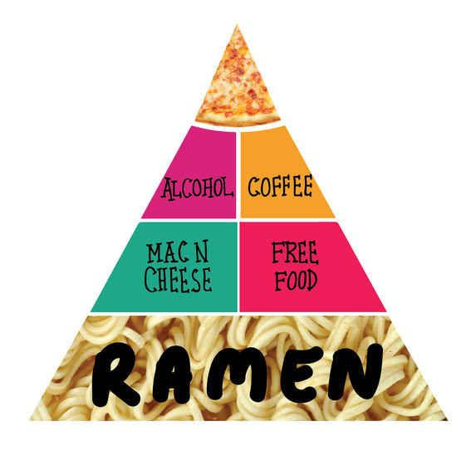
The project
A pantry inventory program
Add items, remove items, display the pantry, and clear the pantry
Store all inventory into text files
Allow user to close the program and return to items later
Using pointers to text files to implement access files throughout entire program

Slide 3
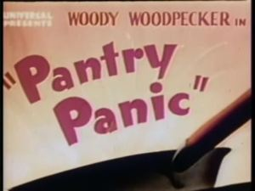
Challenges and Solutions
Adding items to the pantry
Creating individual text files for each of the 8 categories
Use inheritance to declare the functions of each category the same traits as pantyCategory()
Polymorphism so each category can access the same functions of pantryCategory()
Declaring pointers to text files to be used through all .cpp and header files
Making external pointers in Header then assigning them in the menu function to text files
Use <Stdio.h> library for pointer file manipulation
Passing the pointers as a parameter for all of the functions to be accessed and changed

Slide 4

More challenges and Solutions
Removing strings (inventory) from text files
Creating a main vector that stores all of the inventory
Making a temp vector for each category type with the removed inventory item and input that into a redefined category type text file
Closing the files and reopening them to fix the endline problem that caused the program not to read the desired item to be removed correctly
Program cannot add things and immediately remove them until the program is closed and reopened however
Clearing the entire pantry
Using fclose(*P, w+) which clears the entire file and allows it to be rewritten into

Slide 5

Let’s Demo!

Slide 6
Current Progress –specific to Elizabeth
The main functionality of the program is completed
Add, Remove, List, and Clear Pantry all functioning
All of the four options work, however when removing an item, if it was added in the same session, the program must be closed and reopened to remove
Program is well organized and uses a header as well as multiple .cpp files
Still working on the potential to organize the content of each text file

Slide 7
What is Left –specific to Elizabeth
Adding checkers for incorrect input i.e. symbols and chars for an int input
Comments for all of the objectives of the program
Work on user interface; organization of text using endlines
Working on adding a sorting the text files backend component to put all of the items in each text file grouped together
Creating a finalized project specification

