Slide 1
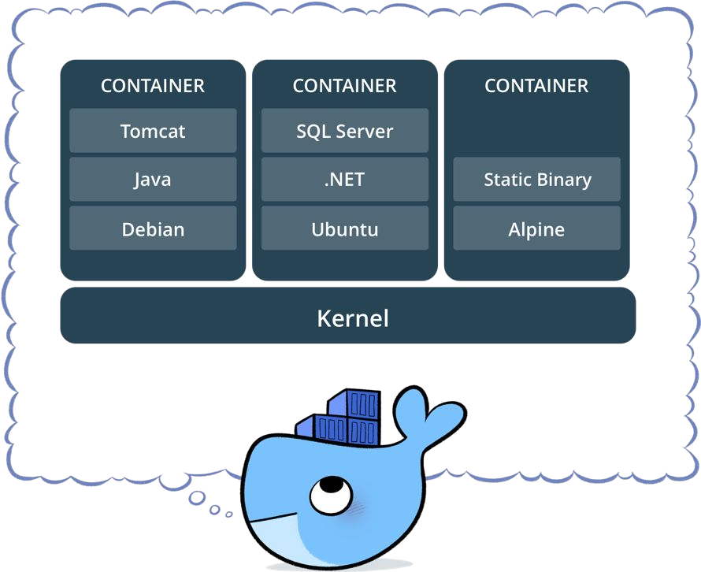
What is a container?
Docker is a set of platform as a service products that use OS-level virtualization to deliver software in packages called containers. Containers are isolated from one another and bundle their own software, libraries and configuration files; they can communicate with each other through well-defined channels.

Slide 2
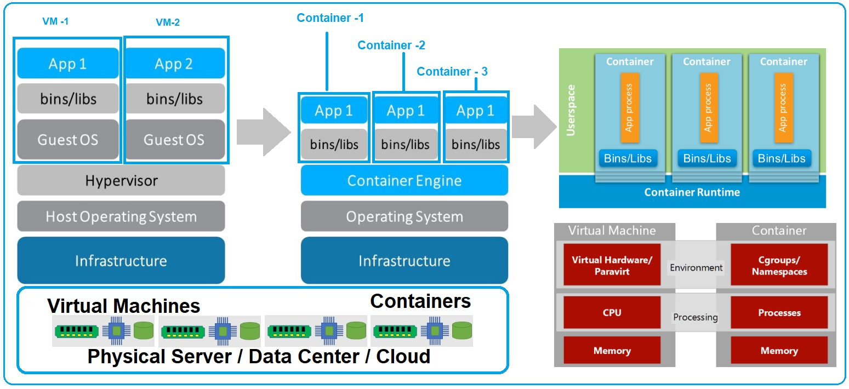

Slide 3
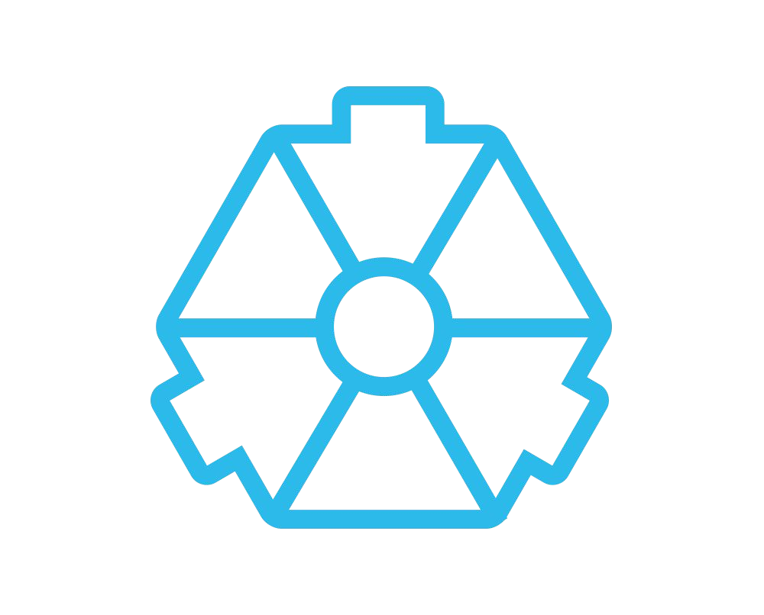
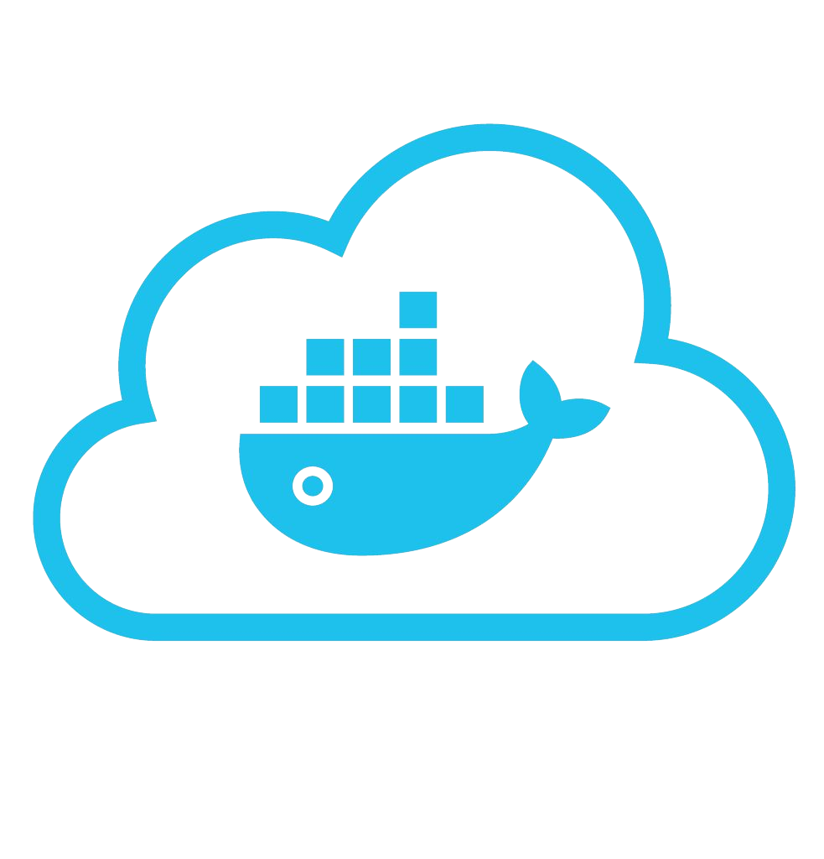










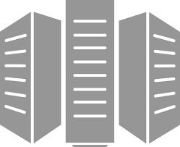



BUILD
Development Environments
SHIP
Create & Store Images
RUN
Deploy, Manage, Scale

Slide 4

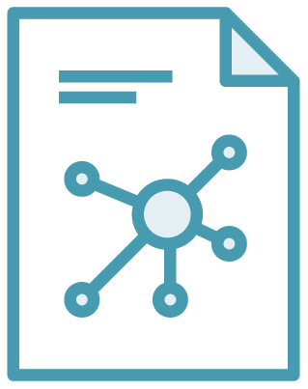
Image vs Container
Image A Docker image is an immutable (unchangeable) file that contains the source code, libraries, dependencies, tools, and other files needed for an application to run.
Container A Docker container is a virtualized run-time environment where users can isolate applications from the underlying system. These containers are compact, portable units in which you can start up an application quickly and easily.

Slide 5




Some Docker vocabulary
Docker Image
The basis of a Docker container. Represents a full application
Docker Container
The standard unit in which the application service resides and executes
Docker Engine
Creates, ships and runs Docker containers deployable on a physical or virtual, host locally, in a datacenter or cloud service provider
Registry Service (Docker Hub(Public) or Docker Trusted Registry(Private))
Cloud or server based storage and distribution service for your images

Slide 6
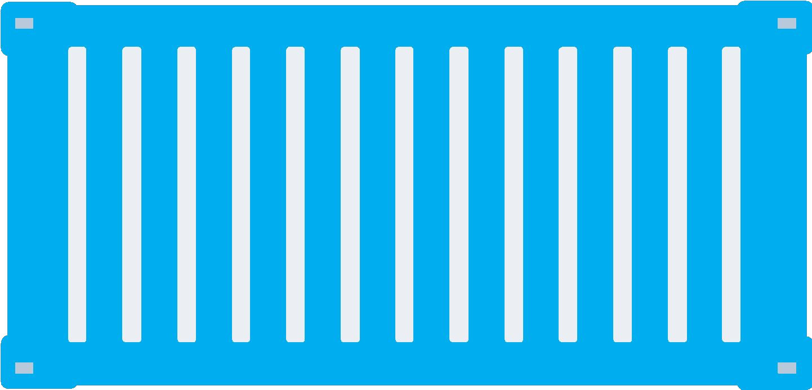


Network
Docker host (Örneğin Ubuntu 18.04)
Docker host (Örneğin Windows Server 2019)
Cntnr 4
Cntnr 5
Cntnr 6
Cntnr 7
Cntnr1
10.0.0.8
:80
bridgenet2
bridgenet3
Bridge
172.14.3.55
:8080
L2/L3 physical network

Slide 7
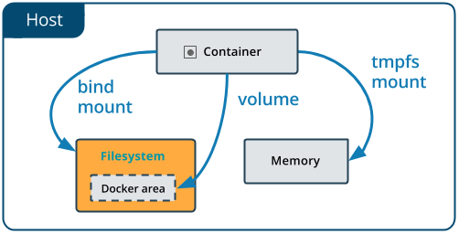
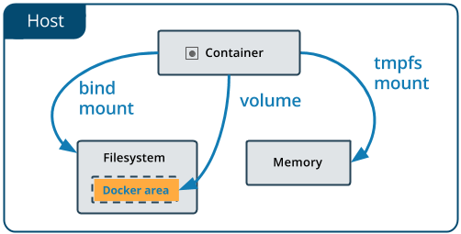
Docker Volume
bind mounts
volume
… type=bind,source="$(pwd)"/target …
docker volume create my-vol
… --mount source=my-vol ...

Slide 8
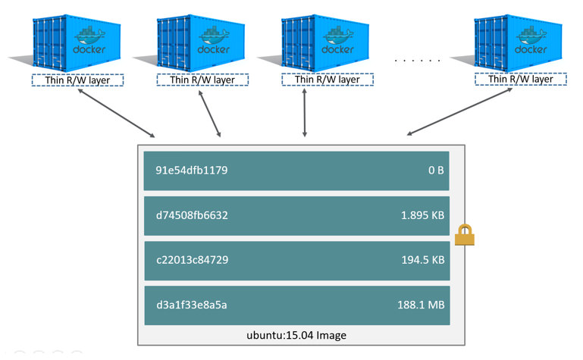
Container and layers

Slide 9
Orchestration
Orchestration is the automated configuration, coordination, and management of computer systems and software.
The portability and reproducibility of a containerized process mean we have an opportunity to move and scale our containerized applications across clouds and data-centers Containers effectively guarantee that those applications run the same way anywhere, allowing us to quickly and easily take advantage of all these environments.
Docker Swarm: Docker
Kubernetes: Google

Slide 10
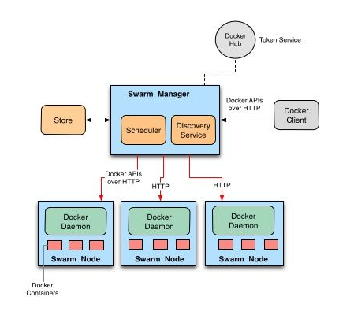
Swarm

Slide 11
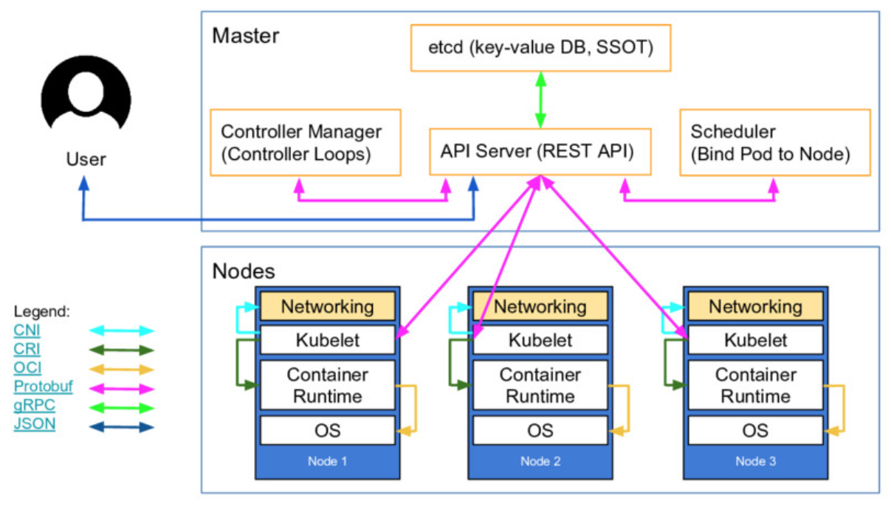
Kubernetes
Network
Storage

Slide 12
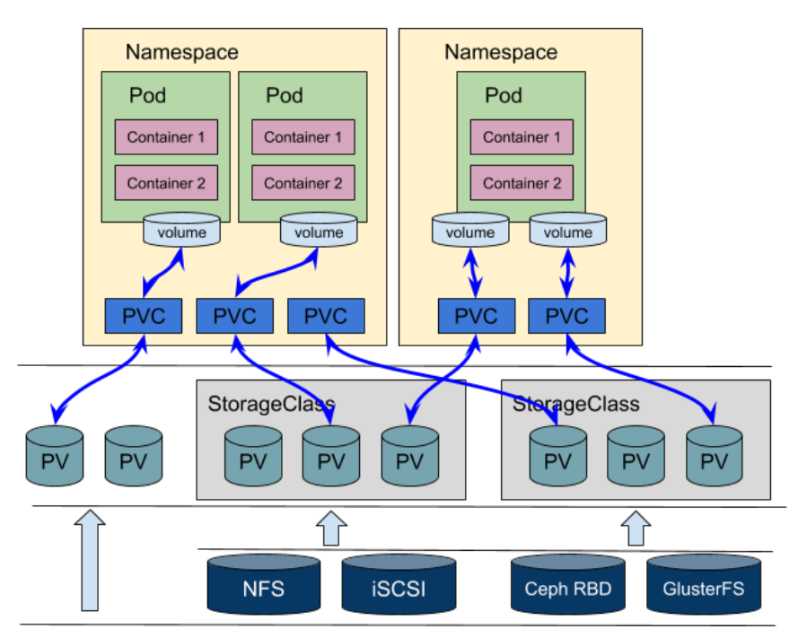
Kubernetes Volume

Slide 13
Kubernetes Cluster Networking
Kube-OVN
Kube-router
L2 networks and linux bridging
Multus (a Multi Network plugin)
OVN4NFV-K8s-Plugin (OVN based CNI controller & plugin)
NSX-T
Nuage Networks VCS (Virtualized Cloud Services)
OpenVSwitch
OVN (Open Virtual Networking)
Project Calico
Romana
Weave Net from Weaveworks
Azure CNI for Kubernetes
Big Cloud Fabric from Big Switch Networks
Cilium
CNI-Genie from Huawei
cni-ipvlan-vpc-k8s
Contiv
Contrail / Tungsten Fabric
DANM
Flannel
Google Compute Engine (GCE)
Jaguar
k-vswitch
Knitter
pods on a node can communicate with all pods on all nodes without NAT agents on a node (e.g. system daemons, kubelet) can communicate with all pods on that node

Slide 14
Kubernetes Volumes
awsElasticBlockStore
azureDisk
azureFile
cephfs
cinder
configMap
csi
downwardAPI
emptyDir
fc (fibre channel)
flexVolume
flocker
gcePersistentDisk
gitRepo (deprecated)
glusterfs
hostPath
iscsi
local
nfs
persistentVolumeClaim
projected
portworxVolume
quobyte
rbd
scaleIO
secret
storageos
vsphereVolume

Slide 15
Docker Swarm Features
Cluster management integrated with Docker Engine
Decentralized design
Declarative service model
Desired state
Multi-host networking
Service discovery
Load balancing
Secure by default
Rolling updates
When a node joins a swarm cluster, it creates an overlay network for services for each host in the docker swarm. It also creates a host-only docker bridge network for containers. This gives users a choice while encrypting the container data traffic to create its own overlay network.

Slide 16
Kubernetes Features
Storage orchestration
Service discovery and load balancing
Automated roll-outs and rollbacks
Secret and configuration management
Self-healing
Batch execution
IPv4/IPv6 dual-stack
Automatic bin packing (https://www.fairwinds.com/blog/5-problems-with-kubernetes-cost-estimation-strategies)
Kubernetes has a flat network model, allowing all the pods to communicate with each other. Network policies are in place to define how the pods interact with one another. The network is implemented typically as an overlay, requiring two CIDRS for the services and the pods. pods on a node can communicate with all pods on all nodes without NAT
https://www.fairwinds.com/blog/5-problems-with-kubernetes-cost-estimation-strategies

Slide 17
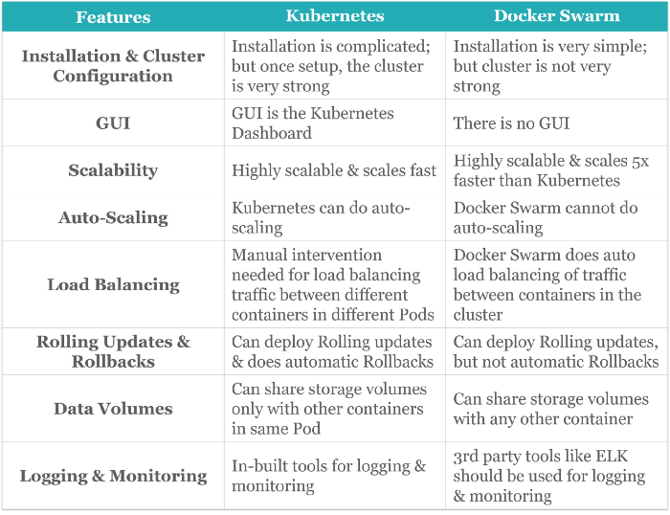
https://vilmate.com/blog/docker-vs-kubernetes/

Slide 18
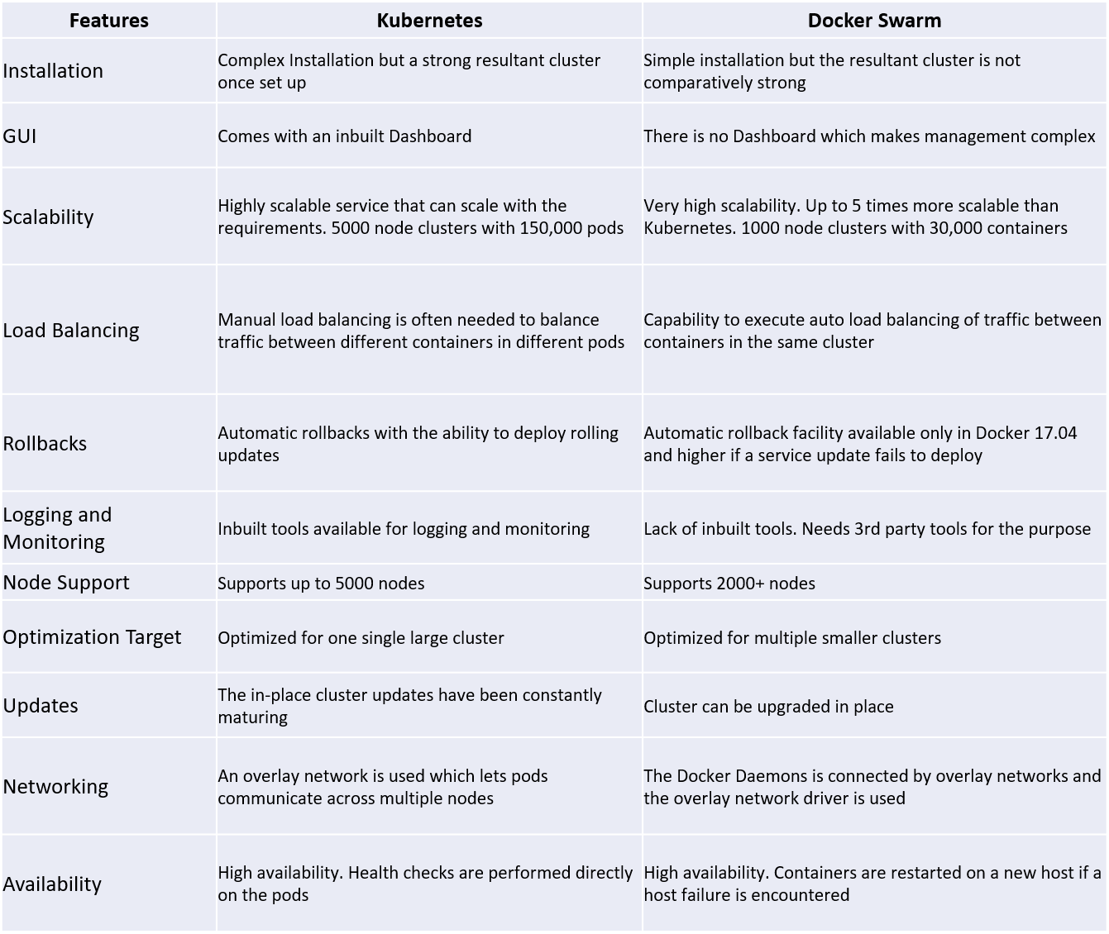

Slide 19
CNCF Cloud Native Interactive Landscape
https://www.cncf.io/
https://landscape.cncf.io/
https://github.com/cncf/landscape
https://www.cncf.io/wp-content/uploads/2020/08/CNCF_Survey_Report.pdf

Slide 20
Windows Infra
Orchestrator: Docker Swarm
Storage: SMB Shared Folder
Service Discover: Swarm Mode Routing Mesh
External Load Balancer: Nginx Load Balancer (Manager Nodes)

Slide 21
Linux Infra
Orchestrator: Kubernetes (Rancher / Ansible)
Storage: Ceph / Rook / NFS
Service Discover: Nginx Ingress / Istio
Network: Calico Project
External Load Balancer: Nginx Load Balancer (Master Nodes)

Slide 22
Shared Resources
Jenkins (1 Linux vm: 4 core, 8 ram, 250 gb)
Image Registery (1 Linux vm: 4 core, 8 ram, 1 tb)

Slide 23
Windows Clusters Test/UAT
1 Manager: 4 Core, 8 Ram, 250 GB
2 Manager and Worker Node: 8 Core, 16 Ram, 250 GB
2 File Server: 2 Core, 4 Ram, 500 GB
Test ve UAT için tek ayrı ayrı file server yük testi yapacağımız durumlarda gerçek ortama bizi yaklaştırır. Bu makinaların backup’ları da alınırsa cluster kurmaya ihtiyaç olmayacaktır.
Başlangıç için yeterli olacaktır. Eski Test ve UAT sisteminde yer alan uygulamalar bu cluser’a taşındıkça kaynkarlar arttırılabilir.

Slide 24
Linux Clusters Test/UAT
1 Master: 4 Core, 8 Ram, 250 GB
2 Master and Worker Node: 8 Core, 16 Ram, 250 GB
2 File Sever: 2 Core, 4 Ram, 500 GB
Test ve UAT için tek ayrı ayrı file server yük testi yapacağımız durumlarda gerçek ortama bizi yaklaştırır. Bu makinaların backup’ları da alınırsa cluster kurmaya ihtiyaç olmayacaktır.
Başlangıç için yeterli olacaktır. Eski Test ve UAT sisteminde yer alan uygulamalar bu cluser’a taşındıkça kaynkarlar arttırılabilir.

Slide 25
Windows Clusters Prod
1 Manager: 4 Core, 8 Ram, 250 GB
2 Manager and Worker Node: 16 Core, 32 Ram, 250 GB
2 File Server: 2 Core, 4 Ram, 500 GB
2 file serverdan Windows Server 2019 storage space, storage replication ve disaster recovery teknolojileri ile 500 GB’lık bir storage oluşturup hem hız hem de backup kazanmış oluruz. Ortam kurulmadan önce tüm uygulamaların statik dosya boyutları incelenerek bu alan arttırılabilir.
Eski sistemlerdeki Web sayfaları taşındıkça buradaki kaynaklar arttırılabilir. Zaten eski sunucular kapandıkça kaynaklar bu tarafa kaydırılabilir.

Slide 26
Linux Clusters Prod
1 Master: 4 Core, 8 Ram, 250 GB
2 Master and Worker Node: 8 Core, 16 Ram, 250 GB
3 File Sever: 4 Core, 8 Ram, 500 GB
Linux (Kubernetes) dünyasında bunun en iyi yolu 3 node’lu bir storage cluster kurmaktır. Bunu en iyi yapan ve en çok kullanılan araçlar Ceph, Gluster ve Minio. Bunlarda klasik cluster sistemlerdeki gibi en az 3 node ile çalışıyorlar.
Bu şu anlama geliyor 2 replica istenirse 750 GB’ lık bir alana sahip olmuş olacağız. Bu alan da aktif uygulamalar incelenerek dahga fazlada kullanılabilir.

