Slide 1


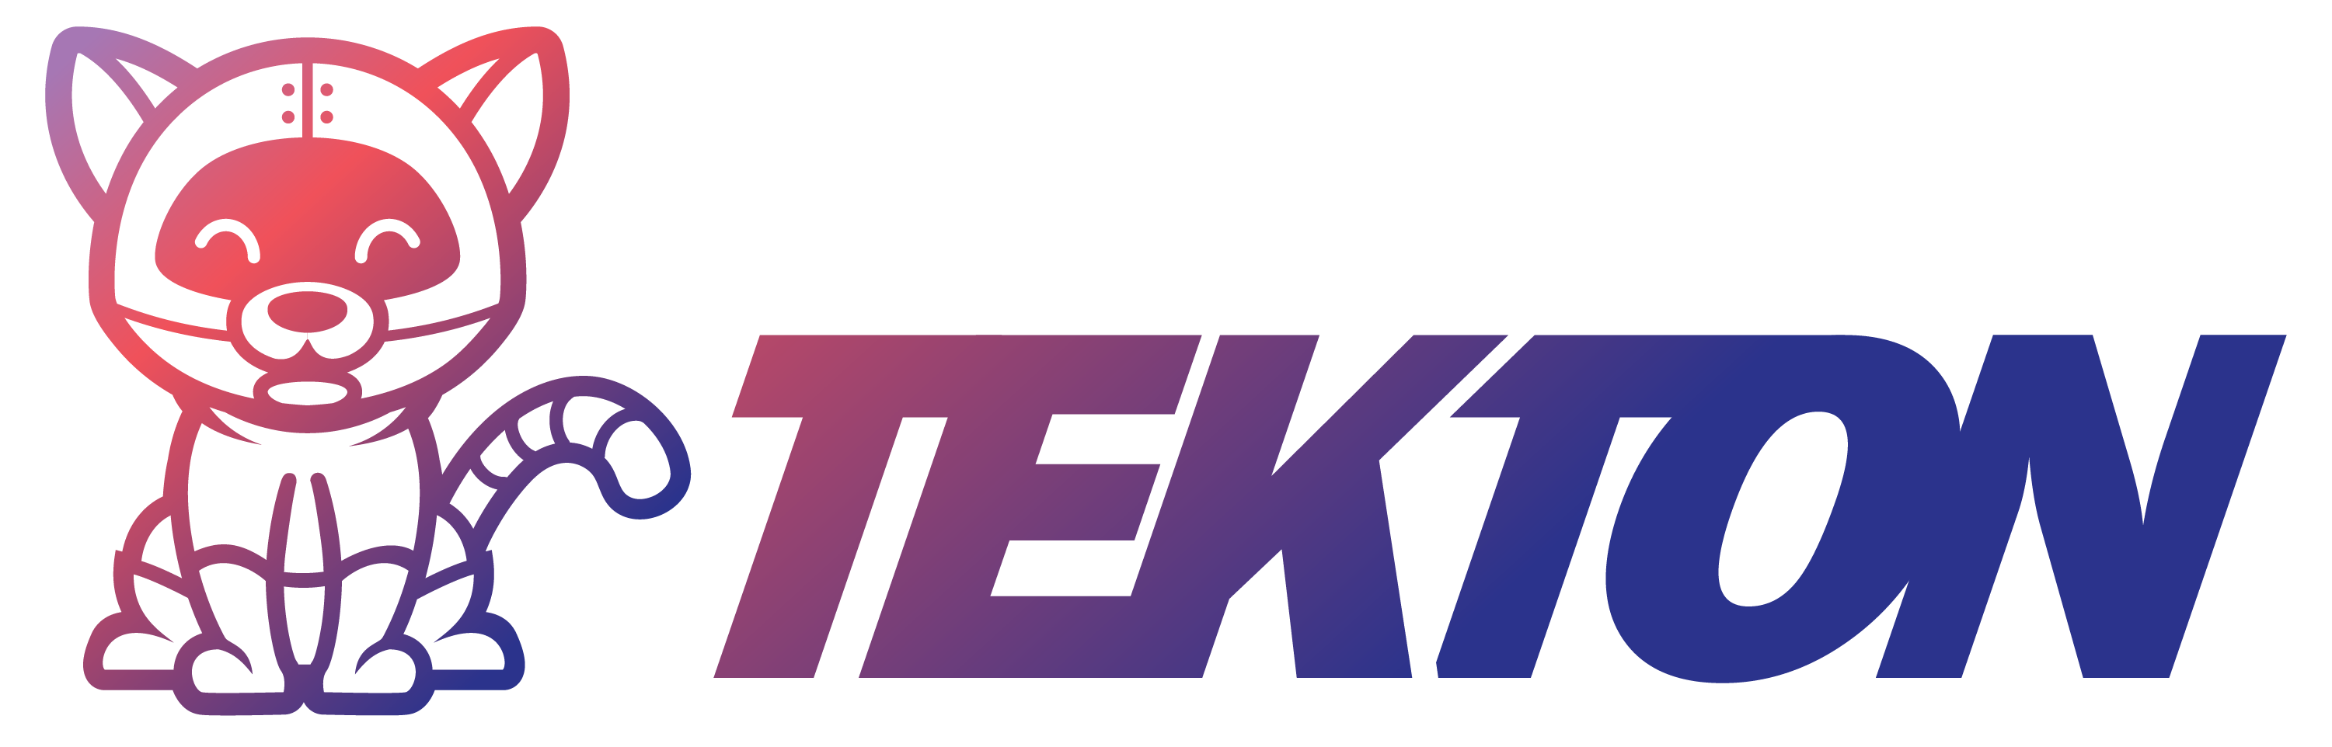
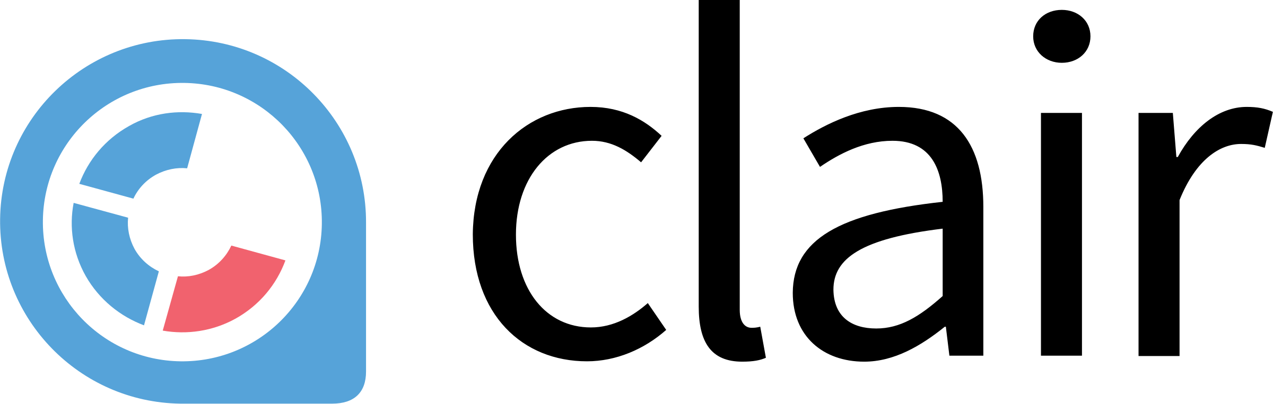



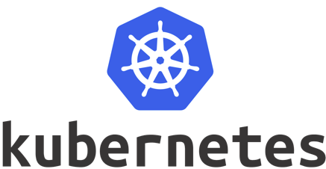
1. Modify application source code
source
manifests
2. webhook
7. Update manifest
(Pull requests)
8. Pull manifests
Tekton Triggers
6. Scan container image
3. Kick pipelines
9. Apply manifests
5. Push container image
Tekton Pipelines
4. Build container image
Continuous Integration
Continuous Delivery

Slide 2
For test request
admin
Access to
user.user.svc.cluster.local
user
Access to
user-db-mysql-master.user.svc.cluster.local
user-db
Remote Kubernetes on Cloud

Slide 3

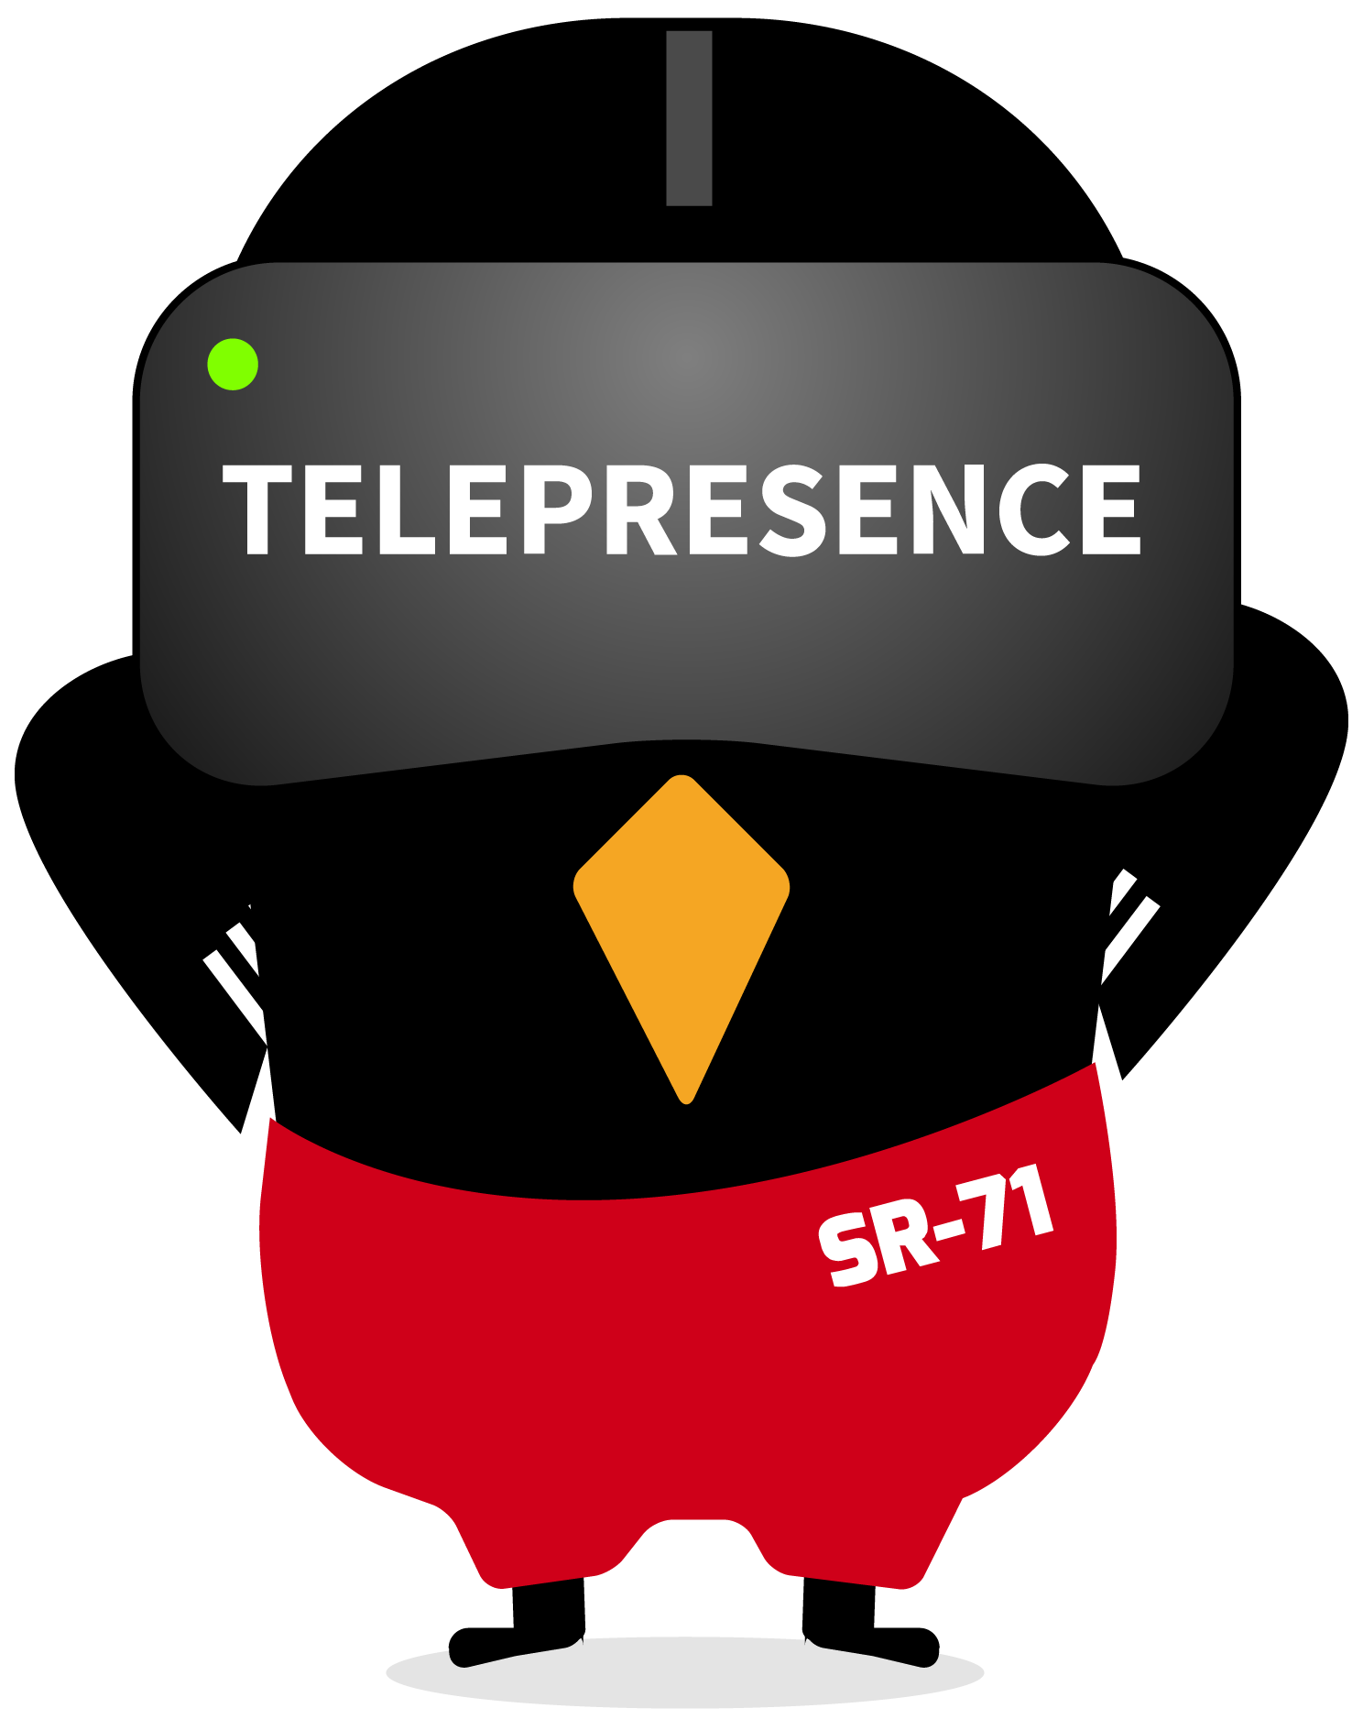
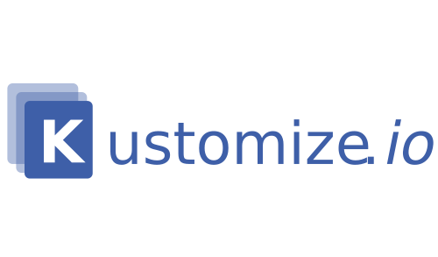
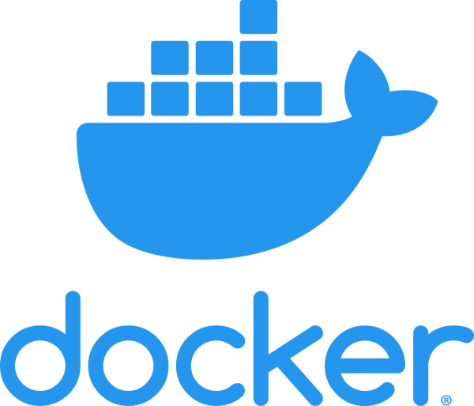
source
manifests
For test request
For test request
Connect network
Watch file changes
and build image
Templating manifests
for using local built image
and apply
admin
Access to
user.user.svc.cluster.local
Port forward
user
Telepresence proxy
Image pull
Access to
user-db-mysql-master.user.svc.cluster.local
Local Kubernetes on Mac
user-db
Mac
Remote Kubernetes on Cloud

Slide 4
VTTablet
MySQL Master
VTTablet
MySQL Replica
VTTablet
MySQL Replica
Shard2
VTGate
VTGate
VTTablet
MySQL Master
VTTablet
MySQL Replica
VTTablet
MySQL Replica
Shard1

Slide 5
Rook
Ceph
EdgeFS
YugabyteDB
Cassandra
MinIO
Storage Provider

