Slide 1
Introduction to Operating Systems
CPSC/ECE 3220
Lecture Notes
OSPP Chapter 2.10-11
(adapted by Brygg Ullmer from Mark Smotherman’s adaptations of Tom Anderson’s slides on OSPP web site)

Slide 2
Virtual Machine Monitor / Hypervisor
Protection – failure isolated to a single VM instance
Replication – run different types or versions of OS
Developing software for multiple platforms
Testing of OS modifications
Running legacy applications with an older version of OS
Running an “appliance” = application and tuned OS instance distributed as a VM
Hardware consolidation – one physical machine appears as multiple virtual servers
Live migration – load balancing and repair

Slide 3
Types of VMMs / Hypervisors

Slide 4
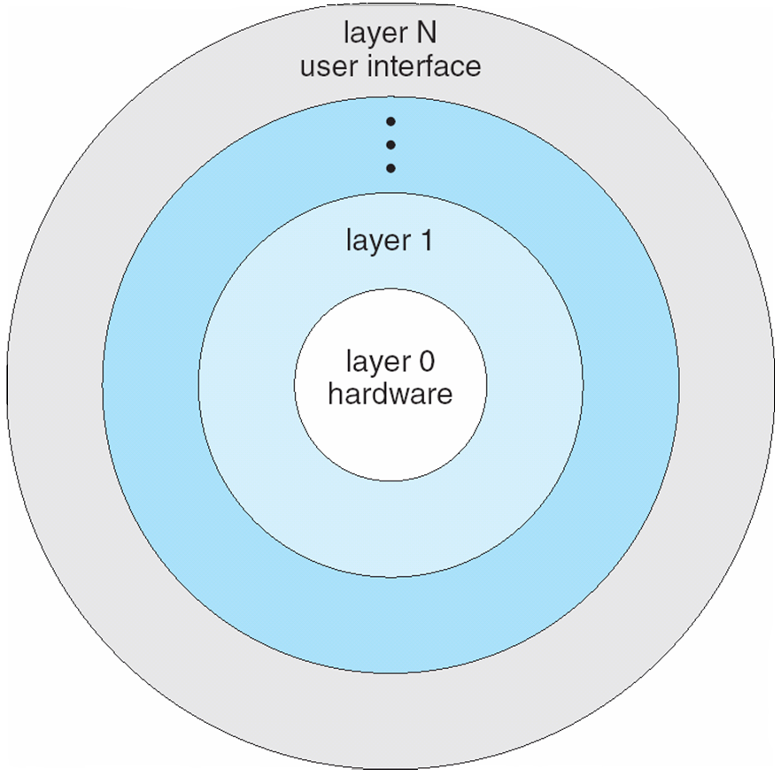
Layered Approach
The operating system is divided into a number of layers (levels), each built on top of lower layers. The bottom layer (layer 0), is the hardware; the highest (layer N) is the user interface.
With modularity, layers are selected such that each uses functions (operations) and services of only lower-level layers

Slide 5
Future directions
Operating system support for fine-grained protection
E.g., location on cell phone; e.g., GC
Application-layer sandboxing
“Increasingly, many applications are becoming mini-operating systems in their own right…”
Doom (1993)
Chrome
Hardware support for virtualization
E.g., GPU virtualization

Slide 6
Introduction to Operating Systems
CPSC/ECE 3220
Lecture Notes
OSPP Chapter 3A
The Programming Interface
(adapted by Brygg Ullmer from Mark Smotherman’s adaptations of Tom Anderson’s slides on OSPP web site)

Slide 7
Ch2: mechanisms needed in the operating system kernel to implement the process abstraction.
Ch3: how we choose to use the process abstraction:
what functionality does the operating system provide applications, and
what should go where

Slide 8
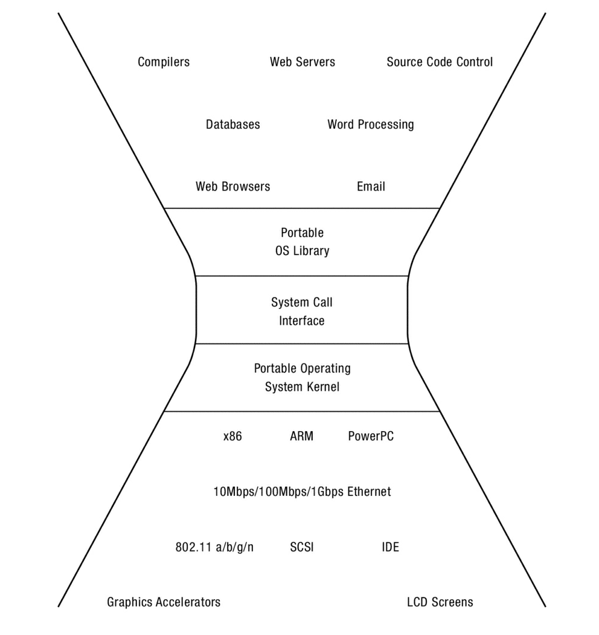

Slide 9
Programmer’s SW perspective on OS
Creating and managing processes
fork, exec, wait
Performing I/O
open, read, write, close
Communicating between processes
pipe, dup, select, connect
Example: implementing a shell

Slide 10
Shell
A shell is a job control system
Allows programmer to create and manage a set of programs to do some task
Windows, MacOS, Linux all have shells
Example: to compile a C program
cc –c sourcefile1.c
cc –c sourcefile2.c
ln –o program sourcefile1.o sourcefile2.o

Slide 11
UNIX Process Management
UNIX fork – system call to create a copy of the current process, and start it running
No arguments!
UNIX exec – system call to change the program being run by the current process
UNIX wait – system call to wait for a process to finish
UNIX signal – system call to send a notification to another process
Notes:
UNIX splits creating a process into two steps, each of them a lot simpler.

Slide 12
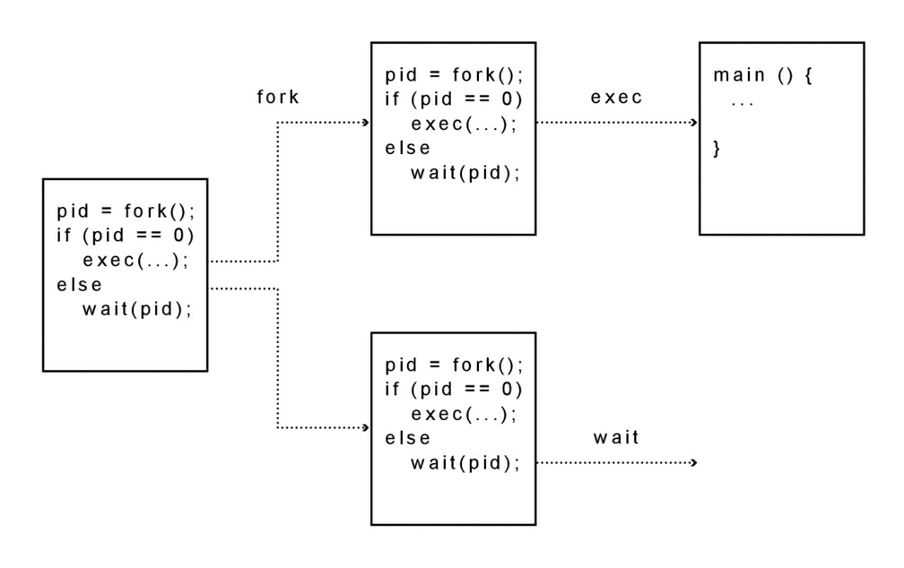
UNIX Process Management
Notes:
How is this used – typically, fork a process, child and parent are now both running the same program. One sets up the child program, and runs exec – becoming the new program
The parent, usually, waits for the child to finish

Slide 13
Question: What does this code print?
int child_pid = fork();
if (child_pid == 0) { // I'm the child process
printf("I am process #%d\n", getpid());
return 0;
} else { // I'm the parent process
printf("I am parent of process #%d\n", child_pid);
return 0;
}
Notes:
Parent could print first, or child could print first – you don’t know!

Slide 14
Questions
Can UNIX fork() return an error? Why?
Can UNIX exec() return an error? Why?
Can UNIX wait() ever return immediately? Why?

Slide 15
Implementing UNIX fork
Steps to implement UNIX fork
Create and initialize the process control block (PCB) in the kernel
Create a new address space
Initialize the address space with a copy of the entire contents of the address space of the parent
Inherit the execution context of the parent (e.g., any open files)
Inform the scheduler that the new process is ready to run

Slide 16
Implementing UNIX exec
Steps to implement UNIX fork
Load the program into the current address space
Copy arguments into memory in the address space
Initialize the hardware context to start execution at ``start''

Slide 17
UNIX I/O
Uniformity
All operations on all files, devices use the same set of system calls: open, close, read, write
Open before use
Open returns a handle (file descriptor) for use in later calls on the file
Byte-oriented
Kernel-buffered read/write
Explicit close
To garbage collect the open file descriptor

Slide 18
UNIX File System Interface
UNIX file open is a Swiss Army knife:
Open the file, return file descriptor
Options:
if file doesn’t exist, return an error
If file doesn’t exist, create file and open it
If file does exist, return an error
If file does exist, open file
If file exists but isn’t empty, nix it then open
If file exists but isn’t empty, return an error
…

Slide 19
Interface Design Question
Why not separate syscalls for open/create/exists?
if (!exists(name))
create(name); // can create fail?
fd = open(name); // does the file exist?

Slide 20
Implementing a Shell
char *prog, **args;
int child_pid;
// Read and parse the input a line at a time
while (readAndParseCmdLine(&prog, &args)) {
child_pid = fork(); // create a child process
if (child_pid == 0) {
exec(prog, args); // I'm the child process. Run program
// NOT REACHED
} else {
wait(child_pid); // I'm the parent, wait for child
return 0;
}
}

