Slide 1
Introduction to Operating Systems
CPSC/ECE 3220
Lecture Notes
OSPP Chapter 3B
(adapted by Brygg Ullmer from Mark Smotherman’s adaptations of Tom Anderson’s slides on OSPP web site)

Slide 2
Implementing UNIX fork
Steps to implement UNIX fork
Create and initialize the process control block (PCB) in the kernel
Create a new address space
Initialize the address space with a copy of the entire contents of the address space of the parent
Inherit the execution context of the parent (e.g., any open files)
Inform the scheduler that the new process is ready to run

Slide 3
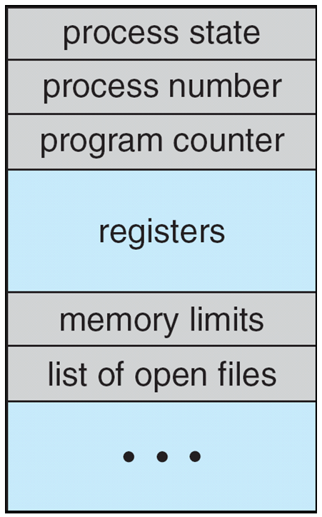
Process Control Block (PCB)
Information associated with each process
(also called task control block)
Process state – running, waiting, etc
Program counter – location of instruction to next execute
CPU registers – contents of all process-centric registers
CPU scheduling information- priorities, scheduling queue pointers
Memory-management information – memory allocated to the process
Accounting information – CPU used, clock time elapsed since start, time limits
I/O status information – I/O devices allocated to process, list of open files

Slide 4
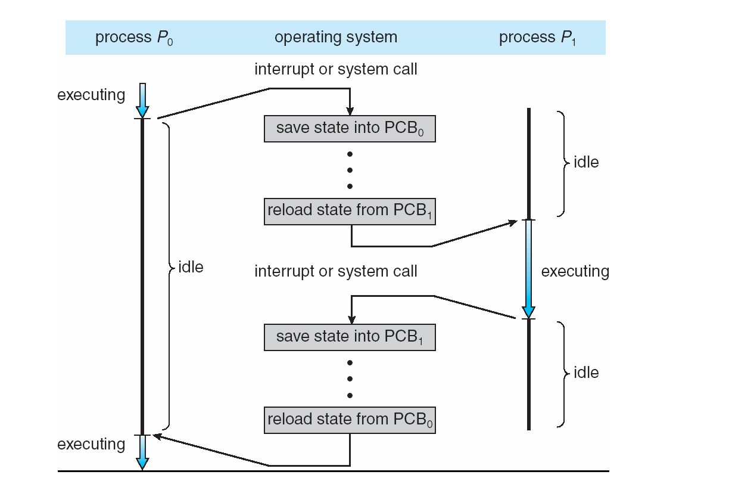
CPU Switch From Process to Process

Slide 5
UNIX I/O
Uniformity
All operations on all files, devices use the same set of system calls: open, close, read, write
Open before use
Open returns a handle (file descriptor) for use in later calls on the file
Byte-oriented
Kernel-buffered read/write
Explicit close
To garbage collect the open file descriptor

Slide 6
UNIX File System Interface
UNIX file open is a Swiss Army knife:
Open the file, return file descriptor
Options:
if file doesn’t exist, return an error
If file doesn’t exist, create file and open it
If file does exist, return an error
If file does exist, open file
If file exists but isn’t empty, nix it then open
If file exists but isn’t empty, return an error
…

