Slide 1
Introduction to Operating Systems
CPSC/ECE 3220
Lecture Notes
OSPP Chapter 4A
(adapted by Brygg Ullmer from Mark Smotherman’s adaptations of Tom Anderson’s slides on OSPP web site)

Slide 2
Thread Operations
thread_create(thread, func, args)
Create a new thread to run func(args)
thread_yield()
Relinquish processor voluntarily
thread_join(thread)
In parent, wait for forked thread to exit, then return
thread_exit(return_value)
Quit thread and clean up, wake up joiner if any

Slide 3
Example: threadHello
#define NTHREADS 10
thread_t threads[NTHREADS];
main() {
for (i = 0; i < NTHREADS; i++) thread_create(&threads[i], &go, i);
for (i = 0; i < NTHREADS; i++) {
exitValue = thread_join(threads[i]);
printf("Thread %d returned with %ld\n", i, exitValue);
}
printf("Main thread done.\n");
}
void go (int n) {
printf("Hello from thread %d\n", n);
thread_exit(100 + n);
// REACHED?
}

Slide 4
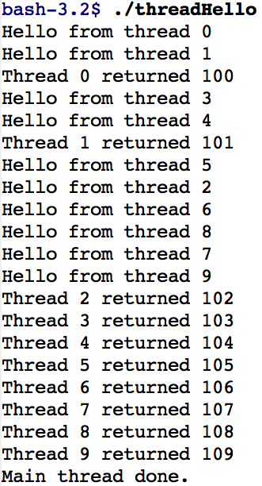
threadHello: Example Output
Why must “thread returned” print in order?
What is maximum # of threads running when thread 5 prints hello?
Minimum?

Slide 5
Thread Data Structures

Slide 6
Thread Metadata
Thread ID
Scheduling priority
Thread state (ready, running, waiting, …)
State of Thread | Location of TCB | Location of Registers
Init | being created | TCB or thread’s stack
Ready | Ready List | TCB/stack
Running | Running List | processor
Waiting | synch. variable’s Waiting List | TCB/stack
Finished | Finished List then deleted | TCB/stack or deleted

