Slide 1
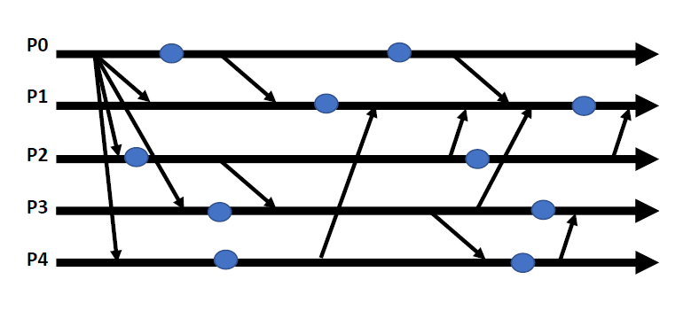
consistent
inconsistent
strongly consistent

Slide 2
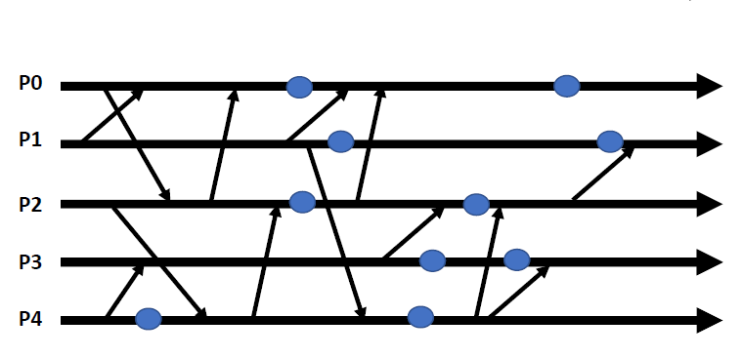
consistent
strongly consistent
inconsistent

