Slide 1
Introduction to Operating Systems
CPSC/ECE 3220
Lecture Notes
OSPP Chapter 2 – Part A
(adapted by Brygg Ullmer from Mark Smotherman’s adaptations of Tom Anderson’s slides on OSPP web site)

Slide 2
Main Points of Chapter 2
Process concept
A process is the OS abstraction for executing a program with limited privileges
Dual-mode operation: user vs. kernel
Kernel-mode: execute with complete privileges
User-mode: execute with fewer privileges
Safe control transfer
How do we switch from one mode to the other?

Slide 3
Kernel
Lowest level of software running on the system
Purpose is to implement protection
Kernel is fully trusted and has access to all the hardware

Slide 4
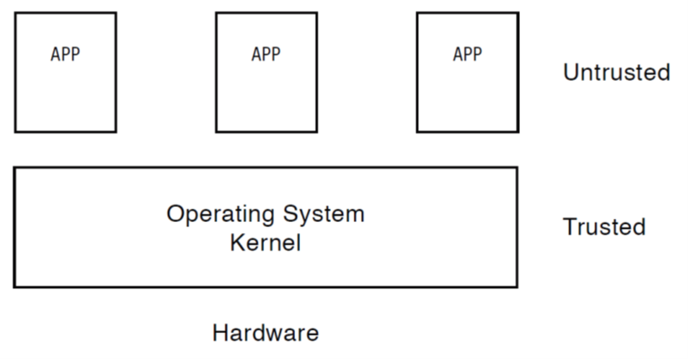
Untrusted Code
We should restrict privileges of untrusted code
Should not have access to all the hardware
Should not have ability to modify the kernel or other applications
Brief debate team consideration of book’s “straight jacket” and “insane asylum” references

Slide 5
Challenge: Protection
How do we execute code with restricted privileges?
Either because the code is buggy or if it might be malicious
Some examples:
A script running in a web browser
A program you just downloaded off the Internet
A program you just wrote that you haven’t fully tested or debugged

Slide 6
Stages of a Program
Source file on disk
Executable file on disk
After compiling and linking
Set of machine instructions (with a specified entry point) and initialized data
Memory image
After loading
Stack, heap, and uninitialized data areas added to provide full execution environment

Slide 7
Compiling and Loading a Program

Slide 8
Process Abstraction
Process: an instance of a program, running with limited rights
Thread: an execution sequence within a process
Potentially many threads per process (for now 1:1)
Address space: the range of valid addresses
Allocated resources: the physical memory, files, and network connections the process can currently access
[in some systems] Capabilities: the permissions the process has (e.g., which system calls it can make, what objects it can access and how)

Slide 9
Thought Experiment
How can we implement execution with limited privilege?
Execute each program instruction in a simulator
If the instruction is permitted, do the instruction
Otherwise, stop the process
Basic model in Javascript and other interpreted languages
How do we go faster?
Run the unprivileged code directly on the CPU!

Slide 10
Hardware Support: Dual-Mode Operation
Kernel mode
Execution with the full privileges of the hardware
Read/write to any memory, access any I/O device, read/write any disk sector, send/rcv any packet
User mode
Limited privileges
Only those granted by the operating system kernel
Mode bit stored in processor status register
(on x86, mode bits are stored in the CS register)

Slide 11
Hardware Support: Dual-Mode Operation
Privileged instructions
Available to kernel
Not available to user code
Limits on memory accesses
To prevent user code from overwriting the kernel
Timer
To regain control from a user program in a loop
Need safe way to switch from user mode to kernel mode, and vice versa

Slide 12
Privileged instructions
Examples
Change mode bit in processor status register
Change which memory locations a user program can access
Send commands to I/O devices
Jump into kernel code
What should happen if a user program attempts to execute a privileged instruction?

Slide 13
Non-Privileged (“Safe”) Instructions
Examples
Load, store
Add, subtract, …
Conditional branch, jump to subroutine, …
Allowed to execute in both kernel and user mode
OS and applications all need the ability to add numbers!
OS and applications all need the ability to use loops and call subroutines!

Slide 14
Valid Instructions
User mode: non-privileged (“safe”) instructions only
Kernel mode: both privileged and non-privileged instructions

Slide 15
Invalid Instructions
Attempt to execute a privileged instruction in user mode?
Stop the application and alert the OS!
Typically the attempt is an error, but for selected instructions we will use this response to intentionally invoke the OS
(Note: could be an inefficient way to implement a virtual machine that is running a guest OS completely in user mode)

Slide 16
Question
For a “Hello world” program, the kernel must copy the string from the user program memory into the screen memory
Why not allow the application to write directly to the screen’s buffer memory?

Slide 17
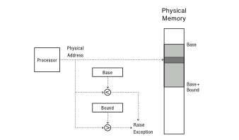
Simple Memory Protection
Physical address generated by processor is range-checked against top and bottom limits

Slide 18
A Better Approach
Virtual address relative to 0 checked against bound
Virtual address added to contents of base register

Slide 19
Even Better Approaches!
Problems with the additive base and bounds?
Memory sharing between processes? (e.g., how to share one copy of same machine instructions)
Memory fragmentation as processes come and go
Paging and segmentation in Chapter 8
Translation done in hardware, using a table for each process
Table is set up and managed by kernel

Slide 20
Test Program – Determine if OS Runs with Virtual Addresses
#include<stdio.h>
int staticVar = 0; // a static variable
main() {
staticVar += 1;
// sleep causes the program to wait for x seconds
sleep(10);
printf ("Address: %p; Value: %d\n", &staticVar, staticVar);
}

Slide 21
Script to Run Processes in Parallel
% cat test.script
./a.out &
./a.out &
./a.out &
wait
echo all done
% csh < test.script
[1] 9453
[2] 9454
[3] 9455
Address: 0x60104c; Value: 1
Address: 0x60104c; Value: 1
Address: 0x60104c; Value: 1
[2] Exit 28 ./a.out
[1] Exit 28 ./a.out
[3] Exit 28 ./a.out
all done

