Slide 1
FTI: high performance Fault Tolerance Interface for hybrid systems
Eric Paulz

Slide 2
Outline
Overview
Motivation
Inspiration
Implementation
Evaluation
Conclusion

Slide 3
1. Overview

Slide 4
Overview
Problem
Current fault tolerance techniques will not be sufficient in post-petascale systems
Proposed Solution
A low-overhead high-frequency multi-level checkpoint technique
Integration of a highly-reliable topology-aware Reed-Solomon encoding in a three-level checkpoint scheme
Implemented by the Fault Tolerance Interface (FTI)

Slide 5
2. Motivation

Slide 6
Motivation
Post-petascale Reliability
Long-running modeling & simulations in the scientific community.
Example in Geophysics: high resolution calculation of the propagation of seismic waves through the entire Earth at 0.5Hz
Improved capabilities with reliable post-petascale systems
https://www.youtube.com/watch?v=u6-mJ6TCi6o

Slide 7
Motivation
Post-petascale Resiliency
Transistor size Soft Error Rate (SER)
SER will increase several times
Soft errors expected to be the most common type of failures for post-petascale systems
Component Count Checkpoint Frequency
More concurrency = increased density = increased probability of correlated failures
Example: two nodes share a power supply

Slide 8


Motivation
Remote-disk checkpoint limitations
I/O bottleneck writing large data to PFS
Speed of I/O Bandwidth Improvement
Speed of Computational Capability Improvement
$$<$$

Slide 9
3. Inspiration

Slide 10
Inspiration: I/O Bottleneck
Initial Solution
Each compute node has local storage
Checkpoint writing bandwidth increases linearly with # of nodes
Drawbacks
Low reliability
Can only restart an application when all checkpoint files are still available
i.e. soft errors or transient failures
Better Solution
Hybrid Model (Dong et al.)
Best of both worlds
Frequent, low-overhead local checkpoints for soft error recovery
Less frequent global checkpoints for hard error recovery

Slide 11
4. Implementation

Slide 12
Implementation: Topology-aware RS Encoding
How to guarantee checkpoint availability after a failure?
Checkpoint replication or erasure codes
Can withstand failures as long as two partner nodes don’t fail simultaneously
Erasure codes transform a message with K symbols (processes) into a message with K+M symbols
Why Reed-Solomon(RS)?
RS encoding guarantees that any K symbols out of the K+M symbols are sufficient to recover the original message
What about XOR encoding?

Slide 13
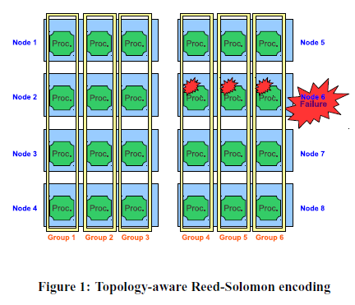
Implementation: Topology-aware RS Encoding
Topology Awareness
If M processes of one group belong to the same node, a crash of that node will result in an unrecoverable failure
The system must be partitioned so that all processes in a group belong to different nodes

Slide 14

Implementation: Performance Model
Previous Encoding Algorithm
$$T_{RSenc.}=t∗(r∗z+\left(m∗\left(a+b∗z+e∗z\right)\right)+w∗z)$$
Question:
What about decoding?
Read/write time is negligible due to local storage on nodes
Further optimization by overlapping communications and computation
Generally twice as long as encoding. Must regenerate lost checkpoint files and then decode them.
Simplified Algorithm
$$T_{RSenc.}=t∗m∗e∗z$$
t = # of blocks
m = group size (# of checkpoint files)
e = encoding rate (seconds per byte)
z = message size
**Note:
Encoding complexity depends on checkpoint size (s=t*z) and group size (k=m), so encoding time increases linearly with these two factors

Slide 15
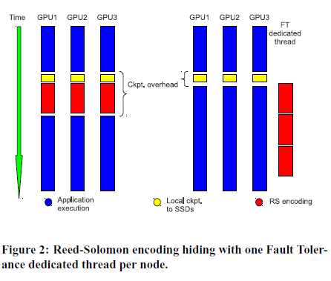
Implementation: FT-dedicated Resources
Hybrid systems often have “idle” resources that can be exploited to increase resiliency. Where does this come from?
GPUs have larger throughput than CPUs, so parallel GPU/CPU mappings tend to leave some CPU cores unused (idle)
Also possible to spawn one extra FT-dedicated thread per node

Slide 16
Implementation: Multi-level Checkpoint Scheme
Frequent local checkpoints to deal with soft errors or transient failures
Low reliability
(L1) – Checkpoint on local SSDs
Deals with one or multiple hard node failures
High reliability
(L2) – Topology-aware RS encoding
Should only be used rarely since L2 is very reliable
(L3) – Standard checkpoint to the PFS

Slide 17
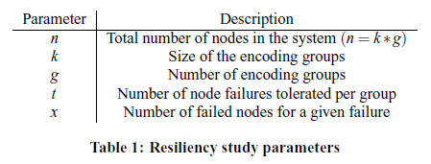

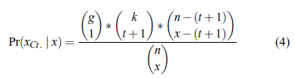
Implementation: Reliability Study
Will be used in evaluation to compare reliability of XOR vs. RS encoding techniques

Slide 18
Implementation: FTI Mechanisms
FTI aims to add a highly reliable layer between the OS and the application
Implemented with C/MPI and Python for portability
FTI Initialization Process
FTI_Init() reads the configuration file filled by the user | Detect which node each process resides in | Write this topology to a file | Delegate one process per node as FT-manager and creates two MPI communicators | Create encoding groups and create one MPI communicator per group, so encodings are kept independent | Each group generates RS encoding matrix and then wait, ready to encode checkpoint files
Time

Slide 19
Implementation: FTI Mechanisms
In case of failure
User can modify one parameter in config file and launch again
FTI_Init() will recognize the change and restart from the last checkpoint
If data is lost due to node hard failure, RS decoding is launched to regenerate lost data (L2)
If more data is lost than L2 can tolerate, FTI will pull the last checkpoint from the PFS (L3)
Last, FTI_Finalize() checks that all FT-managers have finished their jobs and freed all resources

Slide 20
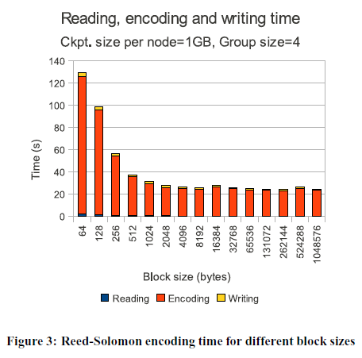
Implementation: Auto-tuning
FTI has a set of commands to automate the process of picking the right block size for optimal network performance
What does it mean when encoding time stabilizes?
Communications are completely hidden by the encoding computation

Slide 21
5. Evaluation

Slide 22
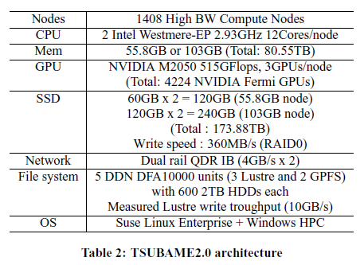
Evaluation: TSUBAME2.0 Configuration

Slide 23
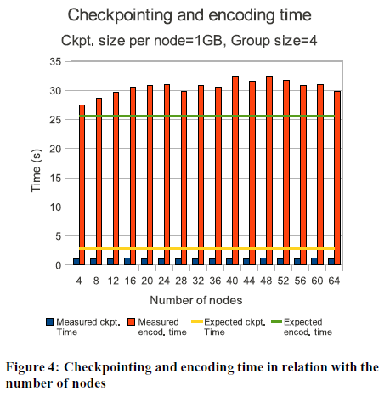
Evaluation: Performance Model & Reliability
It is normal for real encoding time to be longer than predicted by the model. Why?
It also normal for real checkpoint time on local SSDs to be shorter than predicted. Why?

Slide 24
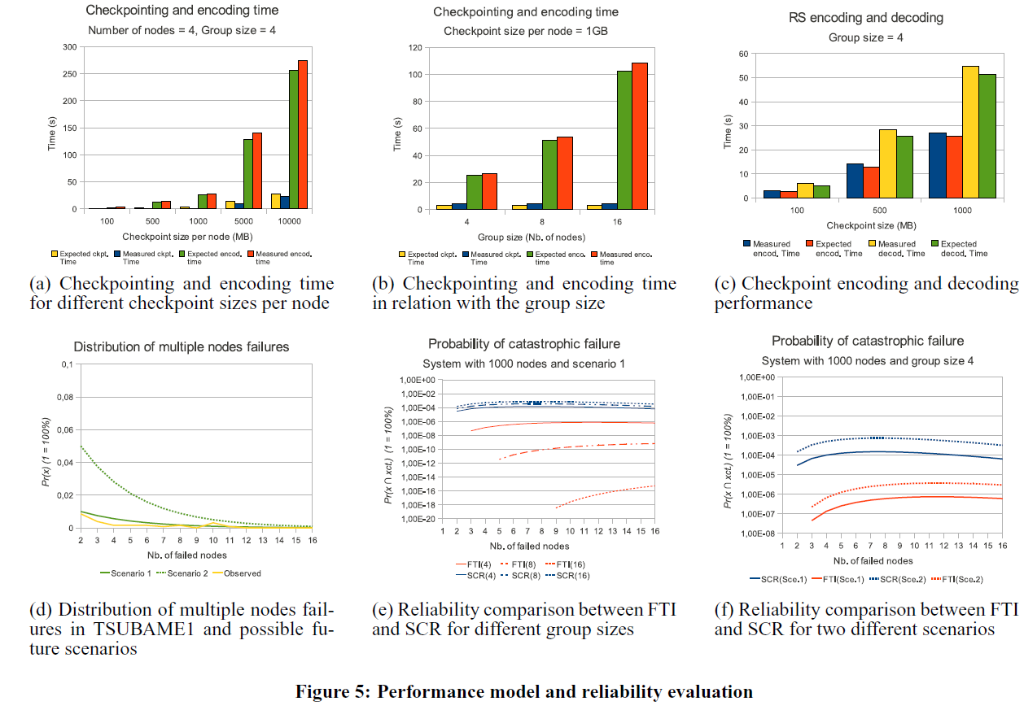
Performance Model & Reliability Comparison

Slide 25
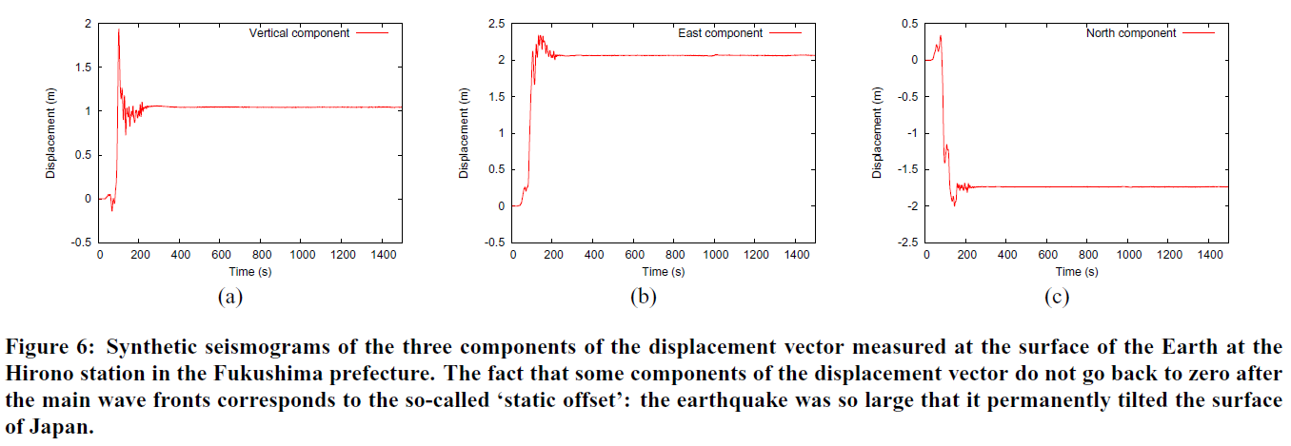
Earthquake Simulation with SPECFEM3D on TSUBAME2.0

Slide 26
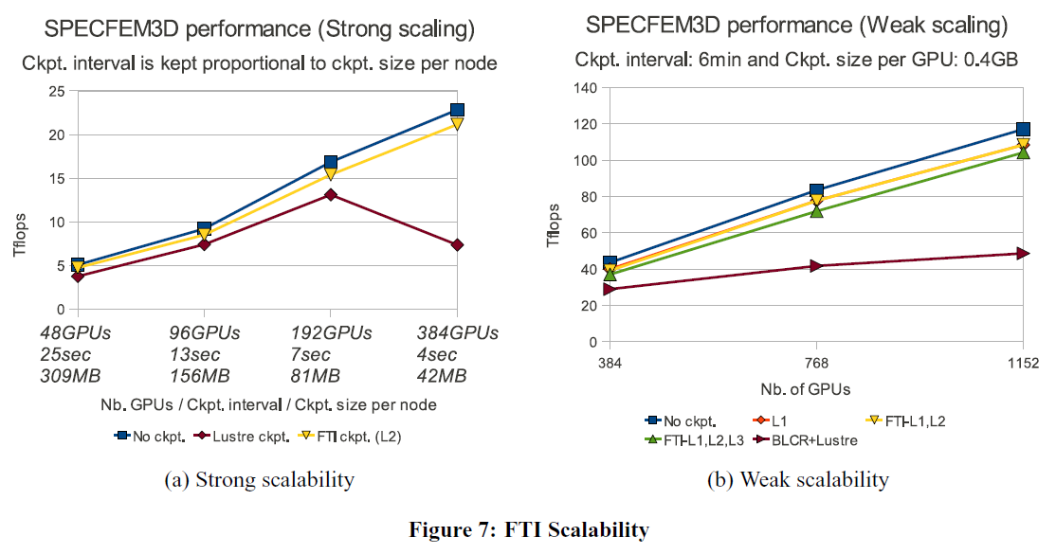
FTI Scalability Study

Slide 27
6. Conclusion

Slide 28
Conclusion
Proposal of a highly-reliable topology-aware RS encoding (1)
Exploitation of FT-dedicated threads to improve checkpoint performance (2)
Integration of (1) and (2) in a multi-level checkpoint model
Packaged and implemented in FTI library
Exhaustive study of correctness of performance model and reliability
First ever evaluation of multi-level technique with a production level scientific application on a hybrid platform
Evaluation with SPECFEM3D successfully showcases FTIs value

Slide 29
Questions / Discussion

