Slide 1
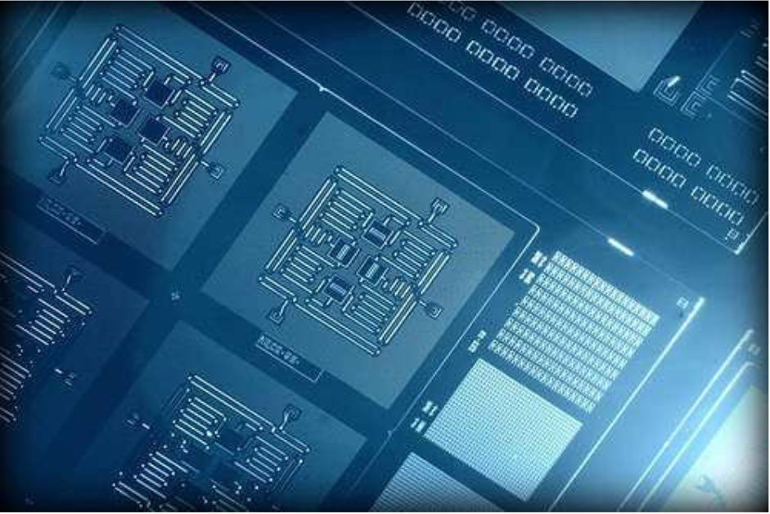
quantum operating systems: opportunities & Challenges
The shift to quantum means reevaluating what we know about operating systems
Fault Tolerance
Error detection/correction is important
Current bits can hold a value of 0 or 1
Qubits can hold a value of 0, 1 or both (superposition)
Security implications?
IBM’s square lattice of four superconducting qubits enables detection of both types of quantum errors (bit-flip & phase-flip) for the first time.

