Slide 1

Does the rise of Winery growth influence Regional dynamics?
Presented by: Eli, Luis, Raquel

Slide 2
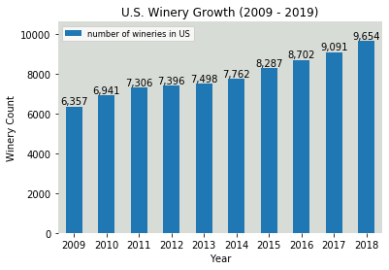

Slide 3
Initial considerations
Theory
Winery presence in the US has increased by 58% over the past 10 years. Where has that growth been strong? What impact has it had on local economy, health, crash and population?
Data Limitations
While a broad reach of data is available, limits to free sets at a city/county level across the information being sought proved less available resulting in pulling back to a state level analysis. Similarly, years of available data were not always consistent and restricted some comparisons as a result.
Outcomes
Given time constraints we ultimately focused on 5 of the most well-known wine states for our analysis. While there are some correlations, we found that items we assumed might have stronger links were not directly relevant and others may be more influenced by additional factors we did not have time to review during this project.

Slide 4
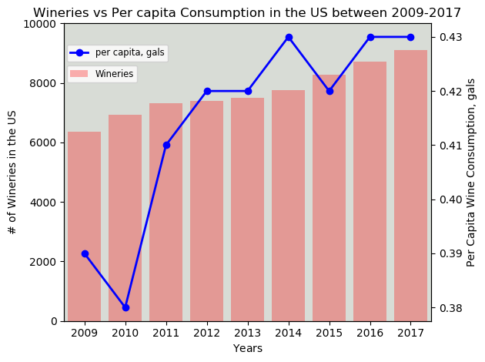
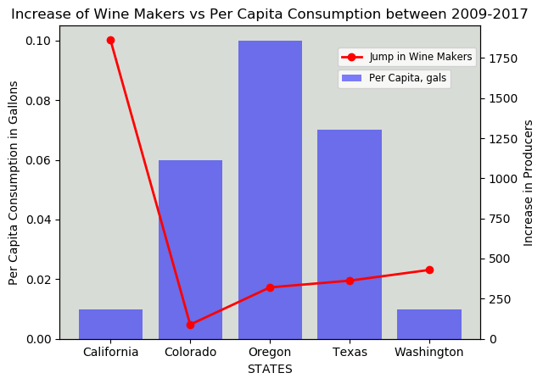
Winery growth and consumption
Fun Facts
The US is the fourth biggest wine producing nation in the Planet, right after France, Spain and Italy
Wine Production in the US dates back to the 16th century, when the French Huguenot settlers made wine in Jacksonville, Florida using Scuppernong grapes
89% of all American wine is produced in California
Data analyzed was narrowed from 2009 to 2017
US consumption per capita rose steadily along with the number of new wineries
On a state-wide basis, the biggest jump in wine producers came from California. However wine consumption per capita in this state saw lowest growth of the considered group
Highest increase in wine consumption per capita appears to occur in Oregon, closely followed by Texas (woo-hoo!!)

Slide 5
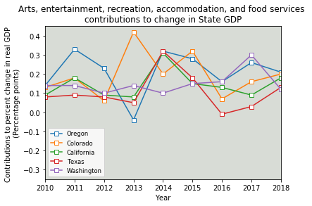
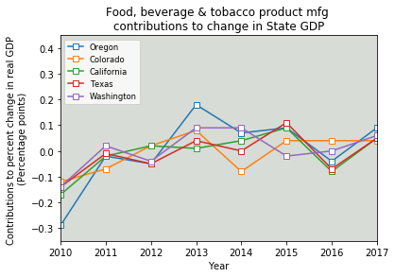
Tourism economic impacts
In general, the categories impacted most by tourism have impacted the overall Gross Domestic Product positively of each state the years shown. However, this may be more impacted by natural aesthetic and seasonal draws such as beaches, mountains, etc. than necessarily the wineries alone.
When drilling down further to the impact of food, beverage and tobacco production in which our winery data would be found, this segment across all states has played a smaller but very similar relative impact to each state since 2010.

Slide 6
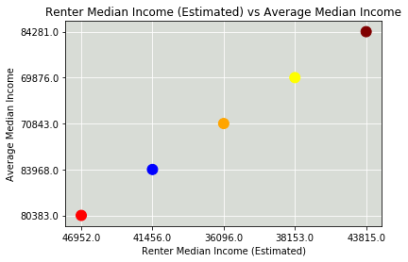
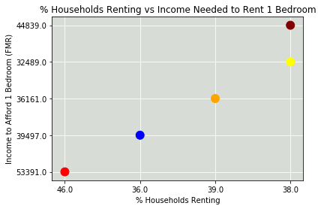
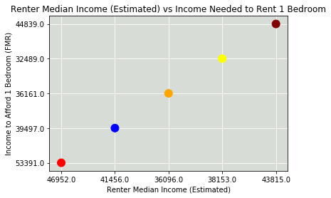
Rental affordability
CA CO OR TX WA
While the wine consumption in these states is higher, when evaluating affordability of the areas themselves on their own we find that the connection is tied more to income and number of renters (demand). Therefore, our top costing area is still California despite the long-standing history of wine in the region.

Slide 7
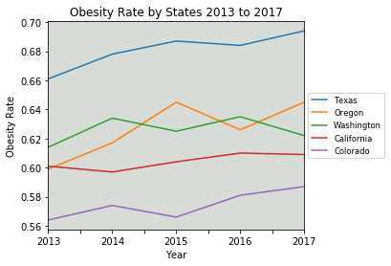
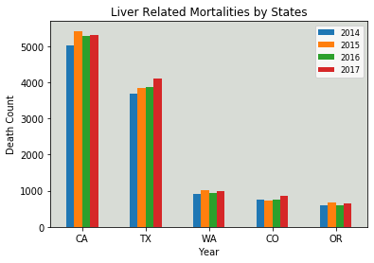
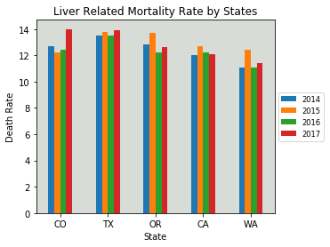
Health implications
While some regions show health concerns associated to alcohol/wine consumption, we found correlation limited based on the data readily available.
Colorado proved our outlier with some the largest shifts in mortality and obesity rates during the years measured.

Slide 8
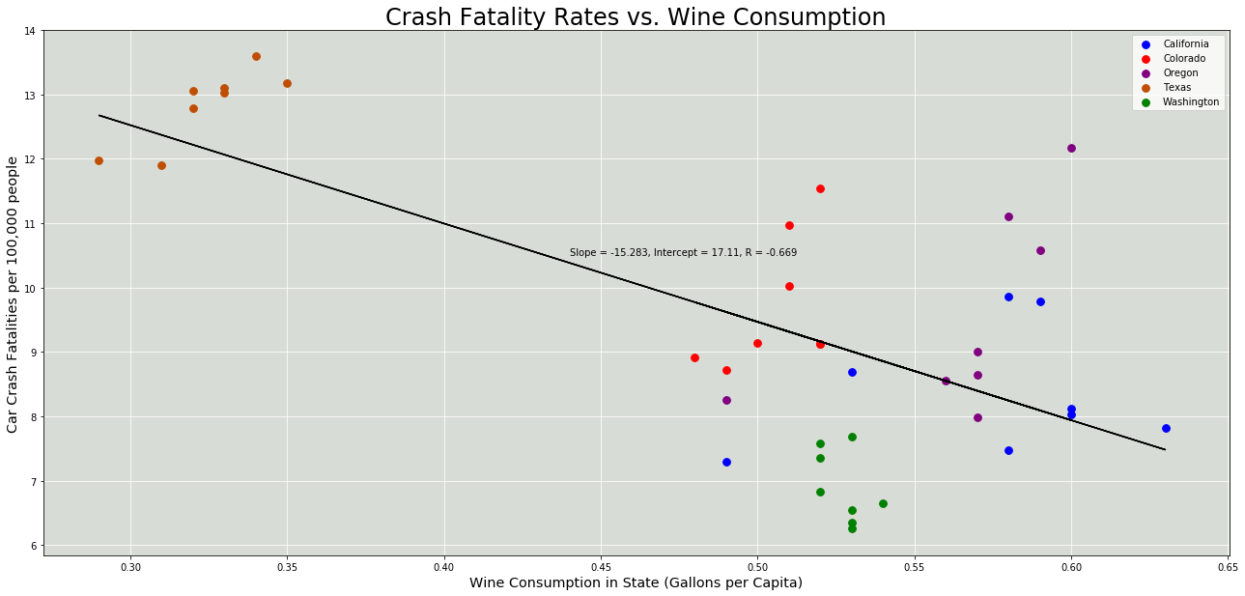
Crash FATALITY RATES VS WINE CONSUMPTION

Slide 9
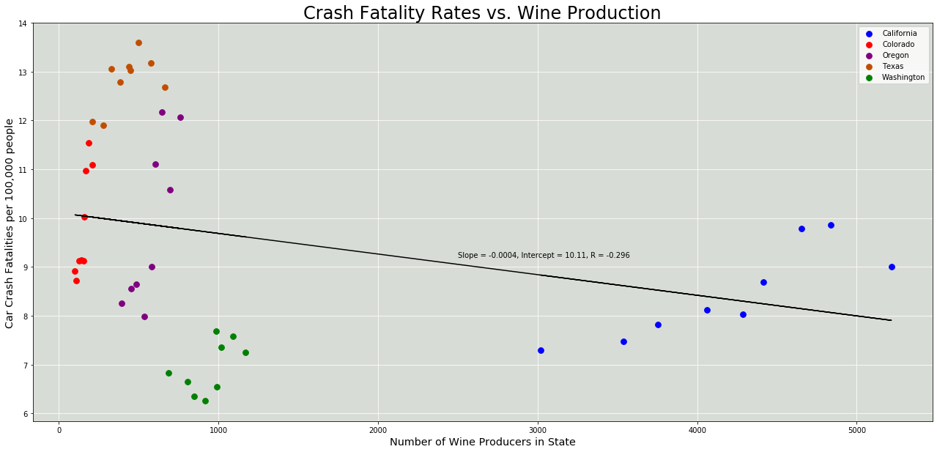
Crash FATALITY RATES VS WINE PRODUCTION

Slide 10
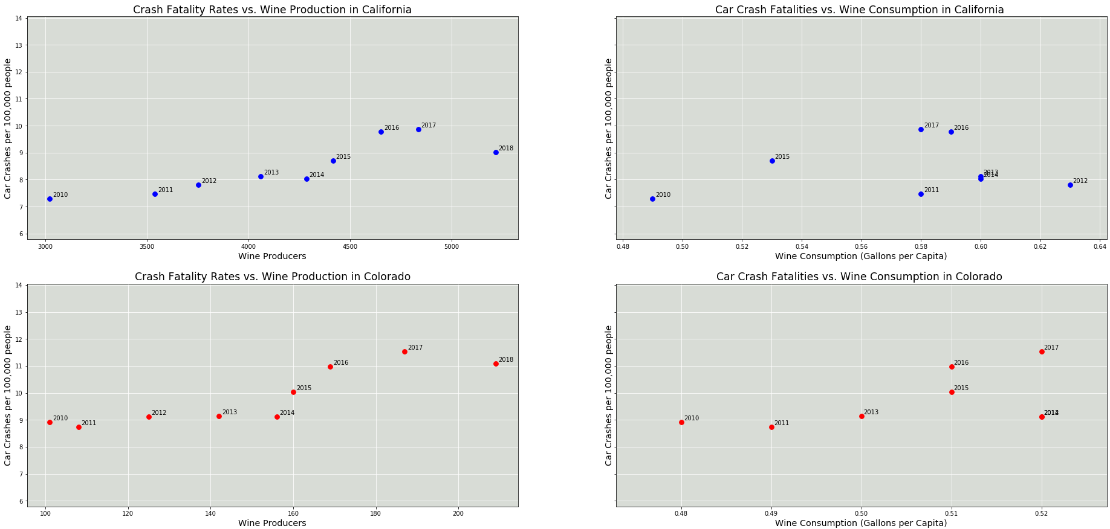
Crash FATALITY RATES – CA & CO

Slide 11
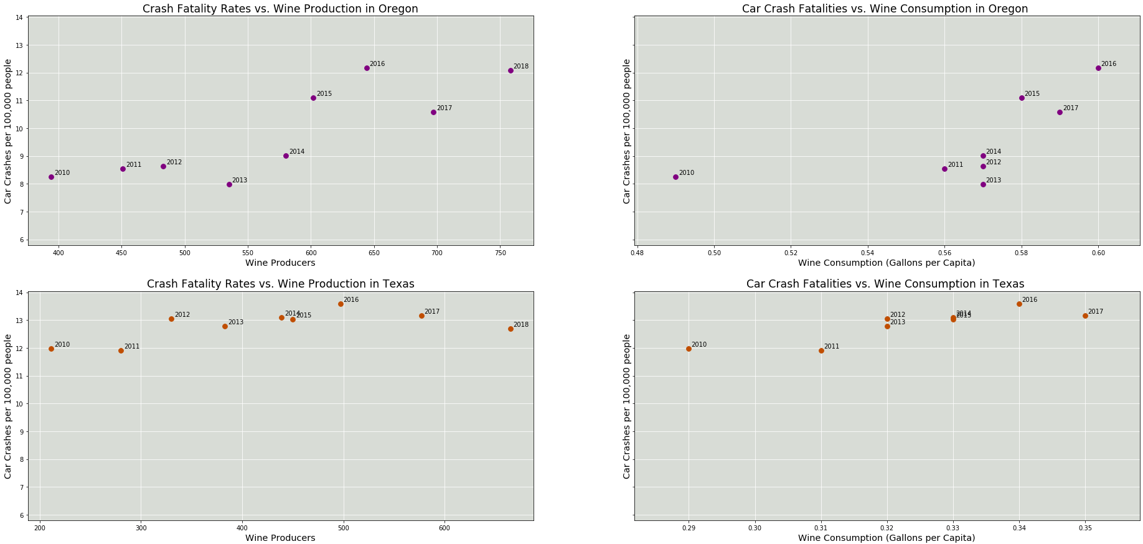
Crash FATALITY RATES – OR & TX

Slide 12
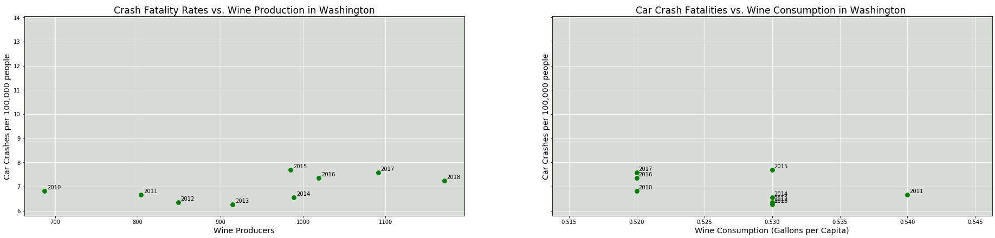
Crash FATALITY RATES – WA

Slide 13
summary
With the data available and time constraints, there are many questions still to be answered to feel confident in the direct nature of the wine growth in the US and the influences it may carry in the local communities.
Of our findings, our most certain is that wine continues to grow in various regions of the country and shows no sign of slowing down based on consumption rates.
Some surprising data came from our crash reviews having a reversed correlation and warrant further investigations to see how much the state versus specific county data may differ.
As for the locations and impact both income and affordability, we found that at a state level there was not enough information to specifically tie to wine production. This is borne out of two reasons:
Many of the states reviewed are generally considered tourist destinations for other reasons such as climate, landmarks, etc. A deeper review of city/county data will bring more certainty to the direct connection in those regions where wine is produced than state views.
Affordability is also directly impacted by other local economic factors and some of our more expensive regions are believed to be more so tied to political, job market and other issues of socioeconomic norms than the wine consumption can address.

Slide 14
Appendix & references

Slide 15
references
Wine & Vines
US Census Bureau
Department of the Treasury, Alcohol, Tobacco Tax and Trade Bureau
National Institute on Alcohol Abuse and Alcoholism
Bureau of Economic Analysis
Centers for Disease Control and Prevention
Kaiser Family Foundation
National Low Income Housing Coalition
National Highway Traffic Safety Administration (API)
Everyvine
VinePair
The preceding analysis was based on data obtained from these sources.
Unless noted, data files were obtained as csv files.

Slide 16
Appendix: Next Steps
Identify more specific location data to identify specific regions within each state and compare to state findings
Evaluate different alcohol types and influence on generalized alcohol relations
Further dives in crash data to more localized areas
Review for external influencing factors in health concerns
Review economic impacts from downturns on overall spend and consumption

Slide 17
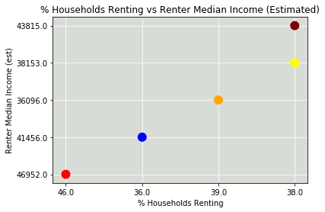
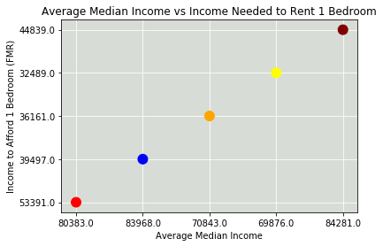
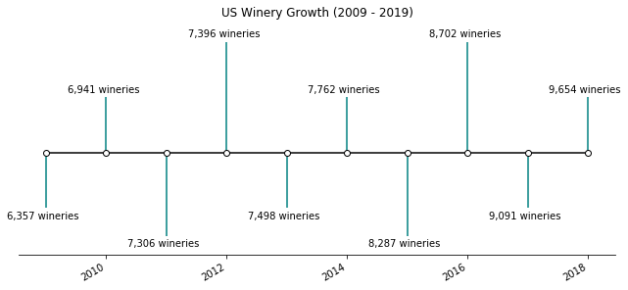
Appendix: Unused Charts

