Slide 1

Consolidated Audit Findings & Root Cause Analysis Report
Client Name: kumar vibe
Meet at site:
Site Category: hotel
Site Address:
Inspection Date: 26 Aug 2026, 04:37 pm
Inspected By: Rohini

Slide 2
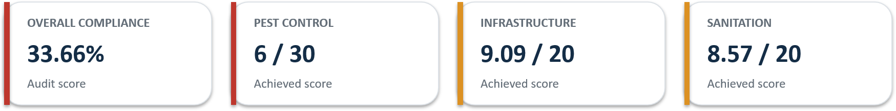
EXECUTIVE SUMMARY
Key findings from the submitted audit matrix
OVERALL COMPLIANCE
60%
AUDIT SCORE
PEST CONTROL
7/30
ACHIEVED SCORE
INFRASTRUCTURE
8/20
ACHIEVED SCORE
SANITATION
9/20
ACHIEVED SCORE
Click to see the detailed Audit Score Report
Live cockroaches were found in the meat room and cockroach egg cases were found in the banquet store room.
Flies were observed in the kitchen/restaurant areas; dead pests and pests in cockroach traps were also recorded.
Multiple gaps/cracks were identified inside staff canteen shelves, bar shelves, barista shelves, the barista dustbin cabinet and restaurant service areas.
Grease, food debris, dirty floor corners, cardboard storage, dirty drains and standing water were identified as conditions requiring corrective action.
The audit indicates that pest-management measures are in place, but environmental conditions need stronger control to reduce recurring pest pressure.

Slide 3
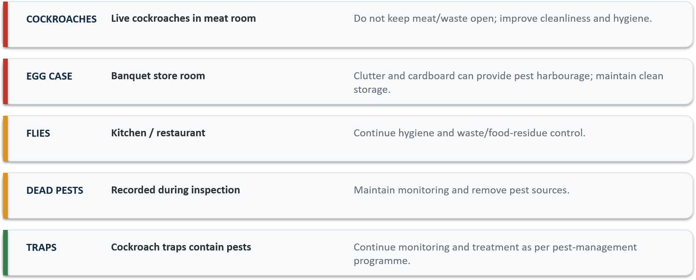
PEST ACTIVITY – KEY FINDINGS
Recorded observations from the audit matrix

Slide 4
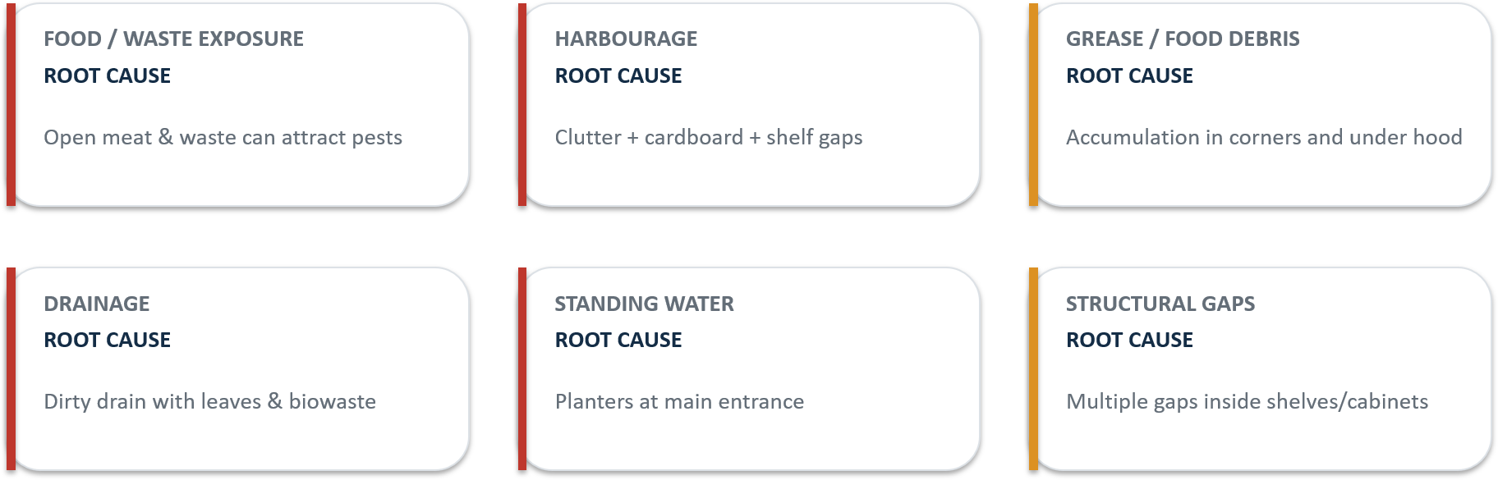
ROOT CAUSE ANALYSIS
Environmental conditions identified during inspection
Pest control addresses the pest population; eliminating food, water and harbourage sources is essential for sustained control.

Slide 5
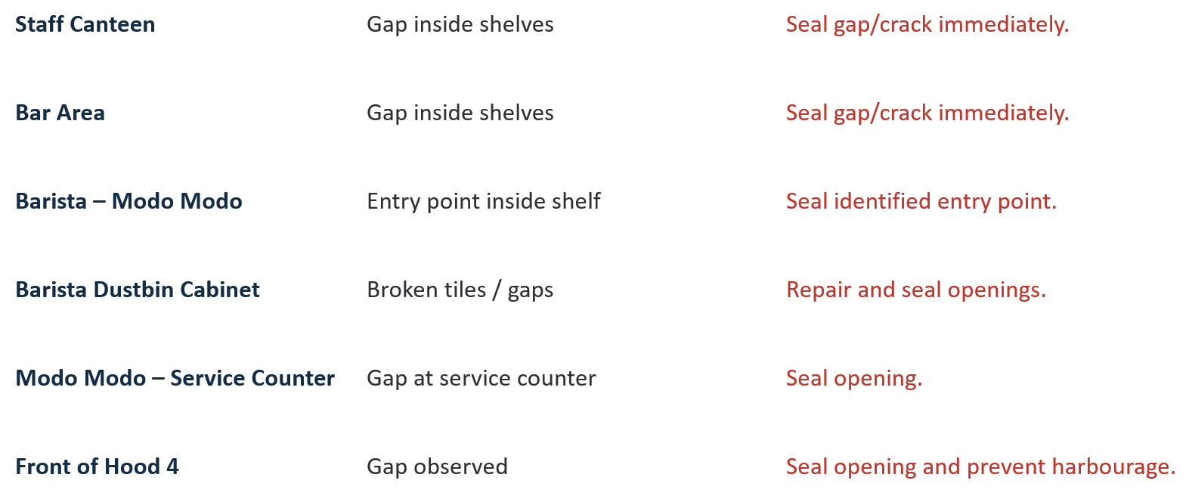
INFRASTRUCTURE NON-CONFORMITIES
Specific locations recorded in the audit

Slide 6
HYGIENE & HOUSEKEEPING NON-CONFORMITIES
Conditions contributing to pest attraction and harbourage
Grease accumulation observed on corners of racks at the lobby of the back entrance of Modo Modo restaurant.
Food debris and grease found on the counter under Hood 4 at Modo Modo.
Floor corners at the back door of Modo Modo require increased cleaning frequency.
Cardboard boxes were found inside the bar area and directly on the floor, providing potential pest harbourage.
Drains were dirty and contained leaves and biowaste.
Standing water was observed in planters at the main entrance, creating a potential mosquito breeding risk
PRIORITY: remove food residue • deep-clean inaccessible areas • clean drains • eliminate standing water • remove excess cardboard

Slide 7
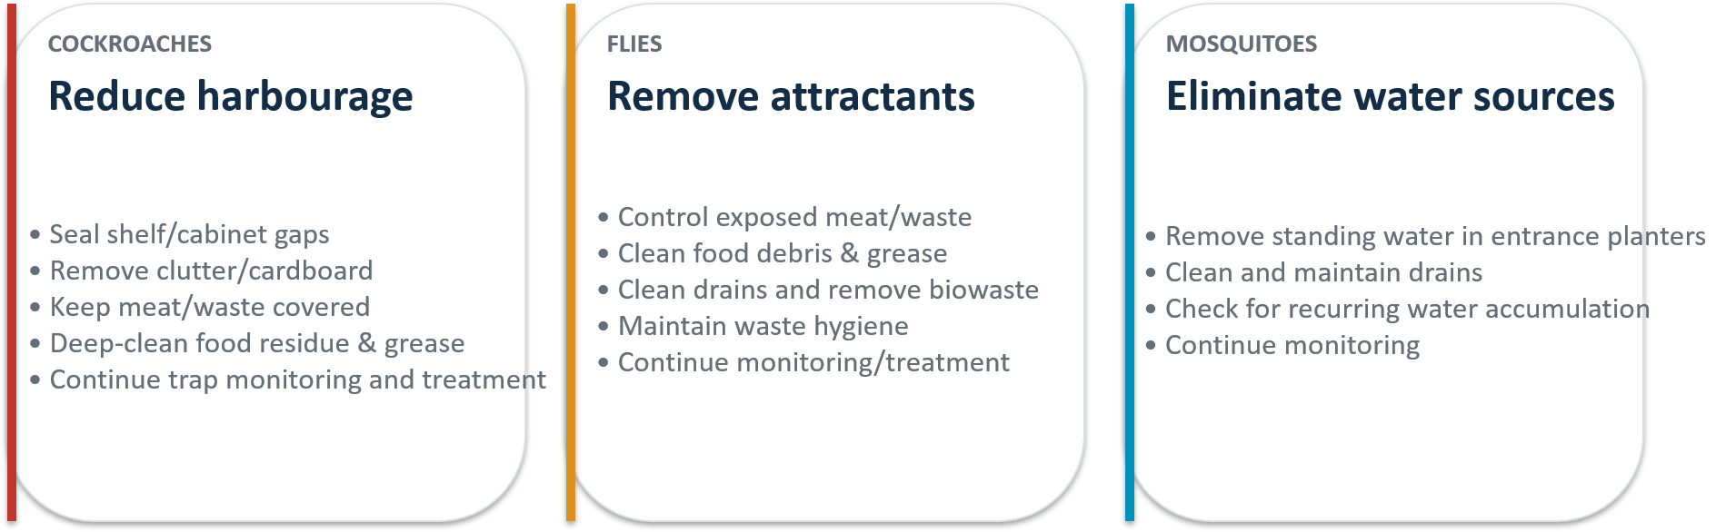
ISSUE-WISE CONTROL STRATEGY
Based on the actual findings in the audit

Slide 8
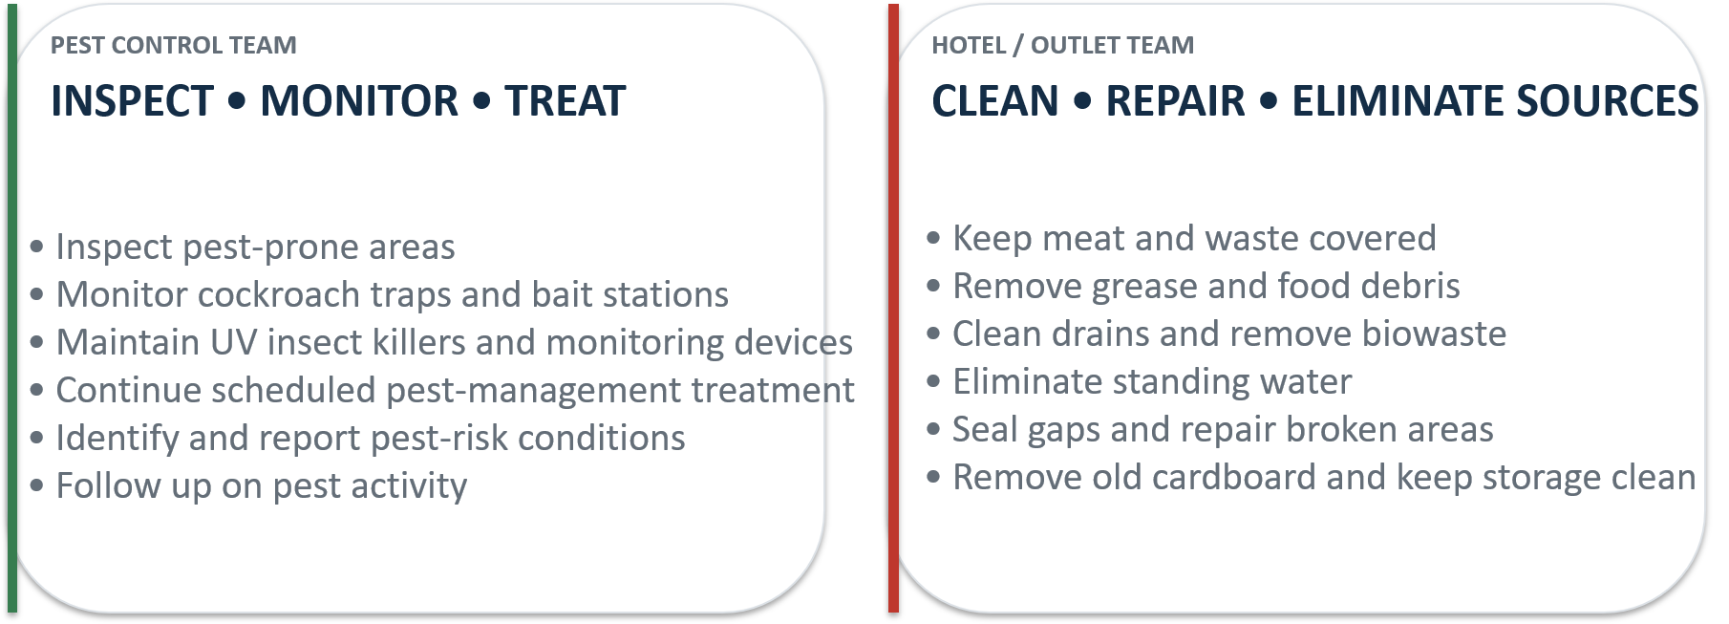
PEST CONTROL & CLIENT RESPONSIBILITIES
SUSTAINABLE CONTROL = PEST MANAGEMENT + HYGIENE + INFRASTRUCTURE CORRECTION

Slide 9
IMMEDIATE CORRECTIVE ACTIONS
Recommended priorities based on audit observations
Seal all identified gaps/cracks in shelves, cabinets and service areas.
Do not keep meat or waste exposed; maintain covered waste and food handling.
Deep-clean grease and food debris from racks, corners and under Hood 4.
Clean drains and remove leaves/biowaste; maintain regular drain hygiene.
Remove standing water from entrance planters immediately.
Remove old cardboard and avoid storing cardboard directly on the floor.
Increase cleaning frequency at back-door/floor-corner areas.
Continue pest-control monitoring and treatment and verify activity reduction.

Slide 10
CONCLUSION
THE ROOT CAUSE IS NOT ONLY PEST ACTIVITY — IT IS THE CONDITIONS SUPPORTING IT.
The audit score of 33.66% indicates significant scope for improvement across pest control, infrastructure and sanitation.
Current pest findings include live cockroaches, cockroach egg cases, flies, dead pests and pest captures in traps.
Multiple structural gaps and hygiene deficiencies provide potential access, food sources and harbourage.
Immediate closure of the identified hygiene, drainage, standing-water and infrastructure issues should be prioritised.
Continue pest-control services and monitoring while corrective actions are implemented and verified.

Slide 11

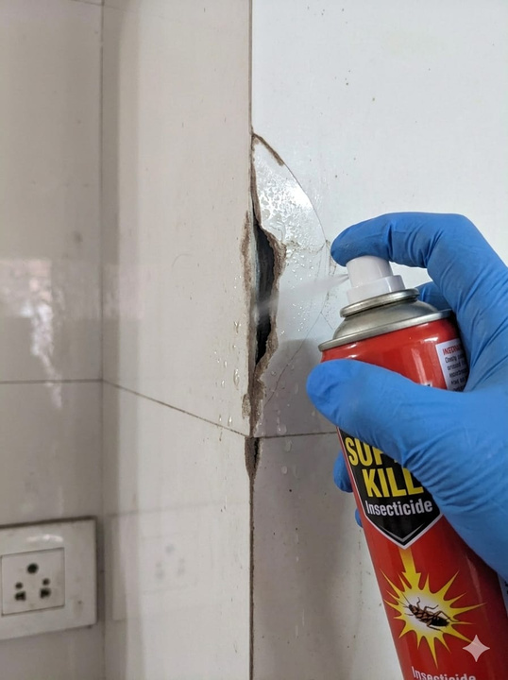
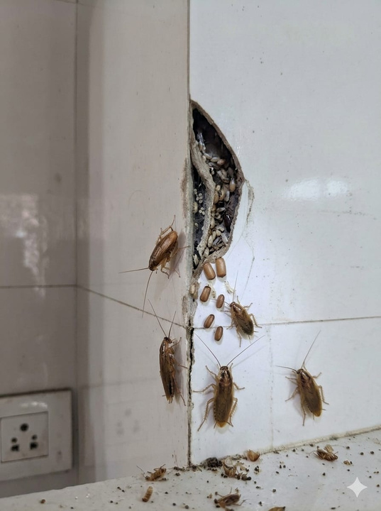
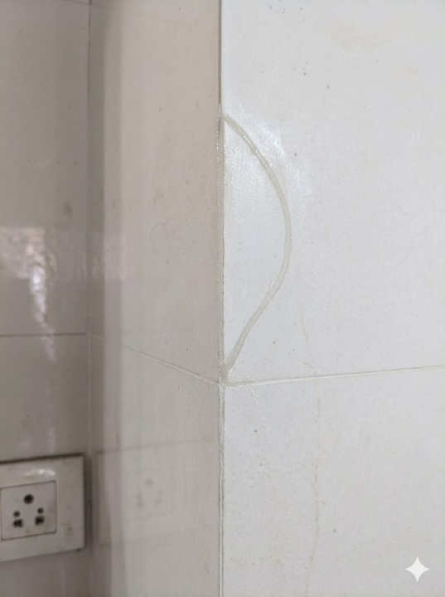




INTEGRATED PEST PROOFING SOLUTIONS by EPCORN:
Why Do Cockroaches Come Back?
They hide inside small cracks
Tile gaps & cabinet joints
Sink edges & wall corners
Deep, unreachable spaces
Spray kills what you see… But not what hides inside.
Our Gap Sealing Solutions:
✔ Crack filling and sealing
✔ Rodent proofing
✔ Utility penetration sealing
✔ Kitchen and storage area proofing
✔ Pest harbourage elimination
✔ Long-term pest prevention
Long-lasting
protection
Safe & professional application
Ideal for kitchen & bathroom gaps
Reduces repeat complaints
Stronger than spray alone
Dont just treat the problem, Seal it permanently.

Slide 12
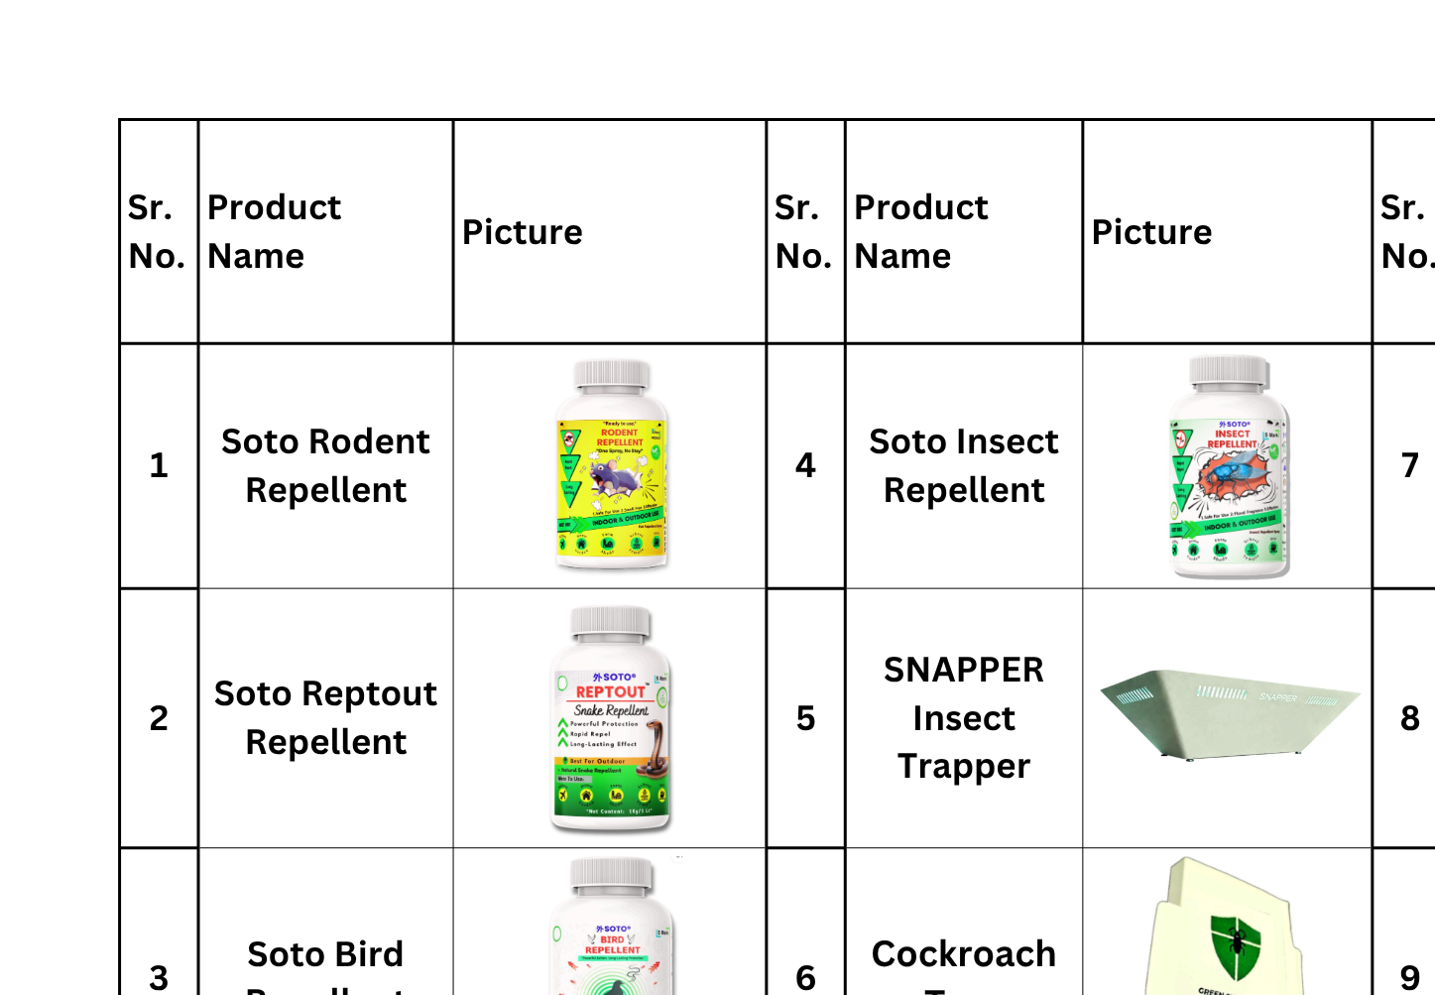
OUR PRODUCTS:

Slide 13
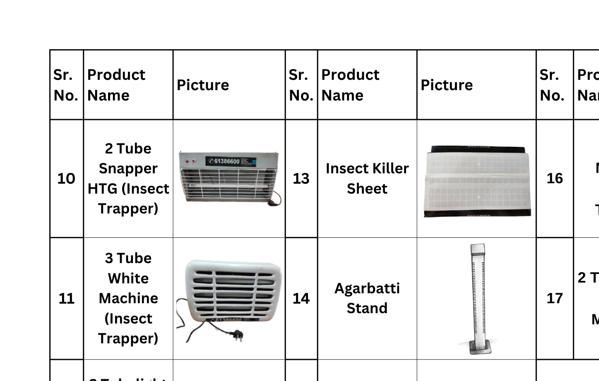

Slide 14


























Trusted By Leading Brands:

Slide 15
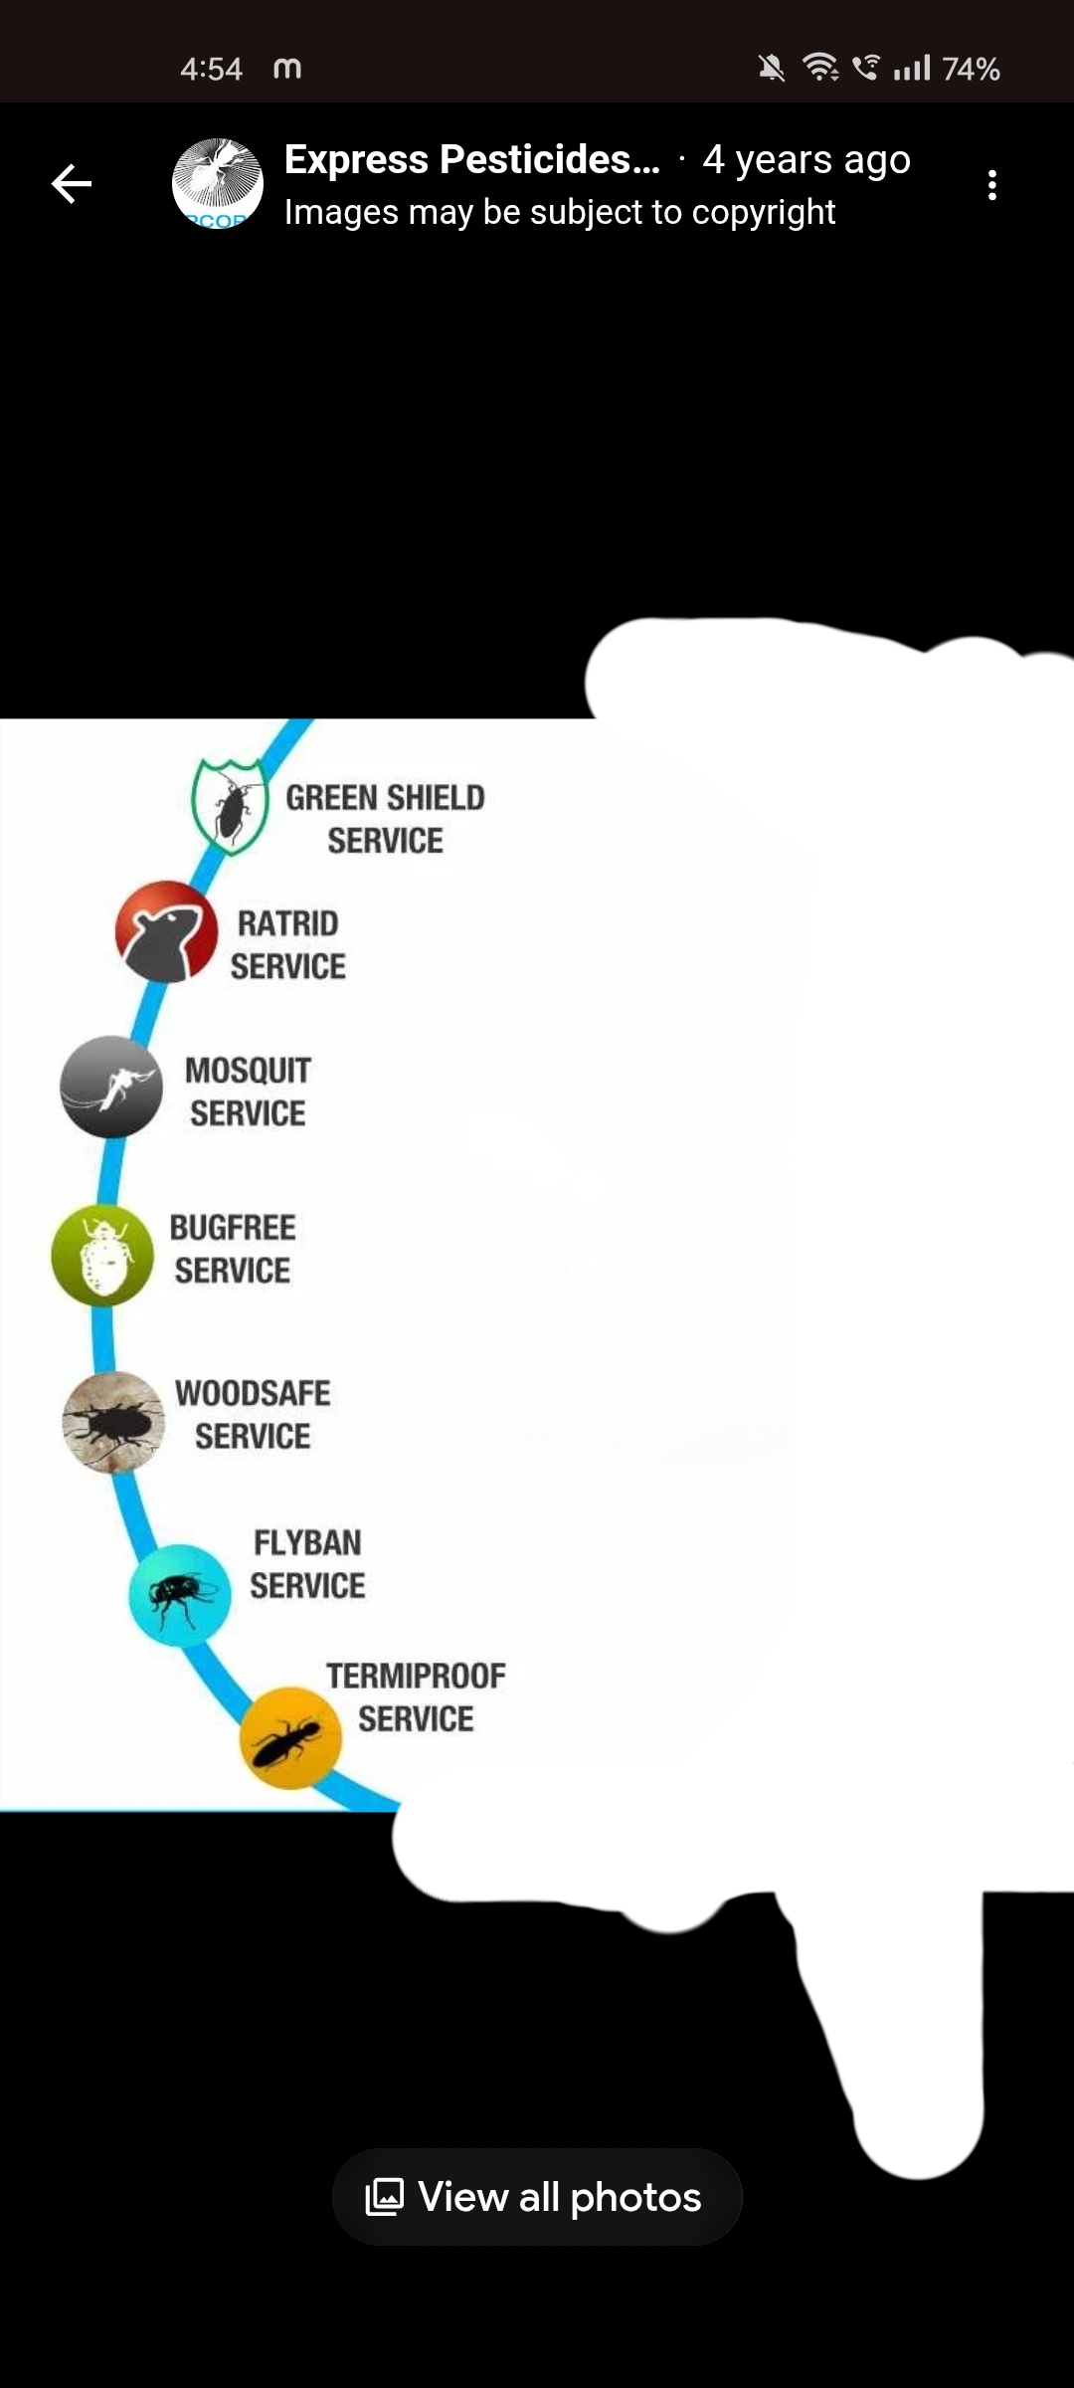

OUR
SERVICES:
CONTACT DETAILS:
S-5 Khira Industrial Estate,B.M.BhargavRoad,Santacruz(W), Mumbai - 400054
Tel: 61386600 Fax: 61386601
Email: epcorn@yahoo.in
Visit: www.epcorn.com

