Slide 1

Consolidated Audit Findings & Root Cause Analysis Report
Client Name: {CLIENT}
Meet at site: {MEETUP}
Site Category: {SITETYPE}
Site Address: {ADDRESS}
Inspection Date: {INSPECTIONDATE}
Inspected By: {AUDITOR}
1

Slide 2
EXECUTIVE SUMMARY
INFRASTRUCTURE CONDITION
SANITATION & HOUSEKEEPING
OVERALL AUDIT SCORE
PEST ACTIVITY & CONTROL
{Oscore}%
{Pscore}
{Iscore}
{Sscore}
Achieved score
Achieved score
Achieved score
Achieved score
• Live cockroach activity was recorded in Nushara Kitchen under platforms.
• Bed bug activity was reported/observed in guest rooms.
• Fresh rodent droppings were noted within shafts; rodent footprints were observed on a glueboard.
• Wall/ceiling gaps and open service shafts were identified as potential pest access/harbourage points.
• Waste holding area requires better housekeeping and sanitation.
• Hotel operations section records pest activity concerns in guest rooms, kitchen, restaurant, banquet area and garbage holding area.
2

Slide 3
PEST ACTIVITY – KEY FINDINGS
Recorded observations from the audit matrix
Live cockroach
Cockroach Egg Cases
{COMMENT0}
{COMMENT1}
{SPECIFICATION0}
{SPECIFICATION1}
Rodent droppings
Live Rodent
{COMMENT2}
{COMMENT3}
{SPECIFICATION2}
{SPECIFICATION3}
Dead Pest Found
Flying insect (flies, mosquitoes, moths, etc.)
{COMMENT4}
{COMMENT5}
{SPECIFICATION4}
{SPECIFICATION5}
3

Slide 4
PEST ACTIVITY – KEY FINDINGS
Recorded observations from the audit matrix
Missing Pest Control Devices
Insect Activity Near Waste Disposal Area
{COMMENT6}
{COMMENT7}
{SPECIFICATION6}
{SPECIFICATION7}
Lizard Infestation
Missing Cockroach Trap
{COMMENT8}
{COMMENT9}
{SPECIFICATION8}
{SPECIFICATION9}
Missing Rodent Trap
{COMMENT10}
{SPECIFICATION10}
3

Slide 5
INFRASTRUCTURE NON-CONFORMITIES
Specific locations recorded in the audit
Wall Cracks/Gaps
Floor Cracks/Gaps
{INFRACOM0}
{INFRACOM1}
{INFRASP0}
{INFRASP1}
Ceiling Cracks/Gaps
Gaps Around Door
{INFRACOM2}
{INFRACOM3}
{INFRASP2}
{INFRASP3}
Window Improperly Sealed/Damaged
Service entry Point
{INFRACOM4}
{INFRACOM5}
{INFRASP4}
{INFRASP5}
4
3

Slide 6
INFRASTRUCTURE NON-CONFORMITIES
Specific locations recorded in the audit
Inadequate Ventilation
Drainage covers Damaged/Missing/Improperly fitted
{INFRACOM6}
{INFRACOM7}
{INFRASP6}
{INFRASP7}
Utility penetration unsealed
Water Leakage
{INFRACOM8}
{INFRACOM9}
{INFRASP8}
{INFRASP9}
Rodent entry point
{INFRACOM10}
{INFRASP10}
4
3

Slide 7
HYGIENE, HOUSEKEEPING & HOTEL OPERATIONS
Conditions requiring corrective action
Waste storage area
Better housekeeping and sanitation required.
Housekeeping / hygiene
Maintain cleaning schedules and ensure waste is removed promptly.
Pest-free hotel areas
Audit records indicate NO compliance for guest rooms, kitchen, restaurant and banquet area pest-free checks.
Garbage holding area
Audit records indicate NO compliance for proper maintenance.
5

Slide 8
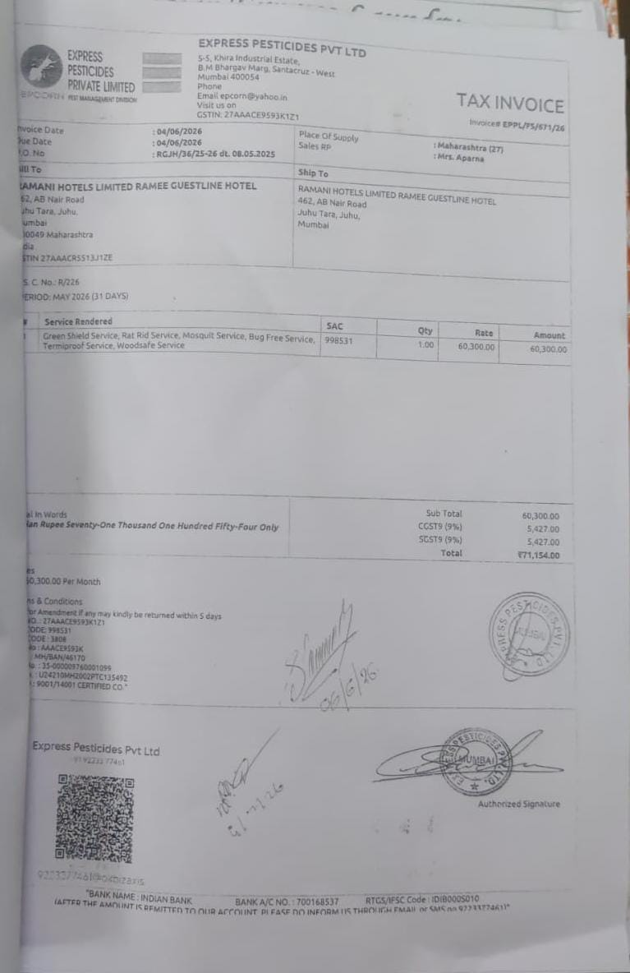
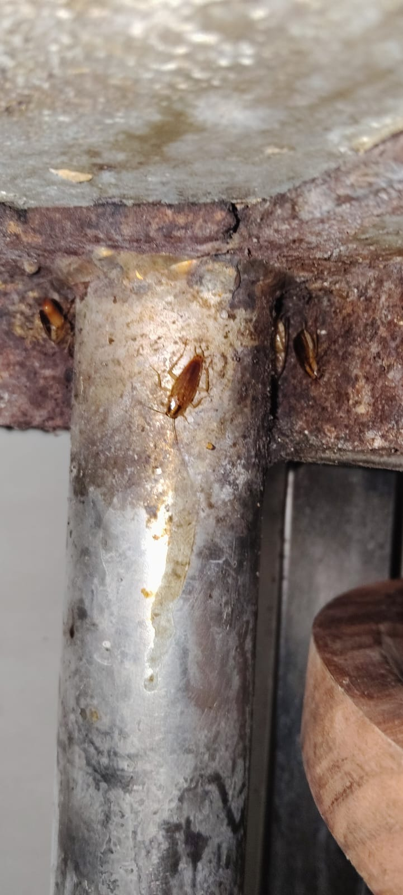
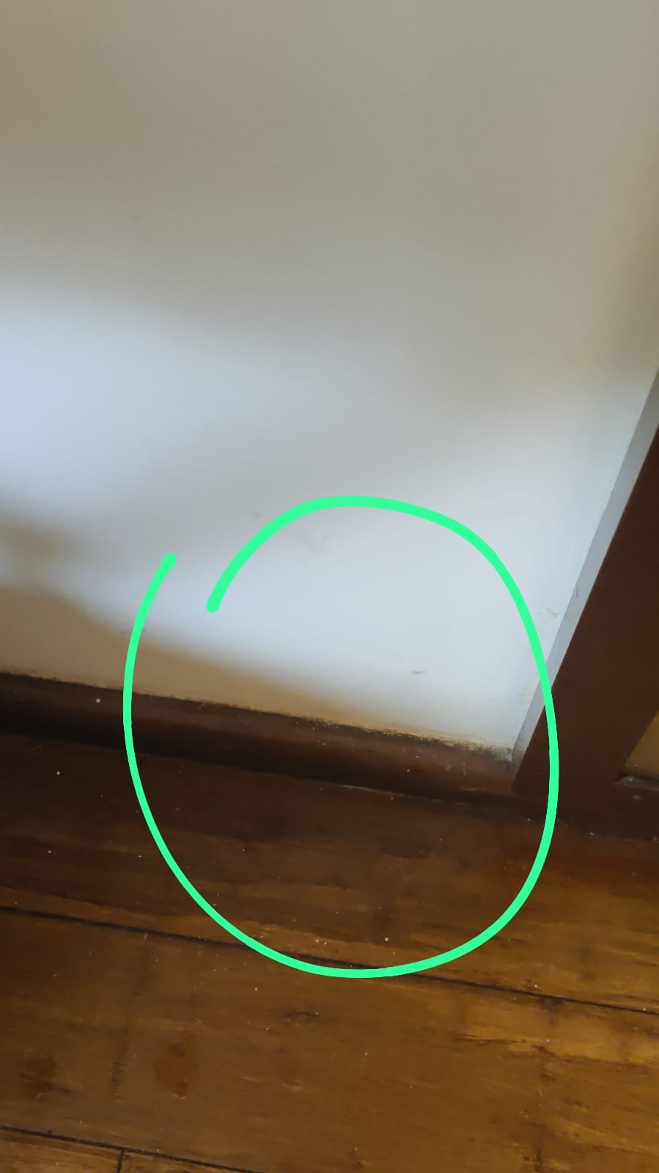
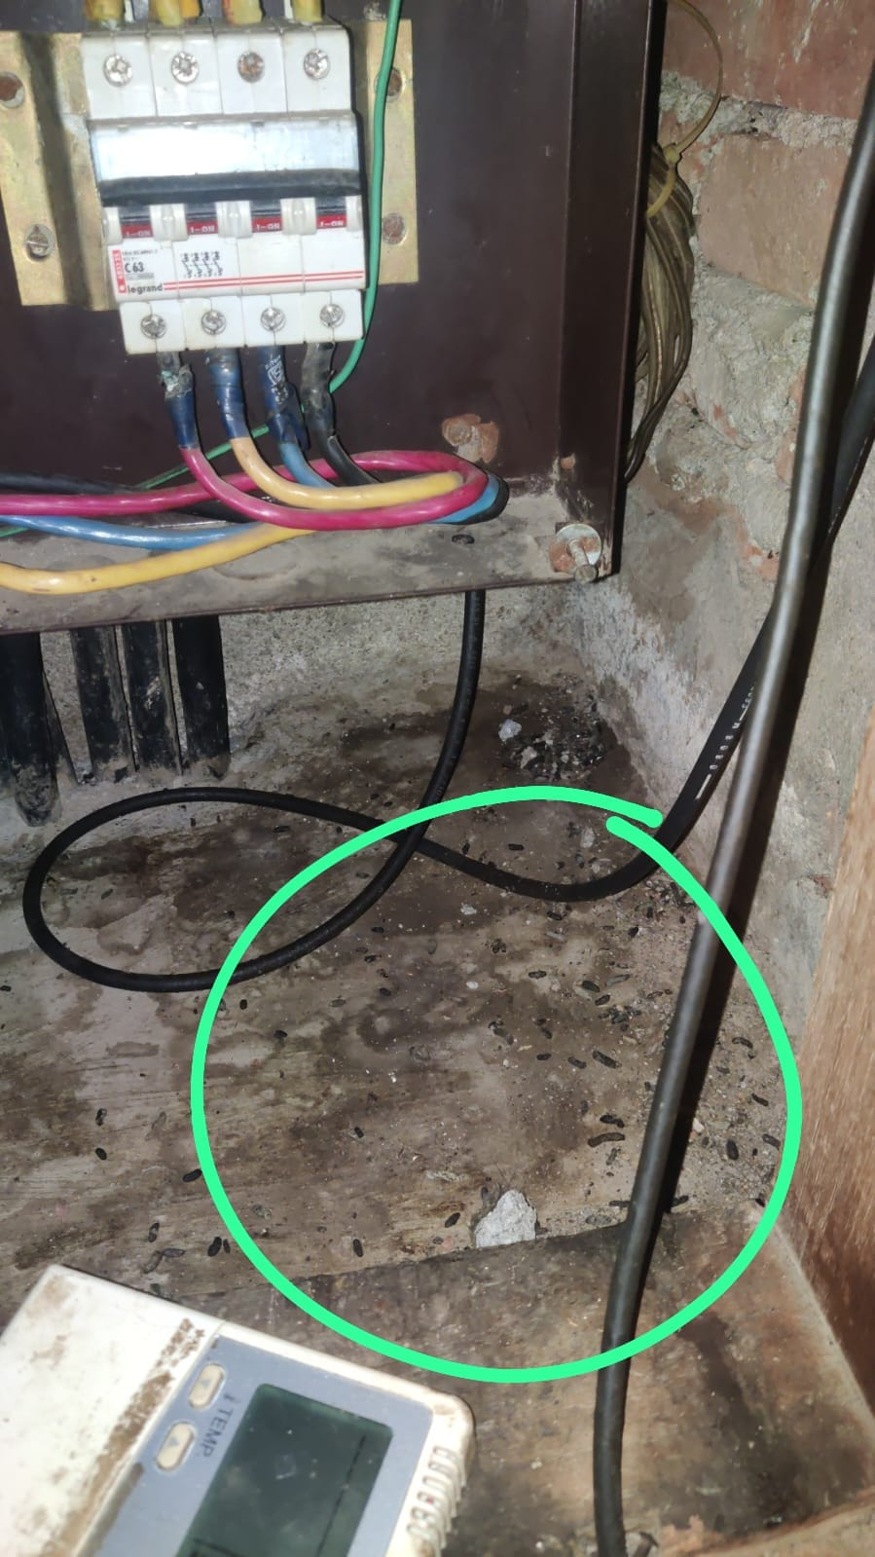
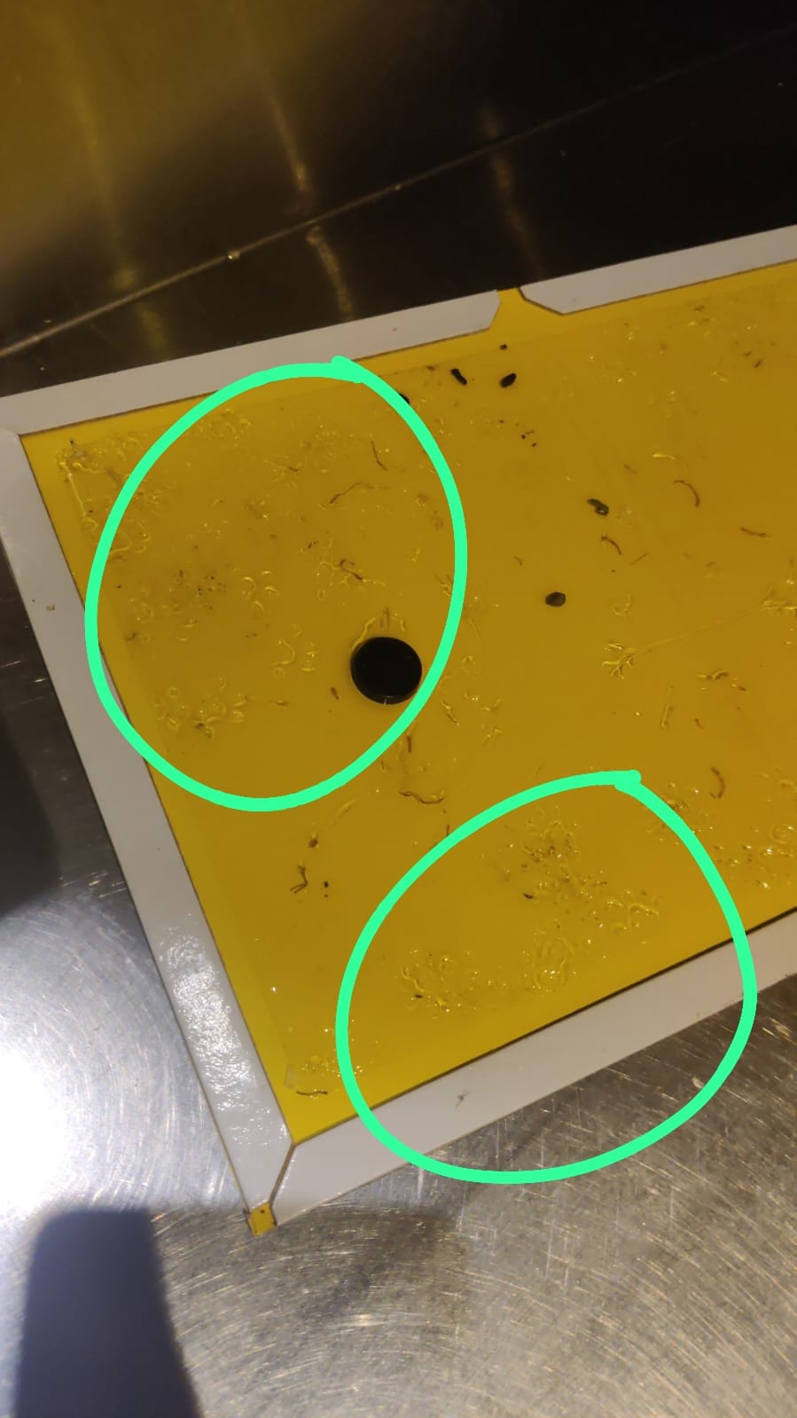
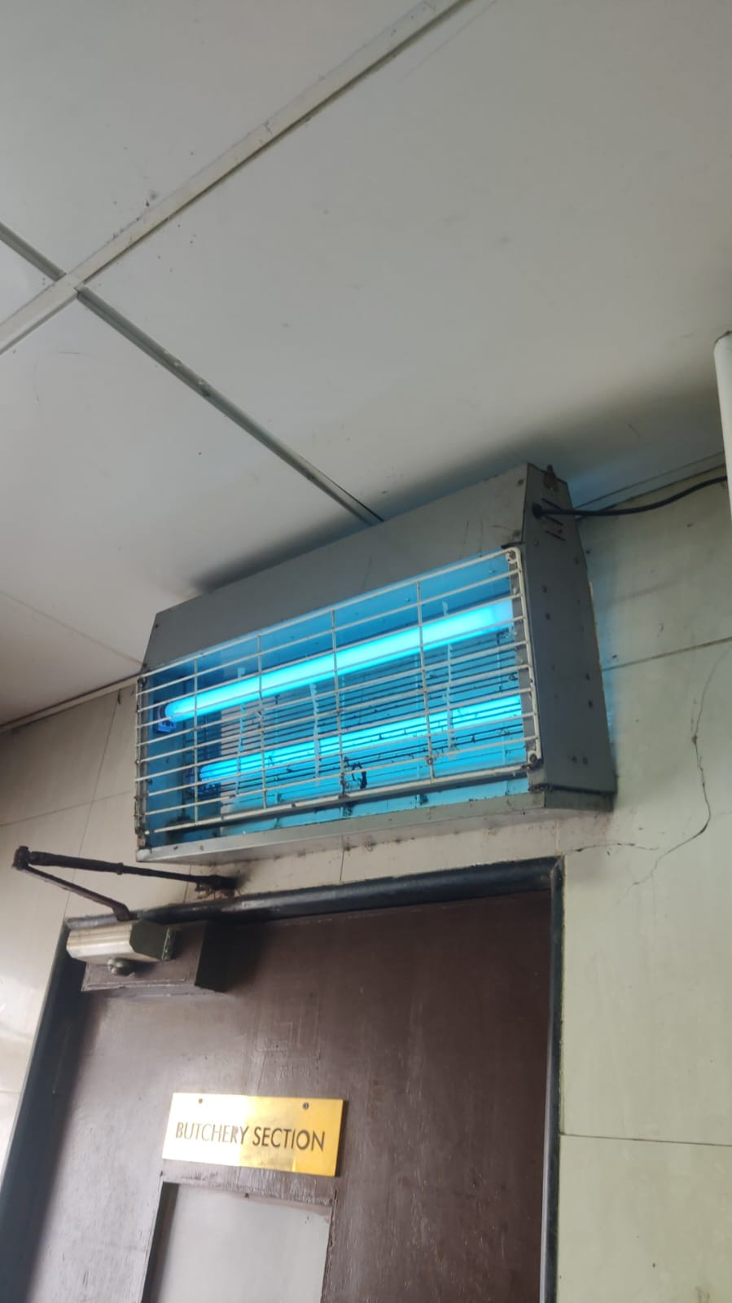
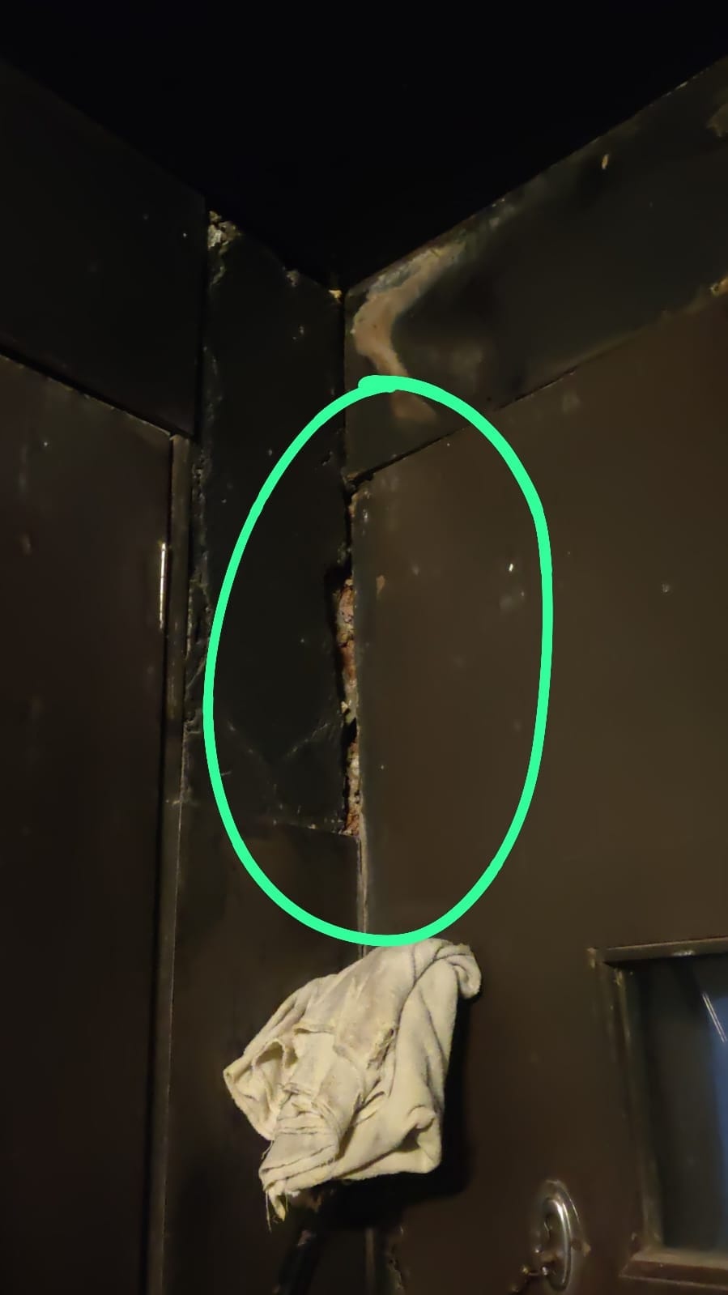
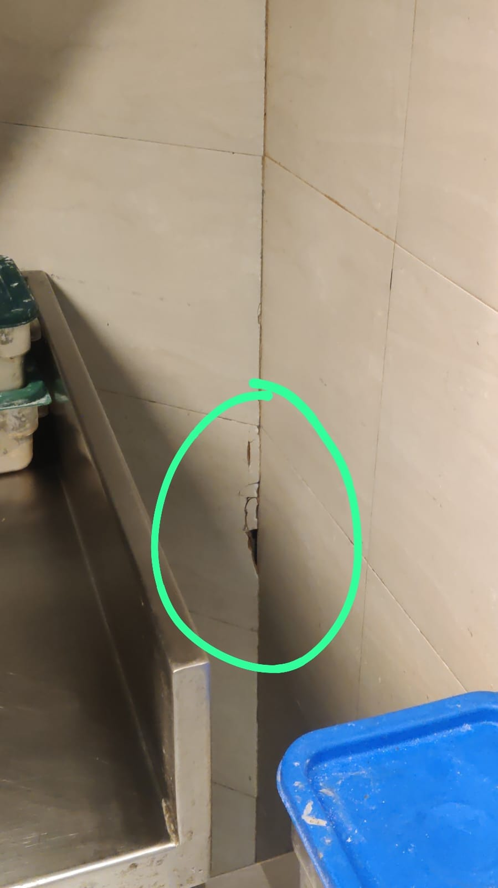
PICTURE EVIDENCE
Location-wise evidence from the submitted audit sheet
Documentation & Records
Nushara Kitchen
Guest Rooms
Shafts
Onsite contract / pest-control documentation
Live cockroach found under kitchen platforms
Bed bug activity reported/observed in guest rooms
Fresh rodent droppings indicating recent activity
Glueboard
Kitchen
Kitchen Corners
Kitchen Corners
Rodent footprints observed on glueboard
UV insect killer / pest-control equipment
Wall cracks providing potential pest harbourage/entry
Additional wall gap/crack observed
6

Slide 9
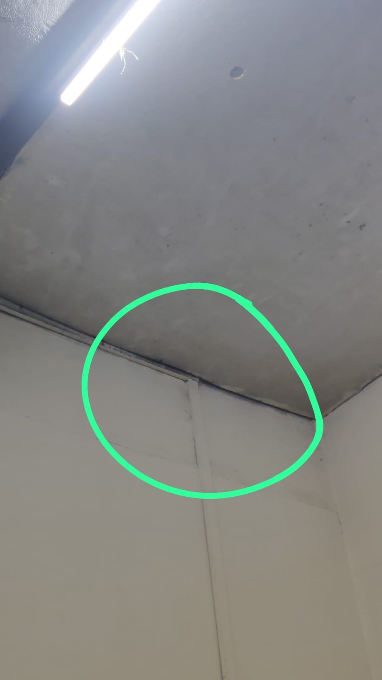
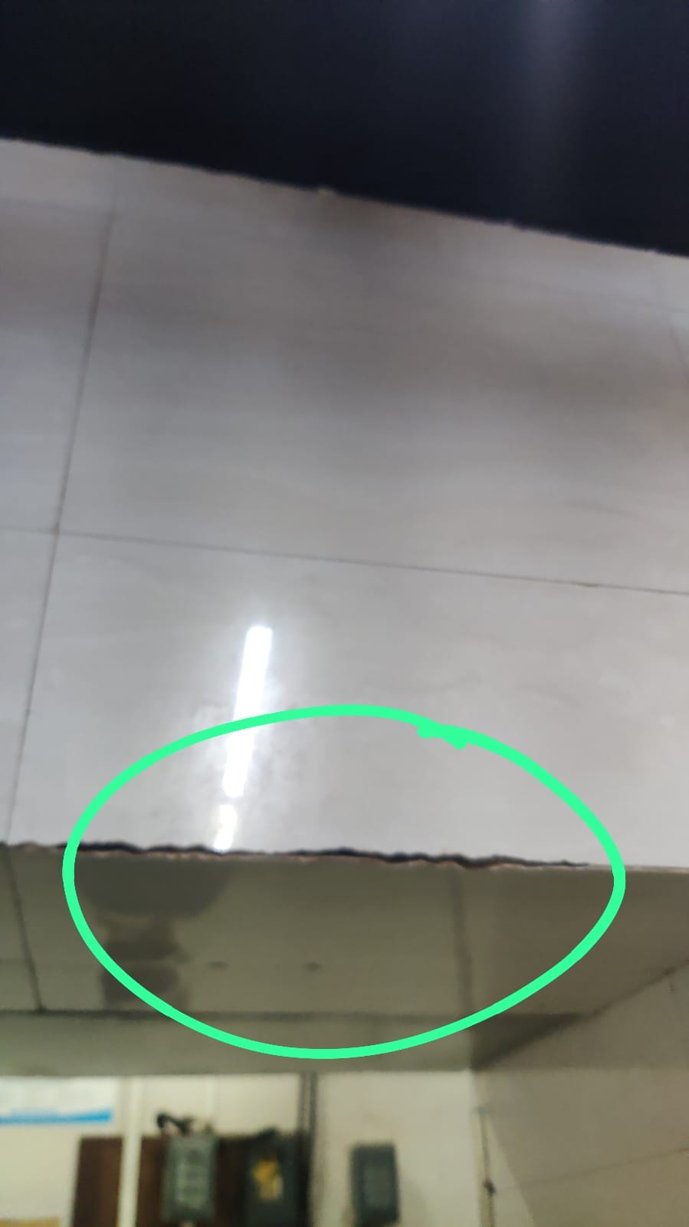
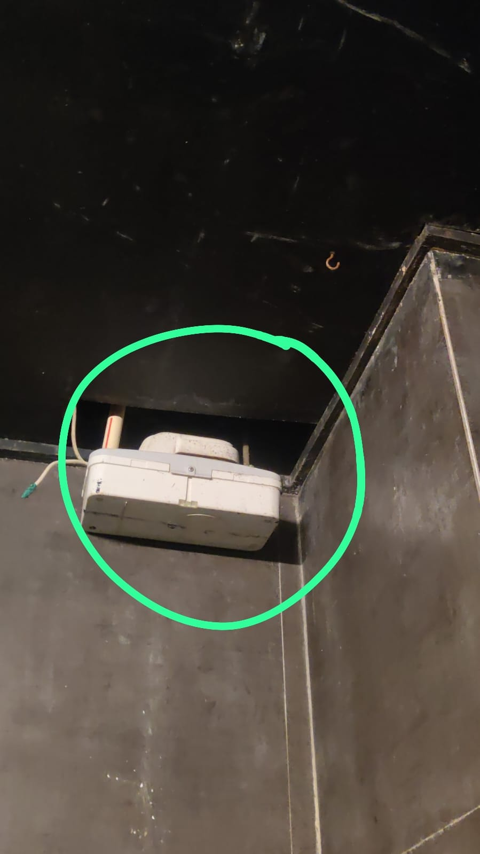
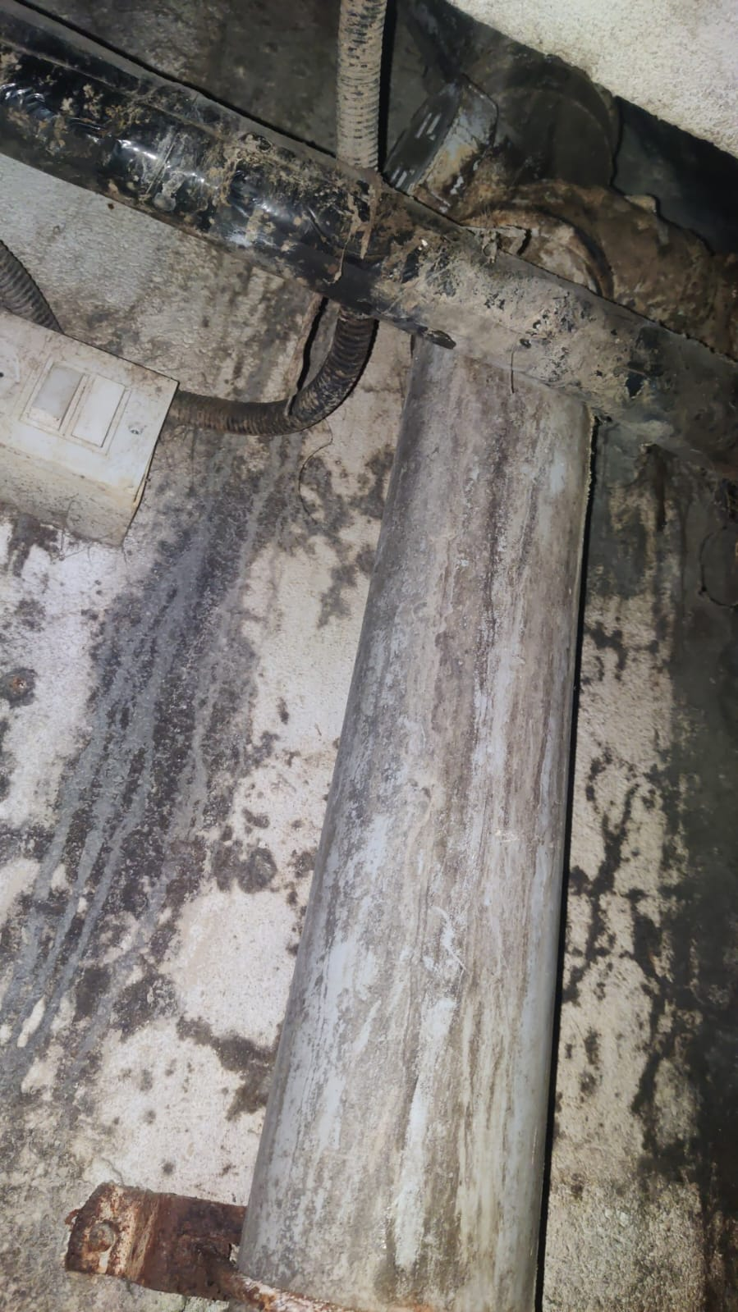
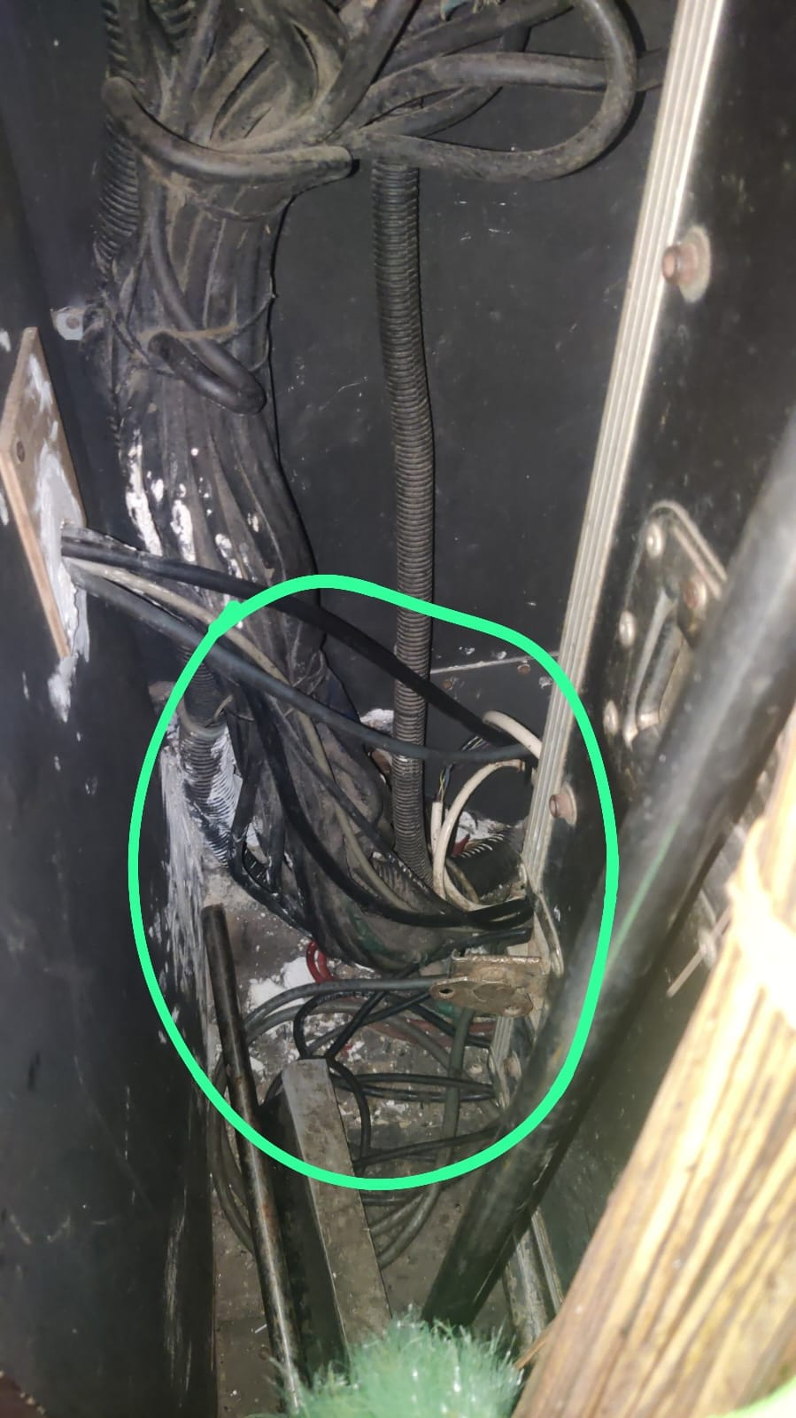
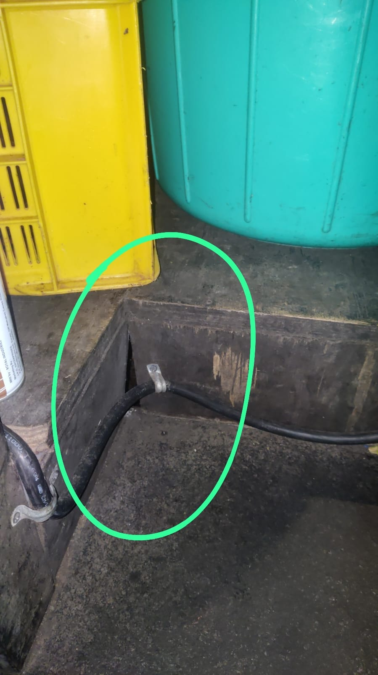
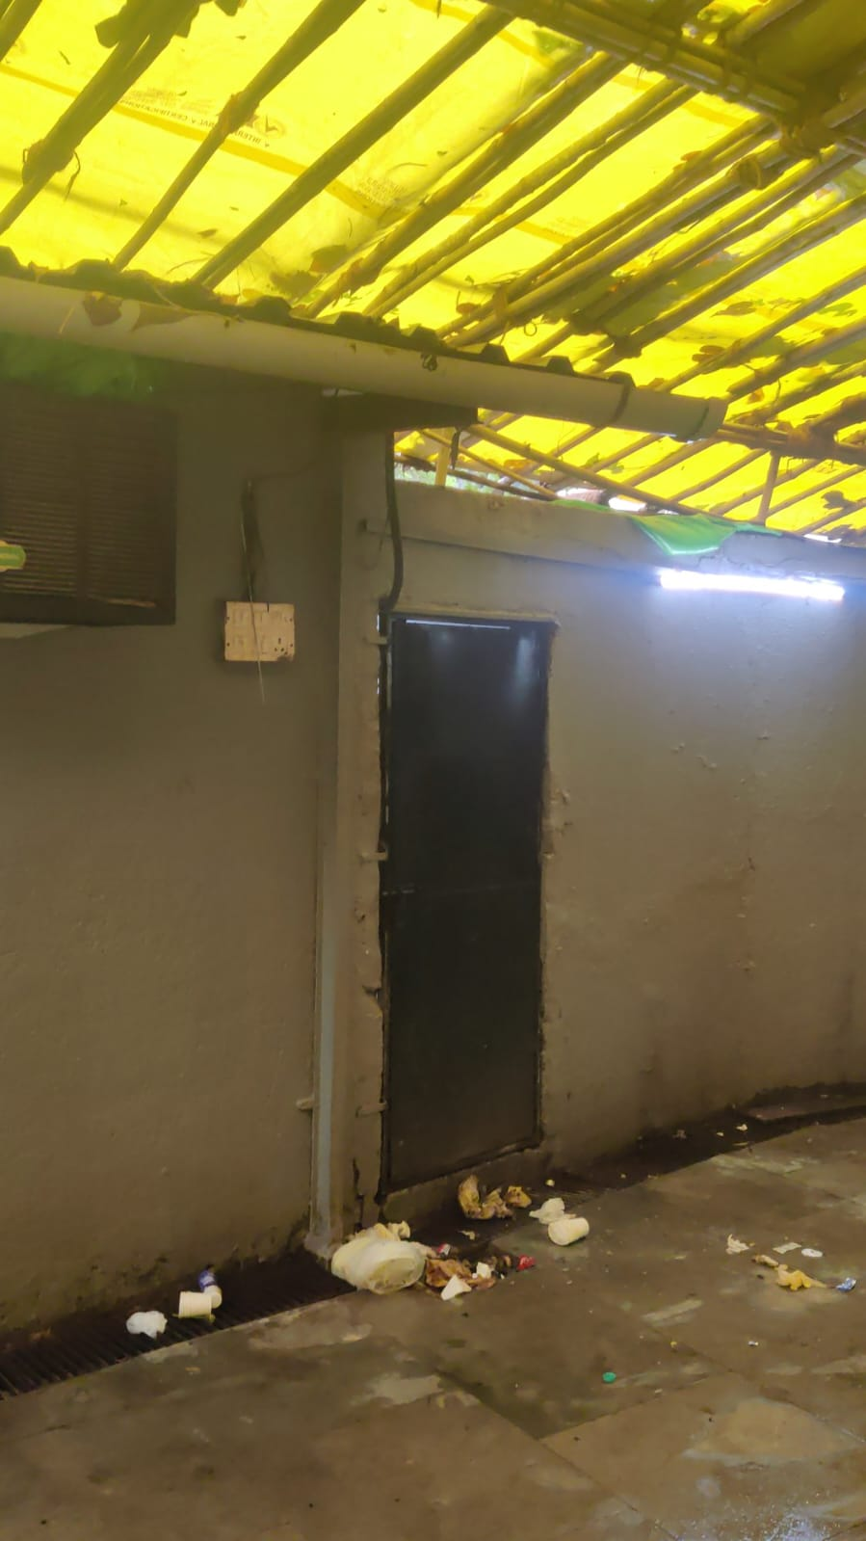
PICTURE EVIDENCE
Location-wise evidence from the submitted audit sheet
Nushara Kitchen
Nushara Kitchen
Service Shafts
Service Shafts
Ceiling gap allowing potential pest harbourage/movement
Additional ceiling gap observed
Open/connected shafts requiring sealing and deep cleaning
Additional open shaft / service area condition
Tanatan Bar
Tanatan Bar
Waste Holding Area
Potential rodent entry point
Additional potential rodent entry point
Housekeeping/sanitation condition requiring improvement
7

Slide 10
IMMEDIATE CORRECTIVE ACTIONS
Priorities based on the actual findings in the audit
01
Deep clean Nushara Kitchen tables, shelves and platforms; carry out intensive spraying and gel treatment.
05
Seal open service penetrations / shafts and deep clean all shafts.
02
Carry out immediate bed bug treatment in affected guest-room areas; inspect adjacent rooms and monitor.
06
Immediately seal potential rodent entry points in Tanatan Bar.
03
Conduct intensive rodent control in shafts; identify harbourage/entry points and increase monitoring.
07
Improve waste holding-area housekeeping, sanitation and covered-bin practices.
04
Seal wall cracks and ceiling gaps, especially in kitchen areas.
08
Continue pest-control monitoring and verify reduction in activity after corrective actions.
8

Slide 11
CONCLUSION
Root-cause focus for sustained pest prevention
THE KEY RISK IS NOT ONLY PEST ACTIVITY — IT IS THE CONDITIONS SUPPORTING IT.
• The audit score is 41.13%, indicating significant scope for improvement across pest control, infrastructure, sanitation and hotel operations.
• Recorded findings include live cockroach activity, bed bug activity, rodent droppings/footprints and pest-risk conditions around the waste holding area.
• Structural gaps, open shafts and potential entry points can support pest movement and harbourage.
• Corrective action should combine pest treatment with sealing, deep cleaning, waste management and verification monitoring.
SUSTAINABLE CONTROL = PEST MANAGEMENT + HYGIENE + INFRASTRUCTURE CORRECTION
9

Slide 12
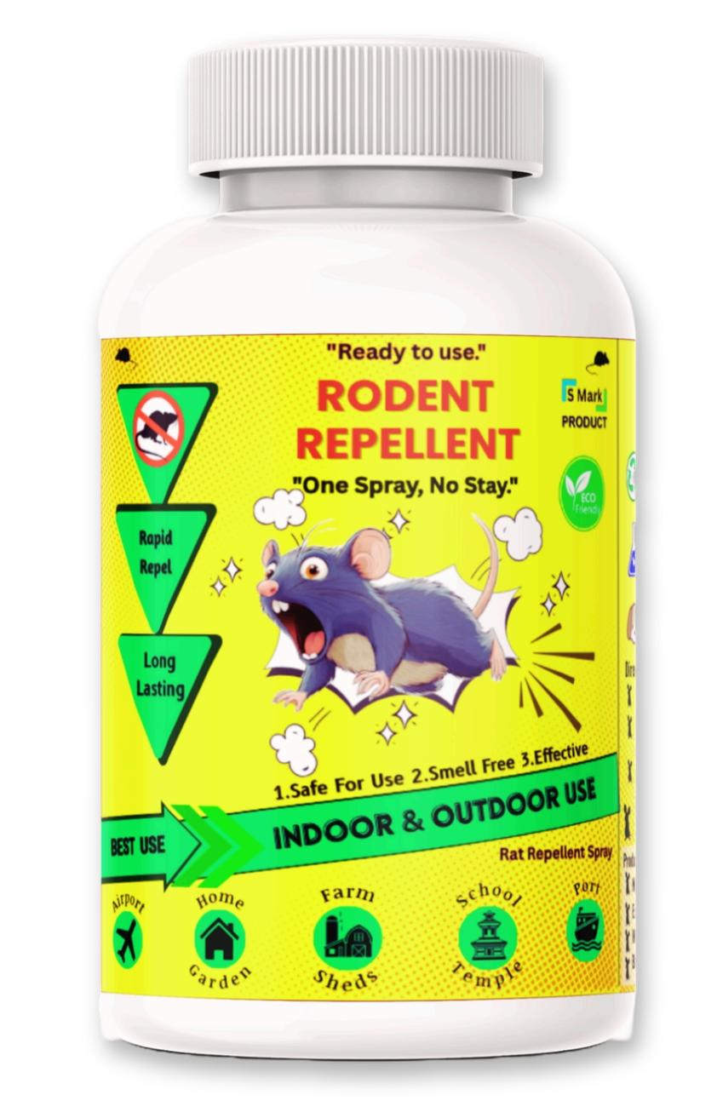
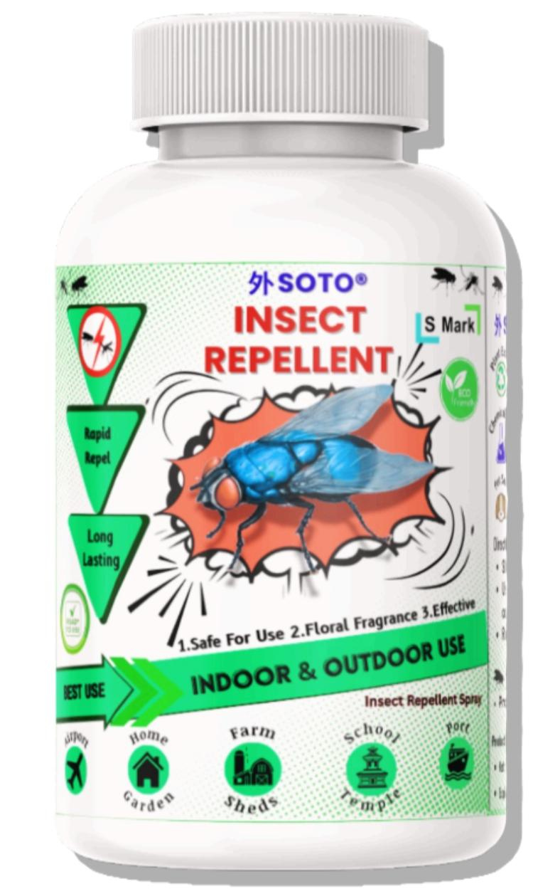
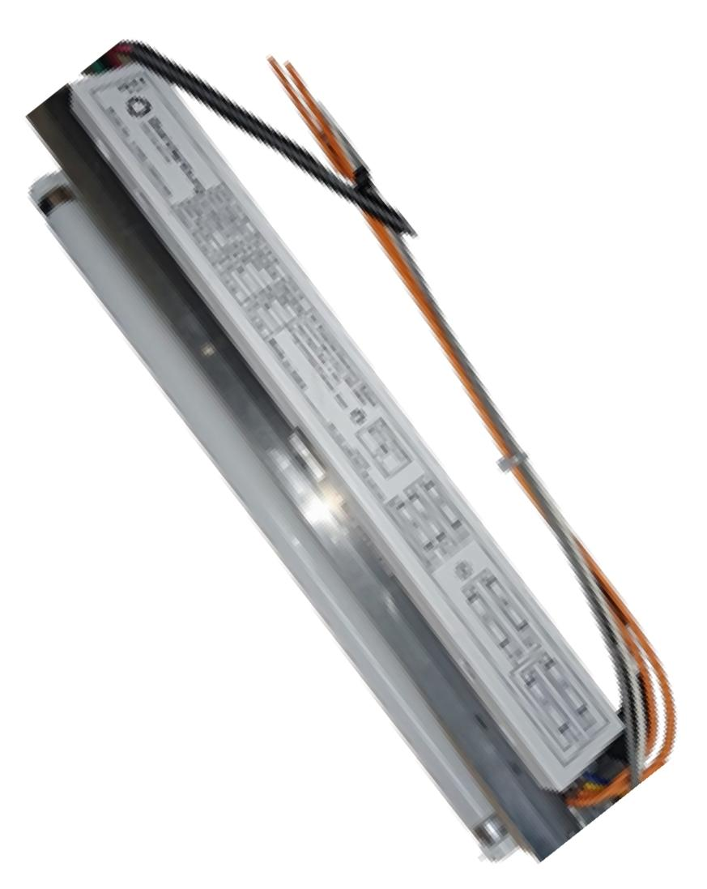
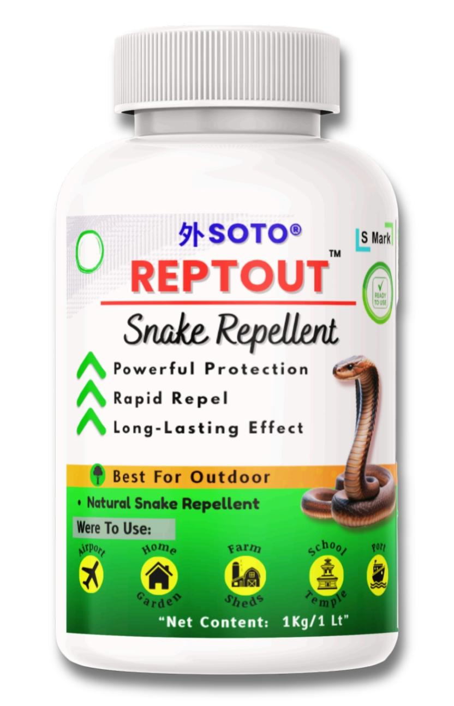
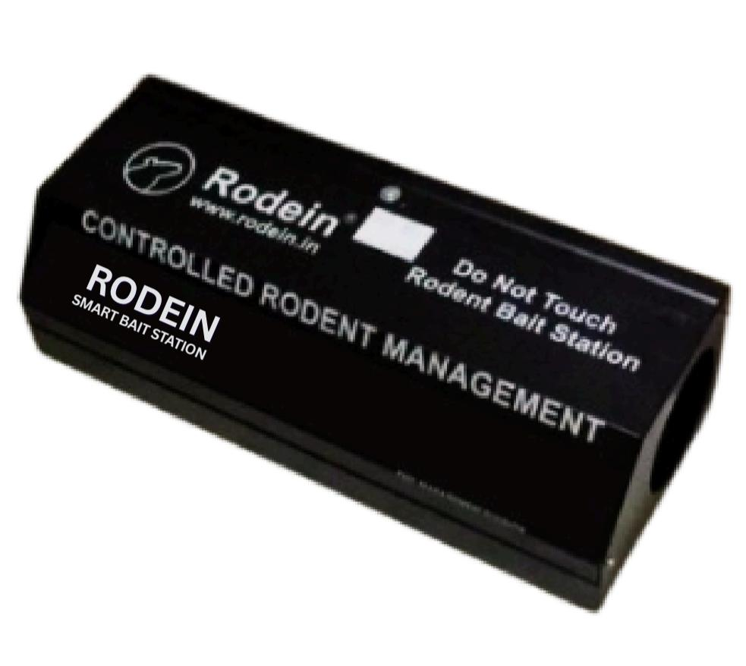
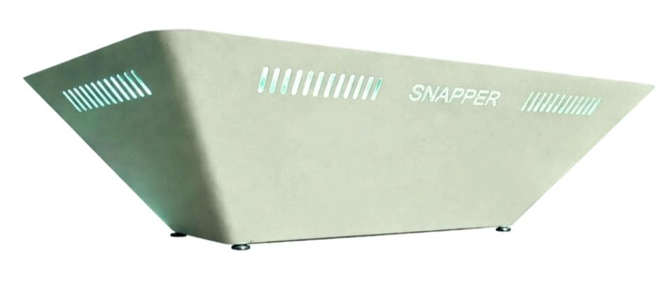
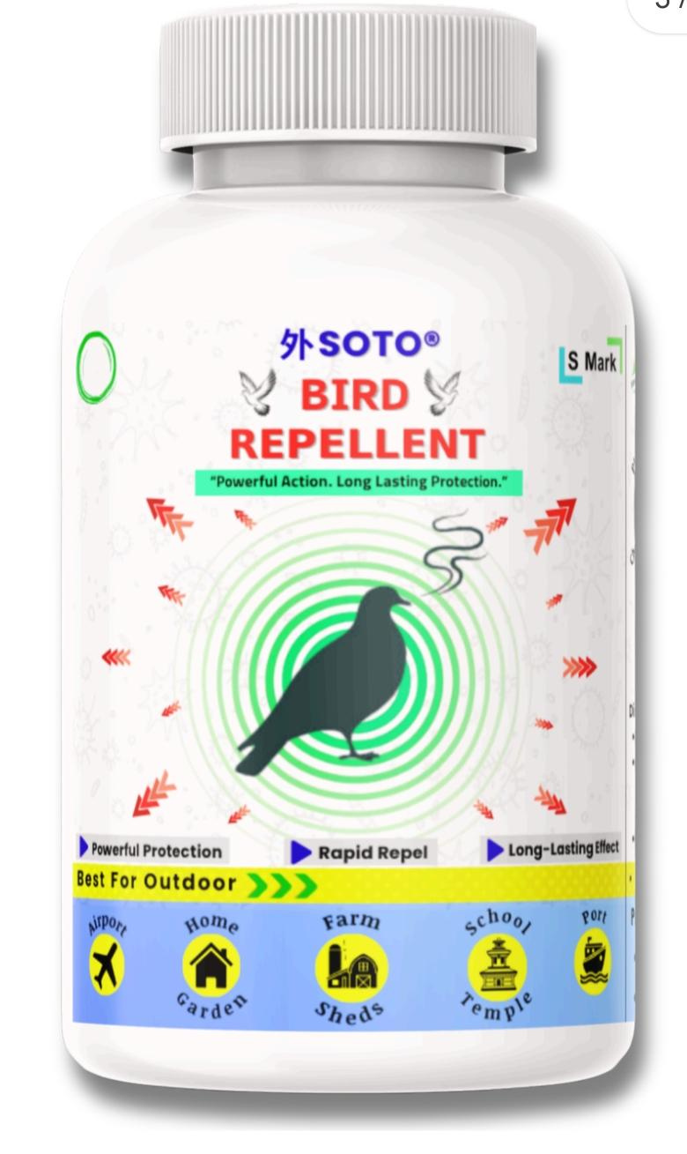
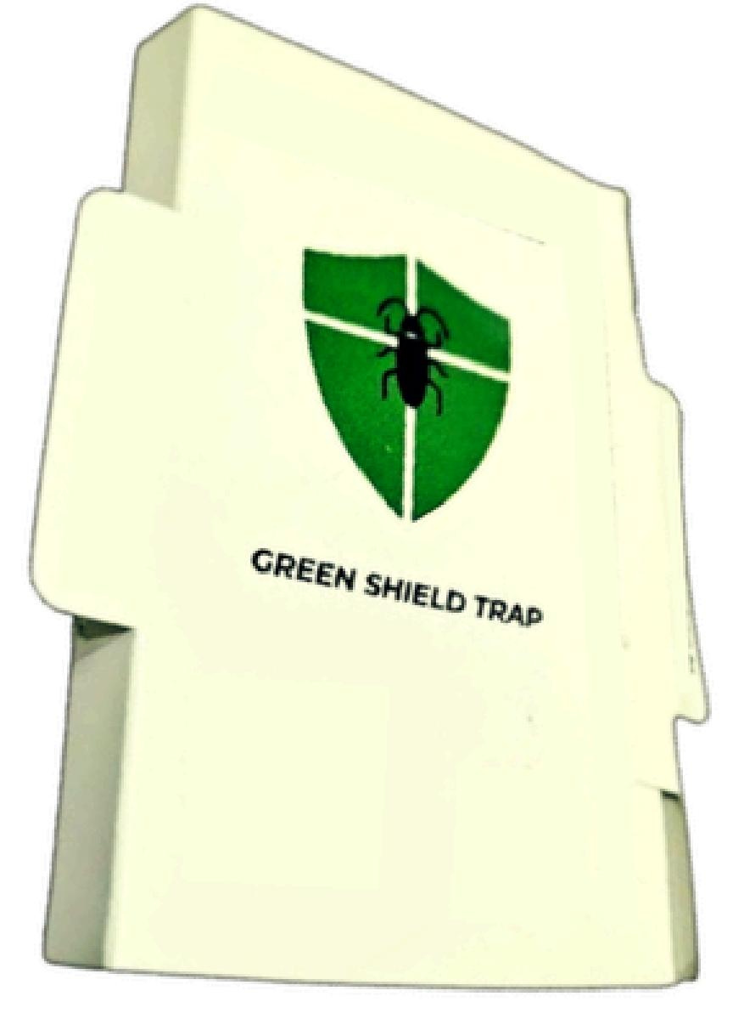
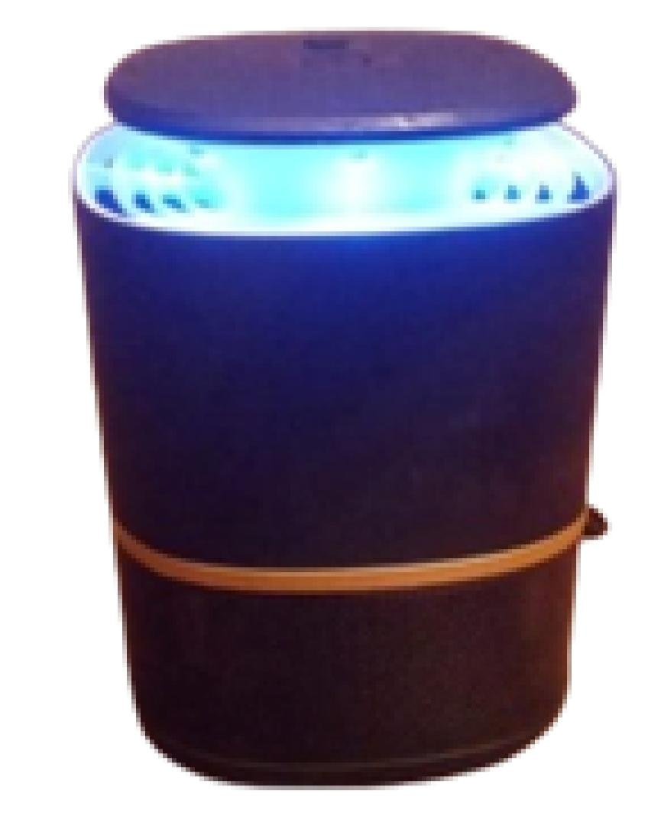
OUR PRODUCTS:
Sr.No. | Product Name | Picture | Sr.No. | Product Name | Picture | Sr.No. | Product Name | Picture
1 | Soto Rodent Repellent |  | 4 | Soto Insect Repellent |  | 7 | Spider bllast
2 | Soto Reptout Repellent |  | 5 | SNAPPER Insect Trapper |  | 8 | RODEIN- Rodent Bait Station
3 | Soto Bird Repellent |  | 6 | Cockroach Trap |  | 9 | Mosquito Trapper

Slide 13
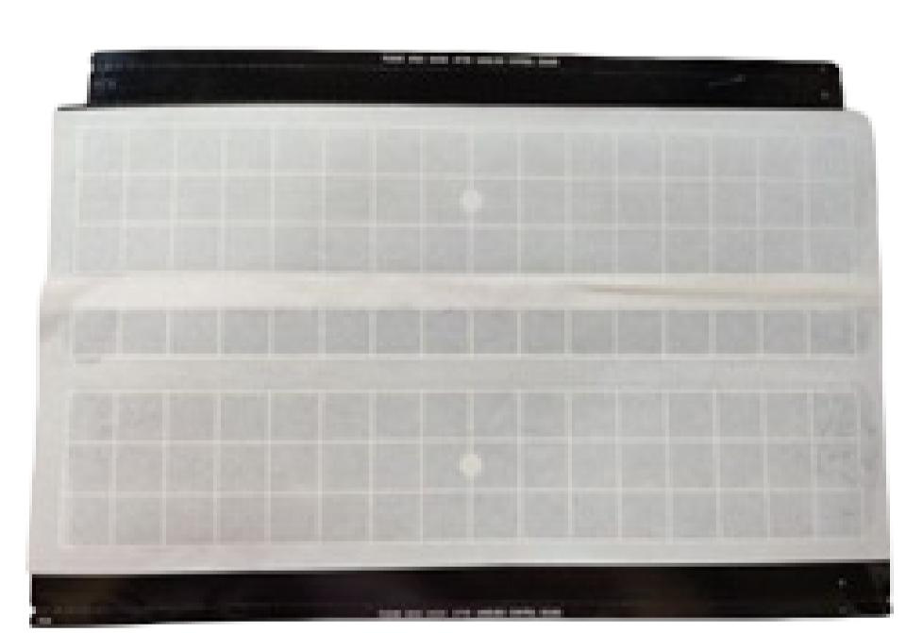
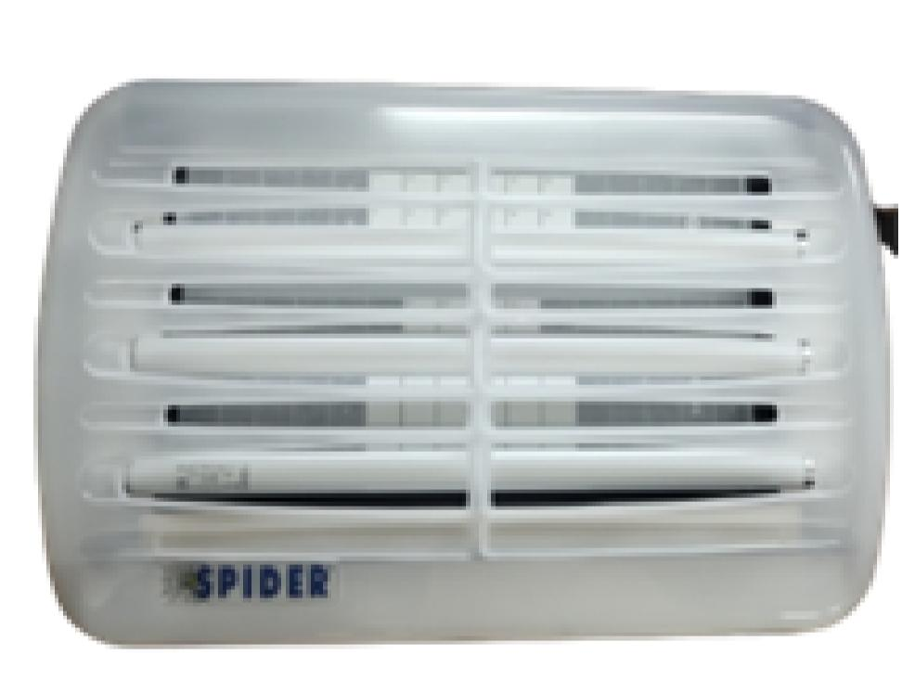
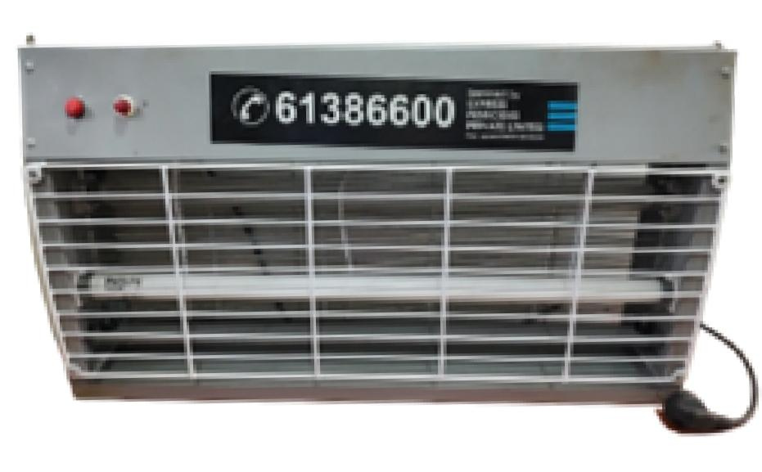
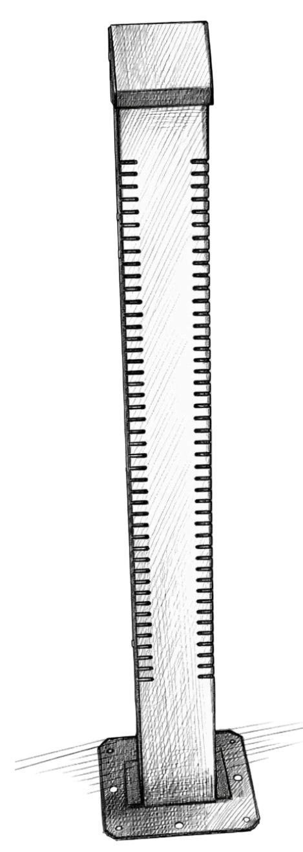
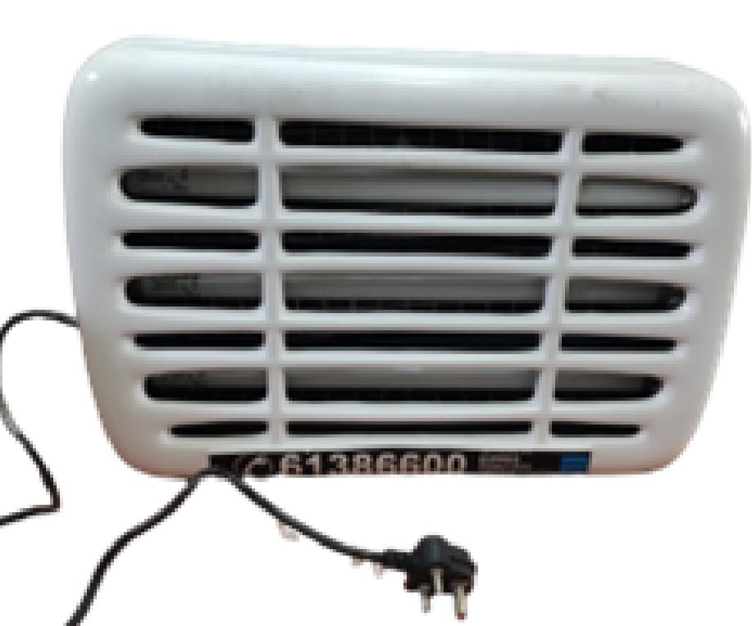
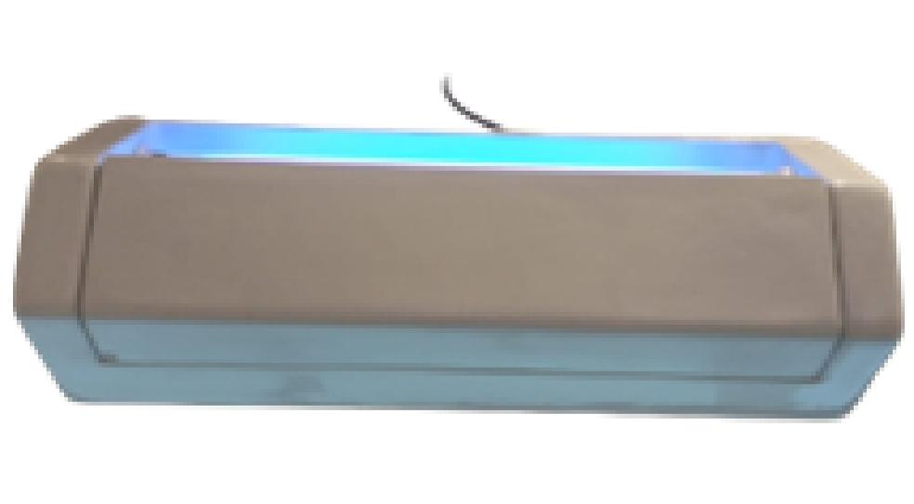
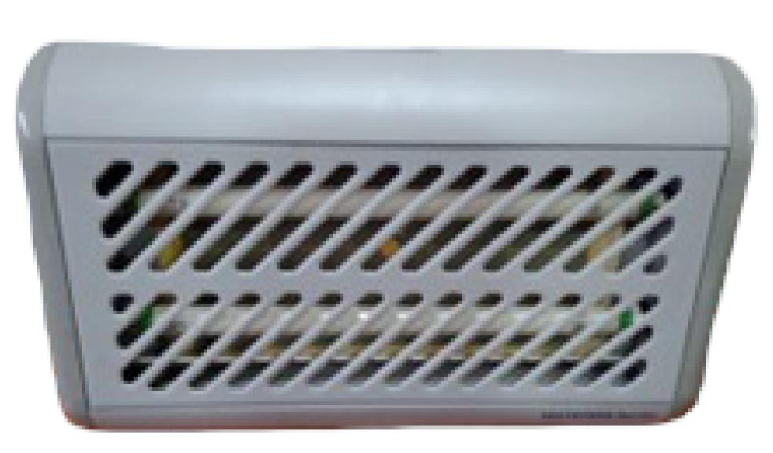

Sr.No. | Product Name | Picture | Sr.No. | Product Name | Picture | Sr.No. | Product Name | Picture
10 | 2 Tube Snapper HTG (Insect Trapper) |  | 13 | Insect Killer Sheet |  | 16 | Spider Machine (Insect Trapper)
11 | 3 Tube White Machine (Insect Trapper) |  | 14 | Agarbatti Stand |  | 17 | 2 Tube Insect Killer Macchine
12 | 2 Tubelight Machine (Insect Trapper) |  | 15 | Samarth Incense Stick

Slide 14


Slide 15
