Slide 1
如何更好的RFQ报价
Lisa Chen

Slide 2
RFQ
数量：3月还剩10个
RFQ报价手机端流程：
采购直达-搜索产品关键词-查找相关度高的RFQ-报价
关注点： 1. 发布时间 2.剩余报价 3. 剩余报价 4.国家 5.数量 6.详情描述 7.买家信息 8.报价记录

Slide 3
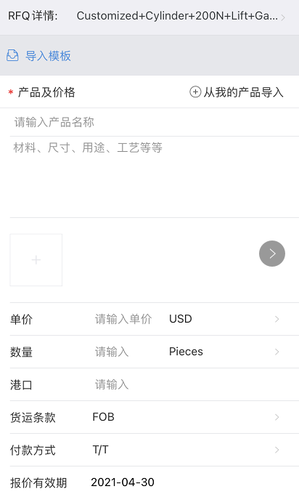
立即报价（按钮）
创建自己的RFQ回复模板
导入相关产品
邮件形式回复
添加2-3张产品图片
基于客户需要的数量与MOQ去填写
Shanghai

Slide 4
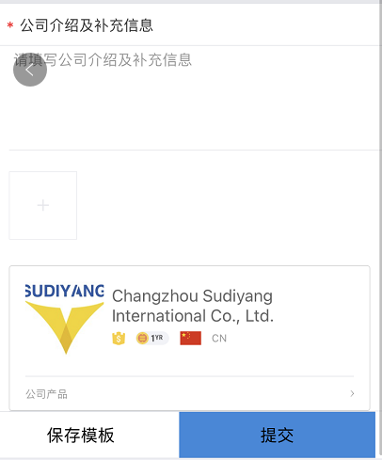
公司卖点加产品卖点
公司/生产-图片
先保存模板再提交-方便后期使用

Slide 5
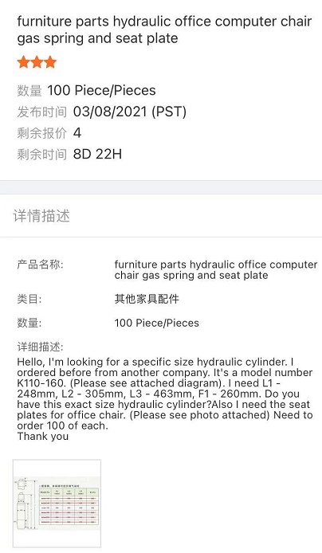
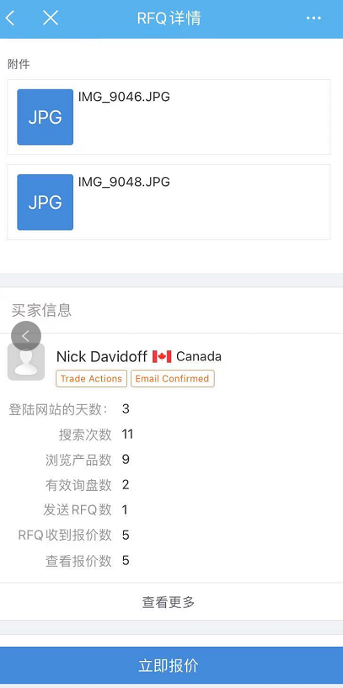
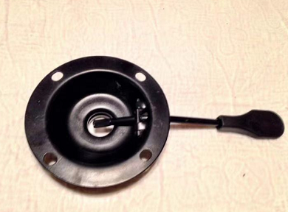
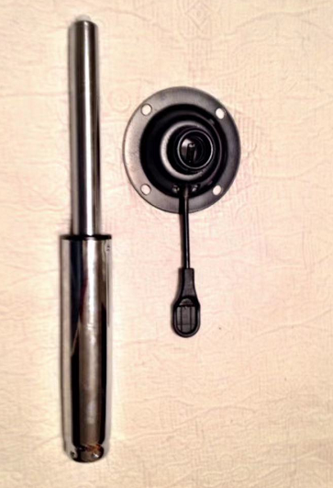
举 栗 子

Slide 6
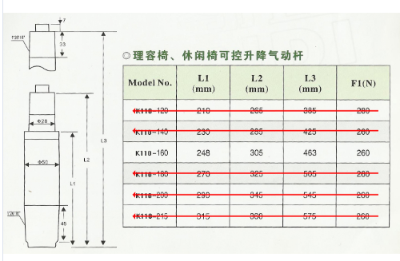

Slide 7
Dear 客户全名，
Wish you have a very nice day!
This is Lisa from Sudiyang, which has exported office chair parts for 16 years. It is vey nice to find your RFQ on 160mm gas spring and round mechanism. In order to quote you exact price including the shipping charge, please kindly help me confirm the following questions:
About gas spring:
1. We have class 1/2/3/4, which class you need?
About the round mechanism:
1. We have 1.5mm 2.0mm 2.5mm thickness, which thickness you need?
2. Normally we have 8*8 and 10*10, which hole-to-hole length you need?
As long as confirm all these information, I will offer you our best price based on 100pcs with shipping charge and lead time. Waiting for your reply sincerely. Thank you in advance.
Best Regards,
Lisa

