Slide 1
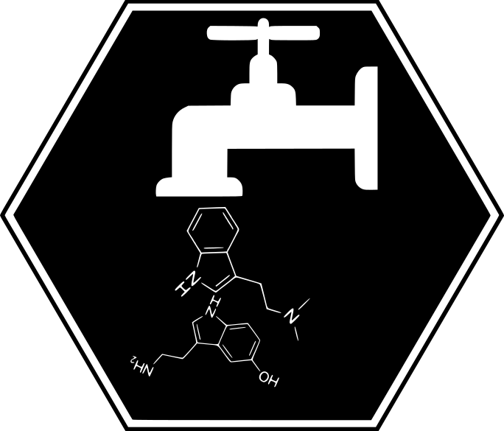
metaboPipe
A Modular Pipeline for Metabolomic Data Pretreatment
Eduard Pérez Méndez

Slide 2
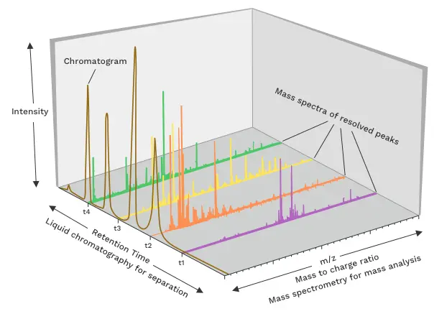
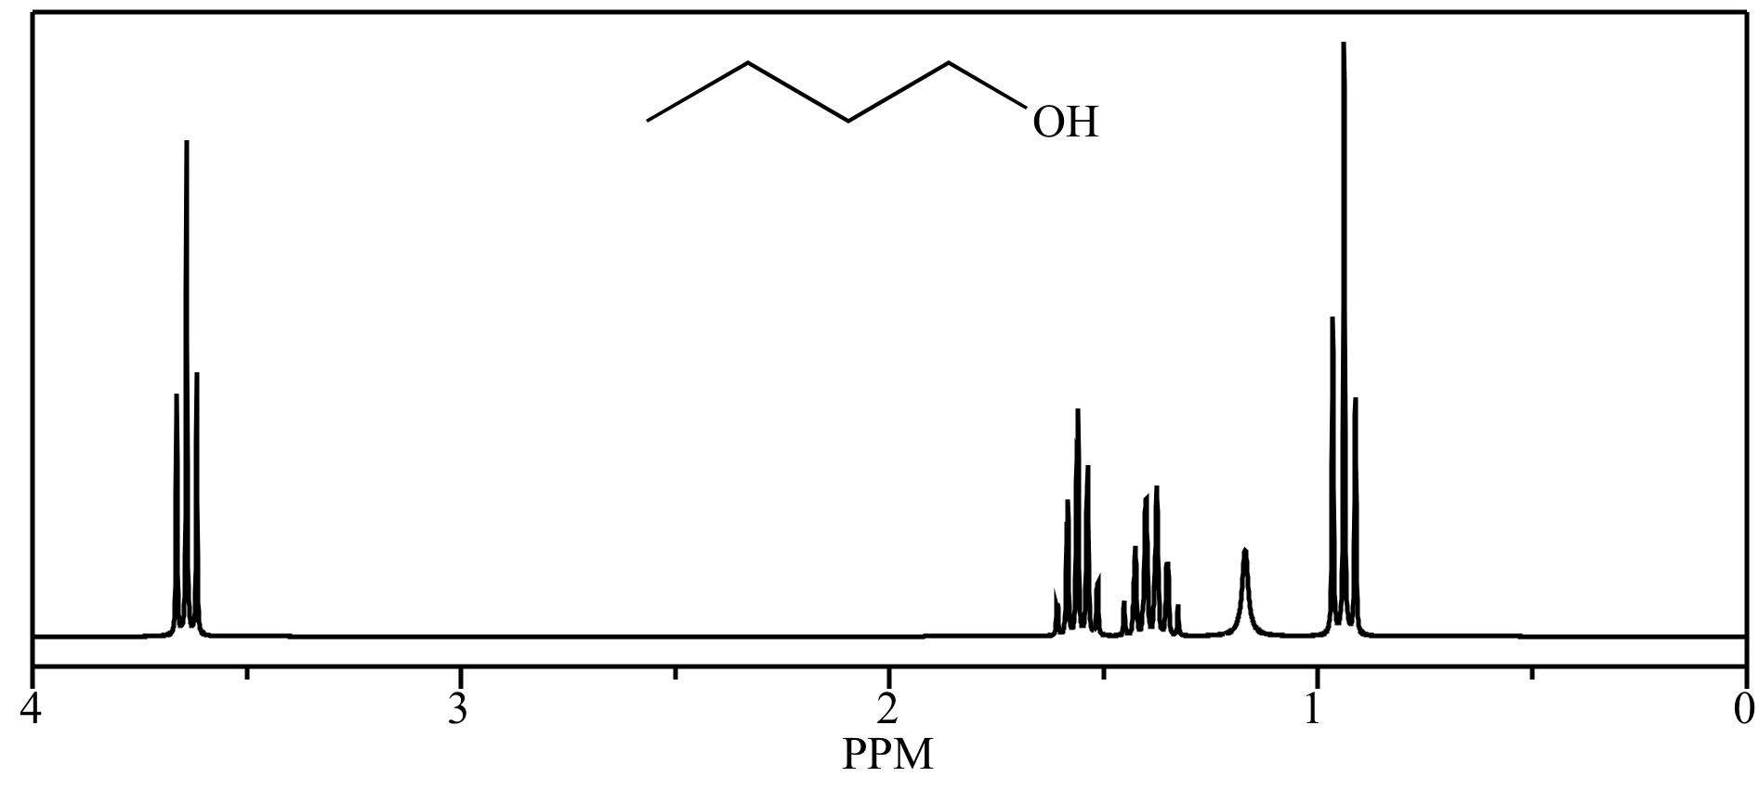
Introduction
MS
NMR

Slide 3

Introduction
MS
NMR
Preprocessing
Denoising
Baseline correction
Peak picking
Quality control
Peak alignment
Spectral binning
$$n×m$$ | $${Feature}_{1}$$ | $${Feature}_{2}$$ | $$⋯$$ | $${Feature}_{m}$$
$${Sample}_{1}$$
$${Sample}_{2}$$
$$⋮$$
$${Sample}_{n}$$

Slide 4

Introduction
MS
NMR
Preprocessing
$$n×m$$ | $${Feature}_{1}$$ | $${Feature}_{2}$$ | $$⋯$$ | $${Feature}_{m}$$
$${Sample}_{1}$$
$${Sample}_{2}$$
$$⋮$$
$${Sample}_{n}$$
Pretreatment
Imputation
Batch Correction
Filtering
Normalization
Scaling
Transformation

Slide 5
Introduction
MS
NMR
Preprocessing
Pretreatment
Imputation
Batch Correction
Filtering
Normalization
Scaling
Transformation

Slide 6
Introduction
MS
NMR
Preprocessing
Pretreatment
Filtering
Imputation
Scaling
Transformation
Batch Correction
Normalization

Slide 7
Introduction
MS
NMR
Preprocessing
Pretreatment
Filtering
Batch Correction
Imputation
Normalization
Transformation
Scaling
Ulaszewska, M. M., Weinert, C. H., Trimigno, A., Portmann, R., Andres Lacueva, C., Badertscher, R., Brennan, L., Brunius, C., Bub, A., Capozzi, F., Cialiè Rosso, M., Cordero, C. E., Daniel, H., Durand, S., Egert, B., Ferrario, P. G., Feskens, E. J. M., Franceschi, P., Garcia-Aloy, M., … Vergères, G. (2019). Nutrimetabolomics: An Integrative Action for Metabolomic Analyses in Human Nutritional Studies. Molecular Nutrition & Food Research, 63(1), 1800384. https://doi.org/10.1002/mnfr.201800384

Slide 8
Introduction
MS
NMR
Preprocessing
Pretreatment
Filtering
Imputation
Transformation
Scaling
Batch Correction
Normalization
Viallon, V., His, M., Rinaldi, S., Breeur, M., Gicquiau, A., Hemon, B., Overvad, K., Tjønneland, A., Rostgaard-Hansen, A. L., Rothwell, J. A., Lecuyer, L., Severi, G., Kaaks, R., Johnson, T., Schulze, M. B., Palli, D., Agnoli, C., Panico, S., Tumino, R., … Ferrari, P. (2021). A New Pipeline for the Normalization and Pooling of Metabolomics Data. Metabolites, 11(9), Article 9. https://doi.org/10.3390/metabo11090631

Slide 9
Introduction
MS
NMR
Preprocessing
Pretreatment
Filtering
Imputation
Transformation
Scaling
Normalization
Batch Correction

Slide 10
Introduction
Filtering
Imputation
Batch Correction
Normalization
Scaling
Transformation
Missing Values
Sample
Feature
Batch
Outliers
Arbitrary Value
LOD
Zero
Mean
Median
kNN
RF
SVD
qRILC
BPCA
PPCA
MI
Internal Standards
QC-RSC
ComBat
PCPR2
LOESS
CSN
PQN
QN
VLN
ISN
PCPR2
Unit Variance
Pareto
VAST
X-VAST
Level
Linear Baseline
Log Transformation
Power Transformation
VSN

Slide 11
Aims
Develop a new pipeline for the pretreatment of targeted metabolomic data with the aim of improving efficiency and modularity compared to existing pipelines. This new pipeline will be implemented in R

Slide 12
Aims
Design a new pipeline for the pretreatment of targeted metabolomic data
Implement the pretreatment pipeline for targeted metabolomic data in R

Slide 13












The Plan

Slide 14










The Plan

Slide 15
Materials and Methods

Slide 16
Results

Slide 17
Conclusion and Future Work
metaboPipe

Slide 18
metaboPipe
A Modular Pipeline for Metabolomic Data Pretreatment
Eduard Pérez Méndez

