Slide 1

metaboPipe
A Modular Pipeline for Metabolomic Data Pretreatment
Eduard Pérez Méndez

Slide 2
Introduction
Metabolomics

Slide 3
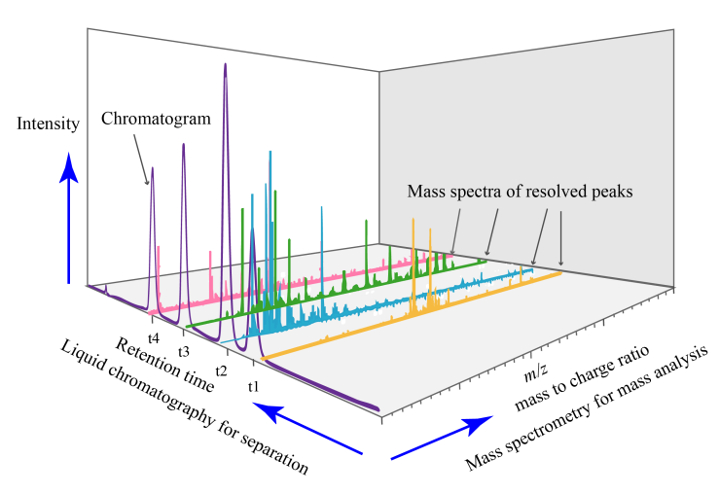
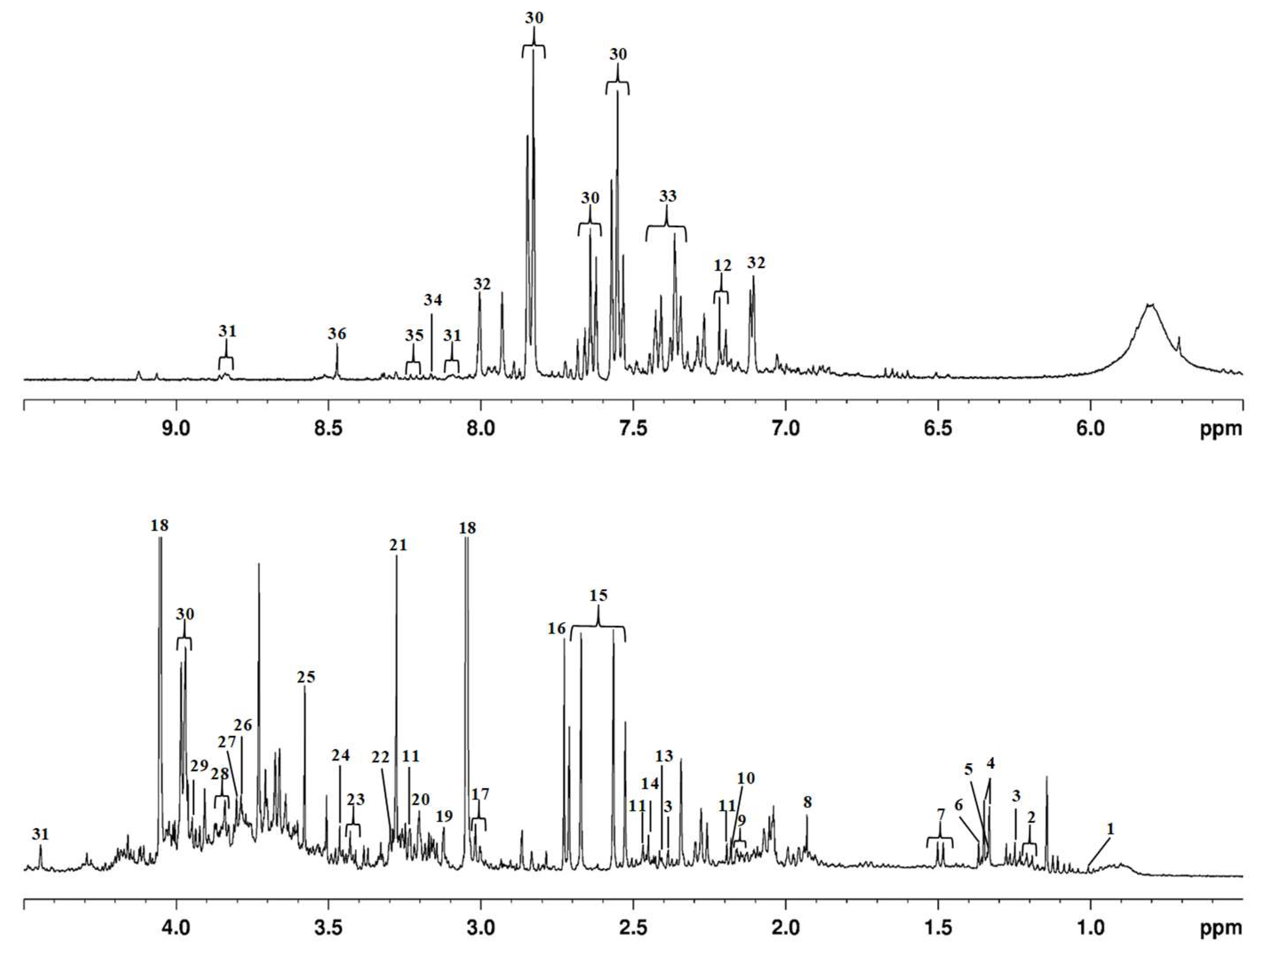
Introduction
MS
NMR
Recovered from: https://w.wiki/AN8Q. Under CC0 license
Silva, C. L., Olival, A., Perestrelo, R., Silva, P., Tomás, H., & Câmara, J. S. (2019). Untargeted Urinary 1H NMR-Based Metabolomic Pattern as a Potential Platform in Breast Cancer Detection. Metabolites, 9(11), Article 11. https://doi.org/10.3390/metabo9110269

Slide 4



Introduction
MS
NMR
Preprocessing
Denoising
Baseline correction
Peak picking
Quality control
Peak alignment
Spectral binning
$$n×m$$ | $${Feature}_{1}$$ | $${Feature}_{2}$$ | $$⋯$$ | $${Feature}_{m}$$
$${Sample}_{1}$$
$${Sample}_{2}$$
$$⋮$$
$${Sample}_{n}$$

Slide 5


Introduction
MS
NMR
Preprocessing
$$n×m$$ | $${Feature}_{1}$$ | $${Feature}_{2}$$ | $$⋯$$ | $${Feature}_{m}$$
$${Sample}_{1}$$
$${Sample}_{2}$$
$$⋮$$
$${Sample}_{n}$$
Pretreatment
$$n×m$$ | $${Feature}_{2}$$ | $${Feature}_{4}$$ | $$⋯$$ | $${Feature}_{m}$$
$${Sample}_{1}$$
$${Sample}_{3}$$
$$⋮$$
$${Sample}_{n}$$

Slide 6

Introduction
MS
NMR
Preprocessing
$$n×m$$ | $${Feature}_{1}$$ | $${Feature}_{2}$$ | $$⋯$$ | $${Feature}_{m}$$
$${Sample}_{1}$$
$${Sample}_{2}$$
$$⋮$$
$${Sample}_{n}$$
Pretreatment
Imputation
Batch Correction
Filtering
Normalization
Scaling
Transformation
$$n×m$$ | $${Feature}_{2}$$ | $${Feature}_{4}$$ | $$⋯$$ | $${Feature}_{m}$$
$${Sample}_{1}$$
$${Sample}_{3}$$
$$⋮$$
$${Sample}_{n}$$

Slide 7
Introduction
MS
NMR
Preprocessing
Pretreatment
Imputation
Batch Correction
Filtering
Normalization
Scaling
Transformation

Slide 8
Introduction
MS
NMR
Preprocessing
Pretreatment
Filtering
Imputation
Scaling
Transformation
Batch Correction
Normalization

Slide 9
Introduction
MS
NMR
Preprocessing
Pretreatment
Filtering
Batch Correction
Imputation
Normalization
Transformation
Scaling
Ulaszewska, M. M., Weinert, C. H., Trimigno, A., Portmann, R., Andres Lacueva, C., Badertscher, R., Brennan, L., Brunius, C., Bub, A., Capozzi, F., Cialiè Rosso, M., Cordero, C. E., Daniel, H., Durand, S., Egert, B., Ferrario, P. G., Feskens, E. J. M., Franceschi, P., Garcia-Aloy, M., … Vergères, G. (2019). Nutrimetabolomics: An Integrative Action for Metabolomic Analyses in Human Nutritional Studies. Molecular Nutrition & Food Research, 63(1), 1800384. https://doi.org/10.1002/mnfr.201800384

Slide 10
Introduction
MS
NMR
Preprocessing
Pretreatment
Filtering
Imputation
Transformation
Scaling
Batch Correction
Normalization
Viallon, V., His, M., Rinaldi, S., Breeur, M., Gicquiau, A., Hemon, B., Overvad, K., Tjønneland, A., Rostgaard-Hansen, A. L., Rothwell, J. A., Lecuyer, L., Severi, G., Kaaks, R., Johnson, T., Schulze, M. B., Palli, D., Agnoli, C., Panico, S., Tumino, R., … Ferrari, P. (2021). A New Pipeline for the Normalization and Pooling of Metabolomics Data. Metabolites, 11(9), Article 9. https://doi.org/10.3390/metabo11090631

Slide 11
Introduction
MS
NMR
Preprocessing
Pretreatment
Filtering
Imputation
Transformation
Scaling
Normalization
Batch Correction

Slide 12
Aims
Develop a new pipeline for the pretreatment of targeted metabolomic data with the aim of improving efficiency and modularity compared to existing pipelines. This new pipeline will be implemented in R

Slide 13
Aims
Design a new pipeline for the pretreatment of targeted metabolomic data
Implement the pretreatment pipeline for targeted metabolomic data in R

Slide 14












The Plan

Slide 15




The problem

Slide 16

The problem

Slide 17






The problem

Slide 18
The problem

Slide 19
The problem

Slide 20
The problem

Slide 21
The problem
MS
NMR
Preprocessing
Pretreatment
Filtering
Imputation
Scaling
Transformation
Batch Correction
Normalization

Slide 22
The problem
Filtering
Imputation
Batch Correction
Normalization
Scaling
Transformation
Missing Values
Sample
Feature
Batch
Outliers
Arbitrary Value
LOD
Zero
Mean
Median
kNN
RF
SVD
qRILC
BPCA
PPCA
MI
Internal Standards
QC-RSC
ComBat
PCPR2
LOESS
CSN
PQN
QN
VLN
ISN
PCPR2
Median
Sample Factor
Unit Variance
Pareto
Range
VAST
X-VAST
Level
Linear Baseline
Mean
Log Transformation
Power Transformation
VSN
Cubic Root

Slide 23
The problem
Filtering
Imputation
Batch Correction
Normalization
Scaling
Transformation
Missing Values
Sample
Feature
Batch
Outliers
Arbitrary Value
LOD
Zero
Mean
Median
kNN
RF
SVD
qRILC
BPCA
PPCA
MI
Internal Standards
QC-RSC
ComBat
PCPR2
LOESS
CSN
PQN
QN
VLN
ISN
PCPR2
Median
Sample Factor
Unit Variance
Pareto
Range
VAST
X-VAST
Level
Linear Baseline
Mean
Log Transformation
Power Transformation
VSN
Cubic Root

Slide 24
The problem
Filtering
Imputation
Batch Correction
Normalization
Scaling
Transformation
Missing Values
Sample
Feature
Batch
Outliers
Arbitrary Value
LOD
Zero
Mean
Median
kNN
RF
SVD
qRILC
BPCA
PPCA
MI
Internal Standards
QC-RSC
ComBat
PCPR2
LOESS
CSN
PQN
QN
VLN
ISN
PCPR2
Median
Sample Factor
Unit Variance
Pareto
Range
VAST
X-VAST
Level
Linear Baseline
Mean
Log Transformation
Power Transformation
VSN
Cubic Root

Slide 25
The problem
Filtering
Scaling
Imputation
Batch Correction
Normalization
Transformation
Missing Values
Sample
Feature
Batch
Outliers
Unit Variance
Pareto
Range
VAST
X-VAST
Level
Linear Baseline
Mean
Arbitrary Value
LOD
Zero
Mean
Median
kNN
RF
SVD
qRILC
BPCA
PPCA
MI
Internal Standards
QC-RSC
ComBat
PCPR2
LOESS
CSN
PQN
QN
VLN
ISN
PCPR2
Median
Sample Factor
Log Transformation
Power Transformation
VSN
Cubic Root

Slide 26
The problem
Filtering
Scaling
Imputation
Batch Correction
Normalization
Transformation
Missing Values
Sample
Feature
Batch
Outliers
Unit Variance
Pareto
Range
VAST
X-VAST
Level
Linear Baseline
Mean
Arbitrary Value
LOD
Zero
Mean
Median
kNN
RF
SVD
qRILC
BPCA
PPCA
MI
Internal Standards
QC-RSC
ComBat
PCPR2
LOESS
CSN
PQN
QN
VLN
ISN
PCPR2
Median
Sample Factor
Log Transformation
Power Transformation
VSN
Cubic Root

Slide 27
The problem
Filtering
Scaling
Imputation
Batch Correction
Normalization
Transformation
Missing Values
Sample
Feature
Batch
Outliers
Unit Variance
Pareto
Range
VAST
X-VAST
Level
Linear Baseline
Mean
Arbitrary Value
LOD
Zero
Mean
Median
kNN
RF
SVD
qRILC
BPCA
PPCA
MI
Internal Standards
QC-RSC
ComBat
PCPR2
LOESS
CSN
PQN
QN
VLN
ISN
PCPR2
Median
Sample Factor
Log Transformation
Power Transformation
VSN
Cubic Root

Slide 28
The problem
Filtering
Transformation
Imputation
Scaling
Batch Correction
Normalization
Missing Values
Sample
Feature
Batch
Outliers
Log Transformation
Power Transformation
VSN
Cubic Root
Arbitrary Value
LOD
Zero
Mean
Median
kNN
RF
SVD
qRILC
BPCA
PPCA
MI
Unit Variance
Pareto
Range
VAST
X-VAST
Level
Linear Baseline
Mean
Internal Standards
QC-RSC
ComBat
PCPR2
LOESS
CSN
PQN
QN
VLN
ISN
PCPR2
Median
Sample Factor

Slide 29
The problem
Filtering
Transformation
Imputation
Scaling
Batch Correction
Normalization
Missing Values
Sample
Feature
Batch
Outliers
Log Transformation
Power Transformation
VSN
Cubic Root
Arbitrary Value
LOD
Zero
Mean
Median
kNN
RF
SVD
qRILC
BPCA
PPCA
MI
Unit Variance
Pareto
Range
VAST
X-VAST
Level
Linear Baseline
Mean
Internal Standards
QC-RSC
ComBat
PCPR2
LOESS
CSN
PQN
QN
VLN
ISN
PCPR2
Median
Sample Factor

Slide 30


The problem
Filtering
Transformation
Imputation
Scaling
Batch Correction
$$n×m$$ | $${Feature}_{1}$$ | $${Feature}_{2}$$ | $$⋯$$ | $${Feature}_{m}$$
$${Sample}_{1}$$
$${Sample}_{2}$$
$$⋮$$
$${Sample}_{n}$$
Normalization
Missing Values
Sample
Feature
Batch
Outliers
Log Transformation
Power Transformation
VSN
Cubic Root
Arbitrary Value
LOD
Zero
Mean
Median
kNN
RF
SVD
qRILC
BPCA
PPCA
MI
Unit Variance
Pareto
Range
VAST
X-VAST
Level
Linear Baseline
Mean
Internal Standards
QC-RSC
ComBat
PCPR2
LOESS
CSN
PQN
QN
VLN
ISN
PCPR2
Median
Sample Factor
Not recommended when
$$n<50$$

Slide 31

The problem
Filtering
Transformation
Imputation
Scaling
Batch Correction
$$n×m$$ | $${Feature}_{1}$$ | $${Feature}_{2}$$ | $$⋯$$ | $${Feature}_{m}$$
$${Sample}_{1}$$
$${Sample}_{2}$$
$$⋮$$
$${Sample}_{n}$$
Normalization
Missing Values
Sample
Feature
Batch
Outliers
Log Transformation
Power Transformation
VSN
Cubic Root
Arbitrary Value
LOD
Zero
Mean
Median
kNN
RF
SVD
qRILC
BPCA
PPCA
MI
Unit Variance
Pareto
Range
VAST
X-VAST
Level
Linear Baseline
Mean
Internal Standards
QC-RSC
ComBat
PCPR2
LOESS
CSN
PQN
QN
VLN
ISN
PCPR2
Median
Sample Factor
Not recommended when
$$n<m$$

Slide 32
The problem
Filtering
Transformation
Imputation
Scaling
Batch Correction
Normalization
Missing Values
Sample
Feature
Batch
Outliers
Log Transformation
Power Transformation
VSN
Cubic Root
Arbitrary Value
LOD
Zero
Mean
Median
kNN
RF
SVD
qRILC
BPCA
PPCA
MI
Unit Variance
Pareto
Range
VAST
X-VAST
Level
Linear Baseline
Mean
Internal Standards
QC-RSC
ComBat
PCPR2
LOESS
CSN
PQN
QN
VLN
ISN
PCPR2
Median
Sample Factor

Slide 33
The problem
Filtering
Transformation
Imputation
Scaling
Batch Correction
Normalization
Missing Values
Sample
Feature
Batch
Outliers
Log Transformation
Power Transformation
VSN
Cubic Root
Arbitrary Value
LOD
Zero
Mean
Median
kNN
RF
SVD
qRILC
BPCA
PPCA
MI
Unit Variance
Pareto
Range
VAST
X-VAST
Level
Linear Baseline
Mean
Internal Standards
QC-RSC
ComBat
PCPR2
LOESS
CSN
PQN
QN
VLN
ISN
PCPR2
Median
Sample Factor

Slide 34
The problem
Filtering
Transformation
Imputation
Scaling
Batch Correction
Normalization
Missing Values
Sample
Feature
Batch
Outliers
Log Transformation
Power Transformation
VSN
Cubic Root
Arbitrary Value
LOD
Zero
Mean
Median
kNN
RF
SVD
qRILC
BPCA
PPCA
MI
Unit Variance
Pareto
Range
VAST
X-VAST
Level
Linear Baseline
Mean
Internal Standards
QC-RSC
ComBat
PCPR2
LOESS
CSN
PQN
QN
VLN
ISN
PCPR2
Median
Sample Factor

Slide 35
The problem
Filtering
Batch Correction
Imputation
Normalization
Transformation
Scaling
Missing Values
Sample
Feature
Batch
Outliers
Internal Standards
QC-RSC
ComBat
PCPR2
LOESS
Arbitrary Value
LOD
Zero
Mean
Median
kNN
RF
SVD
qRILC
BPCA
PPCA
MI
CSN
PQN
QN
VLN
ISN
PCPR2
Median
Sample Factor
Log Transformation
Power Transformation
VSN
Cubic Root
Unit Variance
Pareto
Range
VAST
X-VAST
Level
Linear Baseline
Mean

Slide 36
The problem
Filtering
Imputation
Batch Correction
Normalization
Transformation
Scaling
Missing Values
Sample
Feature
Batch
Outliers
Arbitrary Value
LOD
Zero
Mean
Median
kNN
RF
SVD
qRILC
BPCA
PPCA
MI
Internal Standards
QC-RSC
ComBat
PCPR2
LOESS
CSN
PQN
QN
VLN
ISN
PCPR2
Median
Sample Factor
Log Transformation
Power Transformation
VSN
Cubic Root
Unit Variance
Pareto
Range
VAST
X-VAST
Level
Linear Baseline
Mean

Slide 37
Materials and Methods

Slide 38



Materials and Methods

Slide 39




Materials and Methods
20 years
“metabolomics”, “nutrimetabolomics”, “targeted metabolomics”, “preprocessing”, “pretreatment”, “pipeline”
MTBLS79:
Kirwan, J. A., Weber, R. J. M., Broadhurst, D. I. & Viant, M. R. Direct Infusion MassSpectrometry Metabolomics Dataset: A Benchmark for Data Processing and QualityControl. Scientific Data 1, 140012. ISSN: 2052‑4463 (June 10, 2014)
ST000284:
Zhu, J. et al. Colorectal Cancer Detection Using Targeted Serum Metabolic Profiling. Jour‑nal of Proteome Research 13, 4120–4130. ISSN: 1535‑3907. pmid: 25126899 (Sept. 5, 2014).

Slide 40
Materials and Methods
Package | Version
BiocFileCache | 2.10.2
BiocStyle | 2.30.0
caret | 6.0.94
ComplexHeatmap | 2.18.0
cowplot | 1.1.3
crew | 0.9.2
data.table | 1.15.4
dplyr | 1.1.4
DT | 0.33
fst | 0.9.8
ggforce | 0.4.2
ggplot2 | 3.5.1
gridExtra | 2.3
HotellingEllipse | 1.1.0
impute | 1.76.0
imputeLCMD | 2.1
knitr | 1.47
limma | 3.58.1
MetaboAnalystR | 4.0.0
Package | Version
missForest | 1.5
openxlsx | 4.2.5.2
pcaMethods | 1.94.0
pcpr2 | 0.0.0.1
pmp | 1.14.1
purrr | 1.0.2
renv | 1.0.7
reshape2 | 1.4.4
rmarkdown | 2.27
ropls | 1.34.0
shiny | 1.8.1.1
shinyFiles | 0.9.3
struct | 1.14.1
structToolbox | 1.14.0
SummarizedExperiment | 1.32.0
sva | 3.50.0
tarchetypes | 0.9.0
targets | 1.7.0
testthat | 3.2.1.1
Package | Version
tidyverse | 2.0.0
tinytex | 0.51
tools | 4.3.3
usethis | 2.2.3
VIM | 6.2.2
withr | 3.0.0

Slide 41
Materials and Methods
Package | Version
BiocFileCache | 2.10.2
BiocStyle | 2.30.0
caret | 6.0.94
ComplexHeatmap | 2.18.0
cowplot | 1.1.3
crew | 0.9.2
data.table | 1.15.4
dplyr | 1.1.4
DT | 0.33
fst | 0.9.8
ggforce | 0.4.2
ggplot2 | 3.5.1
gridExtra | 2.3
HotellingEllipse | 1.1.0
impute | 1.76.0
imputeLCMD | 2.1
knitr | 1.47
limma | 3.58.1
MetaboAnalystR | 4.0.0
Package | Version
missForest | 1.5
openxlsx | 4.2.5.2
pcaMethods | 1.94.0
pcpr2 | 0.0.0.1
pmp | 1.14.1
purrr | 1.0.2
renv | 1.0.7
reshape2 | 1.4.4
rmarkdown | 2.27
ropls | 1.34.0
shiny | 1.8.1.1
shinyFiles | 0.9.3
struct | 1.14.1
structToolbox | 1.14.0
SummarizedExperiment | 1.32.0
sva | 3.50.0
tarchetypes | 0.9.0
targets | 1.7.0
testthat | 3.2.1.1
Package | Version
tidyverse | 2.0.0
tinytex | 0.51
tools | 4.3.3
usethis | 2.2.3
VIM | 6.2.2
withr | 3.0.0
structToolbox
targets

Slide 42
Results

Slide 43
Results
=
metaboPipe

Slide 44
Results
metaboPipe

Slide 45
Results
structToolbox
targets
metaboPipe

Slide 46



Results
structToolbox
DatasetExperiment
data
sample_meta
variable_meta
$$n×m$$ | $${Feature}_{1}$$ | $${Feature}_{2}$$ | $$⋯$$ | $${Feature}_{m}$$
$${Sample}_{1}$$
$${Sample}_{2}$$
$$⋮$$
$${Sample}_{n}$$
targets
$$n×p$$ | $${Factor}_{1}$$ | $${Factor}_{2}$$ | $$⋯$$ | $${Factor}_{p}$$
$${Sample}_{1}$$
$${Sample}_{2}$$
$$⋮$$
$${Sample}_{n}$$
$$m×q$$ | $${Factor}_{1}$$ | $${Factor}_{2}$$ | $$⋯$$ | $${Factor}_{q}$$
$${Feature}_{1}$$
$${Feature}_{2}$$
$$⋮$$
$${Feature}_{n}$$

Slide 47




Results
structToolbox
Targets
DatasetExperiment
sample_meta
data
variable_meta

Slide 48




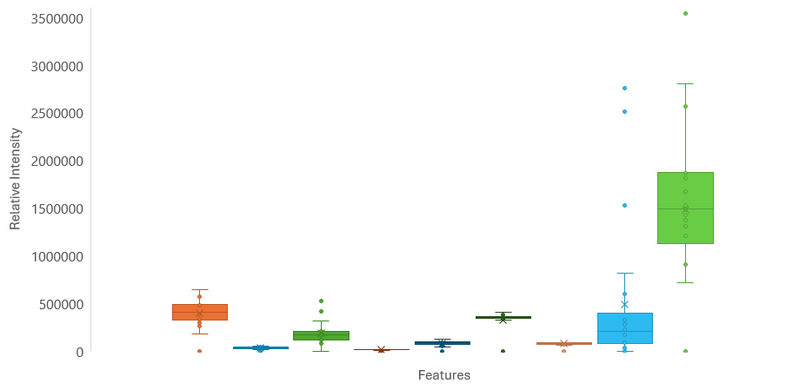
Results
structToolbox
Targets
DatasetExperiment

Slide 49
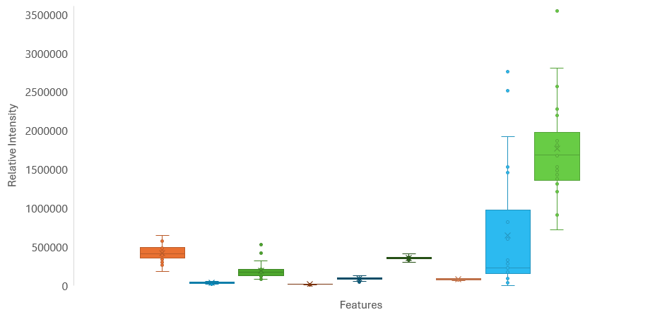
Results
structToolbox
Targets
DatasetExperiment

Slide 50
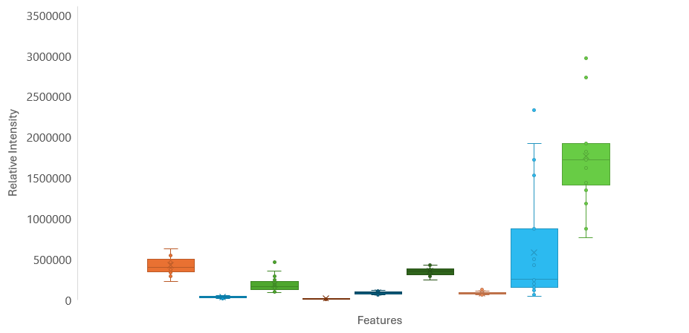
Results
structToolbox
Targets
DatasetExperiment

Slide 51
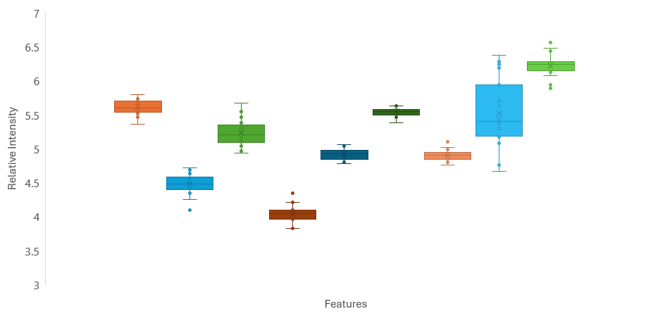

Results
structToolbox
Targets
DatasetExperiment

Slide 52
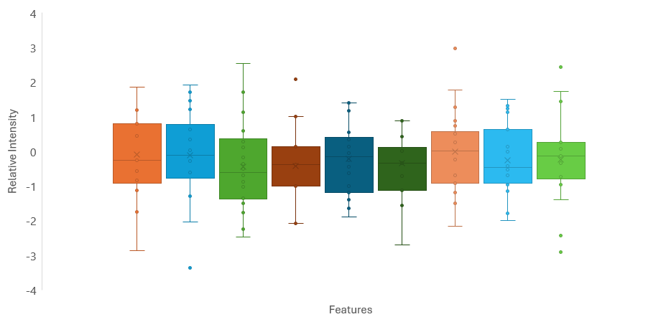
Results
structToolbox
Targets
DatasetExperiment

Slide 53
Results
structToolbox
Targets
DatasetExperiment

Slide 54
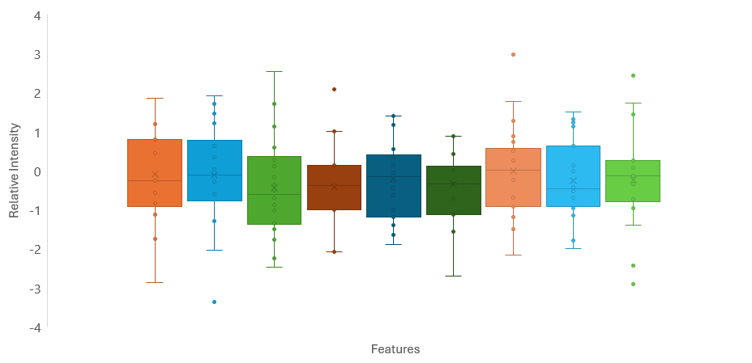
Results
structToolbox
Targets
DatasetExperiment

Slide 55
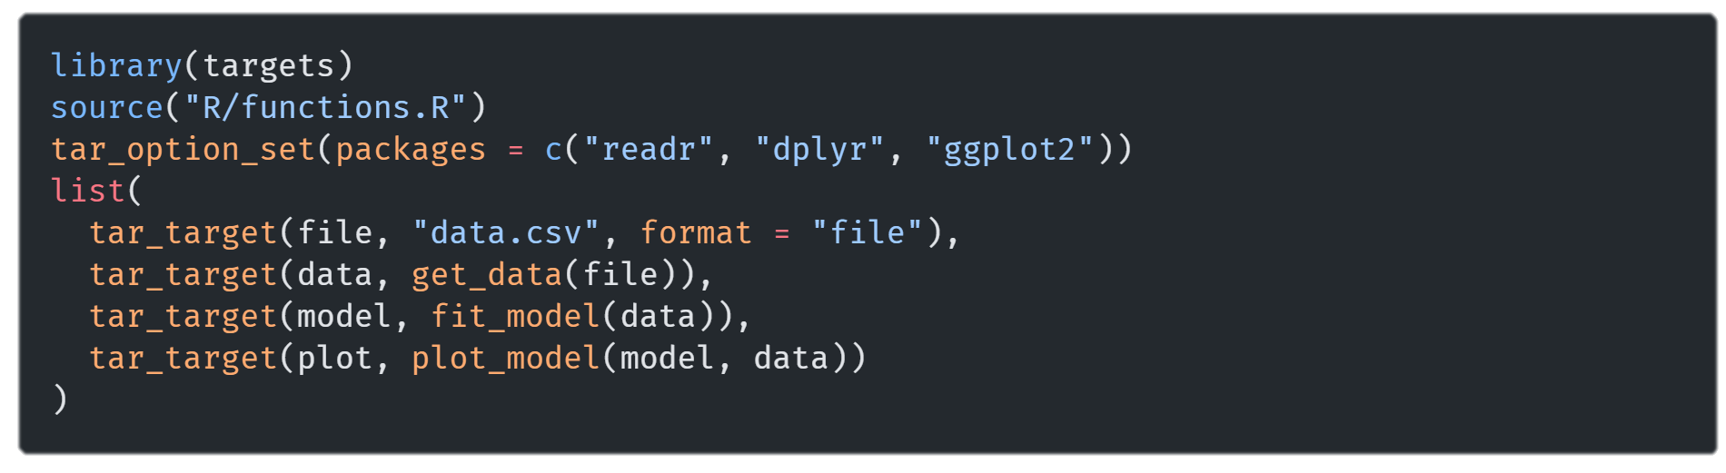
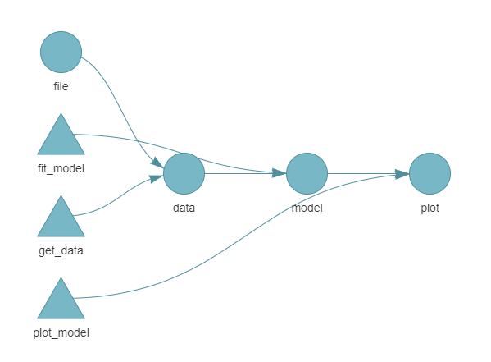
Results
Targets

Slide 56
Results
Targets

Slide 57
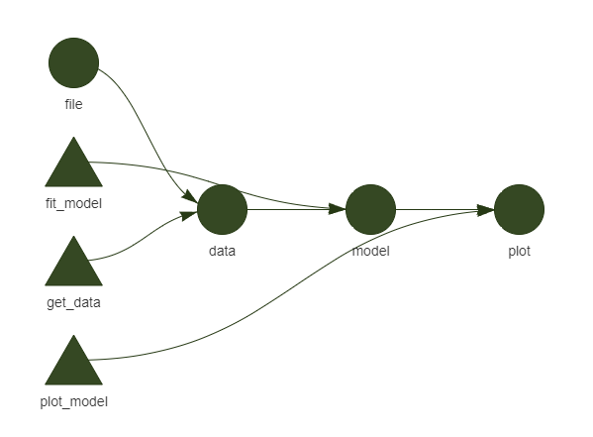
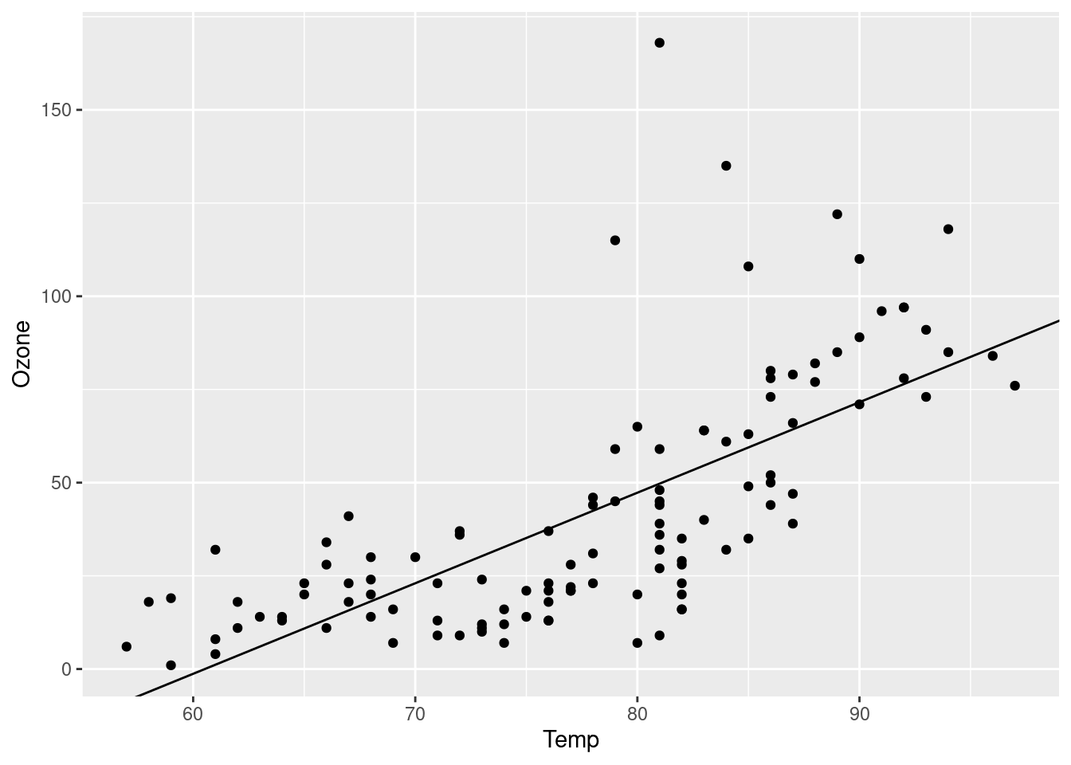
Results
Targets

Slide 58
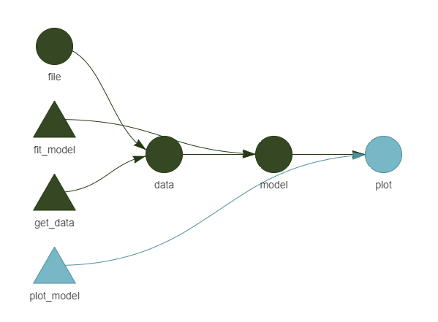
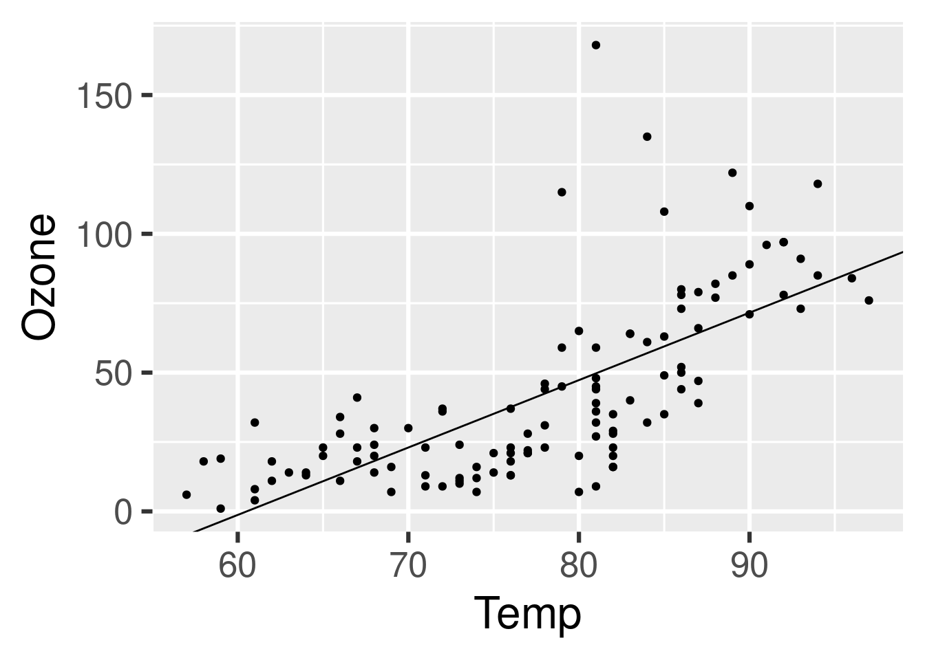
Results
Targets

Slide 59
Results
Filtering
Imputation
Batch Correction
Normalization
Transformation
Scaling
Missing Values
Sample
Feature
Batch
Outliers
Arbitrary Value
LOD
Zero
Mean
Median
kNN
RF
SVD
qRILC
BPCA
PPCA
MI
Internal Standards
QC-RSC
ComBat
PCPR2
LOESS
CSN
PQN
QN
VLN
ISN
PCPR2
Median
Sample Factor
Log Transformation
Power Transformation
VSN
Cubic Root
Unit Variance
Pareto
Range
VAST
X-VAST
Level
Linear Baseline
Mean

Slide 60
Results
Filtering
Imputation
Batch Correction
Normalization
Transformation
Scaling
Missing Values
Outliers
Mean
Median
kNN
RF
SVD
qRILC
BPCA
PPCA
QC-RSC
ComBat
CSN
QN
ISN
Median
Sample Factor
Log Transformation
Cubic Root
Unit Variance
Pareto
Range
Mean
Notes:
Modificar imputation tiempo

Slide 61
Results
Filtering
Imputation
Batch Correction
Normalization
Transformation
Scaling
Notes:
Modificar imputation tiempo

Slide 62

Results
Filtering
Imputation
Batch Correction
Normalization
Transformation
Scaling
Utils
Notes:
Modificar imputation tiempo

Slide 63
Results
Filtering
Imputation
Batch Correction
Normalization
Transformation
Scaling
Utils
Notes:
Modificar imputation tiempo

Slide 64


Results
Filtering
Imputation
Batch Correction
Normalization
Transformation
Scaling
Utils
Create DatasetExperiment
DatasetExperiment Object
Notes:
Modificar imputation tiempo

Slide 65
Results
Filtering
Imputation
Batch Correction
Normalization
Transformation
Scaling
Utils
Create DatasetExperiment
DE
Notes:
Modificar imputation tiempo

Slide 66
Results
Filtering
Imputation
Batch Correction
Normalization
Transformation
Scaling
Utils
Create DatasetExperiment
DE
Notes:
Modificar imputation tiempo

Slide 67
Results
Filtering
Imputation
Batch Correction
Normalization
Transformation
Scaling
Utils
Create DatasetExperiment
DE
Notes:
Modificar imputation tiempo

Slide 68
Results
Filtering
Imputation
Batch Correction
Normalization
Transformation
Scaling
Utils
Utils
Create DE
Create DE
Notes:
Modificar imputation tiempo

Slide 69
Results
Filtering
Imputation
Batch Correction
Normalization
Transformation
Scaling
Utils
Create DE
Utils
Notes:
Modificar imputation tiempo

Slide 70
Results
Filtering
Imputation
Batch Correction
Normalization
Transformation
Scaling
Utils
Utils
Create DE
Notes:
Modificar imputation tiempo

Slide 71
Results
Filtering
Scaling
Filtering
Imputation
Batch Correction
Normalization
Transformation
Utils
Threshold 0.2
Threshold 0.2
Outliers
Outliers
Utils
Create DE
Notes:
Modificar imputation tiempo

Slide 72
Results
Filtering
Imputation
Scaling
Imputation
Batch Correction
Normalization
Transformation
Utils
kNN k = 5
kNN k = 5
Utils
Filtering
Create DE
Threshold 0.2
Outliers
Notes:
Modificar imputation tiempo

Slide 73
Results
Batch Correction
Scaling
Filtering
Imputation
Batch Correction
Batch Correction
Normalization
Transformation
Utils
ComBat
ComBat
QC-RSC
Utils
Filtering
Imputation
Imputation
Create DE
Threshold 0.2
kNN k = 5
Outliers
kNN k = 5
Notes:
Modificar imputation tiempo

Slide 74
Results
Filtering
Imputation
Batch Correction
Scaling
Batch Correction
Normalization
Transformation
Utils
QC-RSC
QC-RSC
Utils
Filtering
Imputation
Batch Correction
Imputation
Imputation
Create DE
Threshold 0.2
kNN k = 5
kNN k = 5
Outliers
kNN k = 5
ComBat
Notes:
Modificar imputation tiempo

Slide 75
Results
Scaling
Filtering
Imputation
Batch Correction
Normalization
Transformation
Scaling
Normalization
Transformation
Scaling
Utils
Normalization
Transformation
ISN = Creatine
Log
Autoscaling
ISN = Creatine
Log
Autoscaling
ISN = Creatine
Log
Autoscaling
Batch Correction
Imputation
Utils
Filtering
QC-RSC
kNN k = 5
Create DE
Threshold 0.2
Outliers
Imputation
Batch Correction
Imputation
kNN k = 5
kNN k = 5
ComBat
Notes:
Modificar imputation tiempo

Slide 76
Results
Filtering
Imputation
Batch Correction
Normalization
Transformation
Scaling
Utils
Batch Correction
Imputation
Normalization
Transformation
Scaling
QC-RSC
kNN k = 5
ISN = Creatine
Log
Autoscaling
Utils
Filtering
Create DE
Threshold 0.2
Outliers
Imputation
Batch Correction
Normalization
Transformation
Scaling
Imputation
kNN k = 5
ISN = Creatine
Log
Autoscaling
kNN k = 5
ComBat
Notes:
Modificar imputation tiempo

Slide 77
Results
Filtering
Imputation
Batch Correction
Normalization
Transformation
Scaling
Utils
Normalization
Transformation
Scaling
Batch Correction
Imputation
Normalization
Transformation
Scaling
Imputation
ISN = Creatine
Log
Autoscaling
RF
ISN = Creatine
Log
Autoscaling
QC-RSC
kNN k = 5
Utils
Filtering
Create DE
Threshold 0.2
Outliers
Imputation
Batch Correction
Normalization
Transformation
Scaling
Imputation
kNN k = 5
ISN = Creatine
Log
Autoscaling
kNN k = 5
ComBat
Notes:
Modificar imputation tiempo

Slide 78
Results
Filtering
Imputation
Batch Correction
Normalization
Transformation
Scaling
Utils
Imputation
Normalization
Transformation
Scaling
RF
ISN = Creatine
Log
Autoscaling
Batch Correction
Imputation
Normalization
Transformation
Scaling
QC-RSC
kNN k = 5
ISN = Creatine
Log
Autoscaling
Utils
Filtering
Create DE
Threshold 0.2
Outliers
Imputation
Batch Correction
Normalization
Transformation
Scaling
Imputation
kNN k = 5
ISN = Creatine
Log
Autoscaling
kNN k = 5
ComBat
Notes:
Modificar imputation tiempo

Slide 79
Results
Filtering
Imputation
Batch Correction
Normalization
Transformation
Scaling
Utils
Imputation
Normalization
Transformation
Scaling
RF
ISN = Creatine
Log
Autoscaling
Batch Correction
Imputation
Normalization
Transformation
Scaling
QC-RSC
kNN k = 5
ISN = Creatine
Log
Autoscaling
Utils
Filtering
Create DE
Threshold 0.2
Outliers
Scaling
Transformation
Scaling
Normalization
Transformation
Imputation
Batch Correction
Normalization
Imputation
Autoscaling
Log
Autoscaling
ISN = Creatine
Log
kNN k = 5
ISN = Creatine
kNN k = 5
ComBat
Notes:
Modificar imputation tiempo

Slide 80
Results
Filtering
Imputation
Batch Correction
Normalization
Transformation
Scaling
Utils
Imputation
Normalization
Transformation
Scaling
RF
ISN = Creatine
Log
Autoscaling
Batch Correction
Imputation
Normalization
Transformation
Scaling
QC-RSC
kNN k = 5
ISN = Creatine
Log
Autoscaling
Utils
Filtering
Create DE
Threshold 0.2
Outliers
Imputation
Batch Correction
Normalization
Transformation
Scaling
Imputation
kNN k = 5
ISN = Creatine
Log
Autoscaling
kNN k = 5
ComBat
Scaling
Normalization
Transformation
Autoscaling
ISN = Creatine
Log
Notes:
Modificar imputation tiempo

Slide 81
Results
Filtering
Imputation
Batch Correction
Normalization
Transformation
Scaling
Notes:
Modificar imputation tiempo

Slide 82
Results

Slide 83
Materials and Methods

Slide 84
Results

Slide 85
Conclusion and Future Work
metaboPipe

Slide 86
metaboPipe
A Modular Pipeline for Metabolomic Data Pretreatment
Eduard Pérez Méndez

