Slide 1

metaboPipe
A Modular Pipeline for Metabolomic Data Pretreatment
Eduard Pérez Méndez

Slide 2
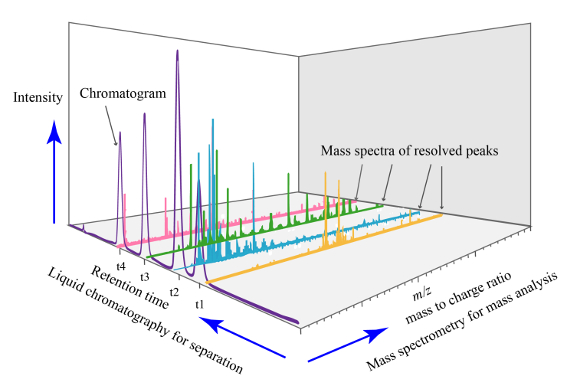
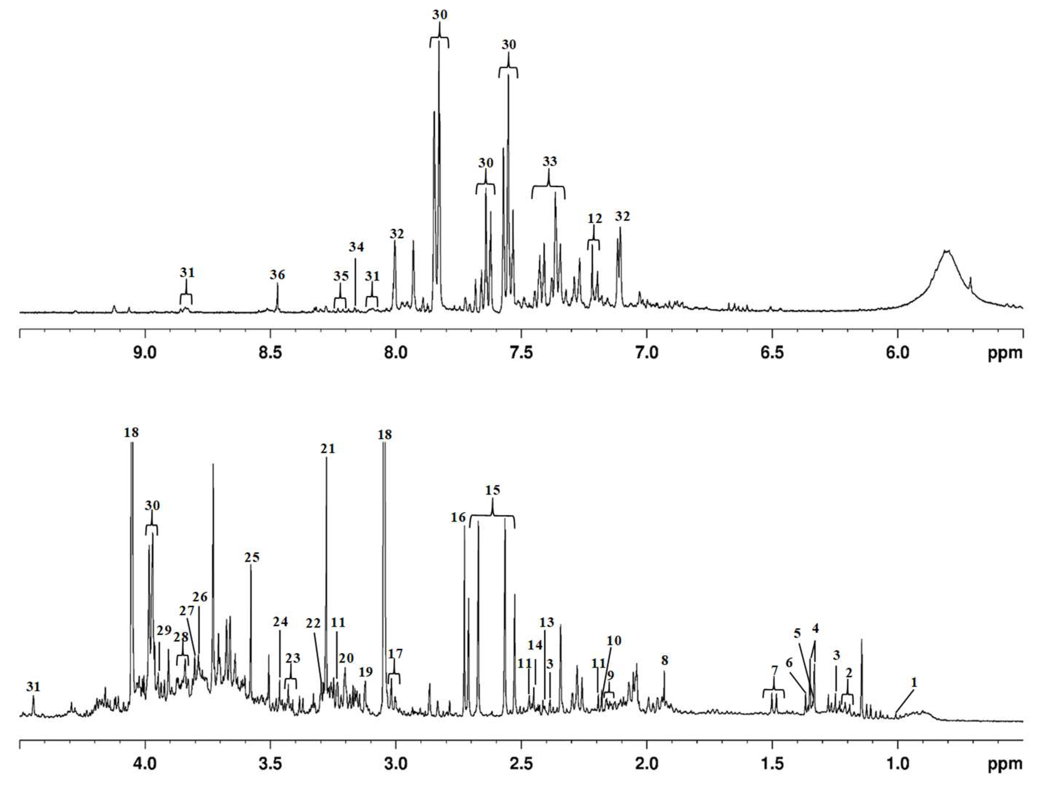
Introduction
MS
NMR
Recovered from: https://w.wiki/AN8Q. Under CC0 license
Silva, C. L., Olival, A., Perestrelo, R., Silva, P., Tomás, H., & Câmara, J. S. (2019). Untargeted Urinary 1H NMR-Based Metabolomic Pattern as a Potential Platform in Breast Cancer Detection. Metabolites, 9(11), Article 11. https://doi.org/10.3390/metabo9110269

Slide 3



Introduction
MS
NMR
Preprocessing
Denoising
Baseline correction
Peak picking
Quality control
Peak alignment
Spectral binning
$$n×m$$ | $${Feature}_{1}$$ | $${Feature}_{2}$$ | $$⋯$$ | $${Feature}_{m}$$
$${Sample}_{1}$$
$${Sample}_{2}$$
$$⋮$$
$${Sample}_{n}$$

Slide 4


Introduction
MS
NMR
Preprocessing
$$n×m$$ | $${Feature}_{1}$$ | $${Feature}_{2}$$ | $$⋯$$ | $${Feature}_{m}$$
$${Sample}_{1}$$
$${Sample}_{2}$$
$$⋮$$
$${Sample}_{n}$$
Pretreatment
$$n×m$$ | $${Feature}_{2}$$ | $${Feature}_{4}$$ | $$⋯$$ | $${Feature}_{m}$$
$${Sample}_{1}$$
$${Sample}_{3}$$
$$⋮$$
$${Sample}_{n}$$

Slide 5

Introduction
MS
NMR
Preprocessing
$$n×m$$ | $${Feature}_{1}$$ | $${Feature}_{2}$$ | $$⋯$$ | $${Feature}_{m}$$
$${Sample}_{1}$$
$${Sample}_{2}$$
$$⋮$$
$${Sample}_{n}$$
Pretreatment
Imputation
Batch Correction
Filtering
Normalization
Scaling
Transformation
$$n×m$$ | $${Feature}_{2}$$ | $${Feature}_{4}$$ | $$⋯$$ | $${Feature}_{m}$$
$${Sample}_{1}$$
$${Sample}_{3}$$
$$⋮$$
$${Sample}_{n}$$

Slide 6
Introduction
MS
NMR
Preprocessing
Pretreatment
Imputation
Batch Correction
Filtering
Normalization
Scaling
Transformation

Slide 7
Introduction
MS
NMR
Preprocessing
Pretreatment
Filtering
Imputation
Scaling
Transformation
Batch Correction
Normalization

Slide 8
Introduction
MS
NMR
Preprocessing
Pretreatment
Filtering
Batch Correction
Imputation
Normalization
Transformation
Scaling
Ulaszewska, M. M., Weinert, C. H., Trimigno, A., Portmann, R., Andres Lacueva, C., Badertscher, R., Brennan, L., Brunius, C., Bub, A., Capozzi, F., Cialiè Rosso, M., Cordero, C. E., Daniel, H., Durand, S., Egert, B., Ferrario, P. G., Feskens, E. J. M., Franceschi, P., Garcia-Aloy, M., … Vergères, G. (2019). Nutrimetabolomics: An Integrative Action for Metabolomic Analyses in Human Nutritional Studies. Molecular Nutrition & Food Research, 63(1), 1800384. https://doi.org/10.1002/mnfr.201800384

Slide 9
Introduction
MS
NMR
Preprocessing
Pretreatment
Filtering
Imputation
Transformation
Scaling
Batch Correction
Normalization
Viallon, V., His, M., Rinaldi, S., Breeur, M., Gicquiau, A., Hemon, B., Overvad, K., Tjønneland, A., Rostgaard-Hansen, A. L., Rothwell, J. A., Lecuyer, L., Severi, G., Kaaks, R., Johnson, T., Schulze, M. B., Palli, D., Agnoli, C., Panico, S., Tumino, R., … Ferrari, P. (2021). A New Pipeline for the Normalization and Pooling of Metabolomics Data. Metabolites, 11(9), Article 9. https://doi.org/10.3390/metabo11090631

Slide 10
Introduction
MS
NMR
Preprocessing
Pretreatment
Filtering
Imputation
Transformation
Scaling
Normalization
Batch Correction

Slide 11
Aims
Develop a new pipeline for the pretreatment of targeted metabolomic data with the aim of improving efficiency and modularity compared to existing pipelines. This new pipeline will be implemented in R

Slide 12
Aims
Design a new pipeline for the pretreatment of targeted metabolomic data
Implement the pretreatment pipeline for targeted metabolomic data in R

Slide 13












The Plan

Slide 14




The problem

Slide 15

The problem

Slide 16






The problem

Slide 17
The problem

Slide 18
The problem

Slide 19
The problem

Slide 20
The problem
MS
NMR
Preprocessing
Pretreatment
Filtering
Imputation
Scaling
Transformation
Batch Correction
Normalization

Slide 21
The problem
Filtering
Imputation
Batch Correction
Normalization
Scaling
Transformation
Missing Values
Sample
Feature
Batch
Outliers
Arbitrary Value
LOD
Zero
Mean
Median
kNN
RF
SVD
qRILC
BPCA
PPCA
MI
Internal Standards
QC-RSC
ComBat
PCPR2
LOESS
CSN
PQN
QN
VLN
ISN
PCPR2
Unit Variance
Pareto
VAST
X-VAST
Level
Linear Baseline
Log Transformation
Power Transformation
VSN

Slide 22
The problem
Filtering
Imputation
Batch Correction
Normalization
Scaling
Transformation
Missing Values
Sample
Feature
Batch
Outliers
Arbitrary Value
LOD
Zero
Mean
Median
kNN
RF
SVD
qRILC
BPCA
PPCA
MI
Internal Standards
QC-RSC
ComBat
PCPR2
LOESS
CSN
PQN
QN
VLN
ISN
PCPR2
Unit Variance
Pareto
VAST
X-VAST
Level
Linear Baseline
Log Transformation
Power Transformation
VSN

Slide 23
The problem
Filtering
Imputation
Batch Correction
Normalization
Scaling
Transformation
Missing Values
Sample
Feature
Batch
Outliers
Arbitrary Value
LOD
Zero
Mean
Median
kNN
RF
SVD
qRILC
BPCA
PPCA
MI
Internal Standards
QC-RSC
ComBat
PCPR2
LOESS
CSN
PQN
QN
VLN
ISN
PCPR2
Unit Variance
Pareto
VAST
X-VAST
Level
Linear Baseline
Log Transformation
Power Transformation
VSN

Slide 24
The problem
Filtering
Scaling
Imputation
Batch Correction
Normalization
Transformation
Missing Values
Sample
Feature
Batch
Outliers
Unit Variance
Pareto
VAST
X-VAST
Level
Linear Baseline
Arbitrary Value
LOD
Zero
Mean
Median
kNN
RF
SVD
qRILC
BPCA
PPCA
MI
Internal Standards
QC-RSC
ComBat
PCPR2
LOESS
CSN
PQN
QN
VLN
ISN
PCPR2
Log Transformation
Power Transformation
VSN

Slide 25
The problem
Filtering
Scaling
Imputation
Batch Correction
Normalization
Transformation
Missing Values
Sample
Feature
Batch
Outliers
Unit Variance
Pareto
VAST
X-VAST
Level
Linear Baseline
Arbitrary Value
LOD
Zero
Mean
Median
kNN
RF
SVD
qRILC
BPCA
PPCA
MI
Internal Standards
QC-RSC
ComBat
PCPR2
LOESS
CSN
PQN
QN
VLN
ISN
PCPR2
Log Transformation
Power Transformation
VSN

Slide 26
The problem
Filtering
Scaling
Imputation
Batch Correction
Normalization
Transformation
Missing Values
Sample
Feature
Batch
Outliers
Unit Variance
Pareto
VAST
X-VAST
Level
Linear Baseline
Arbitrary Value
LOD
Zero
Mean
Median
kNN
RF
SVD
qRILC
BPCA
PPCA
MI
Internal Standards
QC-RSC
ComBat
PCPR2
LOESS
CSN
PQN
QN
VLN
ISN
PCPR2
Log Transformation
Power Transformation
VSN

Slide 27
The problem
Filtering
Transformation
Imputation
Scaling
Batch Correction
Normalization
Missing Values
Sample
Feature
Batch
Outliers
Log Transformation
Power Transformation
VSN
Arbitrary Value
LOD
Zero
Mean
Median
kNN
RF
SVD
qRILC
BPCA
PPCA
MI
Unit Variance
Pareto
VAST
X-VAST
Level
Linear Baseline
Internal Standards
QC-RSC
ComBat
PCPR2
LOESS
CSN
PQN
QN
VLN
ISN
PCPR2

Slide 28
The problem
Filtering
Transformation
Imputation
Scaling
Batch Correction
Normalization
Missing Values
Sample
Feature
Batch
Outliers
Log Transformation
Power Transformation
VSN
Arbitrary Value
LOD
Zero
Mean
Median
kNN
RF
SVD
qRILC
BPCA
PPCA
MI
Unit Variance
Pareto
VAST
X-VAST
Level
Linear Baseline
Internal Standards
QC-RSC
ComBat
PCPR2
LOESS
CSN
PQN
QN
VLN
ISN
PCPR2

Slide 29


The problem
Filtering
Transformation
Imputation
Scaling
Batch Correction
$$n×m$$ | $${Feature}_{1}$$ | $${Feature}_{2}$$ | $$⋯$$ | $${Feature}_{m}$$
$${Sample}_{1}$$
$${Sample}_{2}$$
$$⋮$$
$${Sample}_{n}$$
Normalization
Missing Values
Sample
Feature
Batch
Outliers
Log Transformation
Power Transformation
VSN
Arbitrary Value
LOD
Zero
Mean
Median
kNN
RF
SVD
qRILC
BPCA
PPCA
MI
Unit Variance
Pareto
VAST
X-VAST
Level
Linear Baseline
Internal Standards
QC-RSC
ComBat
PCPR2
LOESS
CSN
PQN
QN
VLN
ISN
PCPR2
Not recommended when
$$n<50$$

Slide 30

The problem
Filtering
Transformation
Imputation
Scaling
Batch Correction
$$n×m$$ | $${Feature}_{1}$$ | $${Feature}_{2}$$ | $$⋯$$ | $${Feature}_{m}$$
$${Sample}_{1}$$
$${Sample}_{2}$$
$$⋮$$
$${Sample}_{n}$$
Normalization
Missing Values
Sample
Feature
Batch
Outliers
Log Transformation
Power Transformation
VSN
Arbitrary Value
LOD
Zero
Mean
Median
kNN
RF
SVD
qRILC
BPCA
PPCA
MI
Unit Variance
Pareto
VAST
X-VAST
Level
Linear Baseline
Internal Standards
QC-RSC
ComBat
PCPR2
LOESS
CSN
PQN
QN
VLN
ISN
PCPR2
Not recommended when
$$n<m$$

Slide 31
The problem
Filtering
Transformation
Imputation
Scaling
Batch Correction
Normalization
Missing Values
Sample
Feature
Batch
Outliers
Log Transformation
Power Transformation
VSN
Arbitrary Value
LOD
Zero
Mean
Median
kNN
RF
SVD
qRILC
BPCA
PPCA
MI
Unit Variance
Pareto
VAST
X-VAST
Level
Linear Baseline
Internal Standards
QC-RSC
ComBat
PCPR2
LOESS
CSN
PQN
QN
VLN
ISN
PCPR2

Slide 32
The problem
Filtering
Transformation
Imputation
Scaling
Batch Correction
Normalization
Missing Values
Sample
Feature
Batch
Outliers
Log Transformation
Power Transformation
VSN
Arbitrary Value
LOD
Zero
Mean
Median
kNN
RF
SVD
qRILC
BPCA
PPCA
MI
Unit Variance
Pareto
VAST
X-VAST
Level
Linear Baseline
Internal Standards
QC-RSC
ComBat
PCPR2
LOESS
CSN
PQN
QN
VLN
ISN
PCPR2

Slide 33
The problem
Filtering
Transformation
Imputation
Scaling
Batch Correction
Normalization
Missing Values
Sample
Feature
Batch
Outliers
Log Transformation
Power Transformation
VSN
Arbitrary Value
LOD
Zero
Mean
Median
kNN
RF
SVD
qRILC
BPCA
PPCA
MI
Unit Variance
Pareto
VAST
X-VAST
Level
Linear Baseline
Internal Standards
QC-RSC
ComBat
PCPR2
LOESS
CSN
PQN
QN
VLN
ISN
PCPR2

Slide 34
The problem
Filtering
Batch Correction
Imputation
Normalization
Transformation
Scaling
Missing Values
Sample
Feature
Batch
Outliers
Internal Standards
QC-RSC
ComBat
PCPR2
LOESS
Arbitrary Value
LOD
Zero
Mean
Median
kNN
RF
SVD
qRILC
BPCA
PPCA
MI
CSN
PQN
QN
VLN
ISN
PCPR2
Log Transformation
Power Transformation
VSN
Unit Variance
Pareto
VAST
X-VAST
Level
Linear Baseline

Slide 35
The problem
Filtering
Imputation
Batch Correction
Normalization
Transformation
Scaling
Missing Values
Sample
Feature
Batch
Outliers
Arbitrary Value
LOD
Zero
Mean
Median
kNN
RF
SVD
qRILC
BPCA
PPCA
MI
Internal Standards
QC-RSC
ComBat
PCPR2
LOESS
CSN
PQN
QN
VLN
ISN
PCPR2
Log Transformation
Power Transformation
VSN
Unit Variance
Pareto
VAST
X-VAST
Level
Linear Baseline

Slide 36
Materials and Methods

Slide 37




Materials and Methods
20 years
“metabolomics”, “nutrimetabolomics”, “targeted metabolomics”, “preprocessing”, “pretreatment”, “pipeline”
MTBLS79:
Kirwan, J. A., Weber, R. J. M., Broadhurst, D. I. & Viant, M. R. Direct Infusion MassSpectrometry Metabolomics Dataset: A Benchmark for Data Processing and QualityControl. Scientific Data 1, 140012. ISSN: 2052‑4463 (June 10, 2014)
ST000284:
Zhu, J. et al. Colorectal Cancer Detection Using Targeted Serum Metabolic Profiling. Jour‑nal of Proteome Research 13, 4120–4130. ISSN: 1535‑3907. pmid: 25126899 (Sept. 5, 2014).

Slide 38
Materials and Methods
Package | Version
BiocFileCache | 2.10.2
BiocStyle | 2.30.0
caret | 6.0.94
ComplexHeatmap | 2.18.0
cowplot | 1.1.3
crew | 0.9.2
data.table | 1.15.4
dplyr | 1.1.4
DT | 0.33
fst | 0.9.8
ggforce | 0.4.2
ggplot2 | 3.5.1
gridExtra | 2.3
HotellingEllipse | 1.1.0
impute | 1.76.0
imputeLCMD | 2.1
knitr | 1.47
limma | 3.58.1
MetaboAnalystR | 4.0.0
Package | Version
missForest | 1.5
openxlsx | 4.2.5.2
pcaMethods | 1.94.0
pcpr2 | 0.0.0.1
pmp | 1.14.1
purrr | 1.0.2
renv | 1.0.7
reshape2 | 1.4.4
rmarkdown | 2.27
ropls | 1.34.0
shiny | 1.8.1.1
shinyFiles | 0.9.3
struct | 1.14.1
structToolbox | 1.14.0
SummarizedExperiment | 1.32.0
sva | 3.50.0
tarchetypes | 0.9.0
targets | 1.7.0
testthat | 3.2.1.1
Package | Version
tidyverse | 2.0.0
tinytex | 0.51
tools | 4.3.3
usethis | 2.2.3
VIM | 6.2.2
withr | 3.0.0

Slide 39
Materials and Methods
Package | Version
BiocFileCache | 2.10.2
BiocStyle | 2.30.0
caret | 6.0.94
ComplexHeatmap | 2.18.0
cowplot | 1.1.3
crew | 0.9.2
data.table | 1.15.4
dplyr | 1.1.4
DT | 0.33
fst | 0.9.8
ggforce | 0.4.2
ggplot2 | 3.5.1
gridExtra | 2.3
HotellingEllipse | 1.1.0
impute | 1.76.0
imputeLCMD | 2.1
knitr | 1.47
limma | 3.58.1
MetaboAnalystR | 4.0.0
Package | Version
missForest | 1.5
openxlsx | 4.2.5.2
pcaMethods | 1.94.0
pcpr2 | 0.0.0.1
pmp | 1.14.1
purrr | 1.0.2
renv | 1.0.7
reshape2 | 1.4.4
rmarkdown | 2.27
ropls | 1.34.0
shiny | 1.8.1.1
shinyFiles | 0.9.3
struct | 1.14.1
structToolbox | 1.14.0
SummarizedExperiment | 1.32.0
sva | 3.50.0
tarchetypes | 0.9.0
targets | 1.7.0
testthat | 3.2.1.1
Package | Version
tidyverse | 2.0.0
tinytex | 0.51
tools | 4.3.3
usethis | 2.2.3
VIM | 6.2.2
withr | 3.0.0
structToolbox
targets

Slide 40
Materials and Methods
structToolbox
targets

Slide 41



Materials and Methods
structToolbox
DatasetExperiment
data
sample_meta
variable_meta
$$n×m$$ | $${Feature}_{1}$$ | $${Feature}_{2}$$ | $$⋯$$ | $${Feature}_{m}$$
$${Sample}_{1}$$
$${Sample}_{2}$$
$$⋮$$
$${Sample}_{n}$$
targets
$$n×p$$ | $${Factor}_{1}$$ | $${Factor}_{2}$$ | $$⋯$$ | $${Factor}_{p}$$
$${Sample}_{1}$$
$${Sample}_{2}$$
$$⋮$$
$${Sample}_{n}$$
$$m×q$$ | $${Factor}_{1}$$ | $${Factor}_{2}$$ | $$⋯$$ | $${Factor}_{q}$$
$${Feature}_{1}$$
$${Feature}_{2}$$
$$⋮$$
$${Feature}_{n}$$

Slide 42




Materials and Methods
structToolbox
Targets
DatasetExperiment
sample_meta
data
variable_meta

Slide 43




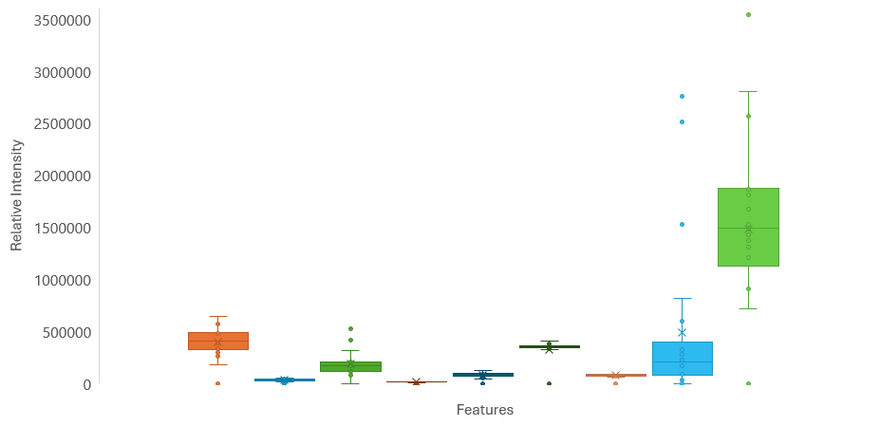
Materials and Methods
structToolbox
Targets
DatasetExperiment

Slide 44
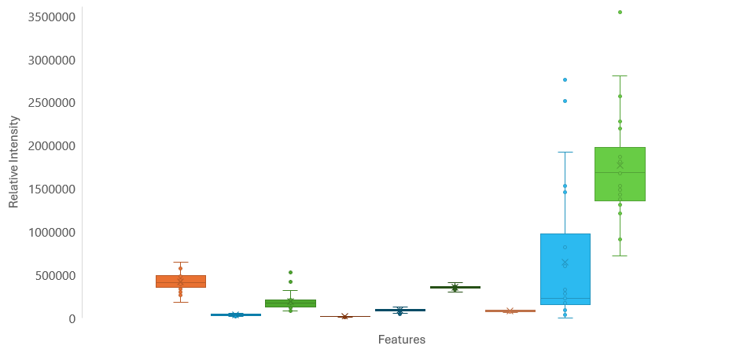
Materials and Methods
structToolbox
Targets
DatasetExperiment

Slide 45
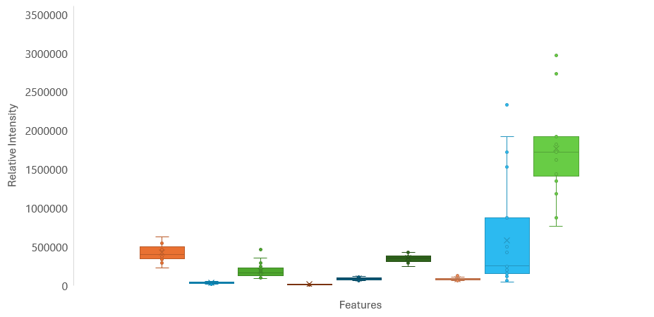
Materials and Methods
structToolbox
Targets
DatasetExperiment

Slide 46
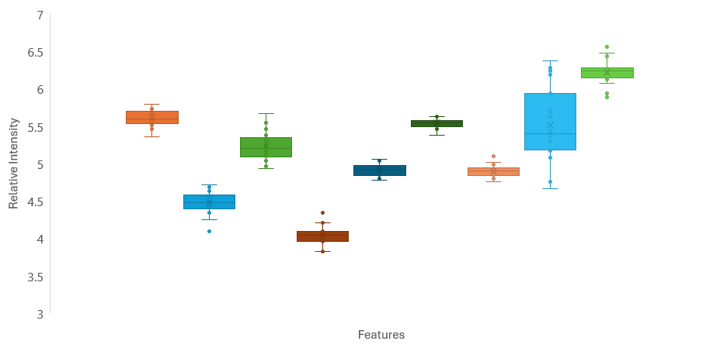

Materials and Methods
structToolbox
Targets
DatasetExperiment

Slide 47
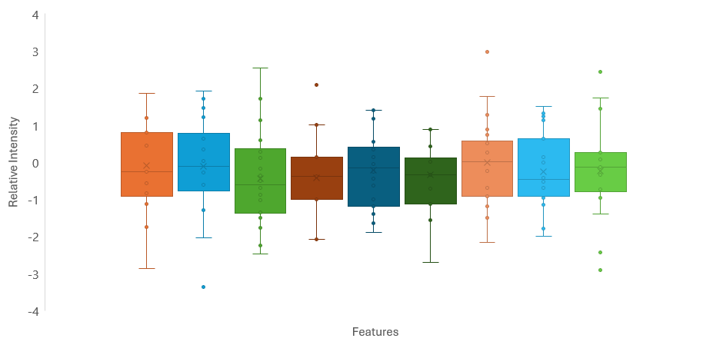
Materials and Methods
structToolbox
Targets
DatasetExperiment

Slide 48
Materials and Methods
structToolbox
Targets
DatasetExperiment

Slide 49
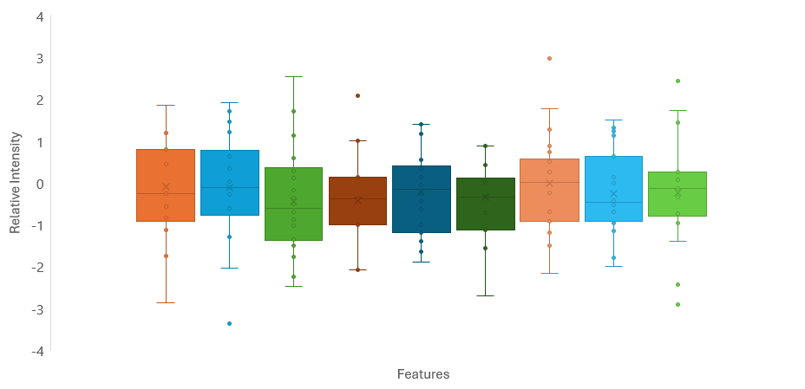
Materials and Methods
structToolbox
Targets
DatasetExperiment

Slide 50
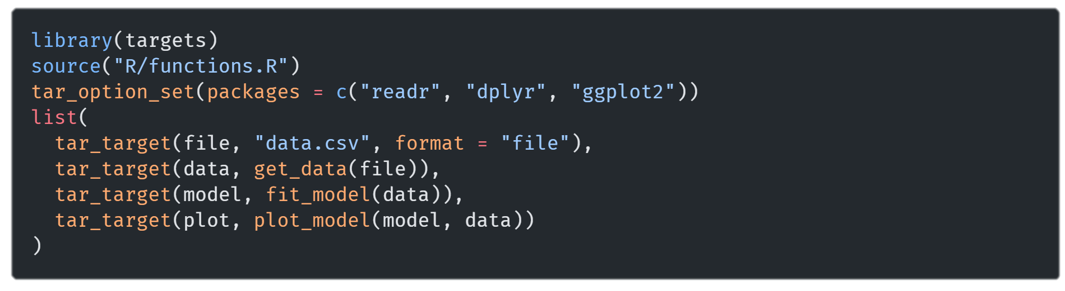
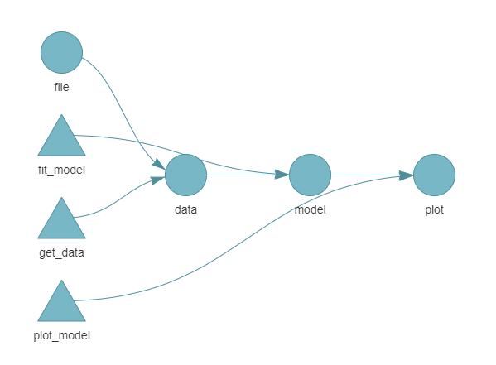
Materials and Methods
Targets

Slide 51
Materials and Methods
Targets

Slide 52
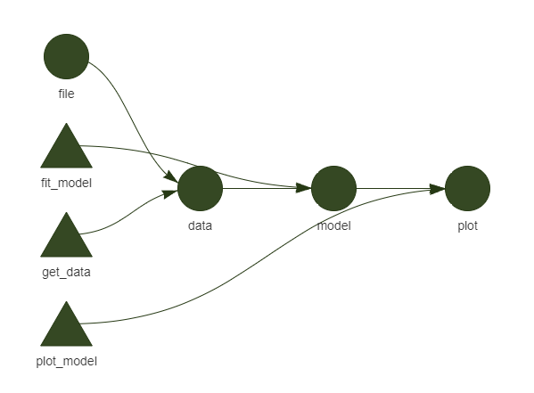
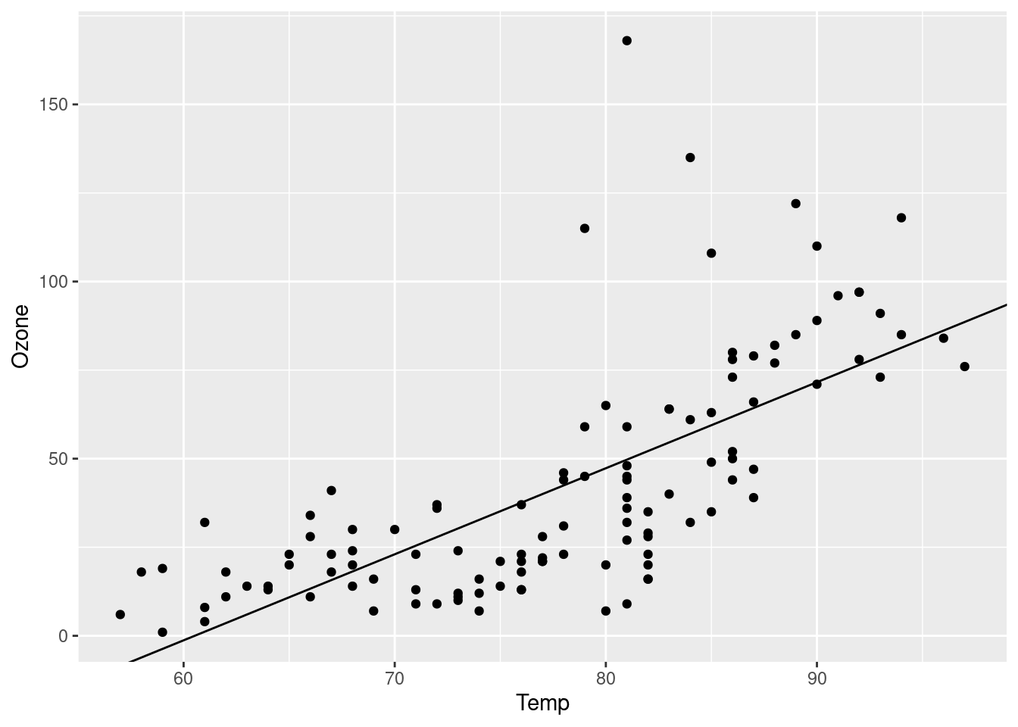
Materials and Methods
Targets

Slide 53
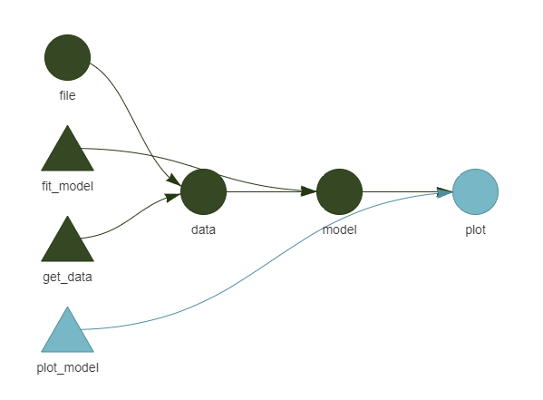
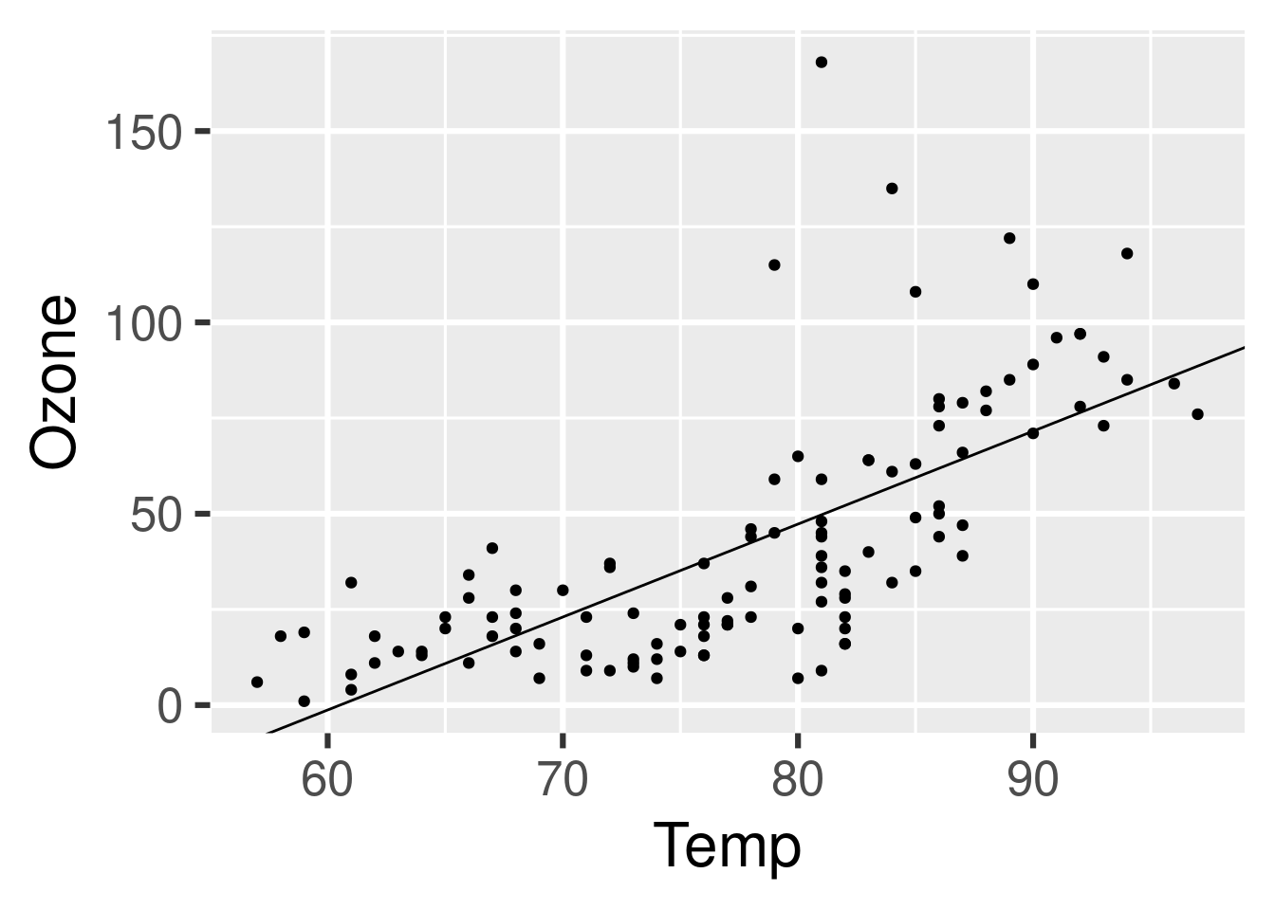
Materials and Methods
Targets

Slide 54
Materials and Methods

Slide 55
Results

Slide 56
Conclusion and Future Work
metaboPipe

Slide 57
metaboPipe
A Modular Pipeline for Metabolomic Data Pretreatment
Eduard Pérez Méndez

