Slide 1
Time Series Analysis Regarding Processor Core Count
D214 P3 Submission
By Edwin Perry

Slide 2
Who am I?
Student of WGU’s Master in Data Analytics
Previously graduated from WGU with Bachelor’s in Software Engineering
Career has consisted solely of technical roles
Started working in IT help desk, then worked in a mixed software engineer/data analyst role
Part of the reason I decided on this analysis question

Slide 3
Problem and Hypothesis
Can a time-series analysis be used to accurately predict the increase in processor cores using solely publicly available data?
Null Hypothesis:The analysis produced by the model will not be sufficiently accurate in determining core count in processors with a mean absolute percent error below 15%
Alternate Hypothesis:The analysis produced by the model will be sufficiently accurate in determining core count in processors with a mean absolute percent error below 15%

Slide 4
Process Summary
Combine data from 2 tables into 1
Drop unnecessary columns
Aggregate data to yearly medians
Account for seasonality and trends
Use differentiation to calculate change to account for this
Identify ideal model
ACF and PACF show an AR(1) model is ideal
Split data to test and training sets
Generate and fit model on training set, then compare predictions against test set

Slide 5
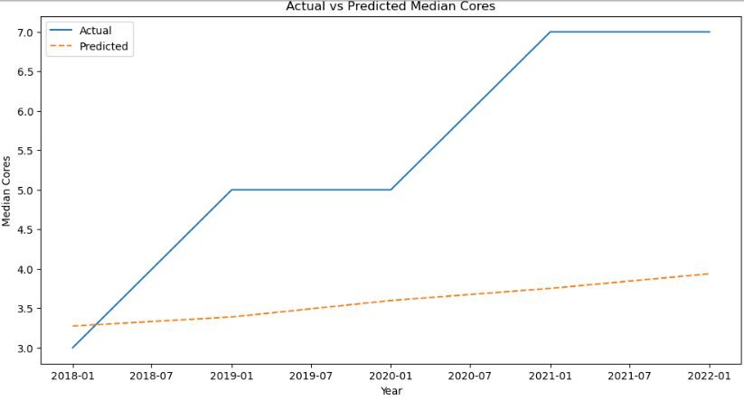
Findings
Low predictive accuracy
31.9% MAPE score
Growth consistently outpaces prediction
Null hypothesis accepted, alternate hypothesis rejected

Slide 6
Limitations
Primary limitation is distinct times
Dataset only contains release year, meaning we have 23 rows to analyze (one for each year)
Dataset does not describe use of processors
Industrial processors may have more cores, bargain processors may have fewer cores, may mislead

Slide 7
Proposal
First, we can reliably say that core count is increasing
Rate seems to be nonlinear growth
Manufacturers can use this information to justify increased resource acquisition, technical teams can assume significant processor improvements going forward
We now know ways to improve the model
Getting specific release date, rather than year, will likely improve model performance
Finding ways to segment data on purpose of processor will allow for more effective predictions

Slide 8
Benefits
This model can be used to justify predictions of significant growth
Possibly exponential growth
Greater raw material acquisition justified, allowing businesses to forecast how to scale to account for these processors with additional cores
Model allows for better models to be produced using better data
Identifying the limitations indicates the methods to improve the model

