Slide 1

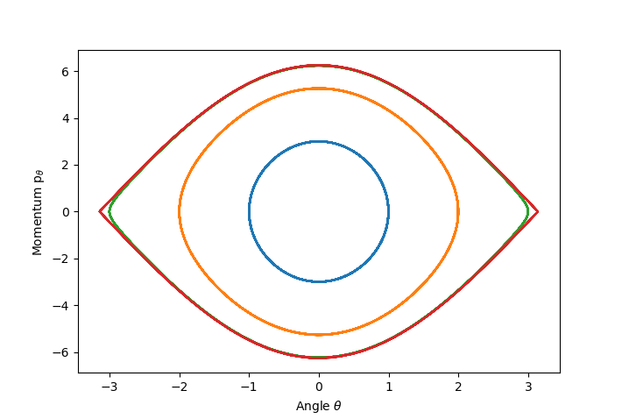
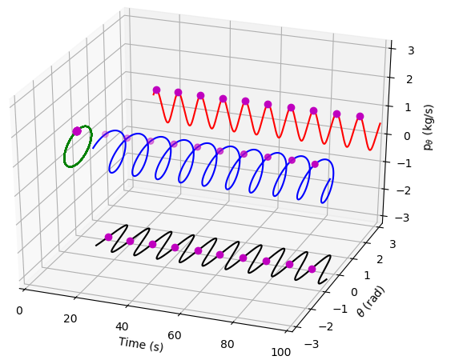
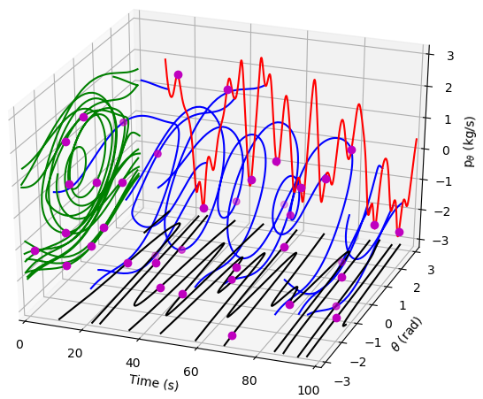
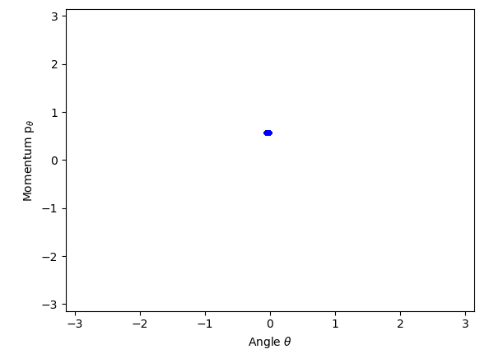
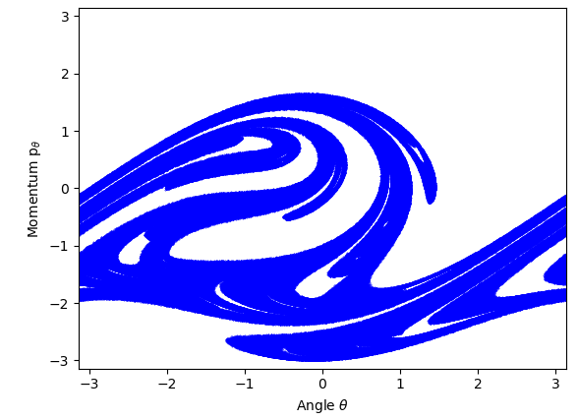






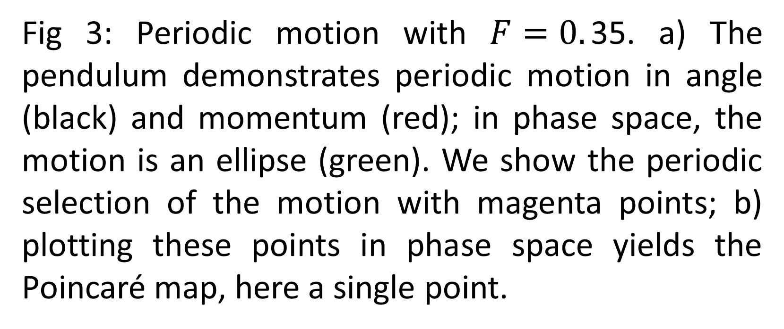



Representations of Chaos in Periodic Systems
TJ Hammond
Phys 3500 – Classical Mechanics
ABSTRACT
THEORY
PHASE SPACE
Although the damped pendulum has a well-known analytic solution for small oscillations, the driven-damped pendulum must be numerically solved in general. We find that we cannot use the scipy library numerical solver for the differential equation and we develop a Runge-Kutta 4th order numerical integration algorithm. We investigate the driving force parameter and the system exhibits periodic or chaotic motion. We use a Poincaré map to illustrate the periodic nature of the system and show that we can easily distinguish between the two cases. We find that stable motion demonstrates a constant periodicity, while chaotic motion leads to a fractal pattern.
Because there is no analytic solution to the driven damped harmonic oscillator, we numerically integrate the second order inhomogeneous differential equation. We find that although the numerical integrator from the Python library scipy is robust for short time integration, it fails when solving for periodic motion exceeding ${10}^{5}$ oscillations and we must create our own algorithm. To this end, we created a Runge-Kutta 4th order (RK4) integrator.
Fig 2: The motion can be described in an angle vs momentum space diagram, called phase space. For SHM, the phase space trajectory is a circle (blue); for larger amplitudes of pendulum motion, the trajectory becomes a prolate circle, or “football shaped” (red). But in both cases, the motion is periodic.
RESULTS: Numerical Model
We solve this differential equation using an Runge-Kutta 4th order integration routine in Python.
INTRODUCTION
RESULTS
DISCUSSION:
A simple pendulum is a system that is described in its differential form as
$$\ddot{θ}+\frac{g}{L}\sin{θ=0}. (1)$$
When we make the small angle approximation, that is $sinθ≈θ,$ we retrieve the equations for simple harmonic motion (SHM) and we can easily solve this differential equation exactly given the initial conditions. Of course, physical systems will have some sort of resistance to the motion, or drag, and we often model this impediment as a velocity dependence force $c\dot{θ}.$ Again, this is an exactly solvable system, where the oscillating motion now has an overall exponential decaying amplitude.
However, solving the driven-damped pendulum does not have an exact solution in general, and can even exhibit chaotic motion. The equation for the driven-damped pendulum is
$$\ddot{θ}+c\dot{θ}+\frac{g}{l}\sin{θ=F\cos{ωt}} (2)$$ where $F$ is the driving amplitude and $ω$ is the (angular) driving frequency. For this demonstration, we use $c=0.05$, $g/l=1$, and $ω=0.7$.
We plot the results of periodic motion in Fig. 3, where we use a driving amplitude $F=0.35$. With this amplitude, the pendulum swings with a periodicity that matches the driving period $T=2π/ω$. We demonstrate the evolution using a 3D representation, where the $xyz$ Cartesian components show the evolution in time, momentum, and angle, respectively. Phase space is the $yz$ projection (green ellipse). We select the position and momentum at regular driving intervals $T$ (magenta points); projecting these points to phase space yields a single point, as shown in b). This single point is called an attractor, where for this motion there is only one.
We increase the driving amplitude $F=0.7$ to demonstrate chaotic motion in Fig. 4. We only show a small time duration evolution of the motion in this 3D representation; however one can get a sense of the apparent randomness of the motion. However, if we let the system evolve for more than ${10}^{7}$ oscillations, an interesting and complicated pattern emerges in the Poincaré map.
This pattern is caused by the chaotic attractor, and the image is called a fractal, a complicated and interesting phenomenon.
A
A
B
B
Fig 3: Periodic motion with $F=0.$35. a) The pendulum demonstrates periodic motion in angle (black) and momentum (red); in phase space, the motion is an ellipse (green). We show the periodic selection of the motion with magenta points; b) plotting these points in phase space yields the Poincaré map, here a single point.
Fig 4: Chaotic motion with $F=0.7$. a) Given a long enough time evolution, the phase space (green) would be filled as the pendulum can take on any angle and momentum. b) The Poincaré map demonstrates that even in this chaotic motion a pattern emerges. This image is a fractal, where increasing the resolution of this map will reveal further detail ad infinitum.
CONCLUSIONS
We numerically solve a second order inhomo-geneous differential equation with a home-built RK4 integrator to simulate the motion of a driven-damped pendulum. We find that with certain driving amplitudes, we can demonstrate chaotic motion. In this chaotic motion, when represented by a Poincaré map, a fractal pattern emerges.
Fig 1: The setup for the driven damped pendulum
$$θ$$
$$l$$
$$F$$
$$m$$
REFERENCES
ST Thornton and JB Marion, Classical Dynamics of Particles and Systems, (5th ed) 2008
WH Press et al, Numerical Recipes in C: the Art of Scientific Computing (2nd ed) 1992

