Slide 1

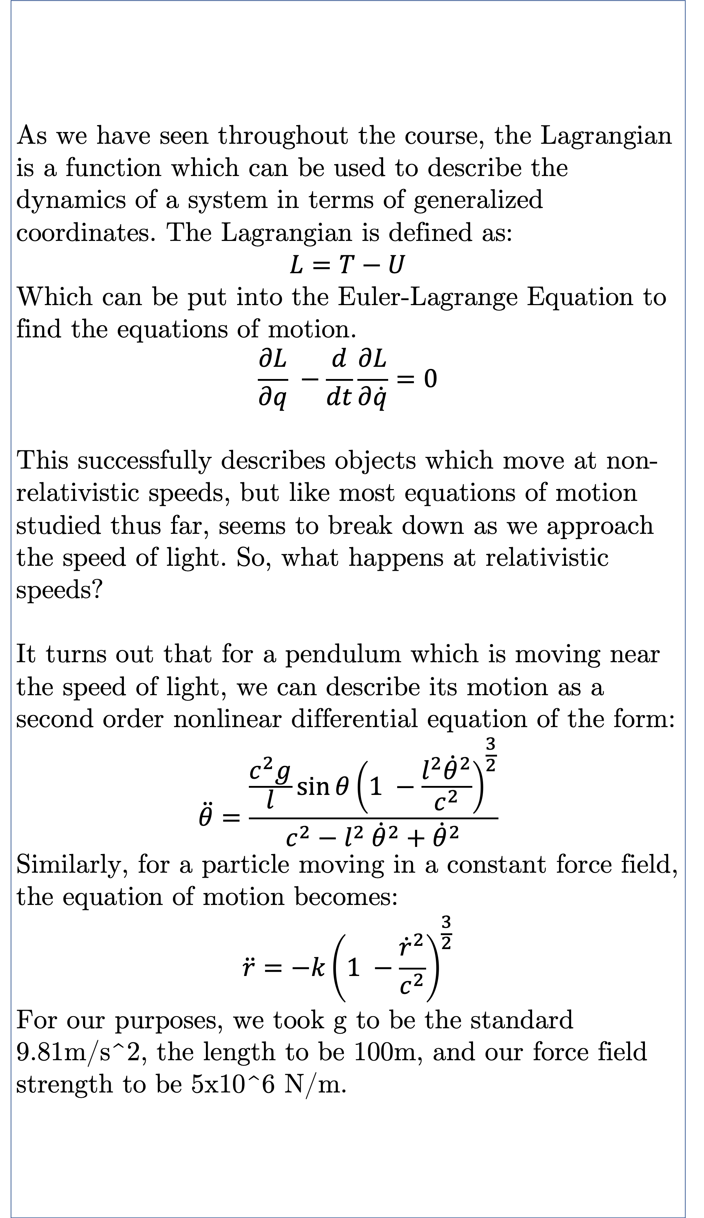
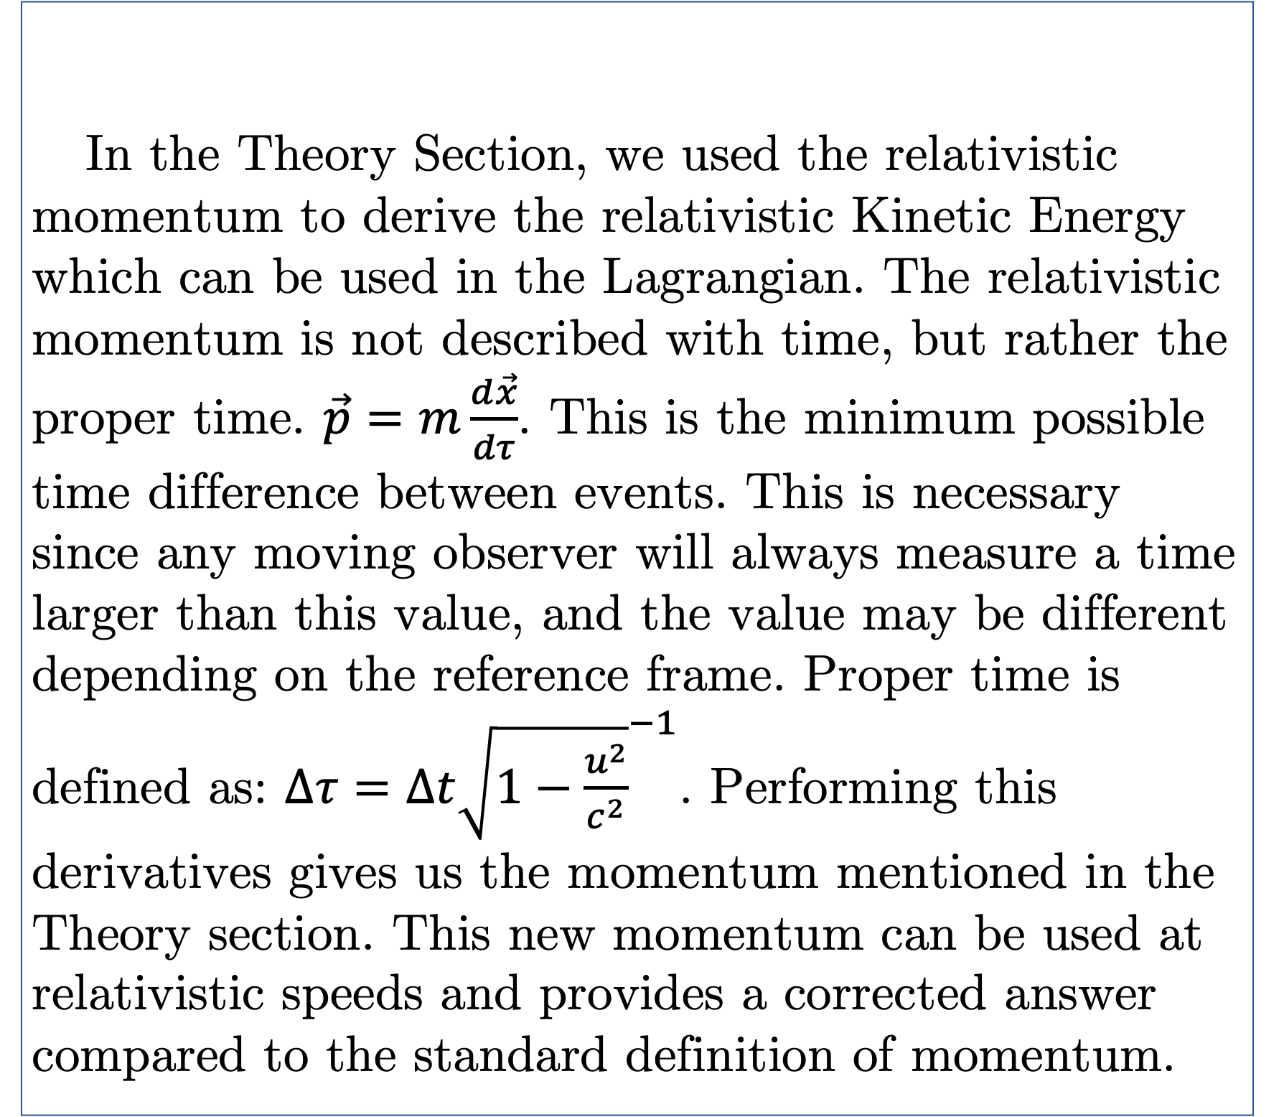
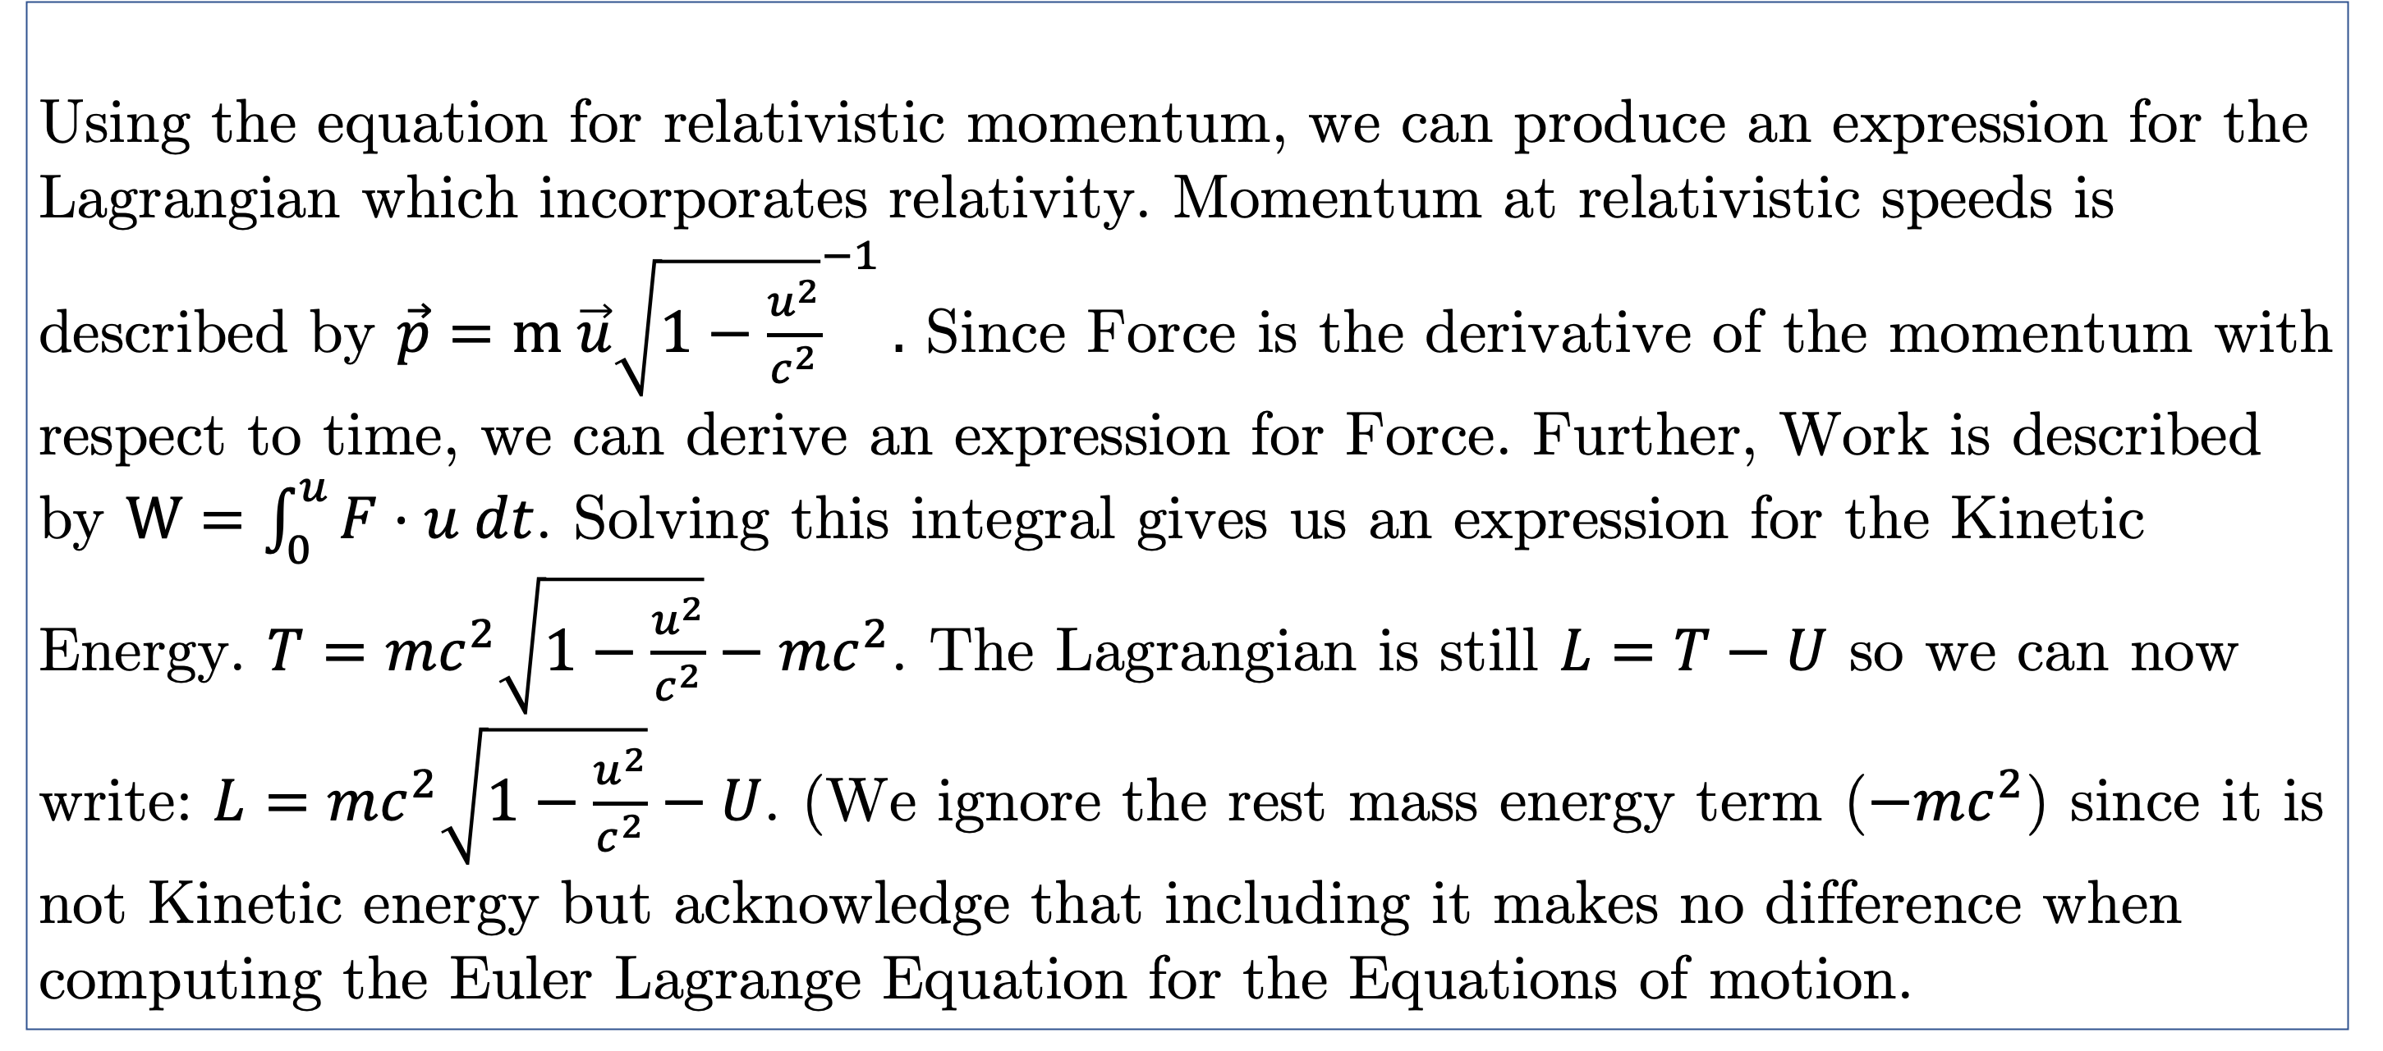
An Investigation of the Relativistic Lagrangian
Evan Petrimoulx
Phys 3500 – Classical Mechanics
Although we have seen the motion of particles and bodies described by the Lagrangian before, we have yet to investigate the equations of motion when our system is moving at near the speed of light. Incorporating relativistic effects into the Lagrangian can prove to be challenging and often results in a non-linear, first and second order differential equations. We can use the Runge-Kutta algorithm to aid us in solving these complicated systems numerically, allowing us to investigate how the motion of an object changes near the universal speed limit. This report investigates two special cases, the motion of a relativistic pendulum, and of a particle under a constant force field. Both cases have been modelled, and the affects of their initial conditions on the system have been studied.
THEORY
ABSTRACT
Using the equation for relativistic momentum, we can produce an expression for the Lagrangian which incorporates relativity. Momentum at relativistic speeds is described by $\vec{p}=m \vec{u}{\sqrt{1−\frac{u^{2}}{c^{2}}}}^{−1}.$ Since Force is the derivative of the momentum with respect to time, we can derive an expression for Force. Further, Work is described by $W=\int_{0}^{u}{F⋅u dt}$. Solving this integral gives us an expression for the Kinetic Energy. $T=mc^{2}\sqrt{1−\frac{u^{2}}{c^{2}}}−mc^{2}$. The Lagrangian is still $L=T−U$ so we can now write: $L=mc^{2}\sqrt{1−\frac{u^{2}}{c^{2}}}−U$. (We ignore the rest mass energy term ($−mc^{2}$) since it is not Kinetic energy but acknowledge that including it makes no difference when computing the Euler Lagrange Equation for the Equations of motion.
In the Theory Section, we used the relativistic momentum to derive the relativistic Kinetic Energy which can be used in the Lagrangian. The relativistic momentum is not described with time, but rather the proper time. $\vec{p}=m\frac{d\vec{x}}{dτ}$. This is the minimum possible time difference between events. This is necessary since any moving observer will always measure a time larger than this value, and the value may be different depending on the reference frame. Proper time is defined as: $Δτ=Δt{\sqrt{1−\frac{u^{2}}{c^{2}}}}^{−1}$. Performing this derivatives gives us the momentum mentioned in the Theory section. This new momentum can be used at relativistic speeds and provides a corrected answer compared to the standard definition of momentum.
RELATIVISTIC MOMENTUM
RESULTS: Numerical Model
We solve this differential equation using an Runge-Kutta 4th order integration routine in Python.
As we have seen throughout the course, the Lagrangian is a function which can be used to describe the dynamics of a system in terms of generalized coordinates. The Lagrangian is defined as:
$$L=T−U$$
Which can be put into the Euler-Lagrange Equation to find the equations of motion.
$$\frac{∂L}{∂q} −\frac{d}{dt}\frac{∂L}{∂\dot{q}}=0$$
This successfully describes objects which move at non-relativistic speeds, but like most equations of motion studied thus far, seems to break down as we approach the speed of light. So, what happens at relativistic speeds?
It turns out that for a pendulum which is moving near the speed of light, we can describe its motion as a second order nonlinear differential equation of the form:
$$\ddot{θ}=\frac{\frac{c^{2}g}{l}\sin{θ}{\left(1 −\frac{l^{2}{\dot{θ}}^{2}}{c^{2}}\right)}^{\frac{3}{2}}}{c^{2}−l^{2} {\dot{θ}}^{2}+{\dot{θ}}^{2}}$$
Similarly, for a particle moving in a constant force field, the equation of motion becomes:
$$\ddot{r}=−k{\left(1 −\frac{{\dot{r}}^{2}}{c^{2}}\right)}^{\frac{3}{2}}$$
For our purposes, we took g to be the standard 9.81m/s^2, the length to be 100m, and our force field strength to be 5x10^6 N/m.
INTRODUCTION
RESULTS
Figure 1:
This graph shows the relationship between the acceleration of an object and its velocity. It can clearly be seen that as the velocity increases to a maximum (the speed of light), the acceleration decreases proportionally. Eventually the acceleration reaches zero, and the velocity becomes a constant. The force constant for this figure and figure 2 was set to be 5 million N/m. To best showcase the acceleration and velocity, the force was set high. If the force is decreased to a small enough value, the acceleration drops to zero almost instantaneously.
Figure 2:
This figure displays the relationship between the velocity and time of an object in a constant force field. As the object increases in velocity, it approaches an asymptote at v = c. This is contrary to the standard classical case, where the object would continue to accelerate to infinity.
Figure 3, 4, 5:
The gifs and diagram below show the second case which was studied in this report, the relativistic pendulum. Given a high enough velocity, the acceleration due to gravity becomes negligible and the system demonstrates circular motion. The classical case studied in class is compared below in the gif on the right side. The length of the pendulum in these examples was set to 100m, and the acceleration due to gravity was set to the standard 9.81 m/s²
Figure 1
DISCUSSION
In these complicated nonlinear differential equations, initial conditions are critical to the outcome. By adjusting the length of the wire in the pendulum simulation, we can make the oscillation slower. For this to be significant the length of the pendulum must be sufficiently large compared to the initial velocity. Otherwise, the period will be reduced but not enough to be seen in a simulation. If we make the initial velocity of the pendulum sufficiently small so that the speed is not relativistic, the motion of a simple pendulum appears. Note that the speeds in both gifs are not comparable as the relativistic case has been slowed significantly for observation purposes.
The initial conditions are less interesting for the constant force field, but still has a large role in how fast the object accelerates at the start of the motion.
It should be noted that in the pendulum’s case, length contraction of the string was not accounted for, and it is assumed that the string is not stretchable and is unbreakable. This means that our pendulum is mostly a theoretical demonstration of the principles of special relativity and Lagrangian mechanics, and not something that will ever be witnessed in the universe.
Figure 2
Figure 3
Overall, the equations of motion for both a pendulum and a particle in a constant force field were discovered. Their differential equations were solved numerically and graphed with Python. We were able to successfully incorporate relativistic effects into the Lagrangian and adapt problems discussed in class to show how their behavior changes as they approach the speed of light.
Figure 4
Figure 5
CONCLUSIONS
REFERENCES
ST Thornton and JB Marion, Classical Dynamics of Particles and Systems, (5th ed) 2008.
V Stevenson, How to Solve Coupled Differential Equations ODEs in Python, YouTube, uploaded by Vincent Stevenson, 15 February 2021, https://www.youtube.com/watch?v=MXUMJMrX2Gw
Scipy.integrate.odeint#. scipy.integrate.odeint - SciPy v1.11.4 Manual. (n.d.). https://docs.scipy.org/doc/scipy/reference/generated/scipy.integrate.odeint.html
Goldstein, Herbert, Classical Mechanics (2nd ed) 1980.

