Slide 1
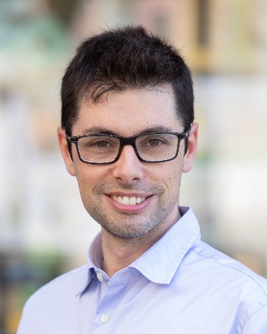
Lessons learned @ SDSC
Alessandro Nesti, PhD
Lab in Data Science (EPFL Master class) – 8th April 2020

Slide 2

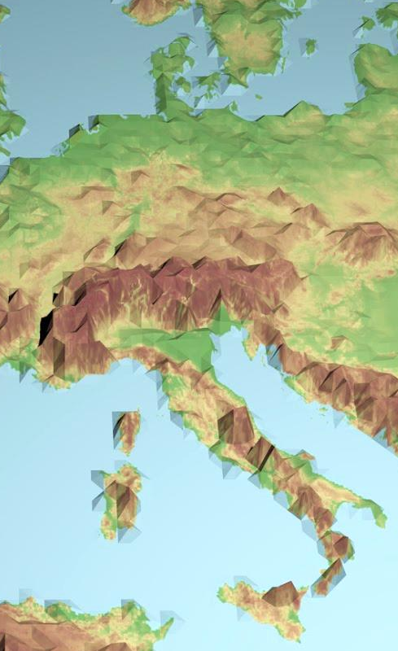



About me
BSc and MSc in biomedical engineering
Tech & medical applications
PhD & PostDoc in neuroscience
Experimental study of the brain
(Industry)
Ecommerce
SDSC
Industry use cases

Slide 3
About SDSC - industry
Mission:
Accelerate adoption of data science
Industry partners:
Different maturity level, but obviously not DS-based companies

Slide 4
About today
10 lessons learned while accelerating Data Science adoption
S
D
Strategy
Data
C
Communication

Slide 5


Lesson 1: The approach
Analytics led
Data led
Business led
Let’s find data scientists and solve problems!
Let’s clean all data, so we can do data science!
We have a problem, can you help?
Business led projects tend to be more successful!
Advice: Fight for a clear question

Slide 6
Lesson 2: Project objective
Industry
Academia
Reach target!
90% accuracy
Automate a process
…
Advance state of the art!
New discovery
Outperform existing standards
…
Simple can be impactful too!
Advice: Stick to the target, don’t overdue

Slide 7
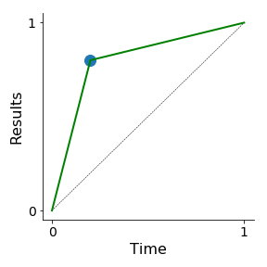
Lesson 3: The path
Pareto principle (80/20 rule): “80% of the effect comes from 20% of the causes”
Progress curves are typically steep, then flatter!
Advice: be careful about allocating time where return is low

Slide 8
Lesson 4: The big picture
Business need
Development
Deployment
Adoption
87% of data science projects never make it into production*
Non-adopted successful models are failures!
Advice: Facilitate adoption in any possible way
* Source: VentureBeat AI https://venturebeat.com/2019/07/19/why-do-87-of-data-science-projects-never-make-it-into-production/

Slide 9
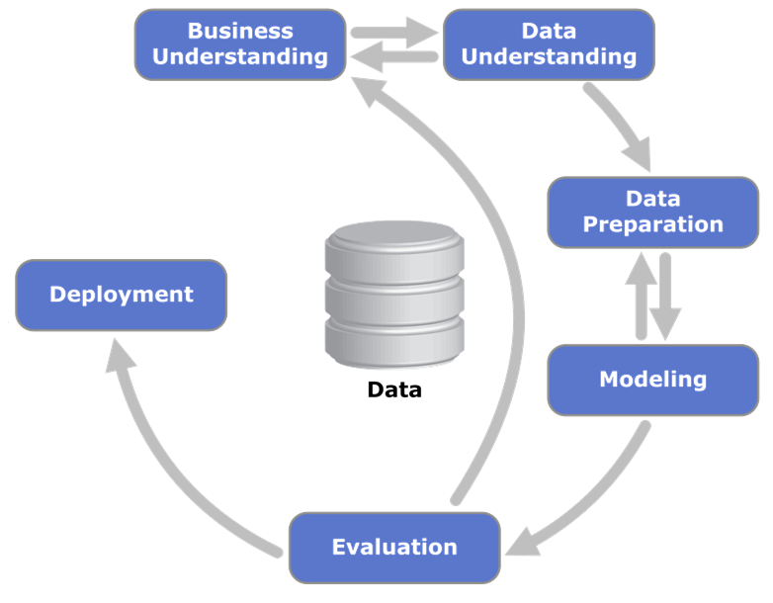
Lesson 5: Development
CRISP – DM model
Development is team work!
source: Wikipedia
Advice: Don’t work disconnected
Identify all collaborators from the start
Keep them involved
Understand their daily workflow and pain points
Notes:
Cross industry standard process

Slide 10


Lesson 6: Communication
Executive
Analyst
Data scientist
Meeting tables are multidisciplinary!
Data engineer
Marketing
Project manager
Advice: Never stop improving communication skills
Invest time in illustrating ideas and approaches
Adapt to the audience
Invite criticism and feedback, and listen!
“There was a meeting” doesn’t mean that communication took place

Slide 11
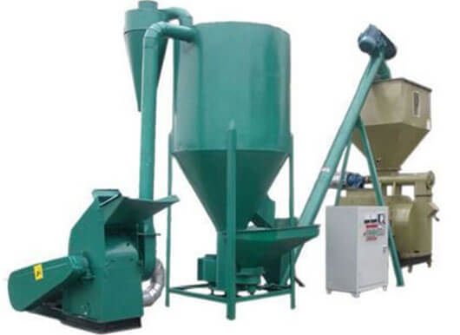
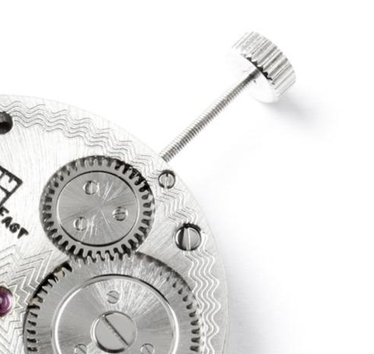
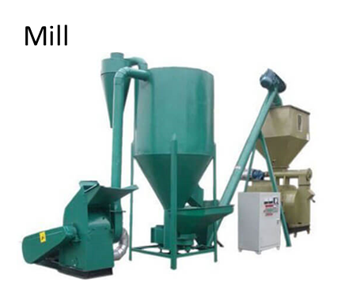
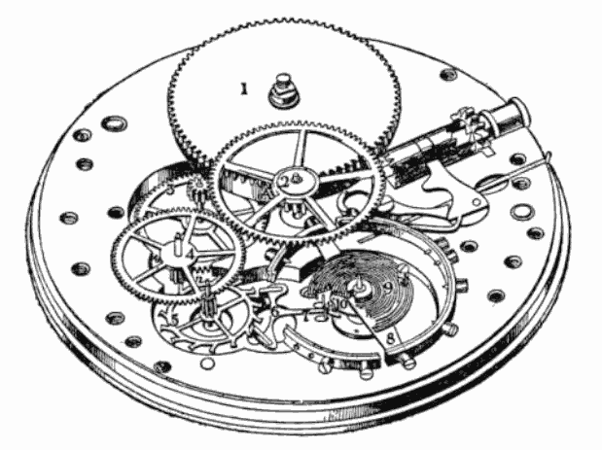
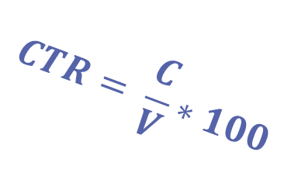
Lesson 7: Domain knowledge
Mill
$$CTR= \frac{C}{V}∗100$$
Speak the business language!
Mechanical winding
Advice: Learn the language
Be interested in your company’s business
Use their terminology
Show that you understand the business before showing how to use data to solve business problems
Less frustration, miscommunication, time wastes, credibility drops,…
Movement

Slide 12


Lesson 8: Expectation management
AI hype and “quick metrics” (eg 99.9% accuracy) stimulate unrealistic expectations in the non-expert crowd
Expectations
REALITY
Expectations need constant management!
Advice: make sure expectations start and remain realistic
Explain metrics
Explain testing periods (if needed) and waiting time
Remind about current baselines

Slide 13


Lesson 9: Data preparation
Data preparation in industry projects is particularly crucial
Remember that data quality affects performances
Don’t be the guy who fails to deliver and blames the data
Data preparation pays off!
Advice: Question every data source, check with domain experts, adjust expectations early

Slide 14

Lesson 10: Model interpretability
Adoption only works if people can trust the model
This might (or might not) require explanation and cross-checking
Model Interpretation can make or break industry applications!
Advice: Assess early the interpretability requirements

Slide 15

Recap
Business led projects tend to be more successful
Simple can be impactful too
Progress curves are typically steep, then flatter
Non-adopted successful models are failures
Development is team work
Meeting tables are multidisciplinary
Speak the business language
Expectations need constant management
Data preparation pays off
Model Interpretation can make or break industry applications

Slide 16
Good luck!
Reach out to me at alessandro.nesti@epfl.ch

