Slide 1
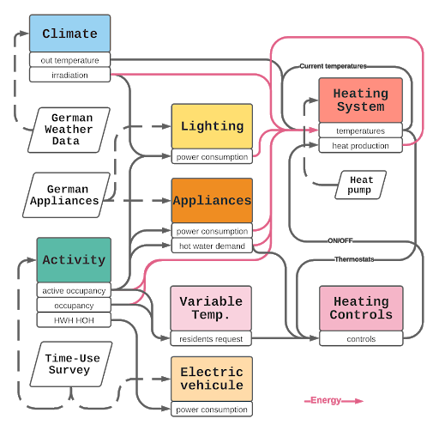

Slide 2
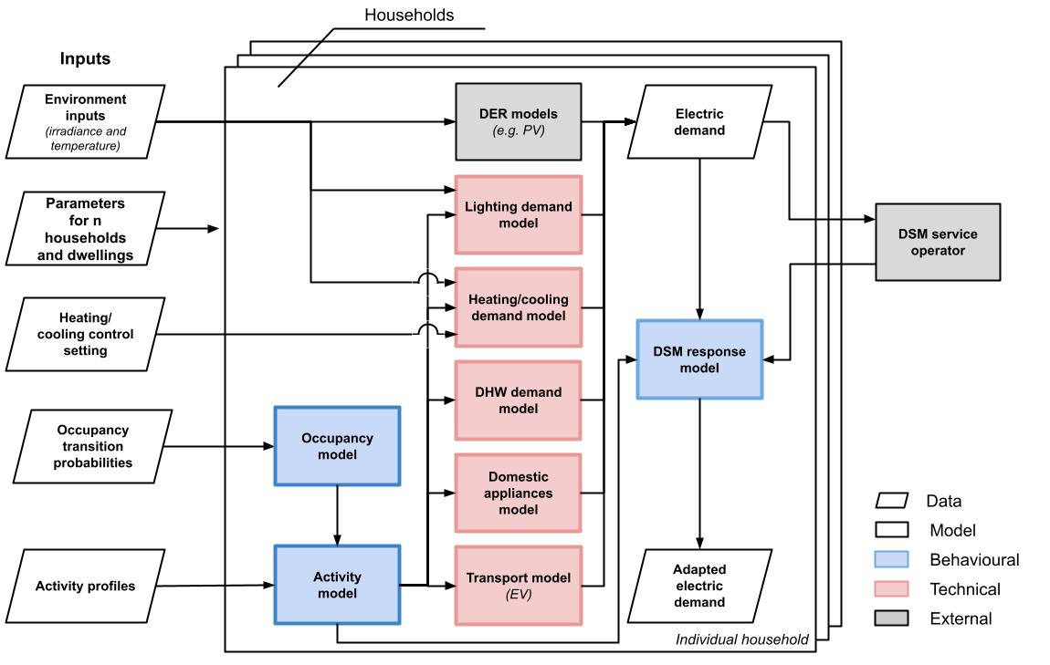

Slide 3
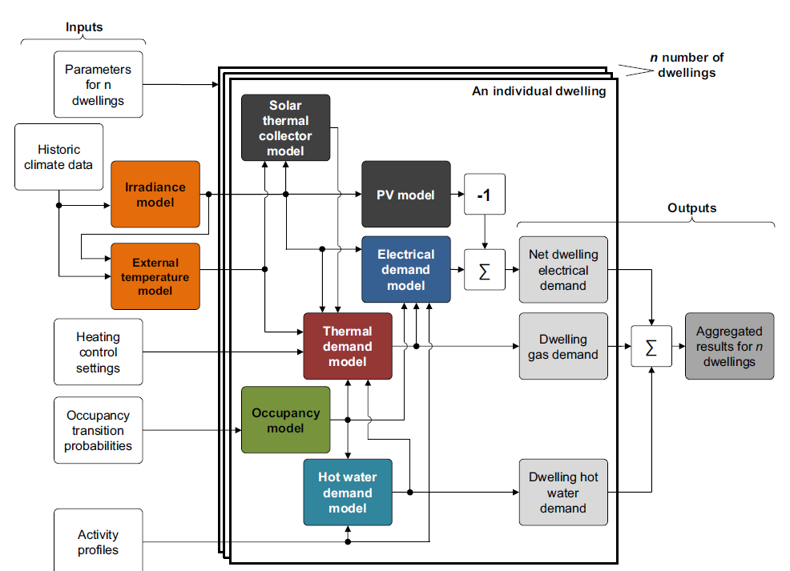
Initialization parameters
Climate
Lighting model
Heating control
Space heating demand model
Heating system model
Electric load
Occupancy TPMs
4-states occupancy model
DHW demand model
Activity profiles
Applicance model

Slide 4
Appliances
Climate
Lighting
Irradiance
Outdoor Temp.

