Slide 1

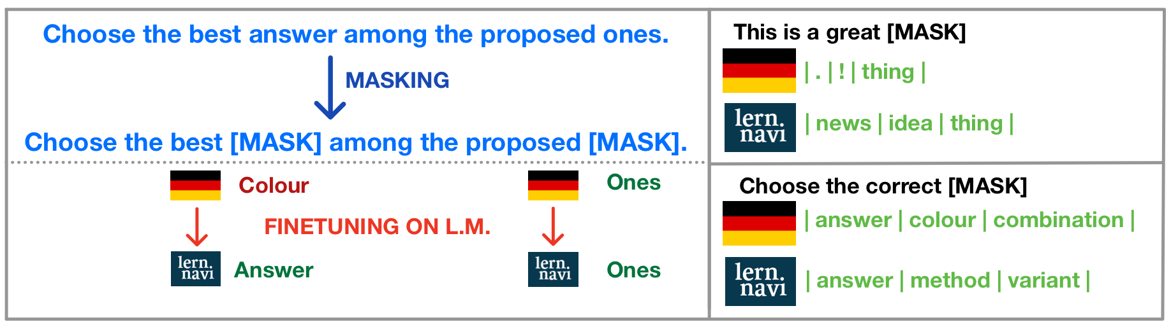
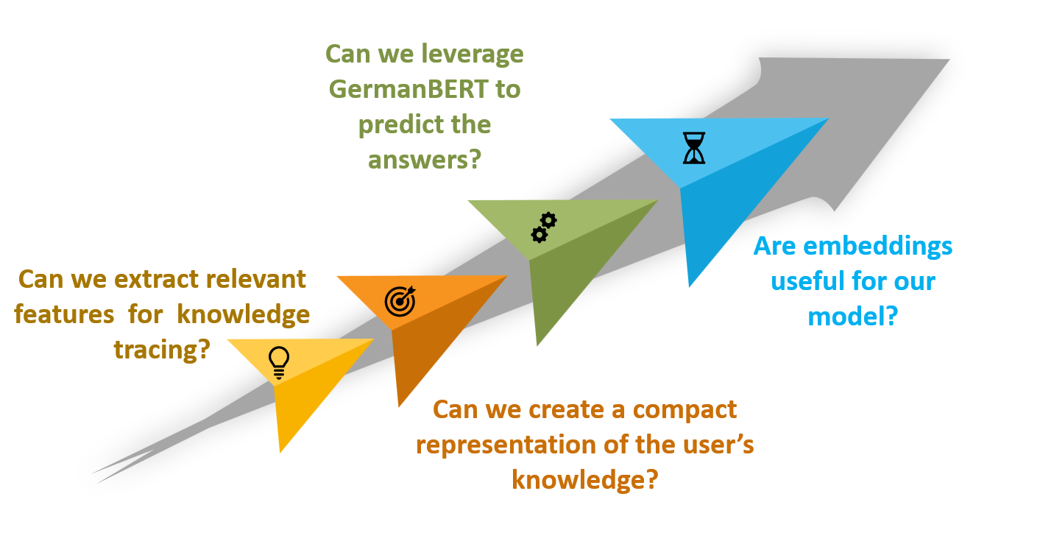
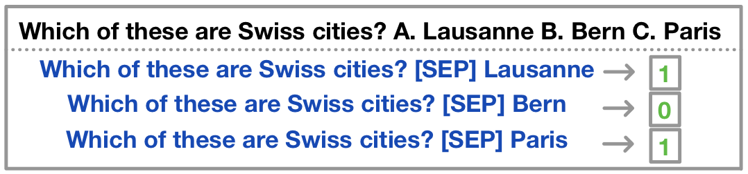
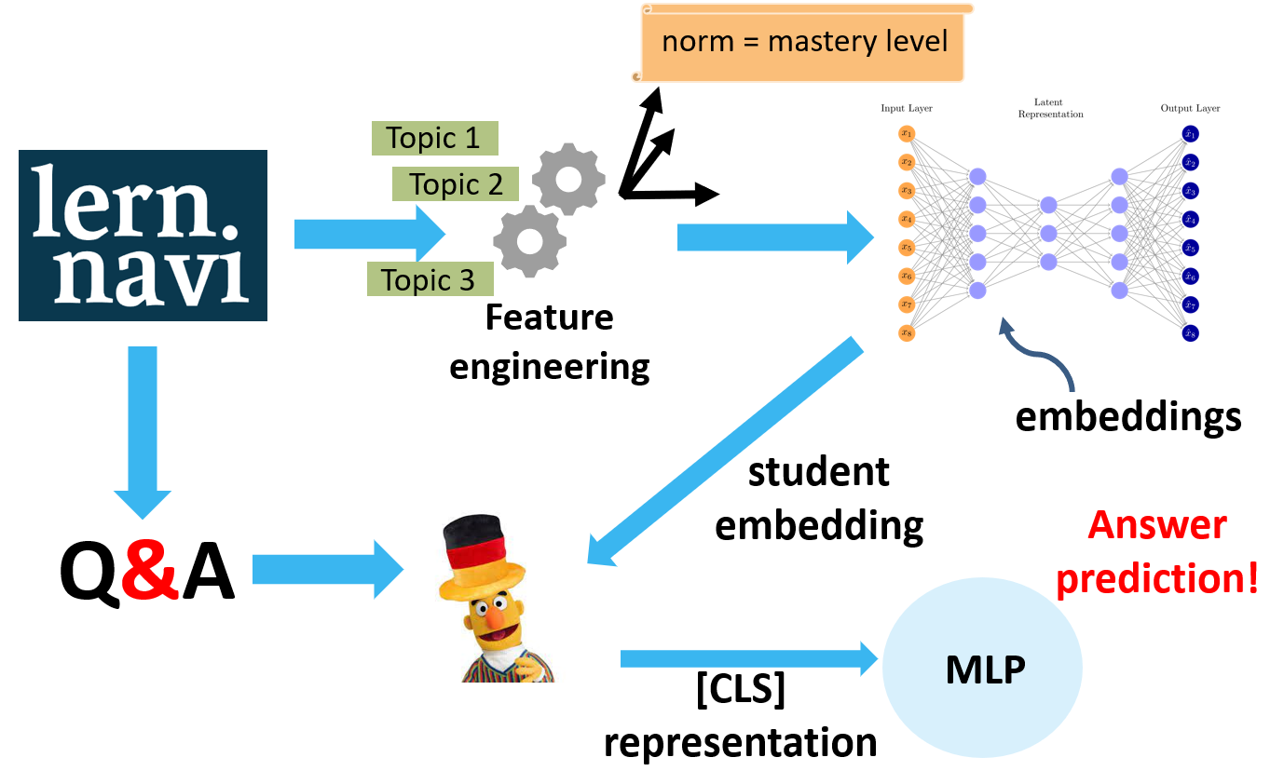
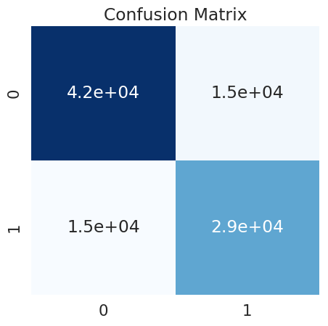
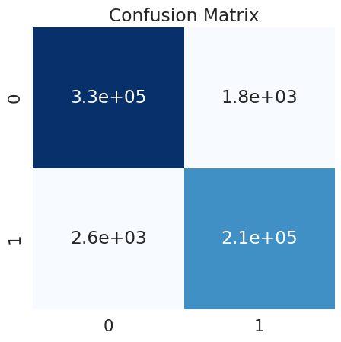
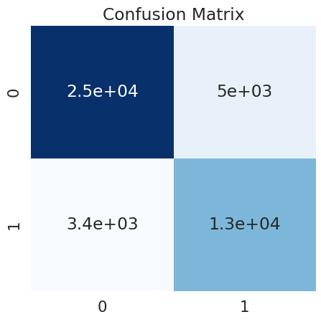
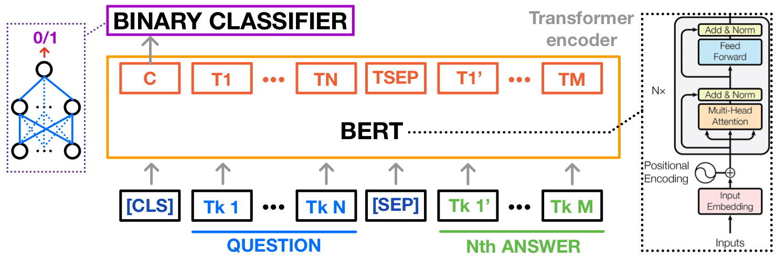
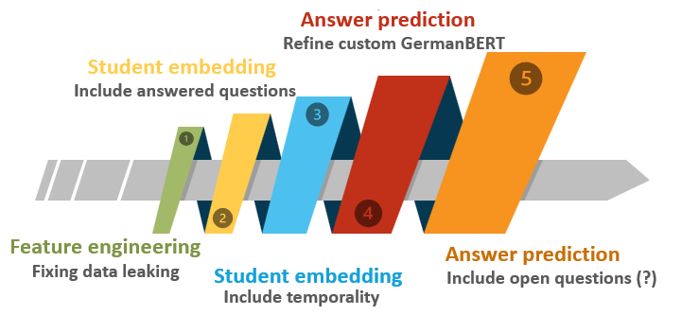
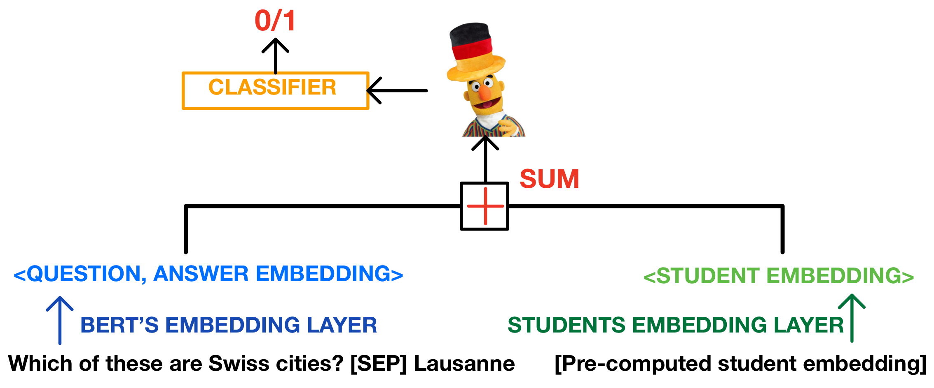
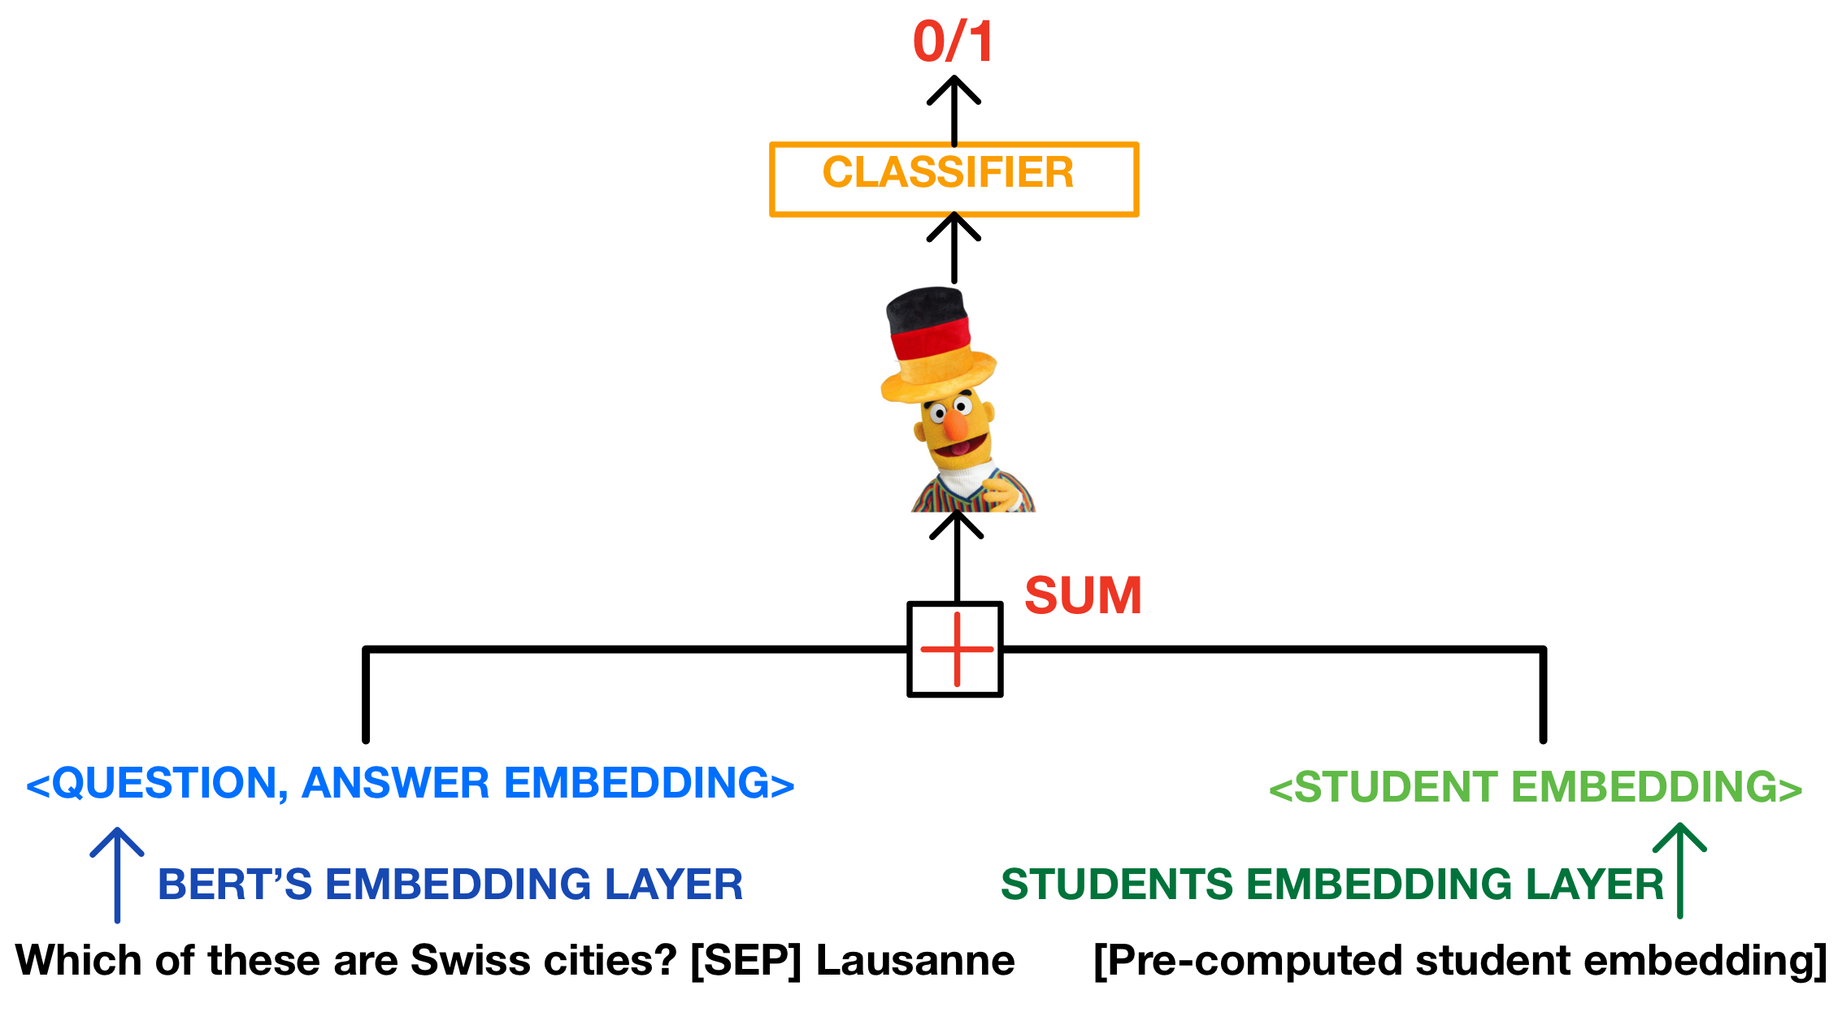
BERT goes to EPFL: MCQ prediction with a Muppet twist!
Answer Forecasting: ML-Driven Predictions in Lernnavi
Luca Zunino, Elena Grazia Gado, Tommaso Martorella
Machine Learning for Behavioral Data (MLBD) Course, EPFL, 2023
1 INTRODUCTION + RESEARCH QUESTIONS
3 RESULTS
Motivation:
ML model to predict how a student will respond to a given question to enable tailored learning experiences
GermanBERT to LernnaviBERT: finetuning with masking
Figure 3. Finetuning GermanBERT on a language modelling task using masking (real examples on the right).
LernnaviBERT finetuning for MCQ answer prediction
2 METHODOLOGY
Figure 4. Procedure used to transform MCQs in a binary classification task. LernnaviBERT is finetuned on predicting the correct answers of MCQs and evaluated both on MCQs never seen before and observed during training.
MCQBert3, new MCQs: average F1 = 0.698, MCC = 0.396
MCQBert3, seen MCQs: average F1 = 0.991, MCC = 0.983
LernnaviBERT finetuning for student answer prediction
Baseline: average F1 = 0.802, MCC = 0.606
MCQBert3: average F1 = 0.805, MCC = 0.612
Model architecture
Figure 5. Confusion matrices for MCQBert3. Left/Center: correct answer prediction, MCQs never seen before/already seen. Right: student answer prediction, MCQs never seen before for the student under analysis.
4 CONCLUSIONS AND FUTURE DIRECTIONS
Masking finetuning: perplexity ↓, aligned word predictions.
MCQ finetuning: LernnaviBERT learns correct answers. Students answers finetuning: effective (high F1 and MCC), student embeddings yield slight improvement over baseline.
Figure 1. Architecture of the BERT model with a binary classifier head, without student embeddings.
MCQBert1-4: embeddings concatenated/summed before the classifier/at BERT’s input.
REFERENCES
Figure 2. Simplified scheme of MCQBert3.
[1] C. Piech, J. Bassen, J. Huang, S. Ganguli, M. Sahami, L. J. Guibas, and J. Sohl-Dickstein, “Deep knowledge tracing”, in Advances in Neural Information Processing Systems, vol. 28. Curran Associates, Inc., 2015
[2] J. Devlin, M.-W. Chang, K. Lee, and K. Toutanova, “Bert: Pre-training of deep bidirectional transformers for language understanding”, 2019.

