Slide 1
Time Series Clustering
Machine Learning for Behavioral Data
April 14, 2026

Slide 2
Today’s Topic
Week | Lecture/Lab
9 | Time Series Clustering
10 | Explainability
11 | Fairness
12 | Reserve
13 | No Lecture
14 | No Lecture
15 | Poster Session

Slide 3

Getting ready for today’s lecture…
Join us on SpeakUp
https://go.epfl.ch/mlbd-speakup

Slide 4

Short quiz about the past…
In K-Means clustering, which of the following parameters affect the goodness of the solution?
Number of iterations
Initial positioning of cluster centers
Choice of k
https://go.epfl.ch/mlbd-speakup
Notes:
ALL

Slide 5
Short quiz about the past…
K-Means clustering is useful when dealing with non-convex clusters:
True
False
https://go.epfl.ch/mlbd-speakup
Notes:
false

Slide 6
Short quiz about the past…
In a binary classification problem, it is appropriate to use the following activation function for the output layer:
Linear
Tanh
Sigmoid
https://go.epfl.ch/mlbd-speakup
Notes:
c)
-> we could in theory do tanh, but then would need another cost function (or normalize to [0-1] range as a basis for binary crossentropy)

Slide 7
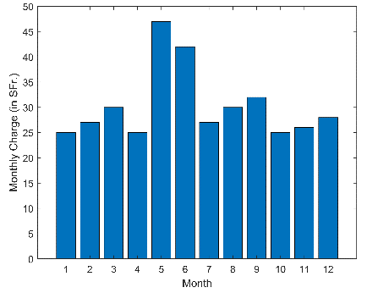
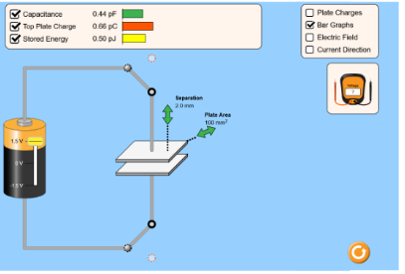
Today – Clustering Time Series Data
Aggregating features over time
Defining fixed time intervals (weeks, levels in a game, etc.)
Dynamic Time Warping
String Metrics
Markov Models
Action Sequences

Slide 8
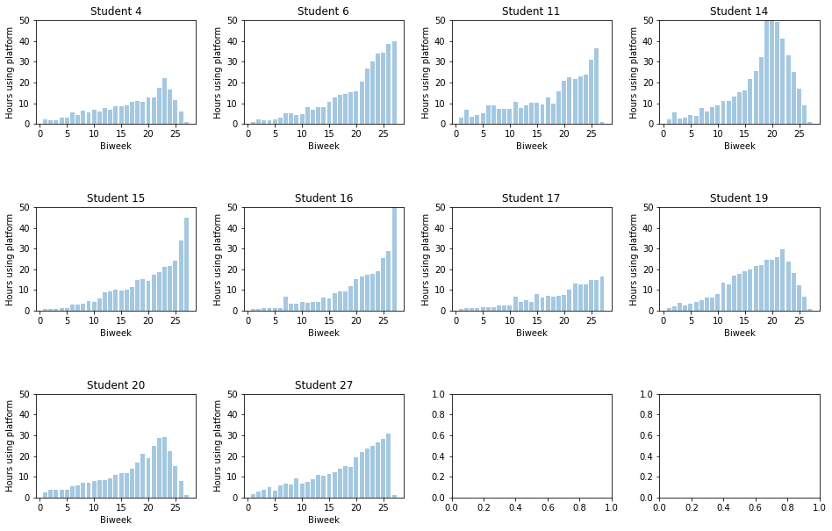
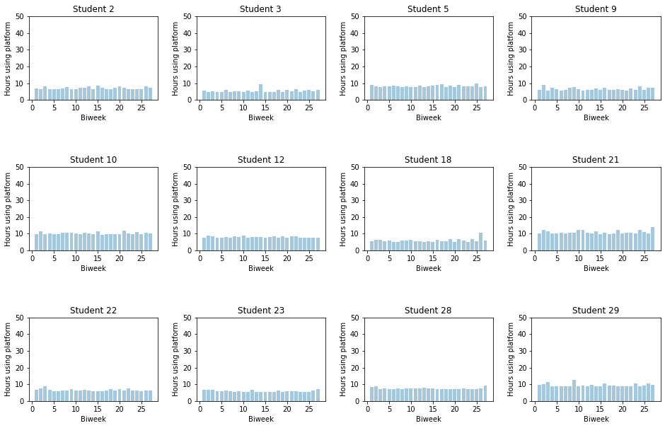
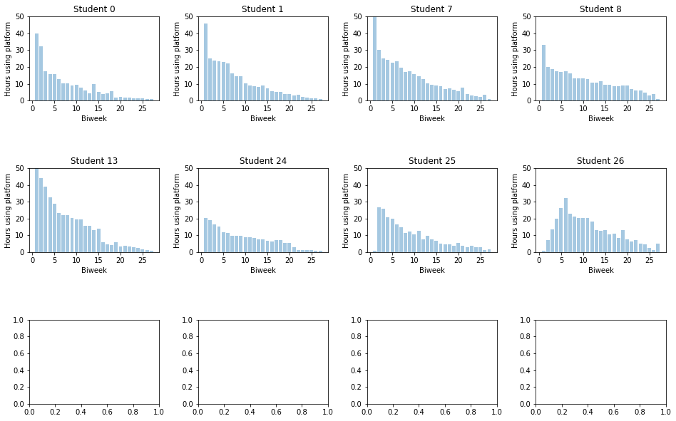
Today’s Use Case
Synthetic data of 30 high school students
Time spent on an e-learning platform over one year (computed per biweek)
Three clusters: 1) precrastinators, 2) regular, 3) procrastinators
Notes:
Full data is in the student notebook

Slide 9
Agenda
Aggregating features over time
Defining fixed time intervals (weeks, levels in a game, etc.)
Dynamic Time Warping
String Metrics
Markov Models

Slide 10
Aggregating features over time
We compute the value of the feature over the whole time series (average, maximum, range, standard deviation)
We do not explicitly represent changes in features over time
We can use standard distance/similarity measures

Slide 11
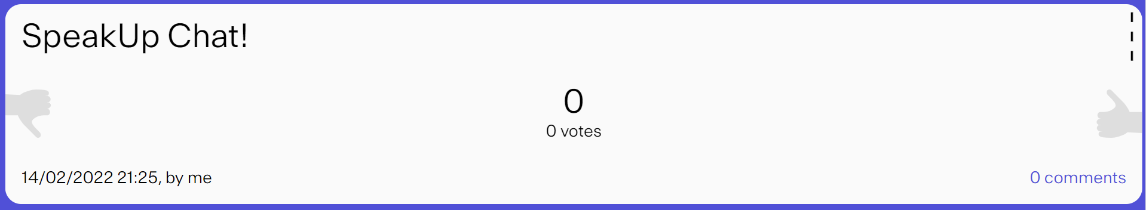
Your Turn – Aggregated Data
Run spectral clustering on the average number of hours:
Can we interpret the different clusters?
Are we able to retrieve the procrastination patterns? If not, why not?
https://go.epfl.ch/mlbd-speakup
Notes:
- Discuss with your neighbor: how many clusters do we get? What is the interpretation of these clusters? Are we able to retrieve the original procastrination patterns? If not, why not? -> Share your answers through Python Anywhere!

Slide 12
Agenda
Aggregating features over time
Defining fixed time intervals (weeks, levels in a game, etc.)
Dynamic Time Warping
String Metrics
Markov Models
Additional Practice

Slide 13
Using fixed time intervals
Compute the feature value at fixed points in time (e.g., weeks, level in a game)
We obtain feature vectors with the same length for every student
We can use standard distance measures
Notes:
Note example on top of slide

Slide 14
Your Turn – Fixed Time Intervals
Run spectral clustering on the vectors of biweeks (dimension = 27) using Euclidean distance:
What is the optimal number of clusters?
How do the results differ from the aggregated feature results?
https://go.epfl.ch/mlbd-speakup
Notes:
Think: what is the optimal number of clusters? How do the results differ from the aggregated feature results?
-> Share your answers on the SpeakUp Chat

Slide 15
Agenda
Aggregating features over time
Defining fixed time intervals (weeks, levels in a game, etc.)
Dynamic Time Warping
String Metrics
Markov Models
Additional Practice (if time permits)

Slide 16
Dynamic Time Warping
Compute distance between two time series, which may vary in speed
Time series can have different lengths
Develop a one-to-many match, i.e. find an optimal alignment between two time series
Notes:
POLL: Who has heard about dynamic time warping?
A point x of a time series can be matched to more than one point y of the other time series
Optimal alignment = minimizing the distance between the two time series

Slide 17
Example: Spoken Digits
[Image Credit: CS 498, Signals AI, University of Illinois]
Notes:
Same digit spoken – we want to align them.

Slide 18
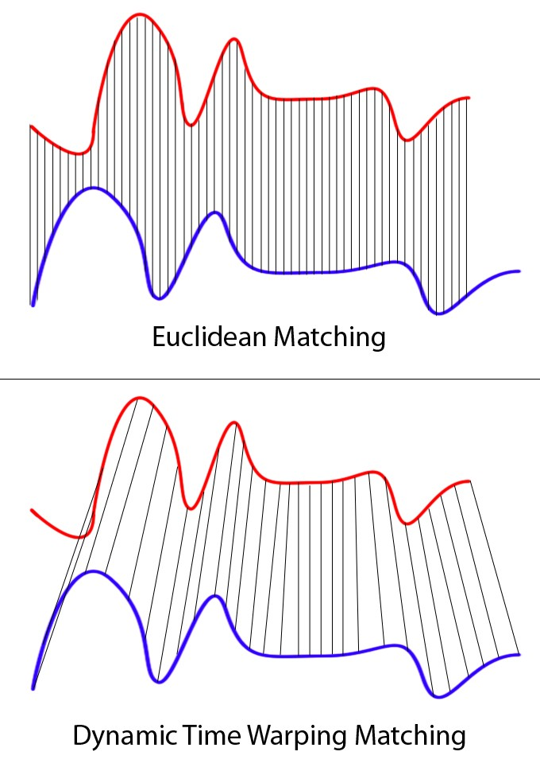
Dynamic Time Warping vs. Euclidean Distance
Euclidean Distance
Dynamic Time Warping
[Image Credit: https://towardsdatascience.com/dynamic-time-warping-3933f25fcdd]

Slide 19
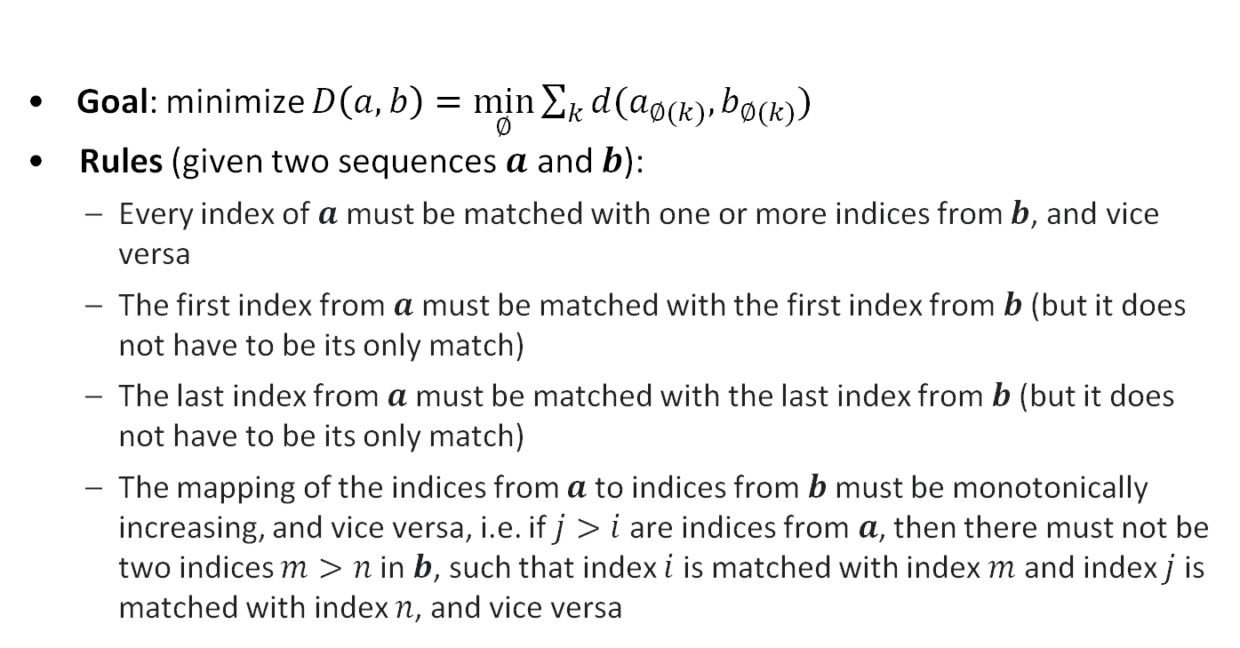
Dynamic Time Warping: Rules
Goal: minimize $D\left(a,b\right)=\min_{∅}{\sum_{k}{d(a_{∅(k)},b_{∅(k)})}}$
Rules (given two sequences $a$ and $b$):
Every index of $a$ must be matched with one or more indices from $b$, and vice versa
The first index from $a$ must be matched with the first index from $b$(but it does not have to be its only match)
The last index from $a$ must be matched with the last index from $b$(but it does not have to be its only match)
The mapping of the indices from $a$to indices from $b$must be monotonically increasing, and vice versa, i.e. if $j>i$ are indices from$a$, then there must not be two indices $m>n$ in $b$, such that index $i$ is matched with index $m$ and index $j$is matched with index $n$, and vice versa
Notes:
d: can for example be the Euclidean distance d(p,q) = sqrt( (p1-q1)^2 + (p2-q2)^2)
k: given alignment (we have as much pairs as the length of the longer sequences), in our example, k would be 6.
-> Write on slide: a = [1,2,3,5]
b=[2,2,2,4,4,3]

Slide 20




Dynamic Time Warping: Example
$$a=\left[1,2,3,5\right]$$
$$b=[2,2,2,4,4,3]$$
3
4
4
2
2
2
 | 1 | 2 | 3 | 5
$$b$$
$$a$$

Slide 21
Dynamic Time Warping: Example
$$a=\left[1,2,3,5\right]$$
$$b=[2,2,2,4,4,3]$$
3
4
4
2
2
2
 | 1 | 2 | 3 | 5
$$b$$
$$a$$
Notes:
Write alignment between sequences on slide

Slide 22
Dynamic Time Warping: Example
$$a=\left[1,2,3,5\right]$$
$$b=[2,2,2,4,4,3]$$
3
4
4
2
2
2
 | 1 | 2 | 3 | 5
$$b$$
$$a$$
Notes:
Write alignment between sequences on slide

Slide 23
Dynamic Time Warping: Possible Paths
$$a=\left[1,2,3,5\right]$$
$$b=[2,2,2,4,4,3]$$
3
4
4
2
2
2
 | 1 | 2 | 3 | 5
Three possible paths from each square
$$b$$
$$a$$

Slide 24
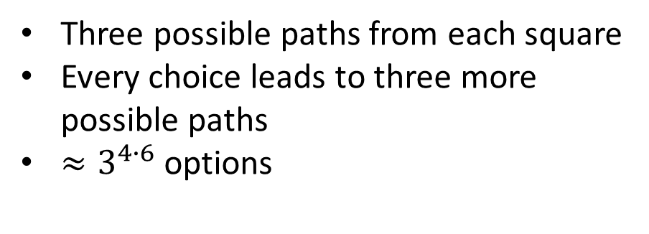
Dynamic Time Warping: Possible Paths
$$a=\left[1,2,3,5\right]$$
$$b=[2,2,2,4,4,3]$$
3
4
4
2
2
2
 | 1 | 2 | 3 | 5
Three possible paths from each square
Every choice leads to three more possible paths
$≈3^{4∙6}$ options
$$b$$
$$a$$
Notes:
Does someone have a better suggestion? Does this problem remind you of something?
-> WRITE in SpeakUp CHAT

Slide 25
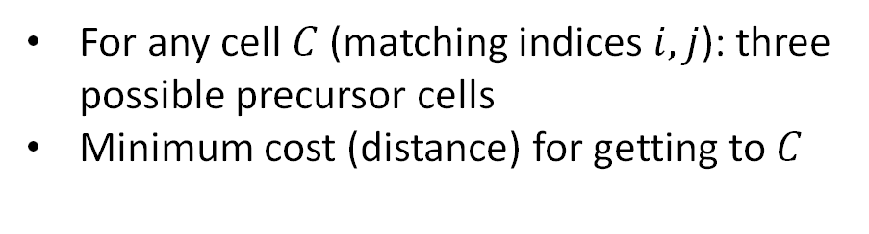
Dynamic Time Warping: Minimum Path
$$a=\left[1,2,3,5\right]$$
$$b=[2,2,2,4,4,3]$$
3
4
4
2
2
2
 | 1 | 2 | 3 | 5
For any cell $C$ (matching indices $i, j$): three possible precursor cells
Minimum cost (distance) for getting to $C$
$$b$$
$$d(i,j)+ min⁡(D\left(i−1,j\right), D\left(i−1,j−1\right),D\left(i,j−1\right))$$
$$a$$
Notes:
Dynamic programming

Slide 26

Dynamic Time Warping: Example
$$a=\left[1,2,3,5\right]$$
$$b=[2,2,2,4,4,3]$$
3 | 2 | 1 | 0 | 2
4 | 3 | 2 | 1 | 1
4 | 3 | 2 | 1 | 1
2 | 1 | 0 | 1 | 3
2 | 1 | 0 | 1 | 3
2 | 1 | 0 | 1 | 3
 | 1 | 2 | 3 | 5
3
4
4
2
2
2
 | 1 | 2 | 3 | 5
$$b$$
$$b$$
$$a$$
$$a$$
1. Compute pairwise distances
2. Compute minimum distance path
Notes:
Just do L1 distance here

Slide 27
Dynamic Time Warping: Example
$$a=\left[1,2,3,5\right]$$
$$b=[2,2,2,4,4,3]$$
3 | 2 | 1 | 0 | 2
4 | 3 | 2 | 1 | 1
4 | 3 | 2 | 1 | 1
2 | 1 | 0 | 1 | 3
2 | 1 | 0 | 1 | 3
2 | 1 | 0 | 1 | 3
 | 1 | 2 | 3 | 5
3
4
4
2
2
2 | 1
 | 1 | 2 | 3 | 5
$$b$$
$$b$$
$$a$$
$$a$$
1. Compute pairwise distances
2. Compute minimum distance path

Slide 28
Dynamic Time Warping: Example
$$a=\left[1,2,3,5\right]$$
$$b=[2,2,2,4,4,3]$$
3 | 2 | 1 | 0 | 2
4 | 3 | 2 | 1 | 1
4 | 3 | 2 | 1 | 1
2 | 1 | 0 | 1 | 3
2 | 1 | 0 | 1 | 3
2 | 1 | 0 | 1 | 3
 | 1 | 2 | 3 | 5
3 | 11
4 | 9
4 | 6
2 | 3
2 | 2
2 | 1
 | 1 | 2 | 3 | 5
$$b$$
$$b$$
$$a$$
$$a$$
1. Compute pairwise distances
2. Compute minimum distance path
Notes:
We cannot go back in time -> sum of pair-wise distances in first column

Slide 29
Dynamic Time Warping: Example
$$a=\left[1,2,3,5\right]$$
$$b=[2,2,2,4,4,3]$$
3 | 2 | 1 | 0 | 2
4 | 3 | 2 | 1 | 1
4 | 3 | 2 | 1 | 1
2 | 1 | 0 | 1 | 3
2 | 1 | 0 | 1 | 3
2 | 1 | 0 | 1 | 3
 | 1 | 2 | 3 | 5
3 | 11
4 | 9
4 | 6
2 | 3
2 | 2
2 | 1 | 1 | 2 | 5
 | 1 | 2 | 3 | 5
$$b$$
$$b$$
$$a$$
$$a$$
1. Compute pairwise distances
2. Compute minimum distance path
Notes:
The same holds along the first row

Slide 30
Dynamic Time Warping: Example
$$a=\left[1,2,3,5\right]$$
$$b=[2,2,2,4,4,3]$$
3 | 2 | 1 | 0 | 2
4 | 3 | 2 | 1 | 1
4 | 3 | 2 | 1 | 1
2 | 1 | 0 | 1 | 3
2 | 1 | 0 | 1 | 3
2 | 1 | 0 | 1 | 3
 | 1 | 2 | 3 | 5
3 | 11
4 | 9
4 | 6
2 | 3
2 | 2 | ?
2 | 1 | 1 | 2 | 5
 | 1 | 2 | 3 | 5
$$b$$
$$b$$
$$a$$
$$a$$
1. Compute pairwise distances
2. Compute minimum distance path
Notes:
The same holds along the first row

Slide 31
Dynamic Time Warping: Example
$$a=\left[1,2,3,5\right]$$
$$b=[2,2,2,4,4,3]$$
3 | 2 | 1 | 0 | 2
4 | 3 | 2 | 1 | 1
4 | 3 | 2 | 1 | 1
2 | 1 | 0 | 1 | 3
2 | 1 | 0 | 1 | 3
2 | 1 | 0 | 1 | 3
 | 1 | 2 | 3 | 5
3 | 11
4 | 9
4 | 6
2 | 3
2 | 2 | 1
2 | 1 | 1 | 2 | 5
 | 1 | 2 | 3 | 5
$$b$$
$$b$$
$$a$$
$$a$$
1. Compute pairwise distances
2. Compute minimum distance path
Notes:
Write on slide: $\text{D}\text{(2,2) = 0 + }\text{min}\text{(}\text{D}\text{(2,1),}\text{D}\text{(1,1),}\text{D}\text{(1,2))}$

Slide 32
Dynamic Time Warping: Example
$$a=\left[1,2,3,5\right]$$
$$b=[2,2,2,4,4,3]$$
3 | 2 | 1 | 0 | 2
4 | 3 | 2 | 1 | 1
4 | 3 | 2 | 1 | 1
2 | 1 | 0 | 1 | 3
2 | 1 | 0 | 1 | 3
2 | 1 | 0 | 1 | 3
 | 1 | 2 | 3 | 5
3 | 11
4 | 9
4 | 6
2 | 3
2 | 2 | 1 | ?
2 | 1 | 1 | 2 | 5
 | 1 | 2 | 3 | 5
$$b$$
$$b$$
$$a$$
$$a$$
1. Compute pairwise distances
2. Compute minimum distance path
Notes:
Write on slide: $\text{D}\text{(2,3) = 1 + }\text{min}\text{(}\text{D}\text{(2,2),}\text{D}\text{(1,2),}\text{D}\text{(1,3))}$

Slide 33
Dynamic Time Warping: Example
$$a=\left[1,2,3,5\right]$$
$$b=[2,2,2,4,4,3]$$
3 | 2 | 1 | 0 | 2
4 | 3 | 2 | 1 | 1
4 | 3 | 2 | 1 | 1
2 | 1 | 0 | 1 | 3
2 | 1 | 0 | 1 | 3
2 | 1 | 0 | 1 | 3
 | 1 | 2 | 3 | 5
3 | 11
4 | 9
4 | 6
2 | 3
2 | 2 | 1 | 2
2 | 1 | 1 | 2 | 5
 | 1 | 2 | 3 | 5
$$b$$
$$b$$
$$a$$
$$a$$
1. Compute pairwise distances
2. Compute minimum distance path

Slide 34
Dynamic Time Warping: Example
$$a=\left[1,2,3,5\right]$$
$$b=[2,2,2,4,4,3]$$
3 | 2 | 1 | 0 | 2
4 | 3 | 2 | 1 | 1
4 | 3 | 2 | 1 | 1
2 | 1 | 0 | 1 | 3
2 | 1 | 0 | 1 | 3
2 | 1 | 0 | 1 | 3
 | 1 | 2 | 3 | 5
3 | 11
4 | 9
4 | 6
2 | 3
2 | 2 | 1 | 2 | ?
2 | 1 | 1 | 2 | 5
 | 1 | 2 | 3 | 5
$$b$$
$$b$$
$$a$$
$$a$$
1. Compute pairwise distances
2. Compute minimum distance path
Notes:
Write on slide: $\text{D}\text{(2,4) = 3 + }\text{min}\text{(}\text{D}\text{(2,3),}\text{D}\text{(1,3),}\text{D}\text{(1,4))}$

Slide 35
Dynamic Time Warping: Example
$$a=\left[1,2,3,5\right]$$
$$b=[2,2,2,4,4,3]$$
3 | 2 | 1 | 0 | 2
4 | 3 | 2 | 1 | 1
4 | 3 | 2 | 1 | 1
2 | 1 | 0 | 1 | 3
2 | 1 | 0 | 1 | 3
2 | 1 | 0 | 1 | 3
 | 1 | 2 | 3 | 5
3 | 11
4 | 9
4 | 6
2 | 3
2 | 2 | 1 | 2 | 5
2 | 1 | 1 | 2 | 5
 | 1 | 2 | 3 | 5
$$b$$
$$b$$
$$a$$
$$a$$
1. Compute pairwise distances
2. Compute minimum distance path

Slide 36
Dynamic Time Warping: Example
$$a=\left[1,2,3,5\right]$$
$$b=[2,2,2,4,4,3]$$
Goal
3 | 2 | 1 | 0 | 2
4 | 3 | 2 | 1 | 1
4 | 3 | 2 | 1 | 1
2 | 1 | 0 | 1 | 3
2 | 1 | 0 | 1 | 3
2 | 1 | 0 | 1 | 3
 | 1 | 2 | 3 | 5
3 | 11 | 6 | 3 | 5
4 | 9 | 5 | 3 | 3
4 | 6 | 3 | 2 | 3
2 | 3 | 1 | 2 | 5
2 | 2 | 1 | 2 | 5
2 | 1 | 1 | 2 | 5
 | 1 | 2 | 3 | 5
$$b$$
$$b$$
$$a$$
$$a$$
1. Compute pairwise distances
2. Compute minimum distance path
Notes:
Minimum distance path to arrive at D(6,4)

Slide 37
Dynamic Time Warping: Example
$$a=\left[1,2,3,5\right]$$
$$b=[2,2,2,4,4,3]$$
Goal
3 | 11 | 6 | 3 | 5
4 | 9 | 5 | 3 | 3
4 | 6 | 3 | 2 | 3
2 | 3 | 1 | 2 | 5
2 | 2 | 1 | 2 | 5
2 | 1 | 1 | 2 | 5
 | 1 | 2 | 3 | 5
$$b$$
$$a$$
2. Compute minimum distance path
Notes:
Minimum distance path to arrive at D(6,4)

Slide 38
Dynamic Time Warping: Example
$$a=\left[1,2,3,5\right]$$
$$b=[2,2,2,4,4,3]$$
Goal
3 | 11 | 6 | 3 | 5
4 | 9 | 5 | 3 | 3
4 | 6 | 3 | 2 | 3
2 | 3 | 1 | 2 | 5
2 | 2 | 1 | 2 | 5
2 | 1 | 1 | 2 | 5
 | 1 | 2 | 3 | 5
$$b$$
$$a$$
2. Compute minimum distance path
Notes:
Minimum distance path to arrive at D(6,4)

Slide 39

Dynamic Time Warping: Example
$$a=\left[1,2,3,5\right]$$
$$b=[2,2,2,4,4,3]$$
Goal
3 | 11 | 6 | 3 | 5
4 | 9 | 5 | 3 | 3
4 | 6 | 3 | 2 | 3
2 | 3 | 1 | 2 | 5
2 | 2 | 1 | 2 | 5
2 | 1 | 1 | 2 | 5
 | 1 | 2 | 3 | 5
$$a=\left[1,2,3,5\right]$$
$$b$$
$$b=[2,2,2,4,4,3]$$
$$a$$
2. Compute minimum distance path
Notes:
Minimum distance path to arrive at D(6,4)

Slide 40
Dynamic Time Warping: Example
$$a=\left[1,2,3,5\right]$$
$$b=[2,2,2,4,4,3]$$
Goal
3 | 11 | 6 | 3 | 5
4 | 9 | 5 | 3 | 3
4 | 6 | 3 | 2 | 3
2 | 3 | 1 | 2 | 5
2 | 2 | 1 | 2 | 5
2 | 1 | 1 | 2 | 5
 | 1 | 2 | 3 | 5
$$a=\left[1,2,3,5\right]$$
$$b$$
$$b=[2,2,2,4,4,3]$$
$$a$$
2. Compute minimum distance path
Notes:
Minimum distance path to arrive at D(6,4)

Slide 41
Dynamic Time Warping: Example
$$a=\left[1,2,3,5\right]$$
$$b=[2,2,2,4,4,3]$$
Goal
3 | 11 | 6 | 3 | 5
4 | 9 | 5 | 3 | 3
4 | 6 | 3 | 2 | 3
2 | 3 | 1 | 2 | 5
2 | 2 | 1 | 2 | 5
2 | 1 | 1 | 2 | 5
 | 1 | 2 | 3 | 5
$$a=\left[1,2,3,5\right]$$
$$b$$
$$b=[2,2,2,4,4,3]$$
$$a$$
2. Compute minimum distance path
Notes:
Minimum distance path to arrive at D(6,4)

Slide 42
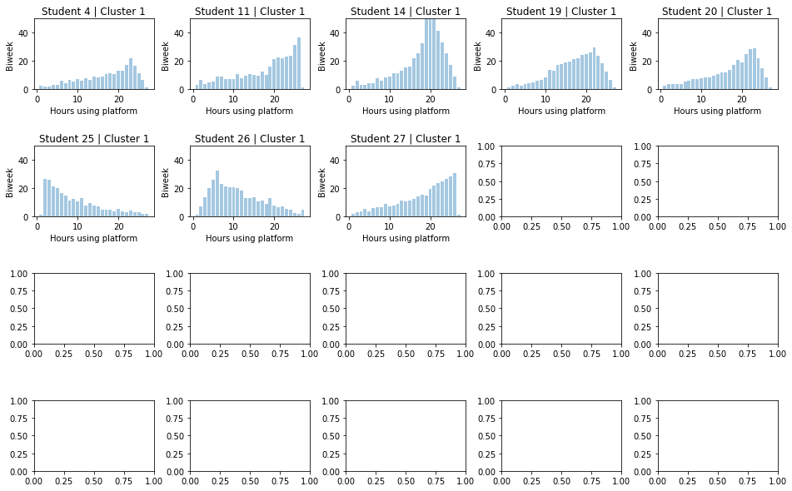
Dynamic Time Warping: Window
Sometimes, we might want to constrain the mapping
Notes:
What would happen is that the second entry of a would be assigned to all entries (which are 2) of b

Slide 43
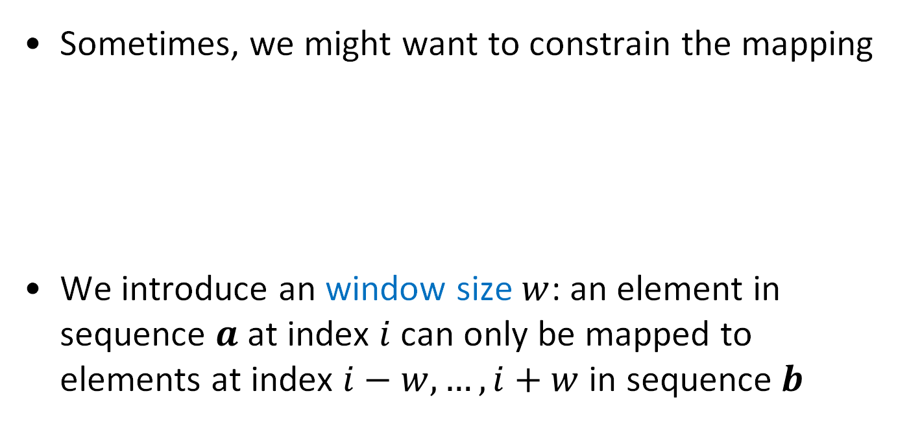
Dynamic Time Warping: Window
Sometimes, we might want to constrain the mapping
We introduce an window size $w$: an element in sequence $a$ at index $i$ can only be mapped to elements at index $i−w,…,i+w$ in sequence $b$
Notes:
What would happen is that the second entry of a would be assigned to all entries (which are 2) of b

Slide 44

Dynamic Time Warping: $w=2$
$$a=\left[1,2,3,5\right]$$
$$b=[2,2,2,4,4,3]$$
3 | 2 | 1 | 0 | 2
4 | 3 | 2 | 1 | 1
4 | 3 | 2 | 1 | 1
2 | 1 | 0 | 1 | 3
2 | 1 | 0 | 1 | 3
2 | 1 | 0 | 1 | 3
 | 1 | 2 | 3 | 5
3
4
4
2
2
2
 | 1 | 2 | 3 | 5
$$b$$
$$b$$
$$a$$
$$a$$
1. Compute pairwise distances
2. Compute minimum distance path

Slide 45
Dynamic Time Warping: $w=2$
$$a=\left[1,2,3,5\right]$$
$$b=[2,2,2,4,4,3]$$
3 | 2 | 1 | 0 | 2
4 | 3 | 2 | 1 | 1
4 | 3 | 2 | 1 | 1
2 | 1 | 0 | 1 | 3
2 | 1 | 0 | 1 | 3
2 | 1 | 0 | 1 | 3
 | 1 | 2 | 3 | 5
3 | -
4 | -
4 | -
2 | 3
2 | 2
2 | 1
 | 1 | 2 | 3 | 5
$$b$$
$$b$$
$$a$$
$$a$$
1. Compute pairwise distances
2. Compute minimum distance path
Notes:
i = 1: j=1,2,3

Slide 46
Dynamic Time Warping: $w=2$
$$a=\left[1,2,3,5\right]$$
$$b=[2,2,2,4,4,3]$$
3 | 2 | 1 | 0 | 2
4 | 3 | 2 | 1 | 1
4 | 3 | 2 | 1 | 1
2 | 1 | 0 | 1 | 3
2 | 1 | 0 | 1 | 3
2 | 1 | 0 | 1 | 3
 | 1 | 2 | 3 | 5
3 | - | -
4 | - | -
4 | - | 3
2 | - | 1
2 | 2 | 1
2 | 1 | 1
 | 1 | 2 | 3 | 5
$$b$$
$$b$$
$$a$$
$$a$$
1. Compute pairwise distances
2. Compute minimum distance path
Notes:
i = 2: j=1,…,4

Slide 47
Dynamic Time Warping: $w=2$
$$a=\left[1,2,3,5\right]$$
$$b=[2,2,2,4,4,3]$$
3 | 2 | 1 | 0 | 2
4 | 3 | 2 | 1 | 1
4 | 3 | 2 | 1 | 1
2 | 1 | 0 | 1 | 3
2 | 1 | 0 | 1 | 3
2 | 1 | 0 | 1 | 3
 | 1 | 2 | 3 | 5
3 | - | - | -
4 | - | - | 3
4 | - | - | 2
2 | - | 1 | 2
2 | 2 | 1 | 2
2 | 1 | 1 | 2
 | 1 | 2 | 3 | 5
$$b$$
$$b$$
$$a$$
$$a$$
1. Compute pairwise distances
2. Compute minimum distance path
Notes:
i = 3: j=1,…,5

Slide 48
Dynamic Time Warping: $w=2$
$$a=\left[1,2,3,5\right]$$
$$b=[2,2,2,4,4,3]$$
3 | 2 | 1 | 0 | 2
4 | 3 | 2 | 1 | 1
4 | 3 | 2 | 1 | 1
2 | 1 | 0 | 1 | 3
2 | 1 | 0 | 1 | 3
2 | 1 | 0 | 1 | 3
 | 1 | 2 | 3 | 5
3 | - | - | - | 5
4 | - | - | - | 3
4 | - | - | 2 | 3
2 | - | 1 | 2 | 5
2 | 2 | 1 | 2 | 5
2 | 1 | 1 | 2 | -
 | 1 | 2 | 3 | 5
$$b$$
$$b$$
$$a$$
$$a$$
1. Compute pairwise distances
2. Compute minimum distance path
Notes:
i = 4: j=2,…,6

Slide 49
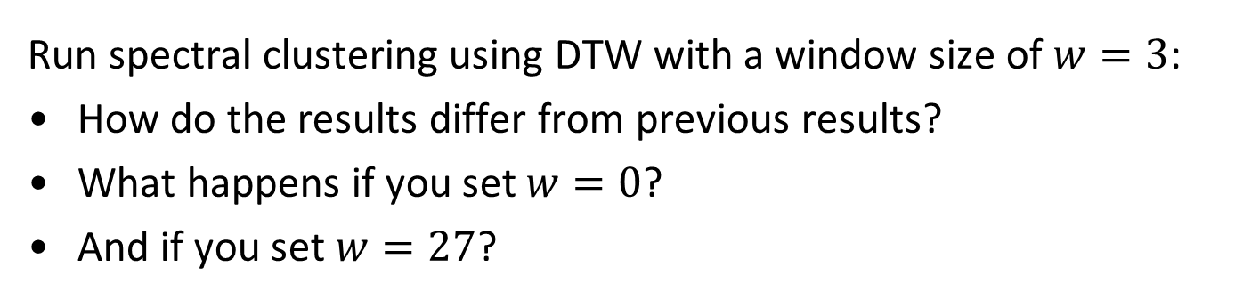
Your Turn – Dynamic Time Warping
Run spectral clustering using DTW with a window size of $w=3$:
How do the results differ from previous results?
What happens if you set $w=0$?
And if you set $w=27$?
https://go.epfl.ch/mlbd-speakup
Notes:
w=0 -> Euclidean distance
w=27: just detects peaks

Slide 50
Agenda
Aggregating features over time
Defining fixed time intervals (weeks, levels in a game, etc.)
Dynamic Time Warping
String Metrics
Markov Models

Slide 51
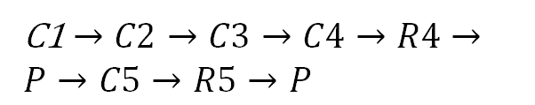
Example from Research: String Metrics
C1 $→C2→C3→C4→R4→P→C5→R5→P$
$$\text{C}\text{4}→\text{R}\text{4}→\text{P}→\text{C}\text{5}→R5→P$$
[Visualization and Confirmatory Clustering of Sequence Data from a Simulation-Based Assessment Task, Berger et al., EDM 2014]

Slide 52
Example from Research: String Metrics
Levensthein distance: minimal number of single character edits (insertion, deletion, substitution) to change one string into the other
Longest common subsequence (LCS): string similarity measure, find the longest common subsequence between two sequences
[Visualization and Confirmatory Clustering of Sequence Data from a Simulation-Based Assessment Task, Berger et al., EDM 2014]

Slide 53
Agenda
Aggregating features over time
Defining fixed time intervals (weeks, levels in a game, etc.)
Dynamic Time Warping
String Metrics
Markov Models

Slide 54
Markov Models
Detailed action sequences provide rich temporal information
Might contain a considerable amount of noise
We might be interested not in the detailed sequence, but in patterns (which actions tend to follow each other)

Slide 55
Markov Models
Game
Perfor- mance
Shop

Slide 56

Markov Models
Game
$$G→S→G→S→G→P→S→G$$
$$G→G→G→G→P→G→G$$
Perfor- mance
Shop
$$G→P→S→G→P→S$$

Slide 57



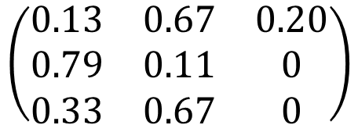


Parameters: Maximum Likelihood Estimation
$G→S→G→S→G→P→S→G→S→S→G→G→S→G→P→G→P→S→G→S→G→S$ $→S→G→S→G→G→S→G→S$ $→S→G→S$
$$p\left(S | G\right)=\frac{10}{15}=0.67$$
$$\begin{matrix}G & S & P\end{matrix}$$
$$\begin{matrix}G \\ S \\ P\end{matrix}$$
$$\left(\begin{matrix}0.13 & 0.67 & 0.20 \\ 0.79 & 0.11 & 0 \\ 0.33 & 0.67 & 0\end{matrix}\right)$$
$$p\left(G | G\right)=\frac{2}{15}=0.13$$
$$p\left(P | G\right)=\frac{3}{15}=0.20$$

Slide 58



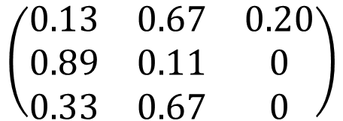
Stationary Distribution
$G→S→G→S→G→P→S→G→S→S→G→G→S→G→P→G→P→S→G→S→G→S$ $→S→G→S→G→G→S→G→S$ $→S→G→S$
$$\begin{matrix}G & S & P\end{matrix}$$
$$\begin{matrix}G \\ S \\ P\end{matrix}$$
$$\left(\begin{matrix}0.13 & 0.67 & 0.20 \\ 0.89 & 0.11 & 0 \\ 0.33 & 0.67 & 0\end{matrix}\right)$$
$$πT=π$$
Notes:
import scipy.linalg as la
lam, vec = la.eig(T, left=True, right=False)
idx = np.argmin(np.abs(lam - 1))
w = np.real(vec[:, idx])
w/w.sum()

Slide 59

Stationary Distribution
$G→S→G→S→G→P→S→G→S→S→G→G→S→G→P→G→P→S→G→S→G→S$ $→S→G→S→G→G→S→G→S$ $→S→G→S$
$$\begin{matrix}G & S & P\end{matrix}$$
$$\begin{matrix}G \\ S \\ P\end{matrix}$$
$$\left(\begin{matrix}0.13 & 0.67 & 0.20 \\ 0.89 & 0.11 & 0 \\ 0.33 & 0.67 & 0\end{matrix}\right)$$
$$πT=π$$
$$π=\left[\begin{matrix}0.48 & 0.43 & 0.09\end{matrix}\right]$$
Notes:
import scipy.linalg as la
lam, vec = la.eig(T, left=True, right=False)
idx = np.argmin(np.abs(lam - 1))
w = np.real(vec[:, idx])
pi = [0,48 0,43, 0,09]
w/w.sum()

Slide 60
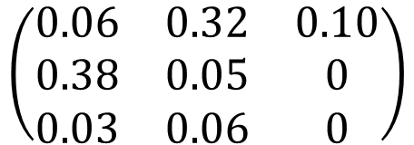


Expected Frequencies
When sequences get very long (n gets large), how often do we expect to observe the transitions?
$$\begin{matrix}G & S & P\end{matrix}$$
$$\begin{matrix}G \\ S \\ P\end{matrix}$$
$$\left(\begin{matrix}0.06 & 0.32 & 0.10 \\ 0.38 & 0.05 & 0 \\ 0.03 & 0.06 & 0\end{matrix}\right)$$
Notes:
pi = [0,48 0,43, 0,09]

Slide 61
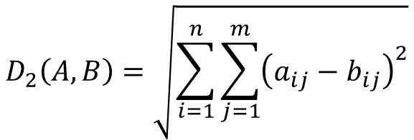
Distance Metrics
Based on Frobenius Norm: equivalent to Euclidean distance over vectors
$$D_{2}\left(A,B\right)=\sqrt{\sum_{i=1}^{n}{\sum_{j=1}^{m}{{\left(a_{ij}−b_{ij}\right)}^{2}}}}$$
Notes:
KL-Divergence: if Q(x) equals 0, than P(x) also needs to be 0 (lim x->0, x*log(x) = 0)

Slide 62
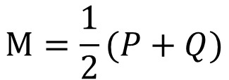
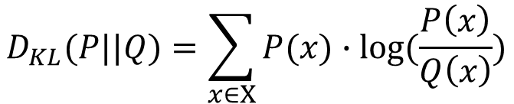
Distance Metrics
Kullback-Leibler Divergence: measures difference between two probability distributions
$$D_{KL}(P||Q)=\sum_{x∈Χ}{P(x)∙log⁡(\frac{P\left(x\right)}{Q\left(x\right)})}$$
Jensen-Shannon Divergence: measures difference between two probability distributions
$$M=\frac{1}{2}(P+Q)$$
$D_{JS}(P||Q)=$ ${\frac{1}{2}D}_{KL}(P|\left|M\right)+{\frac{1}{2}D}_{KL}(M|\left|Q\right)$
Notes:
KL-Divergence: if Q(x) equals 0, than P(x) also needs to be 0 (lim x->0, x*log(x) = 0)
JS-Divergence: between 0 and 1 for log with base 2

Slide 63
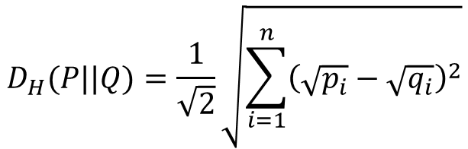
Distance Metrics
Hellinger Distance: measures difference between two probability distributions
$$D_{H}(P||Q)=\frac{1}{\sqrt{2}}\sqrt{\sum_{i=1}^{n}{{\left(\sqrt{p_{i}}−\sqrt{q_{i}}\right)}^{2}}}$$
Notes:
Hellinger Distance: bounded between 0 and 1

Slide 64
Distance between samples: Options
Compute distance between stationary distributions: use Hellinger Distance (or Jensen-Shannon Divergence)
Compute distance between transition matrices: use Frobenius Distance
Compute distance between expected frequencies: use Hellinger Distance (or Jensen-Shannon Divergence)

Slide 65
Example from Research: Spelling Learning
Three clusters:
Focused on the task
Children, who frequently check performance/shop in-between tasks
Spend long amounts of time off-task
Game
Perfor- mance
Shop
[Temporally Coherent Clustering of Student Data, Klingler et al., EDM 2016]
Notes:
-> Use Hellinger Distance between expected frequencies
-> Compute standard k-means on pairwise distance matrices

Slide 66
Summary - Handling Time Series Data
Aggregating features over time
Defining fixed time intervals (weeks, levels in a game, etc.)
Dynamic Time Warping
String Measures
Markov Models
Action Sequences

Slide 67
Administrative
The final exam will be on
Thursday 25.06.2026 from 09h15 to 12h15

