Slide 1
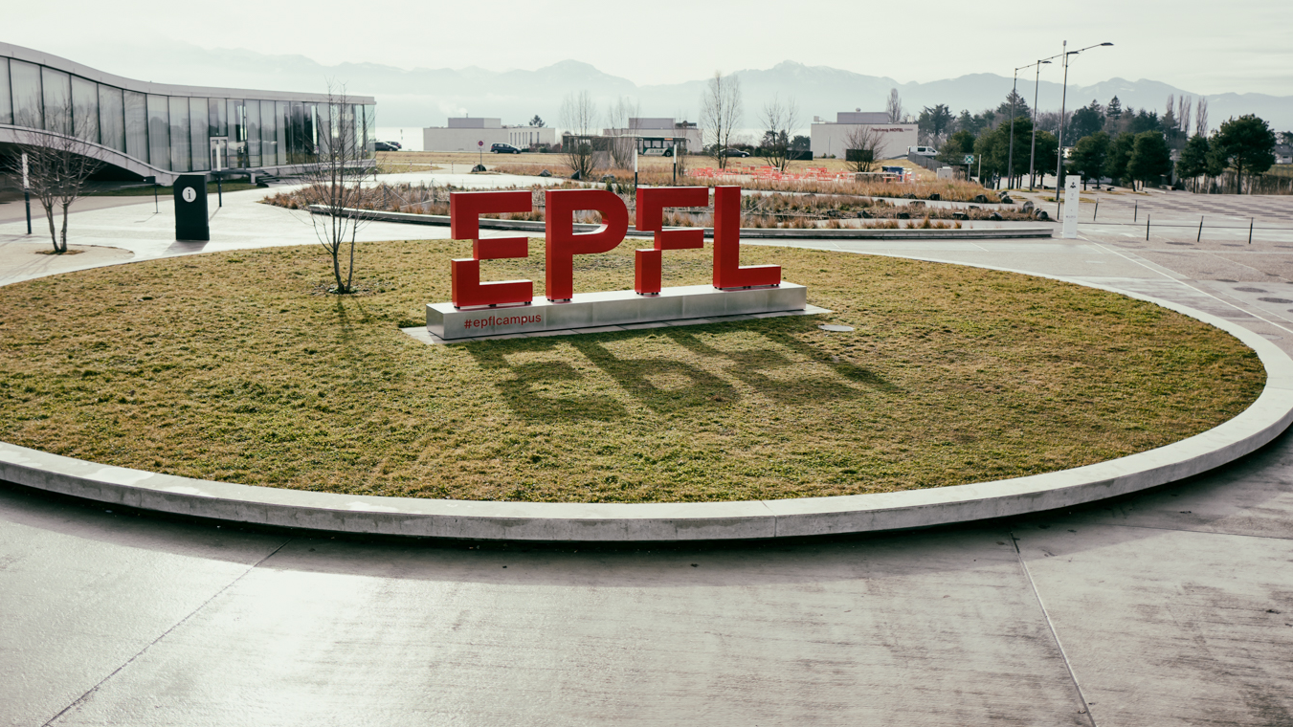
MSE-468 Virtual Machine

