Slide 1

A Study of Neighborhoods in Zurich
Ying Zhang
ying.zhang.fly@gmail.com
April 2020

Slide 2
Business Problem
The city of Zurich is splitted into 34 neighborhoods (German: "Quartier") for administrative purposes. We are interested in the following questions:
What characteristics do different neighborhoods have?
Which neighborhood should I go to if I want to hang out in bars or clubs?
Which neighborhoods are similar, and in what way?
The answers to these questions could help tourists decide how to explore the city; residents choose a neighborhood to live; and city planners make decisions.

Slide 3
Methodology and Data
Data collection: Foursquare.
Exploratory analysis.
Cluster analysis
PCA
K-Means

Slide 4
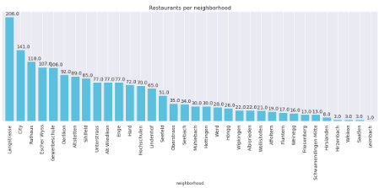
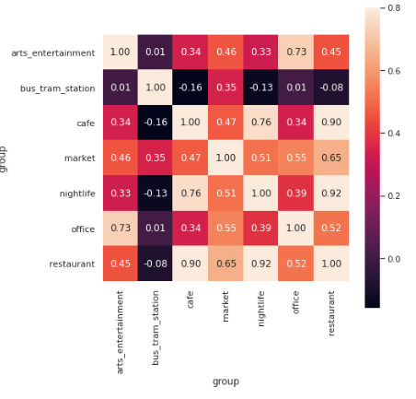
Results - I
Langstrasse is the most popular district for restaurants.
There is high correlation between nightlife, restaurant and cafe; as well as between office and arts_entertainment.
Correlations between market and other categories are low.

Slide 5
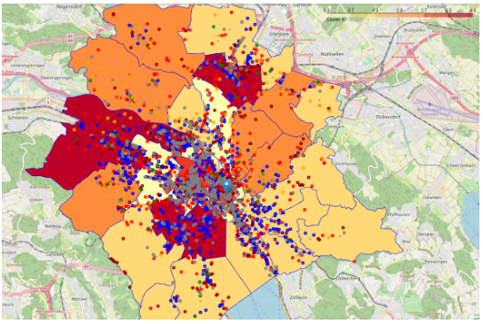
Results - III
Cluster 3 (red) consists of only one neighborhood: Langstrasse. No surprise as this is the well-know district for food, drinks and clubs.
Cluster 0 (light yellow) consists of 8 neighborhoods that are located around the city center. They are featured by high density of art and entertainment venues.
Cluster 4 (dard red) consists of 5 neighborhoods that are a bit away from the center but with rich facilities due to their proximity to respective train stations.
Cluster 2 (orange) consists of 6 neighborhoods that are a bit further away from the city center. They are in fact mostly relatively quite residential areas but still with public transportation to connect to other parts of the city.
Cluster 1 (yellow) consists of the rest of 14 neighborhoods that are less populated. They are mostly on the outskirt of the city with limited public transportation options.

Slide 6
Discussion
Applications
A tourist can use the results of this analysis to plan his or her city visit.
A residence who is about to move home can use the clustering results to help determine potential neighborhoods to consider.
City planners and administrators can consider applying initiatives that are proven successful in one neighborhood to other neighborhoods in the same cluster.
Limitations:
The choice of venue categories was limited to the accuracy and completeness of Foursquare data in Zurich. Crowd-sourced data might have smaller coverage for certain categories (e.g. offices) compared to others (e.g. restaurants). Using Google Map data might solve this issue.
We used abosulote number of venues as features in this analysis. Venue density with regards to area size or population of neighborhoods might describe better the 'feeling' of a district.
We limited our study to the official 34 administrative neighborhoods for simplicity. In fact, the analysis could be easily extended to much smaller grids or or blocks.

