Slide 1
EyeReply / VisioALS
Communication should still sound like you.
Webcam gaze AAC with personalized candidate replies
Kevin Xia • ICCHP 2026 Innovation Area
Notes:
Open with one sentence: ‘AAC can restore a channel for speech, but a channel is not the same thing as authorship.’ Then introduce EyeReply, the name used in the ICCHP program, and VisioALS, the software name. Do not start with the tech stack.

Slide 2
A correct reply can still feel like the wrong person
Illustrative example — same intent, different linguistic identity
“Want some tea?”
GENERIC
STYLE-MATCHED CANDIDATE
“Yes, please.”
“Absolutely. Tea is doing most of the work today.”
The goal is not more eloquent text. It is recognizable authorship.
2
Notes:
This example is intentionally labeled illustrative; do not present it as user-study evidence. Say: ‘The innovation I care about is not simply generating a plausible answer. It is generating choices the person would plausibly choose and phrase themselves.’

Slide 3
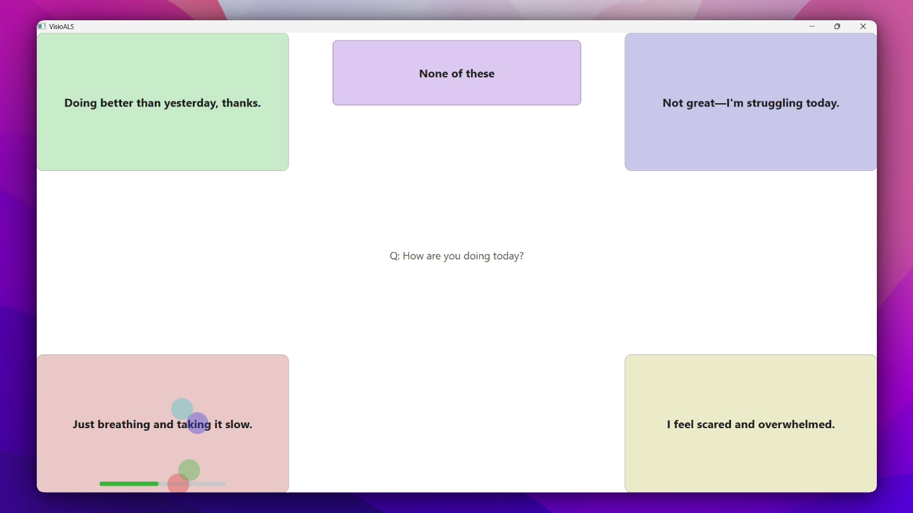
The interaction is deliberately simple
1 A partner speaks
2 Four candidate replies appear
3 The user selects by gaze
4 The chosen reply is spoken
“None of these” is always an answer.
3
Notes:
Use this slide only to set up the live demo. Ask someone in the room to say, ‘How are you doing today?’ Then let the system run. Narrate as little as possible while it is working. Deliberately point out ‘None of these’ because rejection is part of user agency, not an error state.

Slide 4
“Sounds like me” has three separate layers
01
02
03
Learn the style
Retrieve what is relevant
Adapt through choices
Past writing, plus transcripts from audio or video, describe vocabulary, brevity, tone and recurring expressions.
Selections and rejections become preference rules. The language can change; the current intent still comes from the user.
Similar past snippets help shape wording. They are style evidence—not facts about what the person wants now.
4
Notes:
Be precise here. Voice cloning is how the output sounds acoustically; linguistic identity is how the reply is worded. They are different. Also emphasize the safety boundary implemented in the prompt: profile material controls style only, never subject matter.

Slide 5
The user must remain the author
REJECT
ACCESS
None of these
Eyes or head
Rejection generates a new set instead of forcing a bad choice.
The input mode can follow changing motor ability.
FALLBACK
LEARNING
Communication continues
Choices teach the system
Local speech recognition and system TTS reduce total dependence on cloud services.
Adaptation is based on what the person selects—not what the model assumes.
5
Notes:
This is the design-principles slide. Keep it human-centered. Avoid listing model names unless someone asks. The strongest point is that generative suggestions do not remove authorship if the person retains choice, rejection and adaptation control.

Slide 6
We should evaluate the interaction, not just the model
Three small, honest measurements are enough for an Innovation Area demo.
01
02
03
Selection
Speed
Identity
Prompted looks to each target Report target hit rate and recalibrations.
Question end → speech start Report median and slowest trial.
Blind A/B: generic vs personalized Ask: “Which sounds more like you?”
Prototype evidence ≠ clinical evidence. Label the sample and conditions.
6
Notes:
If you can collect these before presenting, replace the descriptions with real numbers and state the device, lighting, number of trials and participant count. If you cannot, present this as the evaluation plan and say so. Do not call automated unit tests a user benchmark.

Slide 7
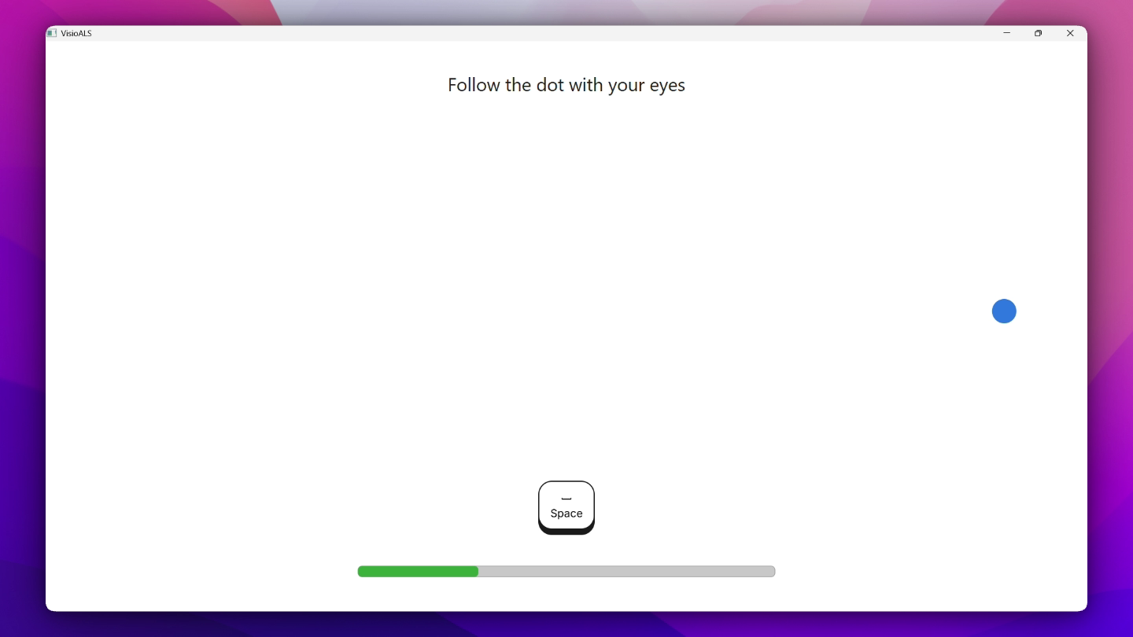
This is a working prototype—and real-world validation is next
What works now
• Standard webcam • Short calibration • Four gaze-selectable replies • Eye/head input modes • Personalized wording and voice
What still needs evidence
Use by people with ALS, across fatigue, posture, lighting and real conversations.
7
Notes:
This slide buys credibility. Say clearly whether any person with ALS has tested the current version. Experts at ICCHP will care more about an honest boundary and a sensible next study than an inflated claim. Invite collaborators who can help with participatory evaluation.

Slide 8
The question
Can fast AAC preserve not only speech—but authorship?
Try it. Reject a reply. Tell me where it stops feeling like the user.
EyeReply / VisioALS • open source
Notes:
Close by returning to the opening distinction between channel and authorship. Then move immediately to hands-on interaction: ‘Please try it. I am especially interested in the failures—bad suggestions, awkward gaze behavior, or anything that feels presumptuous.’

