Slide 1
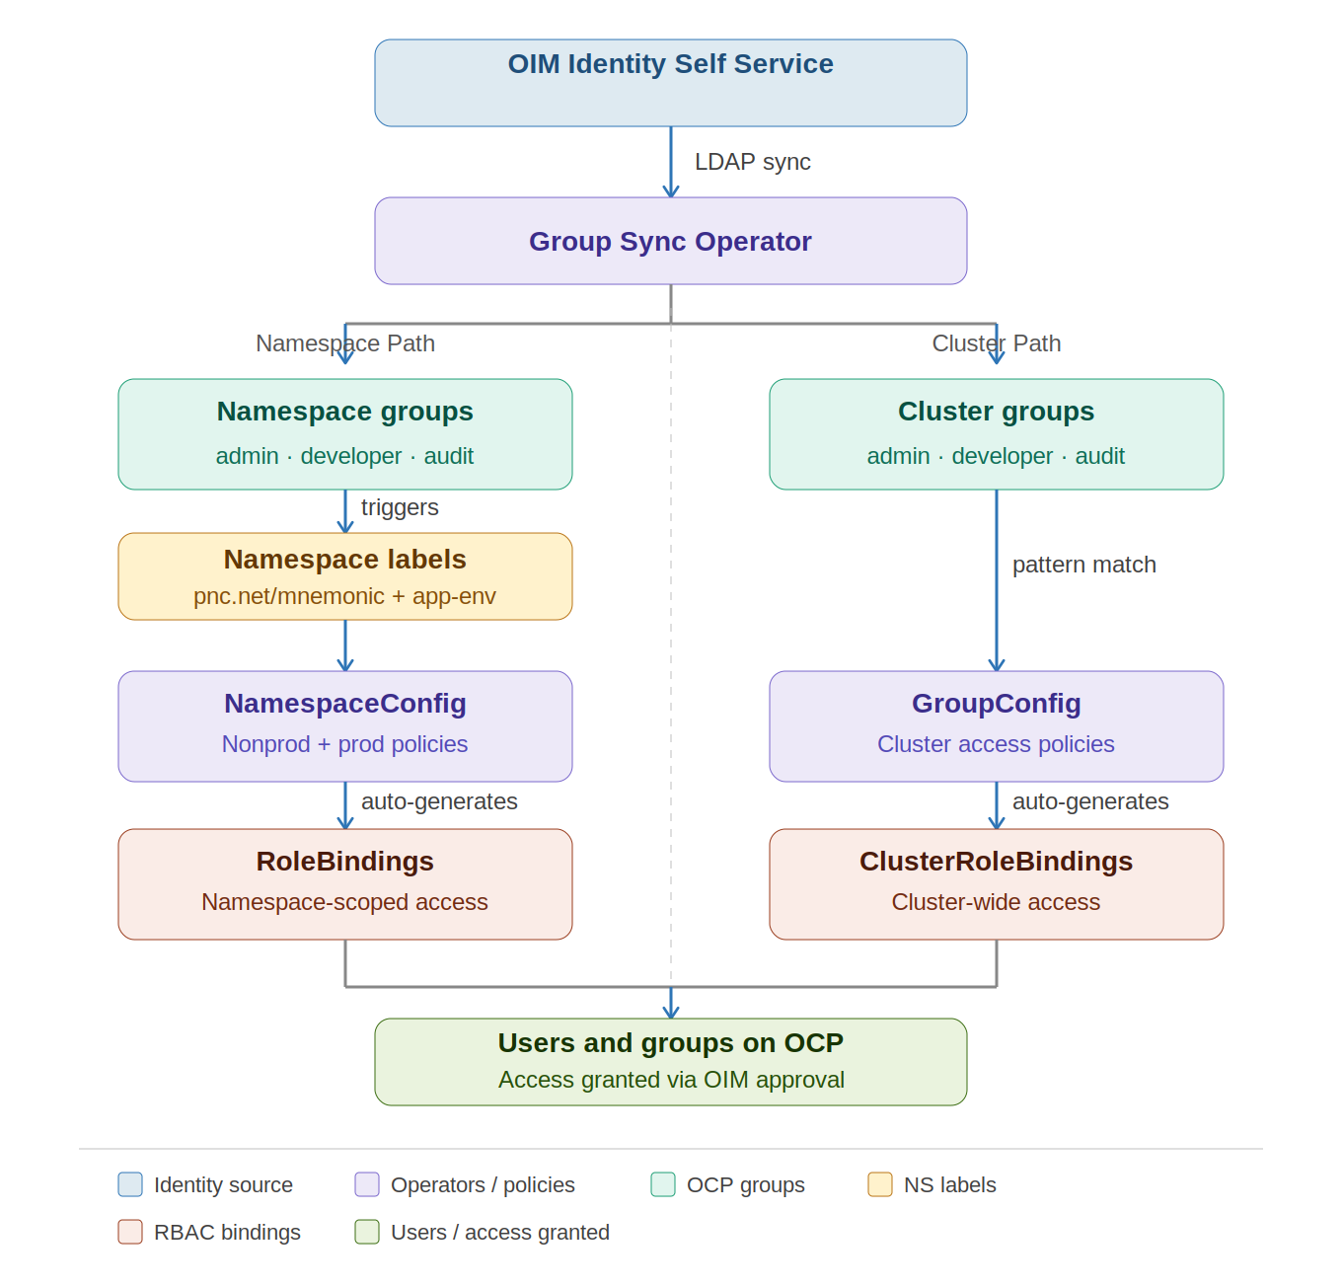
OpenShift RBAC Automation
Automated Group-to-Namespace Permission Mapping
Milestone 1.2 & 1.3
IS-20938 Compliant
OCP CaaS Team
March 2026
Lateef Onifade
Sr. Architect, OCP Team
OpenShift RBAC Automation · OCP CaaS Team · IS-20938 · March 2026
Slide 1 of 10

Slide 2
RBAC Automation — Architecture Overview
DESIGN
OIM — Enterprise Identity (Source of Truth)
syncs LDAP groups
Group Sync Operator
NAMESPACE PATH
CLUSTER PATH
Namespace Labels: pnc.net/mnemonic + app-env
AD Groups: app-ocp-rbac-{mnemonic}-cluster-{role}
watches labels
watches groups
Namespace Configuration Operator
GroupConfig Operator
auto-generates
auto-generates
RoleBindings (per namespace)
ClusterRoleBindings (cluster-wide)
Two automation paths — Namespace Path for MIS teams · Cluster Path for the CaaS team · Both driven by OIM · Both fully automated
OpenShift RBAC Automation · OCP CaaS Team · IS-20938 · March 2026
Slide 2 of 10

Slide 3
The Challenge We Solved
BEFORE
Before — Manual Process
Impact on the Organization
Namespace access tracked manually by platform team
Adding users across 70+ clusters and counting — tedious and error-prone
No authoritative identity system driving permissions
Access changes dependent on engineer availability
No consistent audit trail — who had access, when?
Non-compliant with IS-20938 requirements
Platform team bottleneck for every access request
MIS managers escalate frequently due to access delays
Security audit risk — access not tied to enterprise identity
Inconsistent access policies across teams and environments
Offboarding gaps — revocation not guaranteed or timely
This issue has existed since 2018 when OCP went live — every access change required a manual ticket to CaaS. Not scalable, not auditable, not compliant.
OpenShift RBAC Automation · OCP CaaS Team · IS-20938 · March 2026
Slide 3 of 10

Slide 4




Tools & Technologies
TOOLING
OIM
OpenShift (OCP)
Group Sync Operator
LDAP Frontend — Enterprise Identity Self Service
Container Platform — Kubernetes at enterprise scale
Syncs AD/LDAP groups into OpenShift clusters
Namespace Config Operator
Helm Charts
ArgoCD + GitOps
RBAC Policy Engine — PNC customized version
Packaging — Customized charts for deployment
CI/CD — Continuous deployment and drift reconciliation
All components are Red Hat backed open-source foundations with PNC enterprise customizations — packaged, versioned, and deployed via GitOps
OpenShift RBAC Automation · OCP CaaS Team · IS-20938 · March 2026
Slide 4 of 12

Slide 5
The New Model
SOLUTION
Centralized Identity
Automated Provisioning
Self-Service Access
All access governed through OIM Identity Self Service
Single source of truth for group membership
Offboarding in OIM automatically revokes OpenShift access
OIM approval triggers automatic RoleBinding creation
No platform engineer touches RBAC
Full operator-stamped audit trail on every binding
Developers request their own access through OIM portal
Mnemonic owner approves — access active on next sync
No ticket to the OCP CaaS team required
Zero-touch rollout for newly onboarded clusters
Policy as Code · IS-20938 Compliant · Zero manual RBAC administration · Scalable to any mnemonic
OpenShift RBAC Automation · OCP CaaS Team · IS-20938 · March 2026
Slide 4 of 10

Slide 6
RBAC Automation Stack — Reference Architecture
DESIGN
Two automation paths — Namespace Path for application teams · Cluster Path for the OCP CaaS team · Both driven by OIM · Both fully automated
OpenShift RBAC Automation · OCP CaaS Team · IS-20938 · March 2026
Slide 5 of 10

Slide 7
Policy as Code — The Namespace Config Operator
CONCEPT
Before — Imperative Commands
After — Namespace Config Operator
Engineers run oc adm policy commands manually
Each namespace requires individual RBAC setup
Policies live in runbooks, not in version control
No drift detection — config diverges silently
Changes are one-shot — no continuous reconciliation
RBAC defined as NamespaceConfig / GroupConfig CRDs
Operator watches namespace labels and group patterns
RoleBindings auto-generated and continuously reconciled
Drift is self-healing — operator restores desired state
Policy is versioned, reviewable, and repeatable
The Red Hat Namespace Config Operator turns RBAC policy into declarative CRDs — one policy definition governs every namespace automatically.
OpenShift RBAC Automation · OCP CaaS Team · IS-20938 · March 2026
Slide 6 of 10

Slide 8
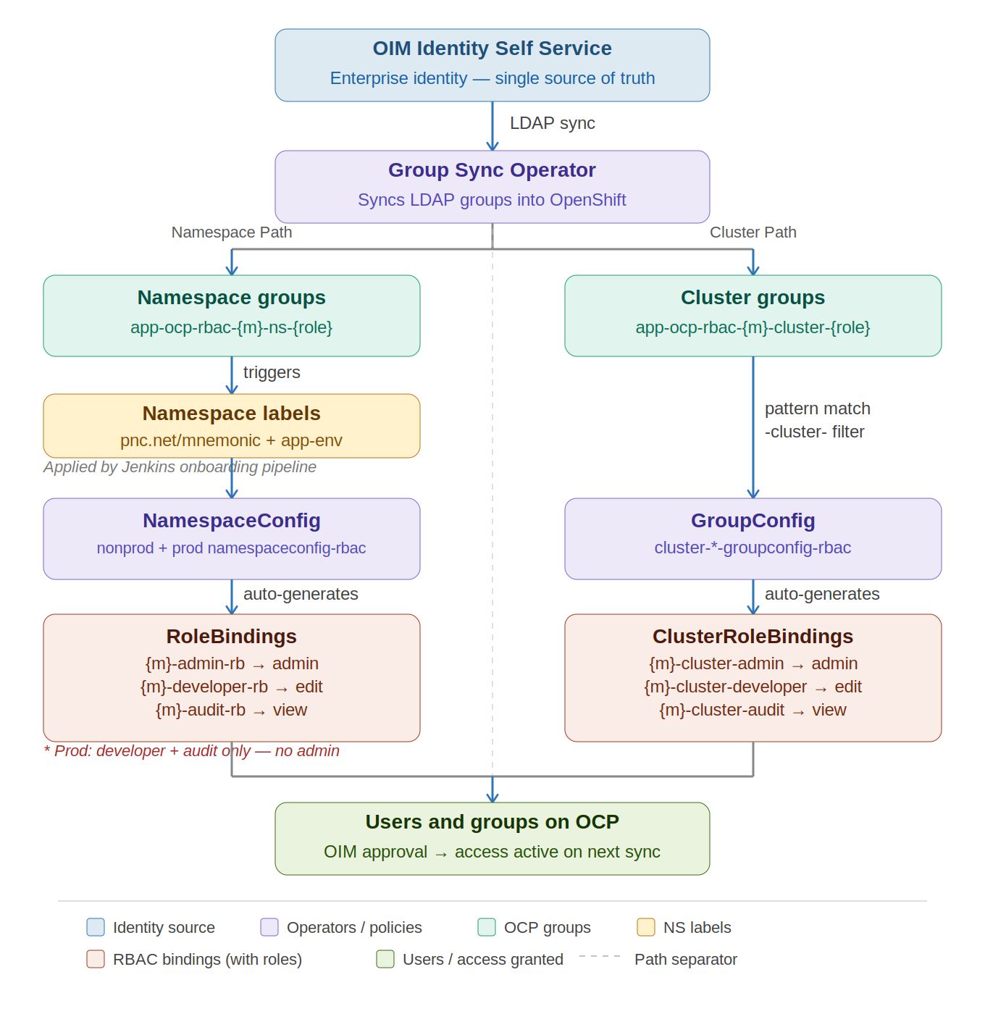
RBAC Automation Stack — Implementation Detail
TECHNICAL
pnc.net/mnemonic + app-env → triggers NamespaceConfig
app-ocp-rbac-{m}-cluster-{role} → triggers GroupConfig
Policy as Code — prod restrictions enforced declaratively
OpenShift RBAC Automation · OCP CaaS Team · IS-20938 · March 2026
Slide 7 of 10

Slide 9
Validated in RND — DAA Mnemonic Case Study
EVIDENCE
Live cluster output — daa-rnd namespace
What the metadata proves
NAME GROUP ROLE CREATED
daa-admin-rb ...daa-ns-admin admin 01:49:27Z
daa-audit-rb ...daa-ns-audit view 01:49:37Z
daa-developer-rb ...daa-ns-developer edit 01:49:01Z
rbac.ocp.io/created-by:
namespace-configuration-operator — not manually created
rbac.ocp.io/group-pattern:
app-ocp-rbac-daa-ns-developer — mnemonic resolved automatically
rbac.ocp.io/environment-restriction:
nonprod-only — correct policy branch applied
rbac.ocp.io/source-namespaceconfig:
nonprod-namespaceconfig-rbac — fully traceable
All 3 RoleBindings created within 36 seconds of a single namespace labeling event. Zero manual commands issued after labeling.
Cluster-level — ocp mnemonic
app-ocp-rbac-ocp-cluster-admin-crb cluster-admin admin app-ocp-rbac-ocp-cluster-admin
app-ocp-rbac-ocp-cluster-developer-crb cluster-developer edit app-ocp-rbac-ocp-cluster-developer
app-ocp-rbac-ocp-cluster-audit-crb cluster-audit view app-ocp-rbac-ocp-cluster-audit
OpenShift RBAC Automation · OCP CaaS Team · IS-20938 · March 2026
Slide 8 of 10

Slide 10
Outcomes
RESULTS
For Application Teams
For OCP CaaS Team
Self-service access through OIM portal
Access active within one sync cycle
Automatic revocation on offboarding
Zero manual RoleBinding administration
No access bottleneck or support tickets
MIS teams self-serve — no dependency on CaaS
Time saved by automating common day-2 request processes
For Security and Audit
For the Enterprise
Full operator-stamped audit trail on every binding
Policy as Code — all RBAC rules are declarative
Prod restrictions enforced automatically
IS-20938 compliant centralized access control
Policy as Code — versioned, reviewable, repeatable
OIM as single source of truth across OpenShift
Eliminates hours of manual effort per week across teams
Policy as Code — IS-20938 compliant, fully automated, and removes all manual RBAC management permanently.
OpenShift RBAC Automation · OCP CaaS Team · IS-20938 · March 2026
Slide 9 of 10

Slide 11
What's Next — Group Creation by Mnemonic Owner
ROADMAP
Next Phase: Mnemonic-Owner-Based Group Creation
1. Identify Owner
Pull mnemonic owner
from CMDB / ServiceNow
2. Create AD Groups
Auto-generate RBAC groups
per mnemonic + namespace
3. Bind to Namespaces
Handled by NamespaceConfig CRD
via Namespace Configuration Operator
What Changes
Developer Action Required
Group naming: app-ocp-rbac-{mnemonic}-{ns}-{role}
Owner auto-assigned from CMDB mnemonic owner
Namespace-scoped RoleBindings only (no ClusterRoles)
Self-service onboarding for new mnemonics
Confirm mnemonic ownership in ServiceNow
Request group creation via self-service portal
Validate bindings in non-prod before promotion
Review updated RBAC roles assigned to your team
Full Instructions on Confluence
https://confluence.pnc.net/display/CAAS/RBAC-Group-Creation-Guide
OpenShift RBAC Automation · OCP CaaS Team · IS-20938 · March 2026
Slide 10 of 11

Slide 12
Impact on Existing Access — Migration Required
ACTION REQUIRED
⚠ DEADLINE: December 4, 2026 — All manually created access will be removed. Access WILL be lost.
What's Changing
Who Must Act Now
All manually created RoleBindings will be removed
Only OIM-driven, operator-managed bindings will remain
Security audit findings require phasing out the old model
The CaaS team has no control or workaround — this is mandatory
Mnemonic Owners — confirm ownership in CMDB
Product Owners — ensure teams migrate to OIM groups
MIS Development Teams — request access via OIM portal
Stakeholders — communicate to downstream teams immediately
Phase 1 Now — Q3 2026
Communication & onboarding. Teams begin OIM migration.
Phase 2 Q3 2026 — Q4 2026
Legacy bindings flagged. Warnings issued to non-migrated teams.
Phase 3 Q4 2026 — Dec 4, 2026
All manual access removed. No exceptions. No workarounds.
Do not wait — begin OIM migration today. After December 4, 2026, there is no path to restore manually created access.
OpenShift RBAC Automation · OCP CaaS Team · IS-20938 · March 2026
Slide 12 of 13

