Slide 1
OCP ACCESS TRACKING DASHBOARD
OpenShift Access Tracking & Reporting
Who can reach what, on every cluster: for the people who hold access, and for the quarterly review that must prove it.
Application 5.8.0 · chart 0.70.12 · every screenshot is from the lab on 2026-10-08: the running dashboard, or a report it generated
Notes:
Introduce the tool by the question it answers: who can reach what. Part 1 is for leadership and audit (why); part 2 is for the platform team (how).

Slide 2
THE PROBLEM
Access on OpenShift fails silently
9
A binding names a group that does not exist
It looks healthy and grants nobody.
RoleBindings granting admin, view and edit to groups that have never existed, found on the reference cluster.
A binding names a person, not a group
Removing them from the directory revokes nothing: it survives offboarding.
oc get rolebinding reports every one of them as healthy.
A group silently stopped being refreshed
The sync still reports success.
Source: the dashboard's README, the failures it surfaces and the reference cluster's finding
2 / 19
Notes:
The point: none of these raise an event or a failed reconcile. Each is an absence, and absences are what a person reading oc get does not notice. The 9 comes from the README's reference cluster.

Slide 3
WHY NOW
Two needs, one source of truth
Self-service
Quarterly access review
Everyone can answer “what access do I have, and how did I get it” without a ticket, an oc login with rights they do not have, or a platform engineer.
Auditors need evidence that names the access, the reviewer, the time and the outcome, and shows what changed since the last review. SOC 2, ISO 27001 A.5.18 (which replaced A.9.2.5 of the 2013 edition) and SOX centre on dormant, orphaned and privileged access.
The same observed data answers both: one view of access per person, and evidence for the review, drawn from it.
Sources: ACCESS_CONTROL.md (the self tier's purpose) · DESIGN_reporting_service.md (compliance guidance)
3 / 19
Notes:
Self-service lowers the load on the platform team; quarterly review is a compliance requirement. The tool serves both from one read-only record.

Slide 4
THE TOOL
What it is
Read-only
Every cluster, one view
It observes; it never creates or edits a GroupSync CR, a binding or a group.
One dashboard on the host cluster reads every joined cluster, each with that cluster's own token.
Signed in with OpenShift
Evidence on demand and on schedule
People log in the way they already do; the cluster decides what each person may see.
Eleven reports as PDF/A, HTML, CSV and JSON, generated by hand or by a schedule.
Source: README · the chart's templates · the reports catalogue
4 / 19
Notes:
Four properties to remember: read-only, every cluster, OpenShift login, evidence. Product name on screen: OCP Access Tracking Dashboard.

Slide 5
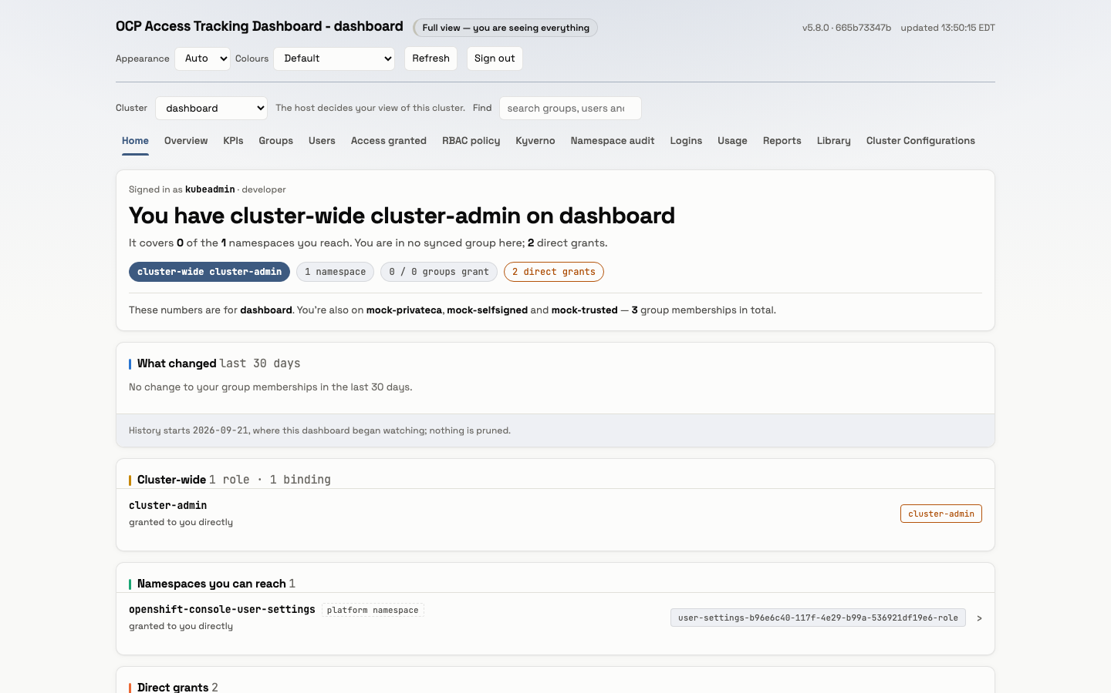
FOR EVERYONE
Self-service: everyone sees their own access
Home is always the reader's own access, administrators included.
It shows the cluster-wide roles, the namespaces they reach and how: through a group, or a grant naming them directly.
A view someone may not open shows a named refusal, never a blank page: an empty audit tab would read as a healthy cluster.
Screenshot: Home, light theme, the lab at 5.8.0 · ACCESS_CONTROL.md and the README for the refusal rule
5 / 19
Notes:
Demo flow: sign in, open Home, read your own access. Direct grants are highlighted because they survive leaving a team.

Slide 6
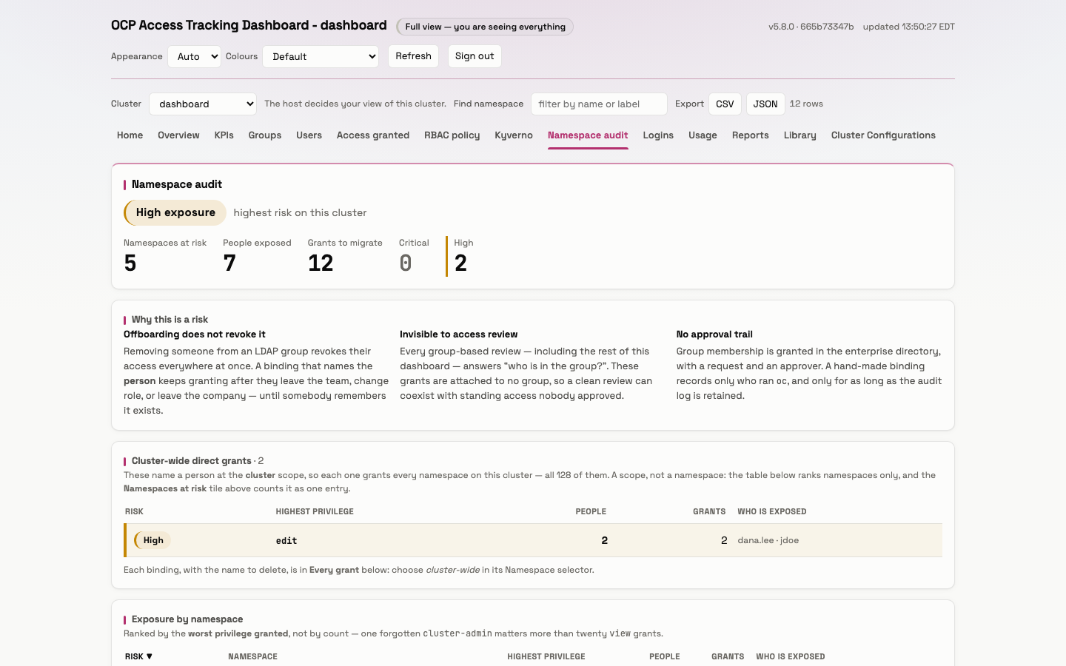
NAMESPACE AUDIT
For owners and auditors: what a group review cannot see
Grants that name a person rather than a group survive offboarding, and every group-based review misses them.
The page ranks namespaces by the worst privilege granted and names who is exposed.
Operational goal: zero rows. At zero, one directory change offboards a person from the entire cluster, and an access review that reads clean is clean.
Screenshot: Namespace audit, light theme, the lab at 5.8.0 · the page's own text
6 / 19
Notes:
The lab shows 5 namespaces at risk, 7 people, 12 grants to migrate. The quote is the page's own operational goal.

Slide 7
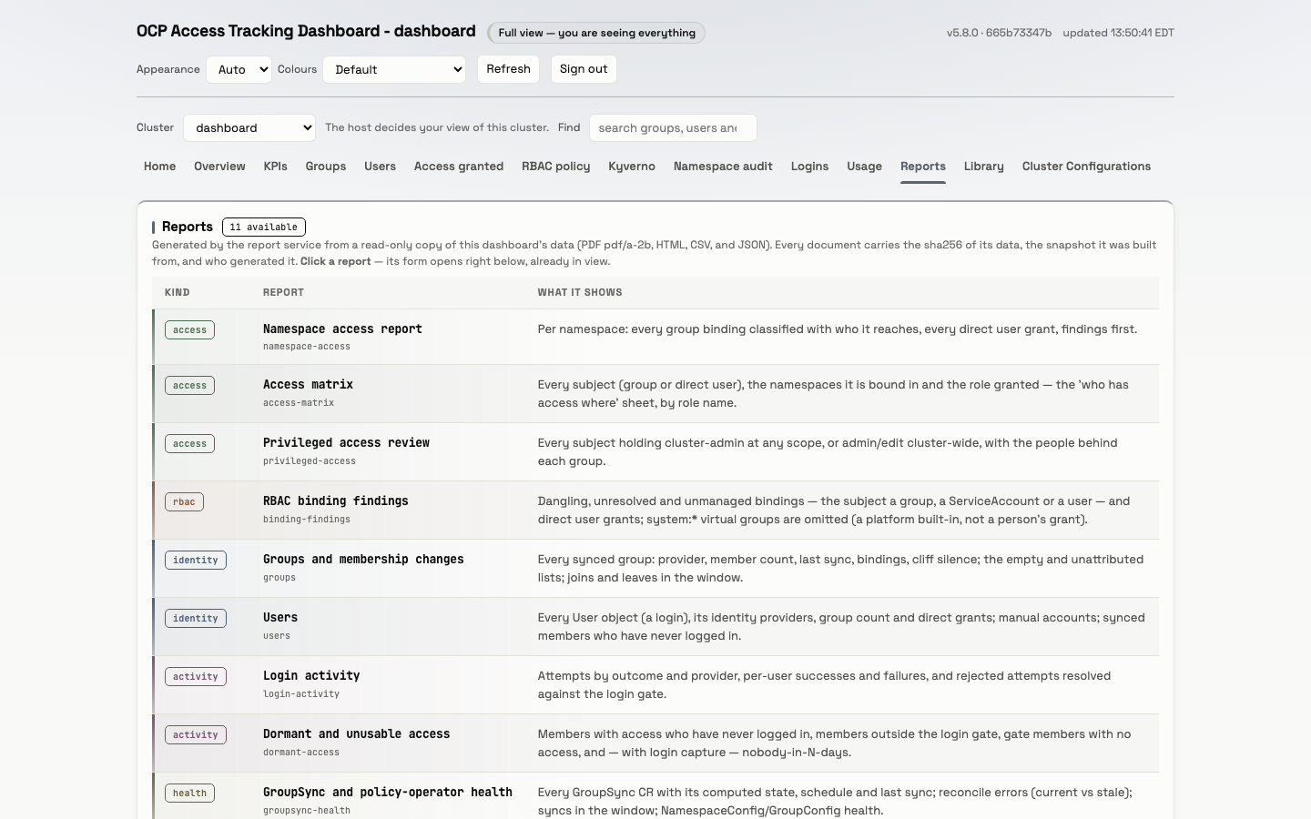
EVIDENCE
Eleven reports, one per review question
Who can reach each namespace; the access matrix; privileged access; binding findings.
Groups and their changes; users; login activity; dormant access; sync health.
A one-page compliance snapshot, and an access certification pack for sign-off.
Every document carries the sha256 of its data, the snapshot it was built from, and who generated it.
Screenshot: Reports, light theme, the lab at 5.8.0 · docs/reports/README.md
7 / 19
Notes:
Walk the catalogue top to bottom; each report answers one question an access review asks. Formats: PDF/A-2b, HTML, CSV, JSON.

Slide 8
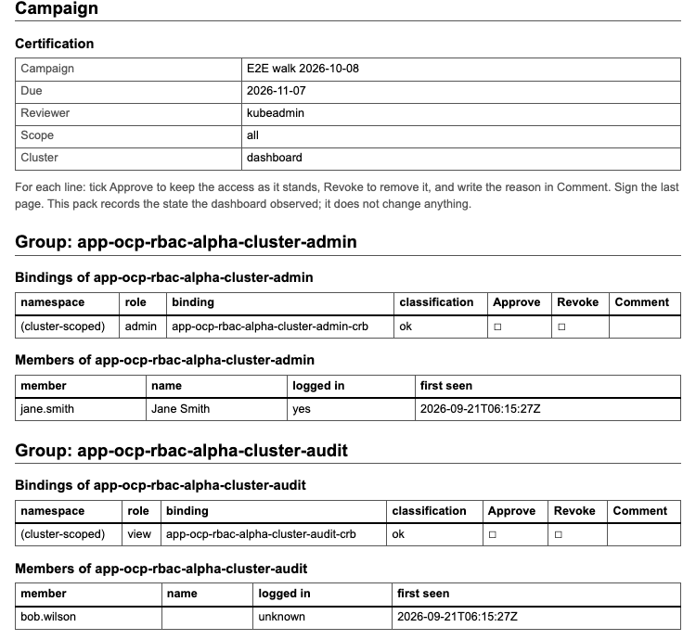
QUARTERLY REVIEW
The certification pack: approve or revoke, line by line
A campaign with a due date and a named reviewer.
Every group's bindings, and every grant naming a person directly, with empty Approve, Revoke and Comment columns, and the members behind each group.
“This pack records the state the dashboard observed; it does not change anything.” The reviewer signs the last page.
Screenshot: the access-certification report as HTML, generated on the lab at 5.8.0
8 / 19
Notes:
This is the artefact the quarterly review signs. Decisions are recorded on paper or in the PDF; the dashboard never changes access.

Slide 9
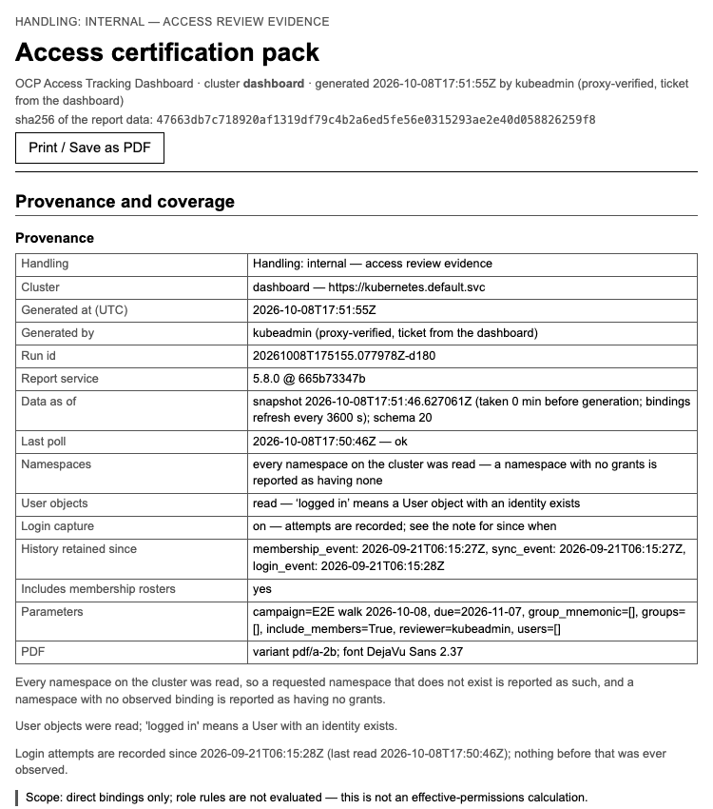
PROVENANCE
Evidence an auditor can trust
The sha256 of the report's data, the snapshot it was read from, and its schema.
Who generated it (a person verified by the OpenShift login, or the schedule by name) and when.
PDF/A-2b for archiving; a report diff answers “what changed since the last review”.
Login attempts are kept 400 days, so a year-over-year review still sees the previous cycle.
Screenshot: the report's provenance, the lab at 5.8.0 · values.yaml (login retention) · SPEC_F3 (report diff)
9 / 19
Notes:
Point at the provenance table: who, when, from which snapshot, with which build. The 400 days is the chart's login retention.

Slide 10
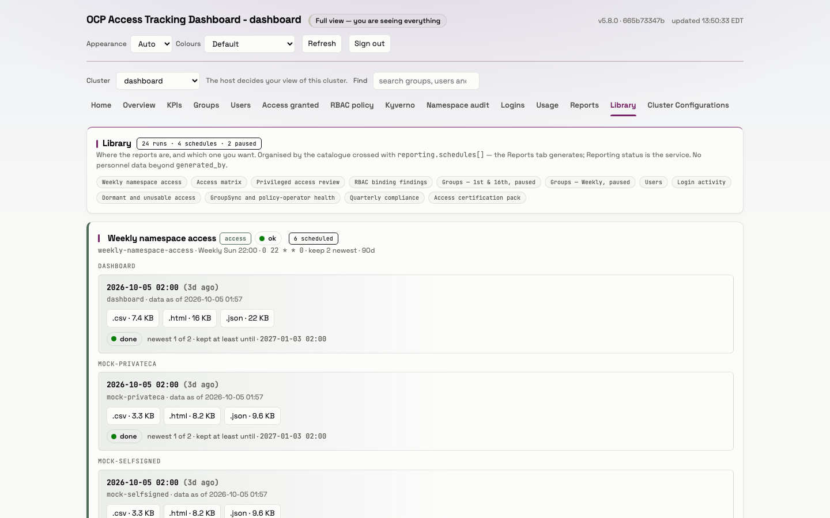
EVERY QUARTER
Scheduled, not remembered
quarterly-compliance
0 5 1 1,4,7,10 *
05:00 New York time on 1 January, April, July and October; every run kept 2,555 days, about seven years, and the newest 12 per cluster beyond that.
Each scheduled run can send one CloudEvent to a webhook.
An alert fires when a schedule runs late.
Screenshot: Library, light theme, the lab at 5.8.0 · environments/crc.yaml (the quarterly schedule)
10 / 19
Notes:
The schedule is the lab's own values. Delivery is a webhook CloudEvent per run; GroupSyncDashboardReportScheduleLate fires on a late schedule.

Slide 11
PART 2
How it works
Read-only by design: it reads clusters, and it never changes anyone's access.
11 / 19
Notes:
Switch to the technical audience: tiers, architecture, one poll, reporting, credentials, operations, rollout.

Slide 12
ACCESS TIERS
Who sees what: the cluster decides
Tier | Who has it | What they see
Self | Everyone who can sign in | Their own access: Home, and their own rows
Auditor | Can list clusterrolebindings, for example through an auditor group | Every cluster-wide audit view, Reports and Library; Usage stays their own
Usage | Passes the usage question; by default the same one as Cluster-admin | The Usage tab: everyone's activity
Cluster-admin | Can update clusterrolebindings | KPIs and Cluster Configurations, plus all of the above
A SubjectAccessReview on the cluster decides each tier; the answer is cached 60 s, and any failure falls back to Self.
Sources: ACCESS_CONTROL.md · values.yaml (adminSar, usageAdminSar, clusterAdminSar) · kube.py TierResolver
12 / 19
Notes:
The dashboard never decides access itself; it asks the cluster. A failed check always narrows, never widens.

Slide 13
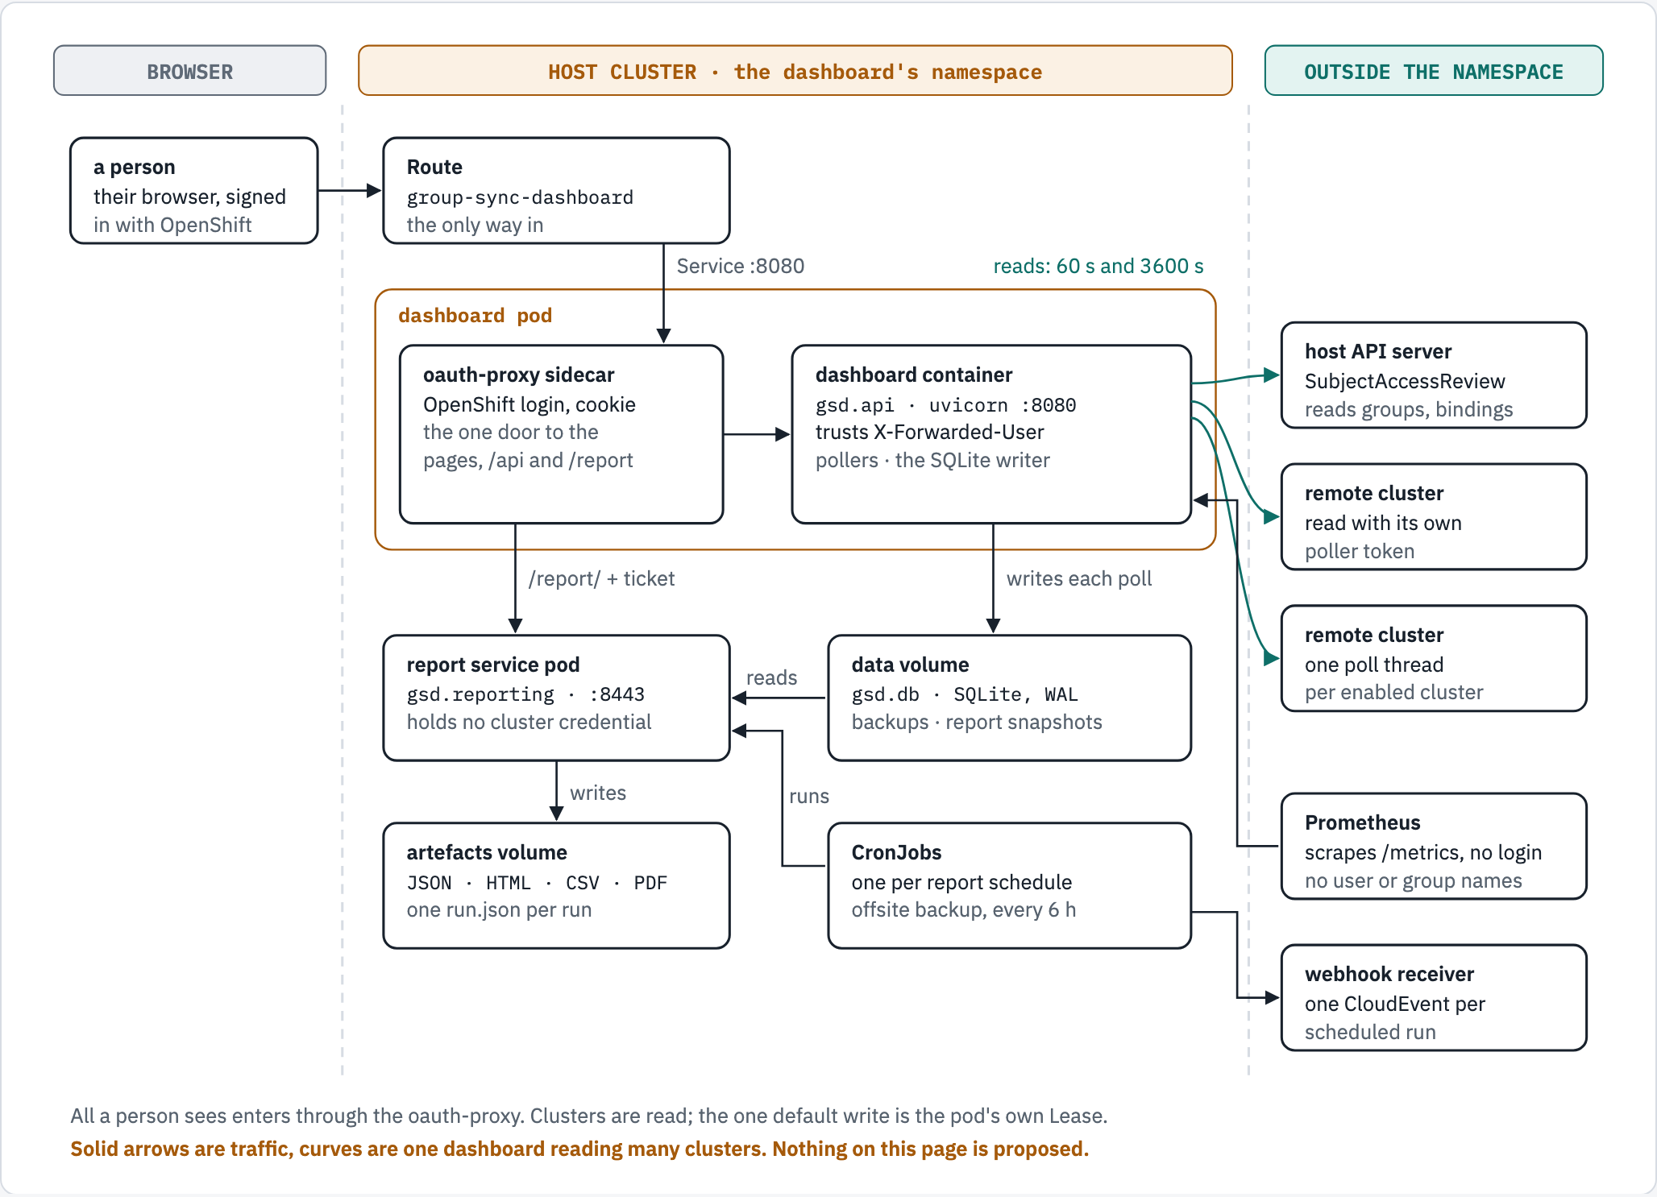
ARCHITECTURE
Architecture at a glance
Figure 1 of docs/guides/architecture-overview.md, drawn from the code at 5.8.0
13 / 19
Notes:
One door (oauth-proxy), one writer (the dashboard), a report pod that reads a snapshot and never a cluster.

Slide 14
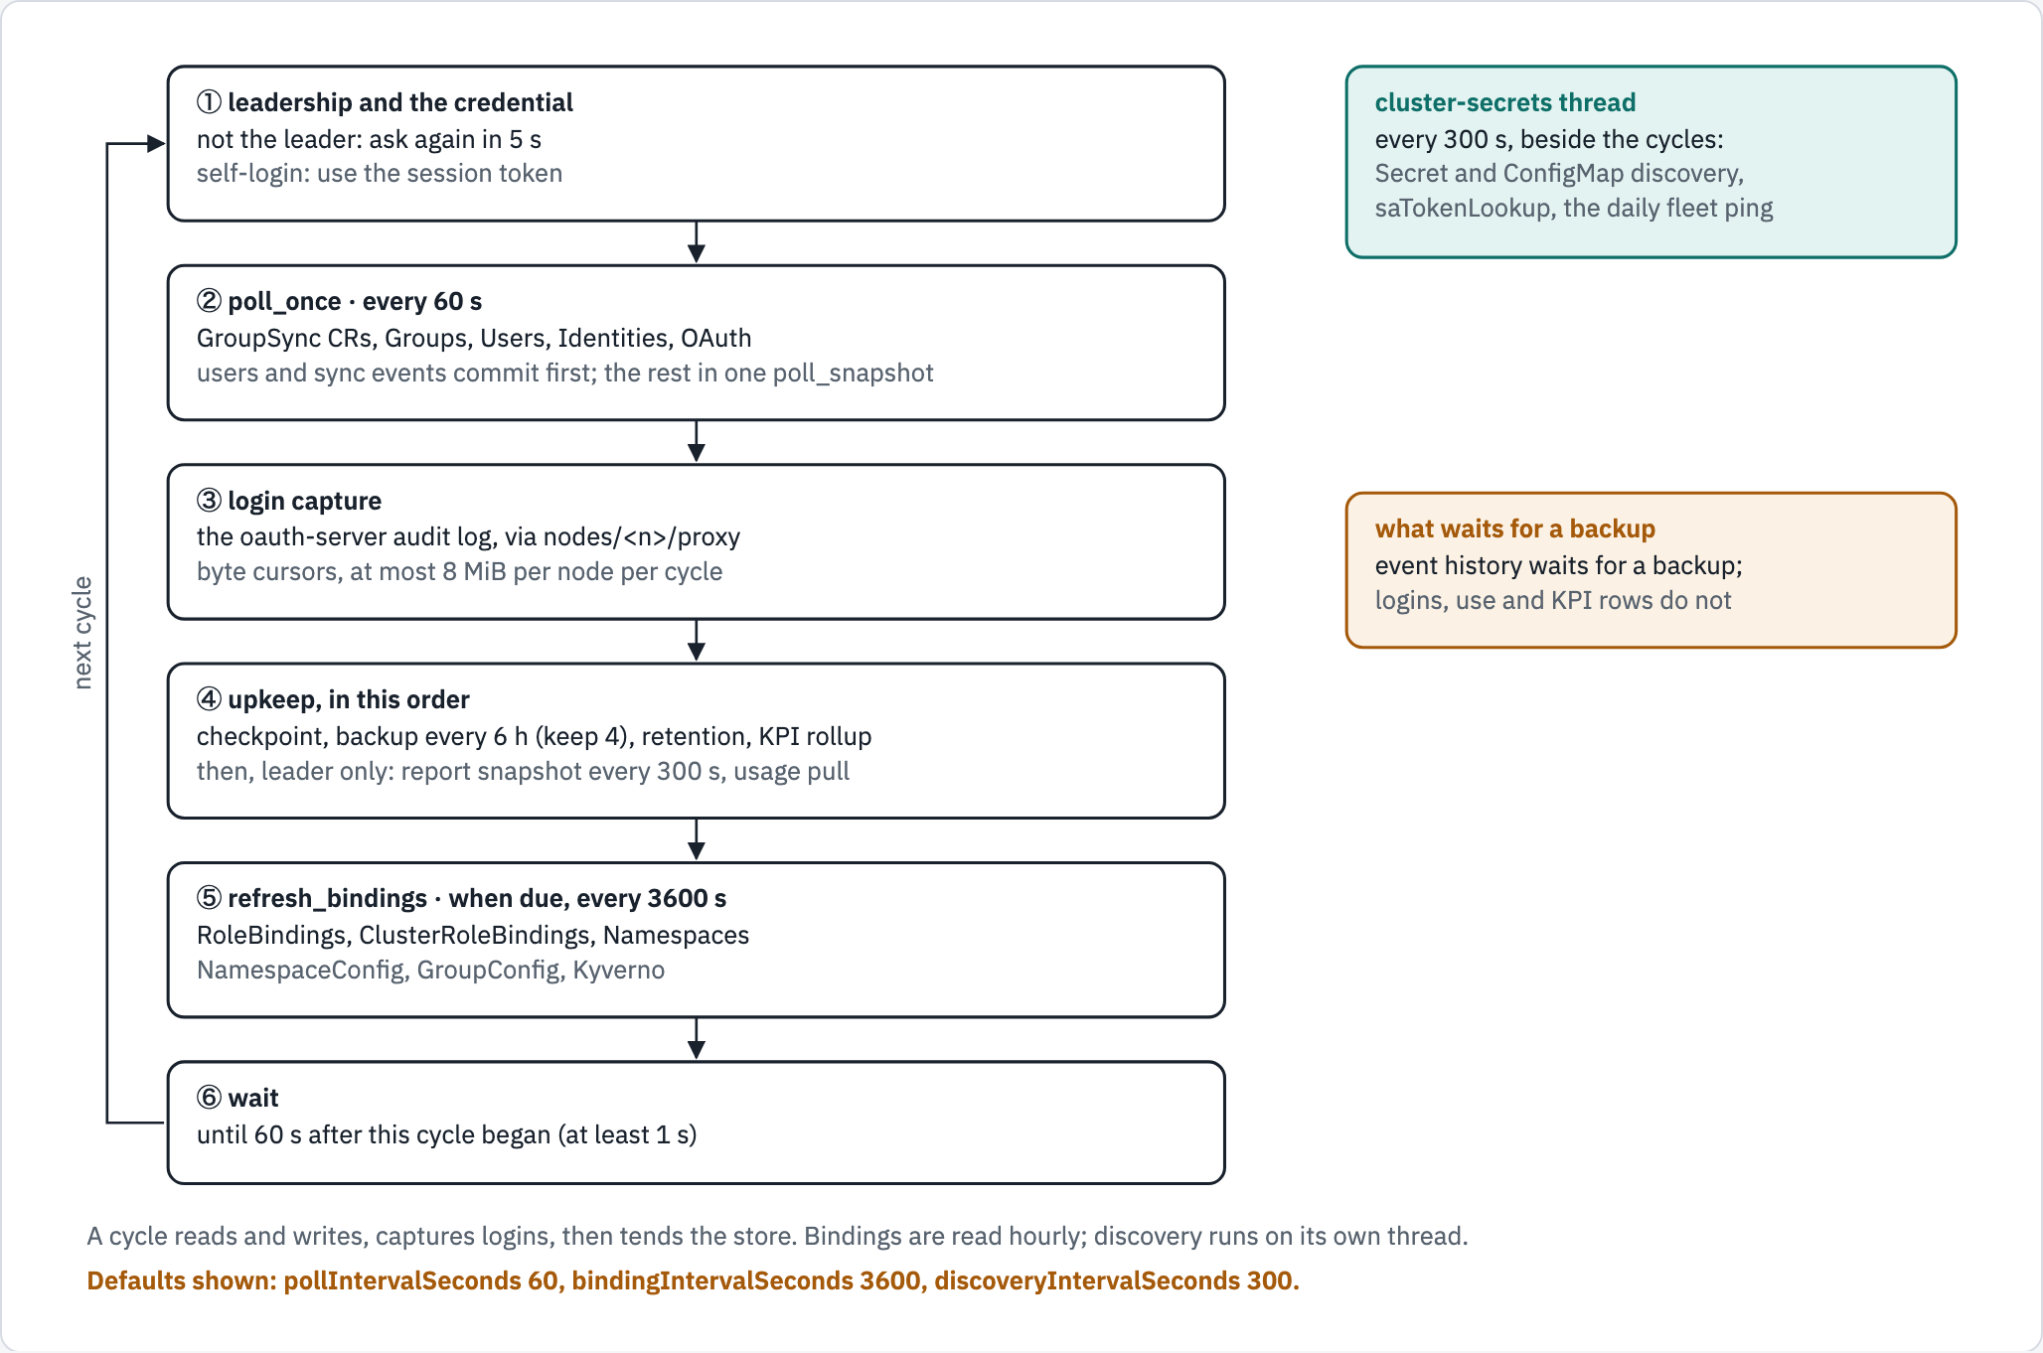
ARCHITECTURE
Inside one poll cycle
Figure 3 of docs/guides/architecture-overview.md
14 / 19
Notes:
Every 60 s each cluster is read and written in one transaction; bindings hourly; sync, membership and Kyverno history is pruned only after a successful backup.

Slide 15
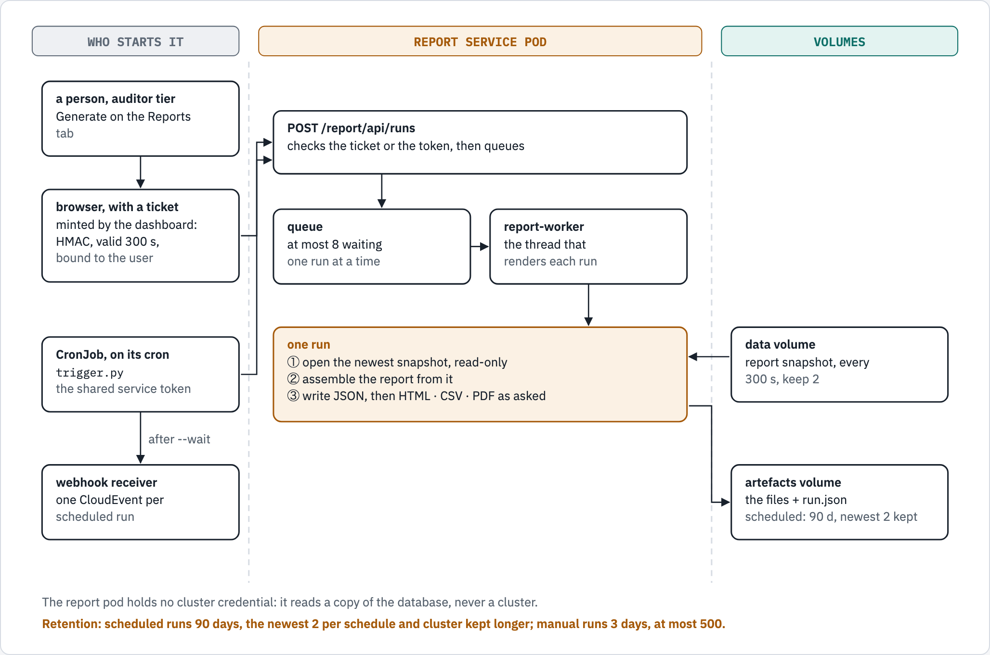
ARCHITECTURE
How a report is made
Figure 5 of docs/guides/architecture-overview.md
15 / 19
Notes:
Two ways in, one pipeline. The report pod holds no cluster credential.

Slide 16
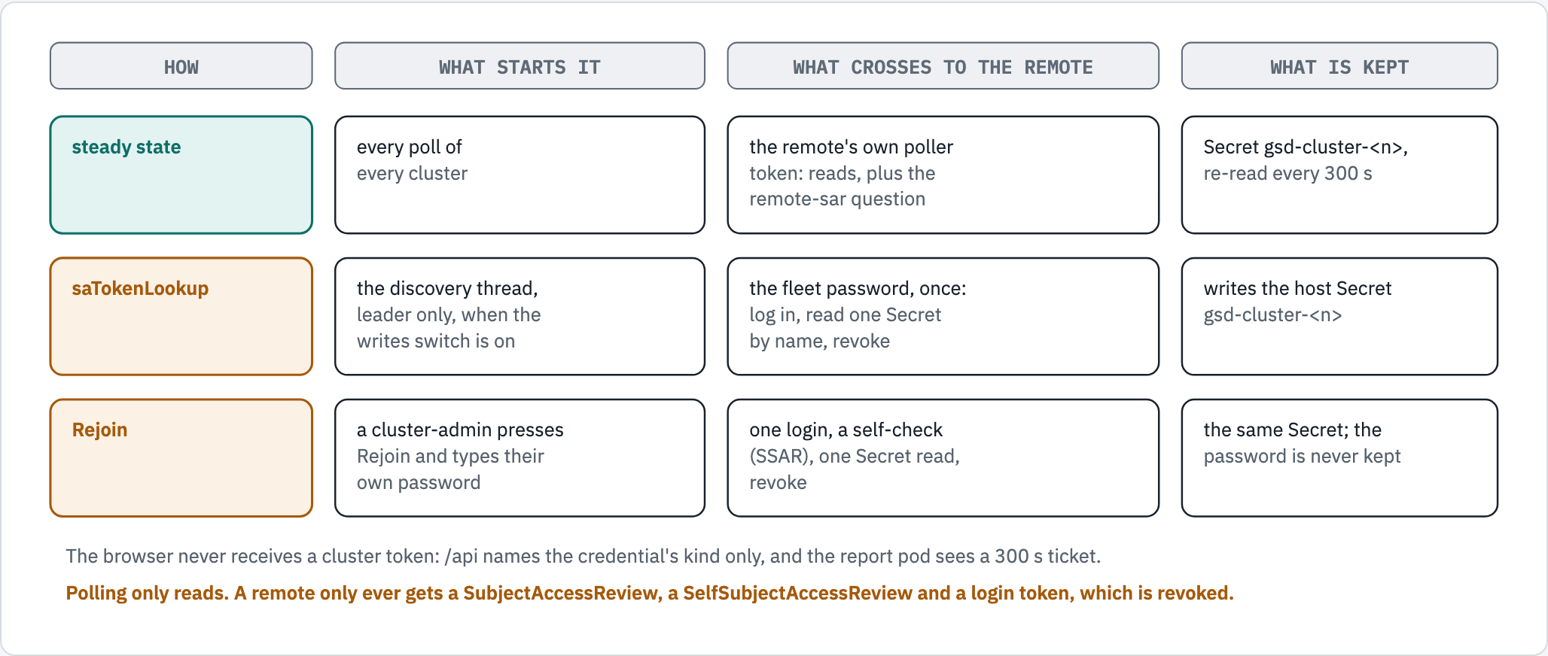
SECURITY
Credentials and trust boundaries
Figure 6 of docs/guides/architecture-overview.md
16 / 19
Notes:
Polling only reads. The browser never receives a cluster token.

Slide 17
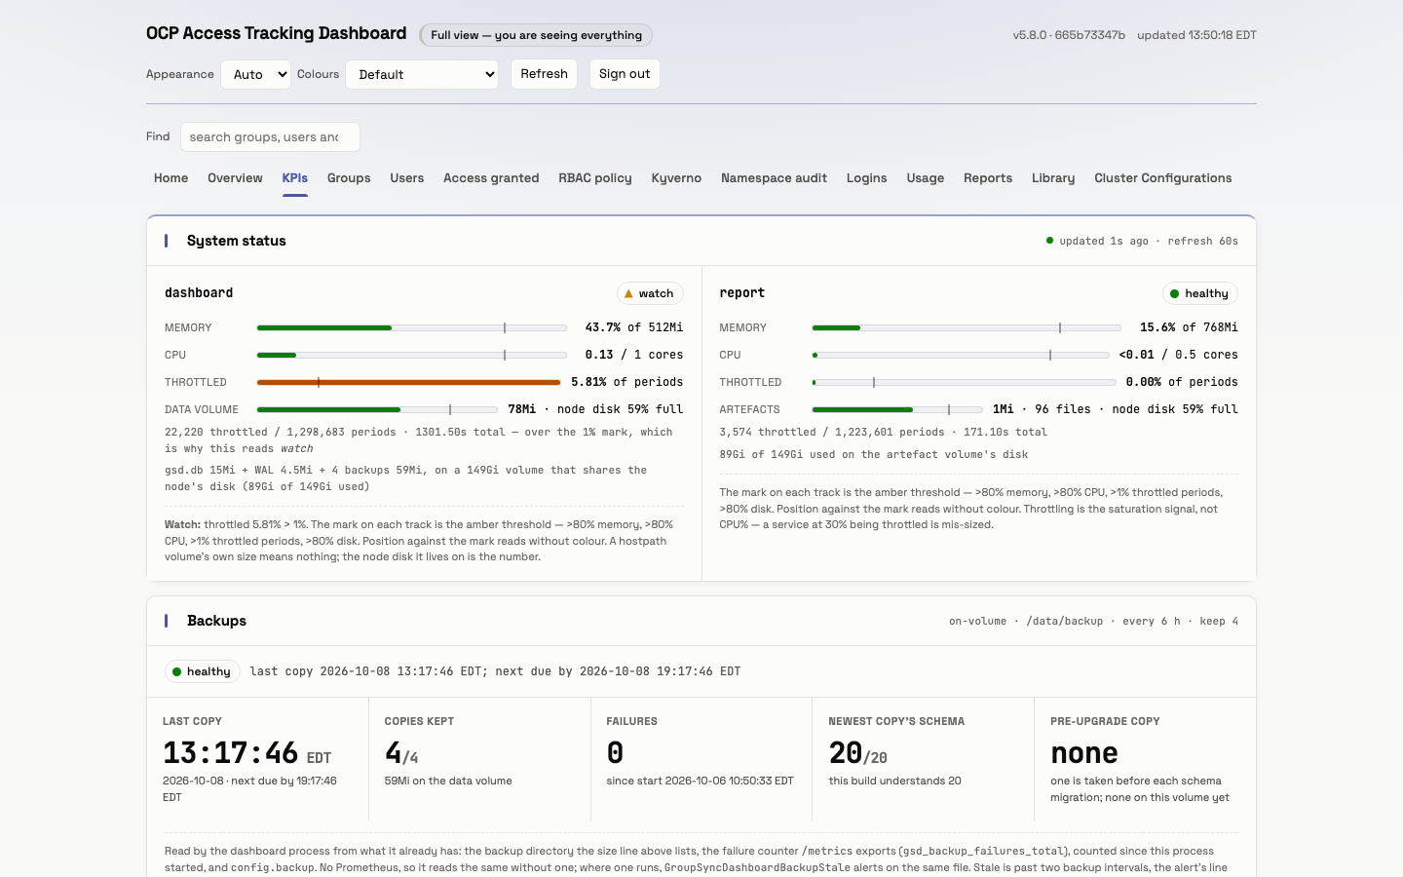
OPERATE
Operations: what the platform team runs
One Helm chart, ready for Argo CD; one dashboard pod and one report pod.
A database backup every 6 h with 4 kept, and an offsite copy every 6 h.
Twenty Prometheus alerts, from a cluster that stops answering to a backup or a schedule running late.
The KPIs page shows the system's own health: memory, CPU, throttling, disk, backups.
Screenshot: KPIs, light theme, the lab at 5.8.0 · the chart's PrometheusRule and backup settings
17 / 19
Notes:
Operators get health from the dashboard itself and from Prometheus. Backups are local every 6 h plus an offsite copy.

Slide 18
NEXT STEPS
Rolling it out
1
2
3
4
Install
Join clusters
Name the auditors
Schedule the evidence
the chart on the host cluster, with Helm or Argo CD.
each with its own token: a Secret, saTokenLookup or Rejoin.
the groups that review access everywhere.
a quarterly compliance schedule, and a webhook for delivery.
No access changes on any cluster: the dashboard reads, and the reports record what it read.
Its only writes are its own: a leader Lease on the host and, when a cluster joins by saTokenLookup or Rejoin, that cluster's token Secret on the host and a login on the remote that it revokes.
Sources: the chart's values.yaml · CLUSTER_CREDENTIALS.md
18 / 19
Notes:
Four steps to production. They map to the chart's clusters (Rejoin is a button on Cluster Configurations), rbacAuditors.groups, reporting.schedules, and a schedule's deliver: webhook.

Slide 19
THANK YOU
Questions, and where to read more
architecture-overview.md
the architecture in seven figures
reference-architecture.md
the full reasoning, claim by claim
ACCESS_CONTROL.md
who sees what, and why
docs/reports/README.md
the eleven reports and their schedules
All documents are in the group-sync-dashboard repository, under docs/
19 / 19
Notes:
Invite questions. Everything in the deck is in these documents, each checked against the code.

