Slide 1
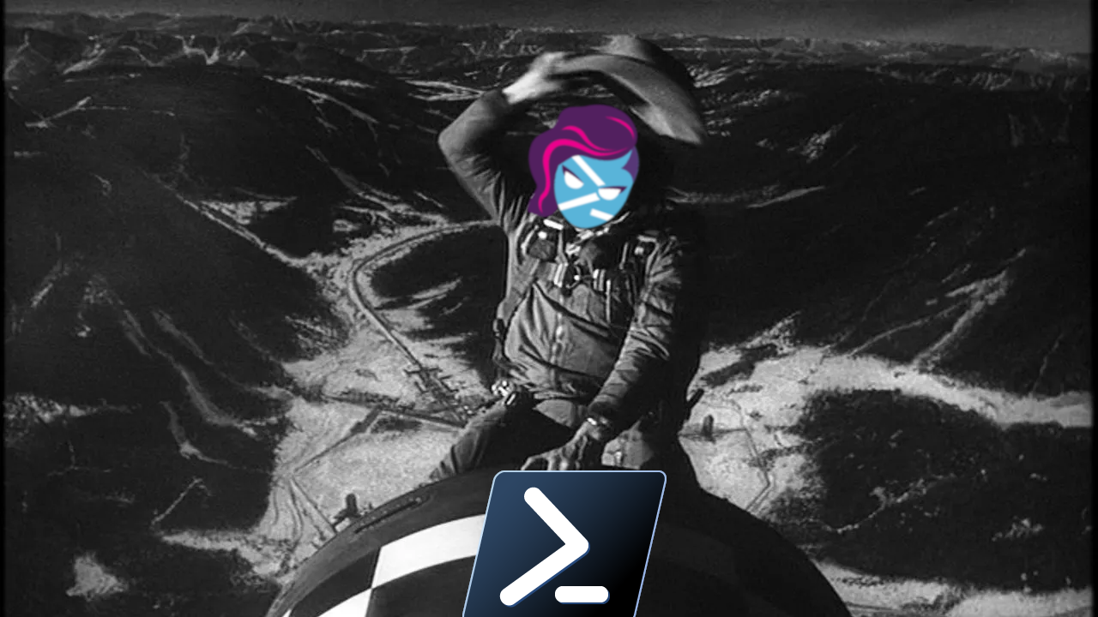
Linux Shell Debates or: How I Stopped Worrying and Learned to Love PowerShell

Slide 2


About Me
PowerShell user for 10+ years
Solutions Engineer at
Loves Linux
Loves Writing Code
Loves Mechanical Keyboards
Not Afraid of ChatGPT
Blog - https://ephos.github.io
Pictured: Me with a Tiny Horse

Slide 3
Agenda
The 4 questions to ask
Demo
  Streaming Shells Compared to PowerShell
  What is POSIX Compliance?
  Where does Python come into this?
  PowerShell Crescendo
Closing comments
Notes:
Who here uses Linux as their daily driver machine at work or home?
Keep your hand up if you use PowerShell as your default shell

Slide 4
The 4 Questions:
https://en.wikipedia.org/wiki/Standard_streams
What do you need to do?
Who is running it?
Where does it need to run?
When does it need to be done by?

Slide 5
https://en.wikipedia.org/wiki/Standard_streams
DEMO

Slide 6
The 4 Questions - Revisited:
https://en.wikipedia.org/wiki/Standard_streams
What do you need to do?
Who is running it?
Where do you need to do it?
When does it need to be done by?

Slide 7
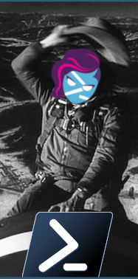
Closing Out
https://en.wikipedia.org/wiki/Standard_streams
Use the right tool for the job!
and…
Don’t be afraid to use PowerShell on Linux!
But also remember the 4 questions, here are some scenarios…
Do you want to actually work with JSON without first deserializing it into an object?
If a perfectly capable shell script exists, do you really want to spend the time to re-write it entirely for PowerShell?
If your company standardized on Python is it worth the battle to try to re-standardize on something else?
Did you catch we used ‘glow’ instead of ‘Show-Markdown’ through this whole demo?

Slide 8

Thank you!
https://en.wikipedia.org/wiki/Standard_streams
Slides and materials available on Github from the code!

