Slide 1

Machine Learning with Go
Ephraim Berkovitch, January 2021

Slide 2
Agenda
Why Go?
ML using Go vs Python
ML Steps
Gorgonia
Flower species prediction by classification
Linear regression
Gota - counterpart of pandas
Gonum - counterpart of numpy and matplotlib
Gophernotes - Jupyter kernel for Go

Slide 3
Accompanying Materials
https://github.com/ephraimberkovitch/golang_ml
https://github.com/go-gota/gota
https://github.com/gorgonia/gorgonia
https://github.com/gonum/gonum

Slide 4
Why Go?
simple syntax
clearly describe complex algorithms
does not obscure developers from understand how to run efficient optimized code
easy to deploy and code
easy to understand and debug
have its performance measured
common practice in infrastructure
take a trained model and automatically implement all the infra features needed—like reproducible deployments, scalable request handling, automated monitoring, etc—to deploy it as an API

Slide 5
ML using Go vs Python
ML frameworks use languages like C/C++ for actual computation
all offer a Python interface
To actually run a production machine learning API at scale, we need an infrastructure to
Autoscaling, so that traffic fluctuations don’t break our APIs (and our AWS stays manageable)
API management, to handle multiple deployments
Rolling updates, so that we can update models while still serving requests
Reliability - first line of defense, to avoid silly type errors - static typing, compilation step, no dead code, no unused imports
Python for data science and scripting, Go for infrastructure

Slide 6
ML Steps
Gather data
Perform exploratory data analysis
Determine the correct machine learning solution to use
Build a model
Train the model
Test the model

Slide 7
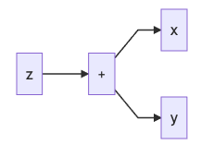
Gorgonia
Deep learning in Go
go get gorgonia.org/gorgonia
Write and evaluate math equations with multi dimensional arrays
g := gorgonia.NewGraph() // expression/computation graph
VM - understands graphs and computes it
compile-once, run-many-times
Demonstration 1 - Gorgonia 1st steps

Slide 8
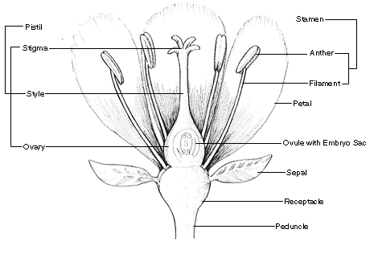
Flower Species Prediction by Classification
Iris dataset (1935) - https://gist.github.com/curran/a08a1080b88344b0c8a7
features - X
sepal_length - אורך עלי הגביע
sepal_width - רוחב עלי הגביע
petal_length - אורך עלי הכותרת
petal_width - רוחב עלי הכותרת
target - y
species - setosa, versicolor, virginica

Slide 9
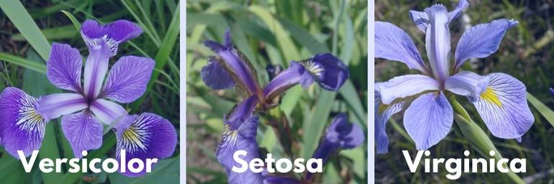
Flower Species Prediction by Classification

Slide 10
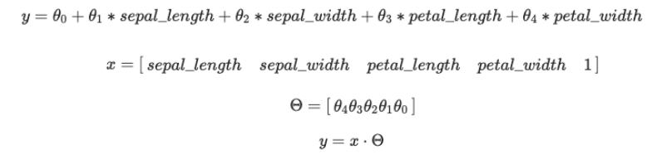
Linear Regression
encode the data (the true facts from observation of different flowers) into a matrix
containing 5 columns (sepal length, sepal width, petal length, petal width and 1 for the bias).
A row of the matrix represents a flower

Slide 11

LInear Regression
Encode categorical data
setosa = 1.0
virginica = 2.0
versicolor = 3.0
Other encoding techniques:
species_setosa = 1/0; species_virginica=0/1; species_versicolor=0/1
Learning phase cost:
Use gradient descent to lower the cost

Slide 12
Gota - counterpart of Pandas
Data wrangling library
Generate / load the training / test set with Gota
dataframe
series
Pre-processing
Generate training / validation data split
Demonstration 2 - gota 1st steps

Slide 13
Gonum - counterpart of numpy and matplotlib
Scientific and plotting library
go get gonum.org/v1/gonum
go get gonum.org/v1/plot
Demonstration 3 - gonum/plot 1st steps

Slide 14
Demonstrations 4 & 5
iris
Training_iris
cli_iris
congress votes (~1980s)
Training_congress
cli_congress

Slide 15
Jupyter kernel for Go
Gophernotes
docker run -it -p 8888:8888 -v $(pwd):/usr/share/notebooks gopherdata/gophernotes:latest-ds
Demonstration 6 - gophernotes

Slide 16
Comparisons
Gorgonia
https://golangdocs.com/golang-machine-learning-libraries
Gota
performance - https://github.com/go-gota/gota/issues/16
other libraries - https://mungingdata.com/go/dataframes-gota-qframe
gophernotes
https://github.com/gopherdata/gophernotes - backend - interpreter
alternatives - lgo https://github.com/yunabe/lgo - backend - official compiler, elder versions

Slide 17
More
TensorFlow for Go is not mature yet
https://www.tensorflow.org/install/lang_go - The TensorFlow Go API is not covered by the TensorFlow API stability guarantees
galeone/tfgo has its fixes to official TensorFlow Go bindings
Cortex - machine learning model serving infrastructure
https://github.com/cortexlabs/cortex
take a trained model and automatically implement all the infra features needed—like reproducible deployments, scalable request handling, automated monitoring, etc—to deploy it as an API

Slide 18
References
Michael Bironneau, Toby Coleman, Machine Learning with Go Quick Start Guide, Packt Publishing, 2019
Xuanyi Chew, Go Machine Learning Projects, Packtpub, 2018
https://towardsdatascience.com/why-we-deploy-machine-learning-models-with-go-not-python-a4e35ec16deb
https://towardsdatascience.com/understanding-regression-using-covid-19-dataset-detailed-analysis-be7e319e3a50
https://towardsdatascience.com/go-for-data-science-lets-try-46850b12a189

Slide 19
References
https://tech.travelaudience.com/training-tensorflow-models-in-python-and-serving-with-go-1b2a9386b0ff
https://jinglescode.github.io/2019/05/07/why-linear-regression-is-not-suitable-for-classification/
https://mungingdata.com/go/dataframes-gota-qframe/#:~:text=Go%20has%20great%20DataFrame%20libraries,manipulation%20and%20grouping%20functionality%20natively
https://towardsdatascience.com/a-gentle-journey-from-linear-regression-to-neural-networks-68881590760e

