Slide 1

Philosophy of Information
Exploring Luciano Floridi's Metaphysical and Ethical Framework for the Digital Age

Slide 2
Conceptual Foundations
Shift from a materialist worldview to an informational ontology

Slide 3

The Fourth Revolution
Redefining Human Self-Understanding
•
Copernicus displaced Earth from the center of the universe.
•
Darwin displaced humanity from the center of the biological realm.
•
Freud displaced conscious human reason from the center of mind.
•
Floridi proposes Alan Turing initiated the 4th Revolution, displacing humans from the center of the informational domain.

Slide 4


Infosphere & Inforgs
The Infosphere
Inforgs (Informational Organisms)
The entire environment constituted by all informational entities, including their properties, processes, and mutual relations. It encompasses both online digital spaces and offline physical reality integrated as a single continuum.
Humans, AI agents, and devices re-conceptualized not merely as biological or physical bodies, but as interconnected, mutually dependent informational organisms continuously shaping and inhabiting the infosphere.

Slide 5






Pillars of Philosophy of Info
Informational Ontology
Epistemology & Design
Information Ethics
Reality is fundamentally composed of informational entities rather than inert material substances or purely physical particles.
Knowledge is generated through active conceptual design and modeling rather than passive representation of external objects.
An ecocentric, patient-oriented macroethics expanding moral respect to all informational structures and avoiding entropy.

Slide 6

Shift to Onlife Reality
100%
The Merging of Digital and Physical
Floridi coined "Onlife" to denote the seamless, permanent merging of online and offline experiences. In modern technological society, the distinction between digital interaction and physical reality has dissolved, rendering connected devices an inescapable ambient reality.
Onlife Integration

Slide 7
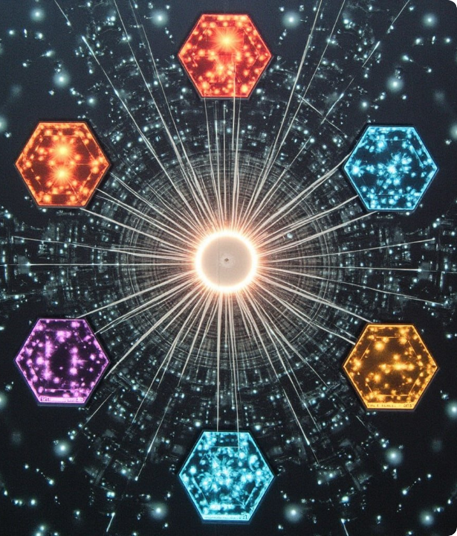
Information Ethics Framework
Non-Anthropocentric Ethics
Traditional ethics focuses exclusively on human agents or sentient beings. Information Ethics (IE) expands the moral sphere to treat every informational entity—human, biological, or digital artifact—as possessing intrinsic value deserving of protection.

Slide 8
Principles of Info Ethics
Entropy Prevention: Moral agents ought to prevent the destruction, corruption, or degradation (informational entropy) of entities in the infosphere.
Non-Maleficence: Informational entropy ought not to be caused or increased across physical, digital, or social systems.
Entropy Removal: Existing informational damage or distortion ought to be corrected, repaired, and actively removed.
Flourishing of the Infosphere: Agents ought to cultivate, enrich, and promote the overall well-being and growth of the informational ecosystem.

Slide 9
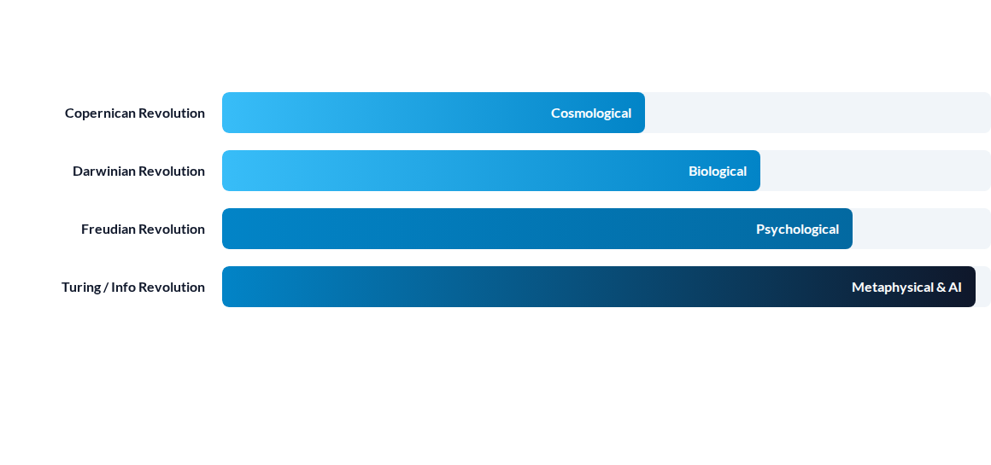
Impact of Revolutions
The Fourth Revolution re-ontologizes humanity from physical biological managers to informational organisms navigating autonomous AI artificial agents.

Slide 10
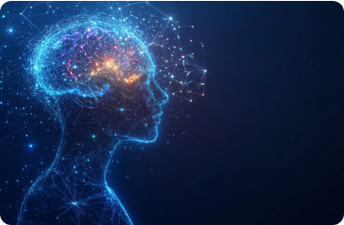
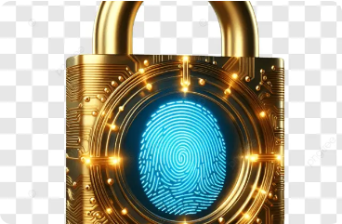
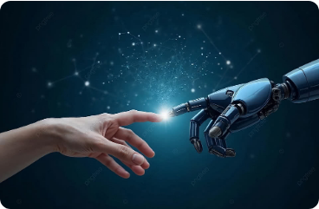
Challenges in AI Governance
Distributed Agency
Data Sovereignty
Human Agency
AI algorithms execute decisions autonomously, obscuring traditional moral accountability lines.
Protection of personal identity and informational integrity against pervasive surveillance.
Ensuring AI governance safeguards human dignity while fostering beneficial digital innovation.

Slide 11




Evolution of Floridi's Work
2013
Ethics of Info Formulating macroethical principles to prevent informational entropy in the infosphere.
2019+
Logic & AI Ethics Applying PI principles to international AI governance frameworks and global policy.
2011
2014
Philosophy of Info Foundational monograph establishing information as fundamental as being or knowledge.
4th Revolution Detailing how the modern infosphere transforms human self-understanding and onlife reality.

Slide 12
Questions & Dialogue
Thank you for exploring Luciano Floridi's Philosophy of Information.
Infosphere & AI Governance Series

Slide 13





Image Sources
https://as1.ftcdn.net/v2/jpg/20/46/80/70/1000_F_2046807010_HTwDXOcBaKNJkJUp356Qlf9SXmaRiR1d.jpg
Source: www.europosters.se
https://images.squarespace-cdn.com/content/v1/647f71644da23c460898dc9f/328f7369-d8cb-4bba-ac47-fc27c39dc92a/ritual-os-central-glyph-quantum-mandala-min.jpg
Source: www.ultra-unlimited.com
https://images.presentationgo.com/2025/04/ai-neural-network-brain.jpg
Source: www.presentationgo.com
https://png.pngtree.com/png-vector/20250901/ourlarge/pngtree-d-digital-padlock-icon-for-cyber-security-data-protection-privacy-and-png-image_17346810.webp
Source: pngtree.com
https://png.pngtree.com/thumb_back/fw800/background/20250605/pngtree-human-and-robot-hands-touching-connection-technology-artificial-intelligence-future-interaction-image_17290221.jpg
Source: pngtree.com

