Slide 1
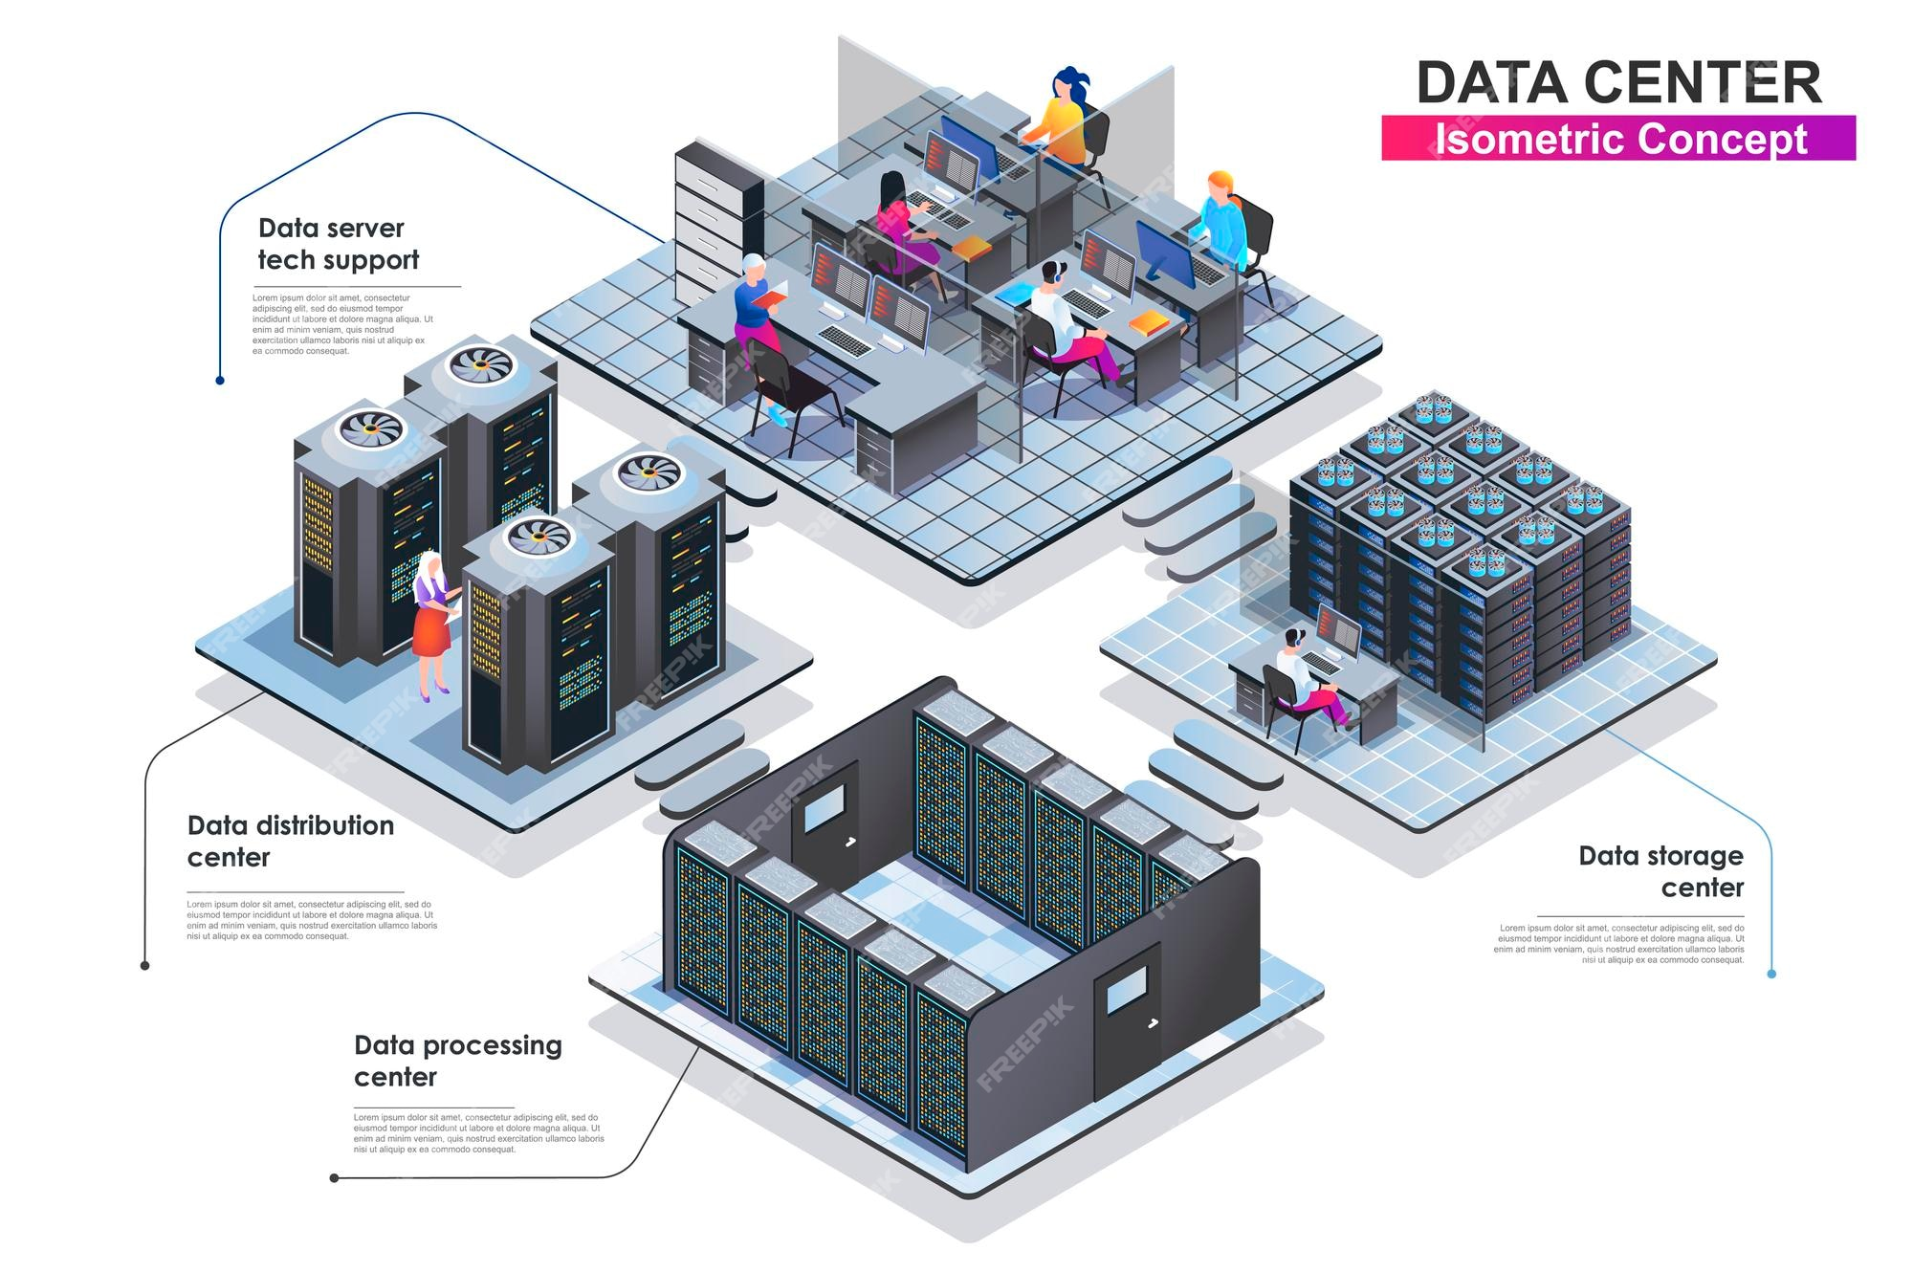
Tier 3
Data Centers
Notes:
Click to add Notes

Slide 2
Data Centers
A data center is a building, a dedicated place in a building or a group of buildings used to house computer systems and associated components such as telecommunication and storage systems.
Notes:
Data Center:
Building/ Dedicated Space within a building/ Group of buildings
Used to house computer systems and associated components, such as telecommunications and storage systems
they store, manage and process large amounts of data and applications for organizations. They support various IT operations with data storage, cloud computing and running business applications.
A Modern data center has the following REQUIREMENTS:
Performance
Energy efficiency
Security

Slide 3
Data Centers
House computer systems and associated peripherals.
Store, manage and process large amounts of data for organizations.
Support various IT operations with data storage, cloud computing and business applications.
Notes:
Data Center:
Building/ Dedicated Space within a building/ Group of buildings
Used to house computer systems and associated components, such as telecommunications and storage systems
they store, manage and process large amounts of data and applications for organizations. They support various IT operations with data storage, cloud computing and running business applications.
A Modern data center has the following REQUIREMENTS:
Performance
Energy efficiency
Security

Slide 4
Tiers of Data Centres
Data Centres are classified in 4 tiers based on the following parameters:
  Uptime Guarantees
  Redundancy Levels
  States of cooling and power infrastructure
  Ability to handle concurrent maintainability
  Service Cost
  Security Level
  Character neutrality

Slide 5
Tiers of Data Centres
Tier I
Single path for power and cooling
No backup components
99.671%
N
Tier II
Single path for power and cooling
Some backup components
99.741%
Partial N+1
Tier III
Multiple paths for power and cooling
Concurrent Maintainability
99.982%
Full N+1
Tier IV
Completely Fault Tolerant
Redundancy for every component
99.995%
2N / 2N+1
Notes:
Partial N+1:
It means that not all entities may have a backup.
e.g. The power supply may have a backup .
The servers may not and vice versa
Full N+1:
It means that all entities have a backup.
e.g. The power supply and the Servers both have a backup

Slide 6
Tier III Data Centers
Tier III Data Centers have Multiple paths for power and cooling.
They have a backup for every component, though not necessarily isolated.
They have an maximum downtime of 1.6 Hours per year. (99.982% uptime guarantee)

Slide 7
Tier III Data Centers
Must have a 72 hour outage protection (3 days of independent power not connected to any outside source).
They support maintainablity without taking the system offline.

Slide 8
Multiple Distribution Paths
More than one path for power and cooling; only one needs to be active at a time.
Acts as a backup in case one of the paths fail.

Slide 9
N+1 Redundancy
Each entity (e.g. power, cooling) must have atleast one backup component.
Let’s say there are 4 servers in the configuration, then there must be 1 server which will take over when one of the working servers fails or is under maintenance.

Slide 10
Uptime and Reliability Standards
Tier III DC’s must commit to 99.982% of Uptime, which is equivalent to 1.6 hours of downtime per year.

Slide 11
Outage Protection
Tier III Data Centers must have 3 days of outage protection, which means in case of a local power cut, the DC must be able to self-sustain for 72 hours.
This can be achieved by battery banks, generators and UPS systems.

Slide 12
Concurrent Maintainability
Developers / Engineers should be able to work on the system without taking it offline.
The redundant system (backup) handles the traffic while the maintainance is going on.

Slide 13
Network Infrastructure
Data Centres have multiple ISP connections, redundant network switches, routers and diverse fiber entry points for high connectivity and uptime.
This ensures seamless connectivity with minimal latency.

Slide 14
Benefits of Tier III Data Centers
High reliability with minimized downtime.
Scalability to support future IT needs.
Balance between performance and costs:
  More resilient than Tier I, II
  More affordable than Tier IV

Slide 15
Tier III Certification Process
Data center tier certifications are overseen by the Uptime Institute.
The certification process involves sumbitting site plans and undergoing an on-site inspection to verify that the data center meets the required standards.

Slide 16
Tier III Certification Process
These standards encompass various aspects of the data center’s design, construction and operational protocols.
The purpose is to ensure that the data center meets the criteria for its designated tier according to data center tier standards.

Slide 17
Summary
Data Centers are dedicated spaces to store, manage and process data for organizations.
Data Centres are divided into 4 tiers based primarily on Downtime allowed and Cost incurred.
Tier 3 Data Centers
  Have multiple paths for power and cooling
  Have full N+1 redundancy
  Can be maintained without taking the system offline
  Allow no more than 1.6 hours of downtime annually

Slide 18
Sources
stock.adobe.com (cover page art)
https://uptimeinstitute.com/tiers
https://phoenixnap.com/blog/data-center-tiers-classification
https://encoradvisors.com/tier-3-data-center/

Slide 19
Sources
https://www.maysteel.com/blog/types-of-data-centers-how-do-you-choose-the-right-data-center

