Slide 1
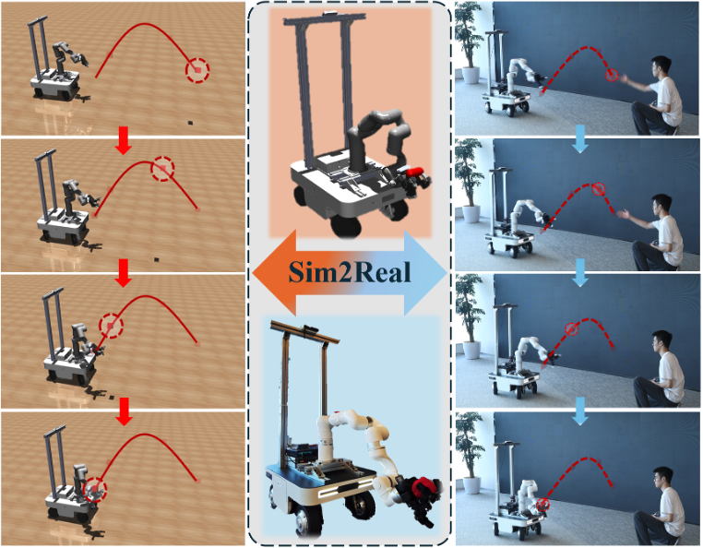
Catch It!
Learning to Catch in Flight with Mobile Dexterous Hands
Yuanhang Zhang · Tianhai Liang · Zhenyang Chen · Yanjie Ze · Huazhe Xu
ICRA 2025 · arXiv:2409.10319v1
Presenter: Joseph Tian
10/21/2026
Notes:
当一个物体被随机抛向机器人时，机器人能不能在物体落地之前移动到合适的位置，并用灵巧手把它接住。
作者搭建了一套由移动底盘、六自由度机械臂和灵巧手组成的移动操作机器人，并使用两阶段强化学习来训练整个身体的控制策略。论文主要在仿真环境中训练，再把策略迁移到真实机器人上。
Hello everyone. Today I will introduce a paper titled Catch It! Learning to Catch in Flight with Mobile Dexterous Hands.
This paper studies a simple but challenging problem: when an object is randomly thrown toward a robot, can the robot move to the right position and catch it before it falls?
The authors build a mobile manipulator consisting of a mobile base, a six degree of freedom arm, and a dexterous hand. They use a two-stage reinforcement learning framework to train the robot in simulation and then transfer the learned policy to a real robot.

Slide 2
02
Why catching in flight is hard？
Three problems：
• Coordinate a mobile base, 6-DoF arm, and dexterous hand as one controller
• Optimize a high-dimensional action space without wasting hand control when the object is far away
• Generalize across random throws and object geometries
Paper gap：
Prior work often trades away either workspace (no mobile base) or object adaptability (no dexterous hand). Catch It! combines both.
Notes:
空中接物的时间窗口非常短，论文中提到整个动作通常只有大约两秒。
在这段时间里，机器人需要同时完成几件事。移动底盘要快速调整位置，机械臂要把手送到物体的运动轨迹附近，灵巧手还要在接触的瞬间完成合适的抓取动作。
与此同时，系统的动作空间非常大。底盘、机械臂和手部都有自己的控制变量，如果一开始就让所有部件同时学习，强化学习会面对非常复杂的优化问题。
第三个困难是物体和抛掷轨迹都具有随机性。物体可能从不同位置、以不同速度被抛出，形状和大小也会改变。
过去的研究通常只解决其中一部分问题。有些系统有机械臂，但没有移动底盘，工作空间有限。有些系统有移动能力，但使用的不是灵巧手，对不同形状物体的适应性有限。Catch It! 尝试把这两种能力结合起来。
Catching a flying object is difficult because the robot has only a very short time window. According to the paper, the entire motion usually takes place within about two seconds.
During this time, the mobile base has to adjust its position, the arm has to move the hand toward the object’s trajectory, and the dexterous hand has to perform the right grasping motion at the moment of contact.
The action space is also very large. The base, arm, and hand all have their own control variables. If all of them are trained together from the beginning, reinforcement learning has to solve a very difficult optimization problem.
The robot must also handle random throwing trajectories and different object shapes and sizes.
Earlier studies often focused on only one side of this problem. Some systems used an arm without a mobile base, which limited their workspace. Other systems had mobile manipulation but lacked a dexterous hand, which limited their ability to handle different objects.
Catch It! combines both capabilities.

Slide 3
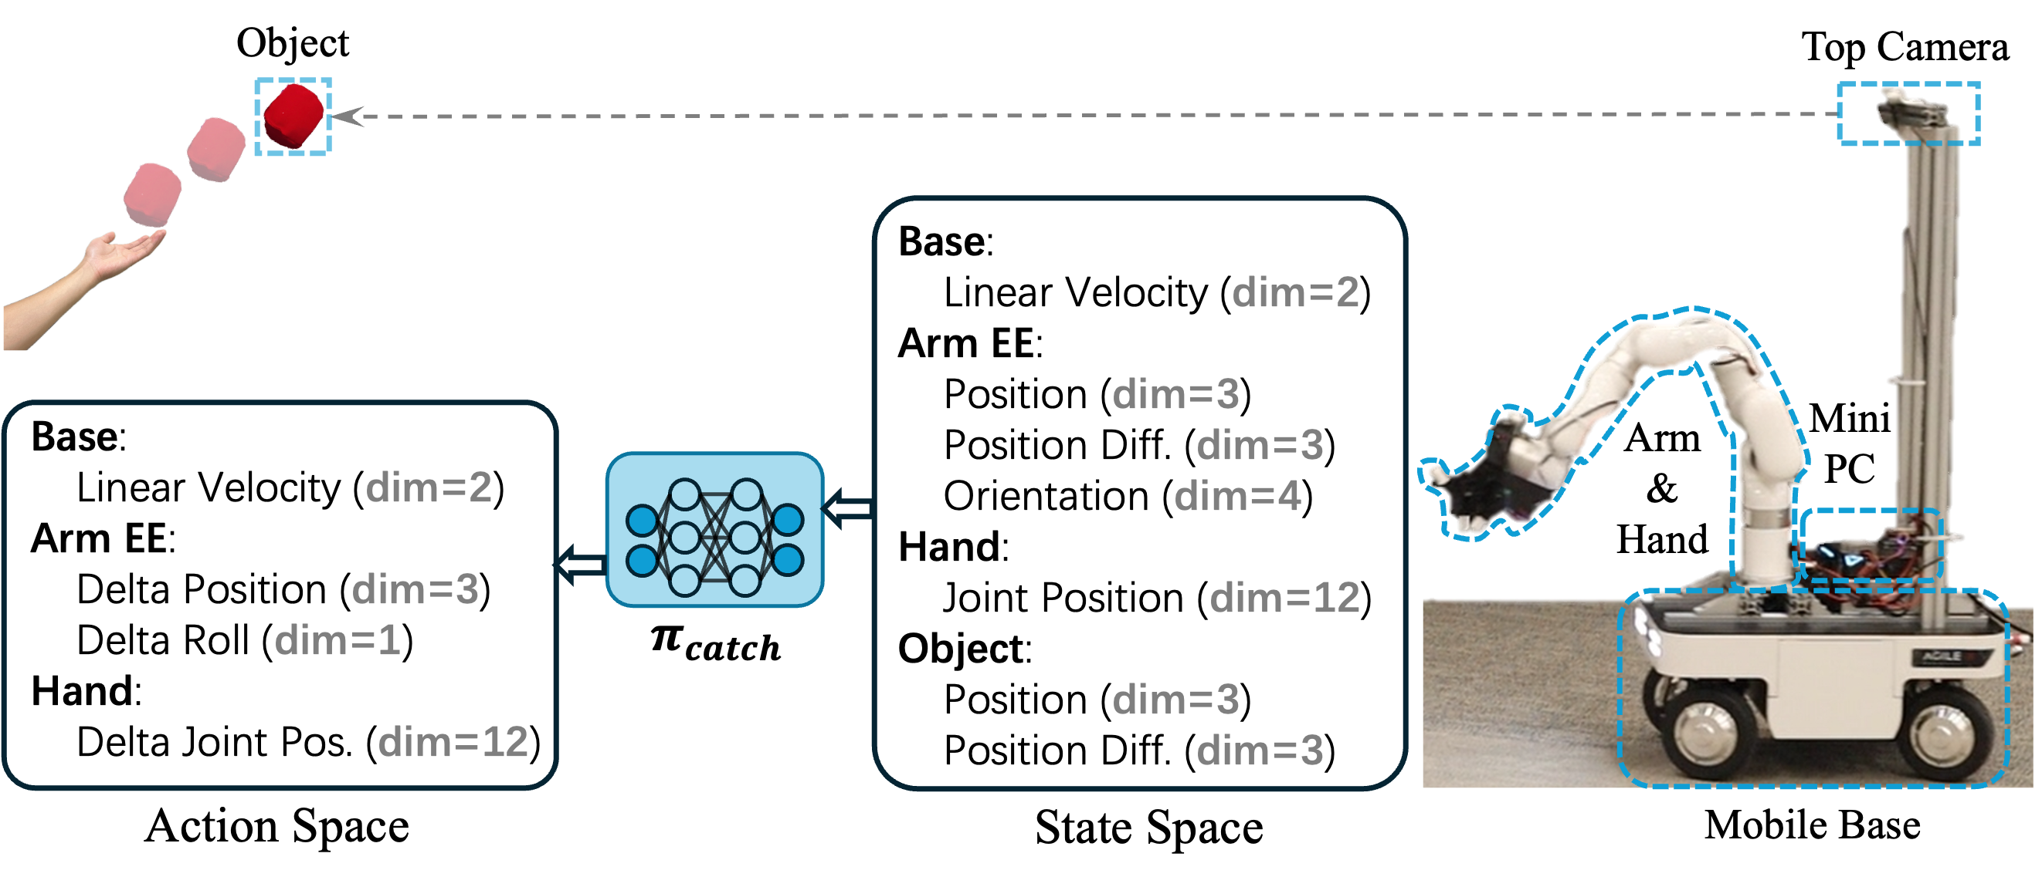
03
System Overview
Hardware
• Ranger Mini V2 omni-base
• XArm6, 6 DoF
• LEAP Hand, 12 DoF
• RealSense D455 for 3D object tracking
• Mini-PC with RTX 4060 for onboard inference
Observation
Two consecutive object and end-effector positions are combined with proprioception in the arm-base frame.
Notes:
底部是 Ranger Mini V2 全向移动底盘，它负责扩大机器人的工作范围。上面连接的是 XArm6 六自由度机械臂，用来把末端移动到物体附近。末端使用 LEAP Hand，策略控制其中 12 个手部关节，用于完成接触和抓取。
系统通过 RealSense D455 RGB-D 摄像头估计物体的三维位置，并使用一台带 RTX 4060 的小型计算机进行实时推理。
在观测方面，策略不仅使用当前物体位置和末端位置，还使用连续两个时刻的位置差。这样可以近似得到物体和末端的运动趋势，再结合机器人的本体状态，作为强化学习策略的输入
This slide shows the hardware system.
The robot uses a Ranger Mini V2 omnidirectional mobile base. The base expands the robot’s reachable workspace. On top of it is an XArm6 six degree of freedom arm. The end effector is a LEAP Hand, with 12 actuated hand joints used by the control policy for contact and grasping.
A RealSense D455 RGB-D camera estimates the object’s three dimensional position. An onboard mini PC equipped with an RTX 4060 GPU runs the policy in real time.
For the observation, the policy uses the object position and the end effector position at two consecutive time steps. Their difference provides information about the motion trend of the object and the robot. This information is combined with the robot’s proprioceptive state and expressed in the arm-base coordinate frame.

Slide 4
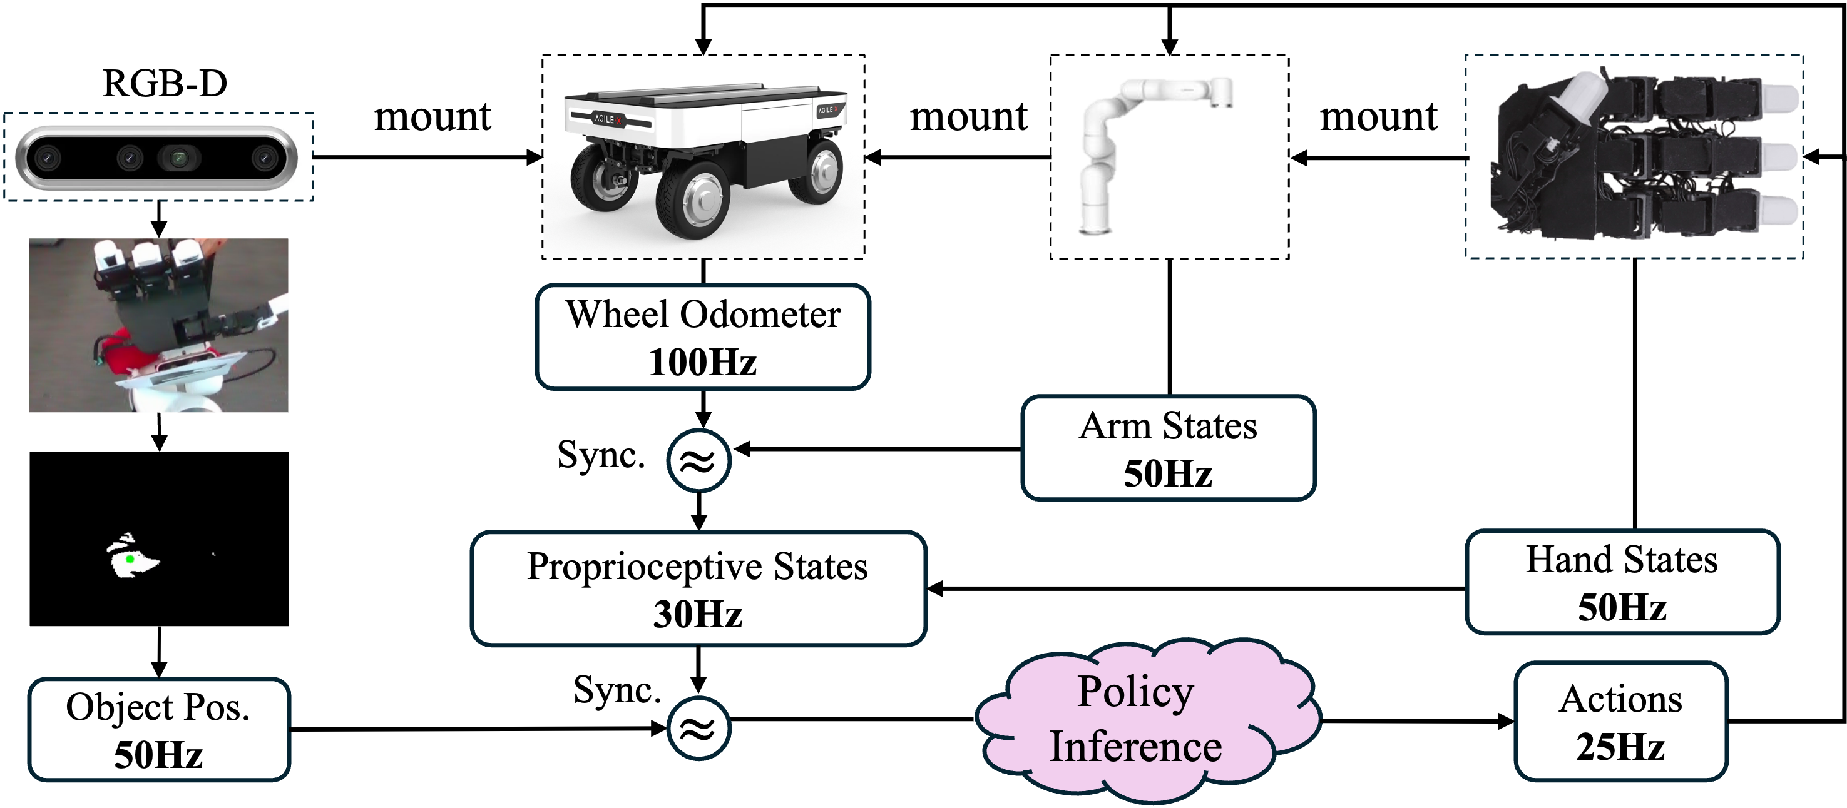
04
Real-time Control
• Proprioception is synchronized to 30 Hz
• RGB-D object position arrives at 50 Hz
• Whole-body policy runs at 25 Hz
• The same 25 Hz rate is used in simulation and deployment
The multi-process controller keeps heterogeneous sensors and actuators aligned before policy inference.
Notes:
这套系统中的传感器和执行器工作频率并不相同，因此需要一个多进程控制器把它们同步起来。
机器人的本体状态以 30 Hz 进行同步，RGB-D 摄像头以 50 Hz 提供物体位置，整个身体的策略以 25 Hz 运行。仿真和真实机器人都采用 25 Hz 的策略频率，这样可以减少训练环境和部署环境之间的差异。
简单来说，控制器先收集底盘、机械臂和手部的状态，再融合摄像头得到的物体位置，最后交给策略网络生成下一步动作。这个过程需要持续实时运行，因为物体一直在飞行，延迟会直接影响最终能不能接住。
The sensors and actuators in this system operate at different frequencies, so a multi-process controller is required to synchronize them.
The robot’s proprioceptive state is synchronized at 30 Hz. The RGB-D camera provides the object position at 50 Hz. The whole-body policy runs at 25 Hz.
The policy runs at the same 25 Hz frequency in simulation and on the real robot. This helps reduce the difference between training and deployment.
In each control cycle, the system collects the base, arm, and hand states, combines them with the object position from the camera, and then sends the resulting observation to the policy network. The network generates the next action while the object is still in flight.

Slide 5
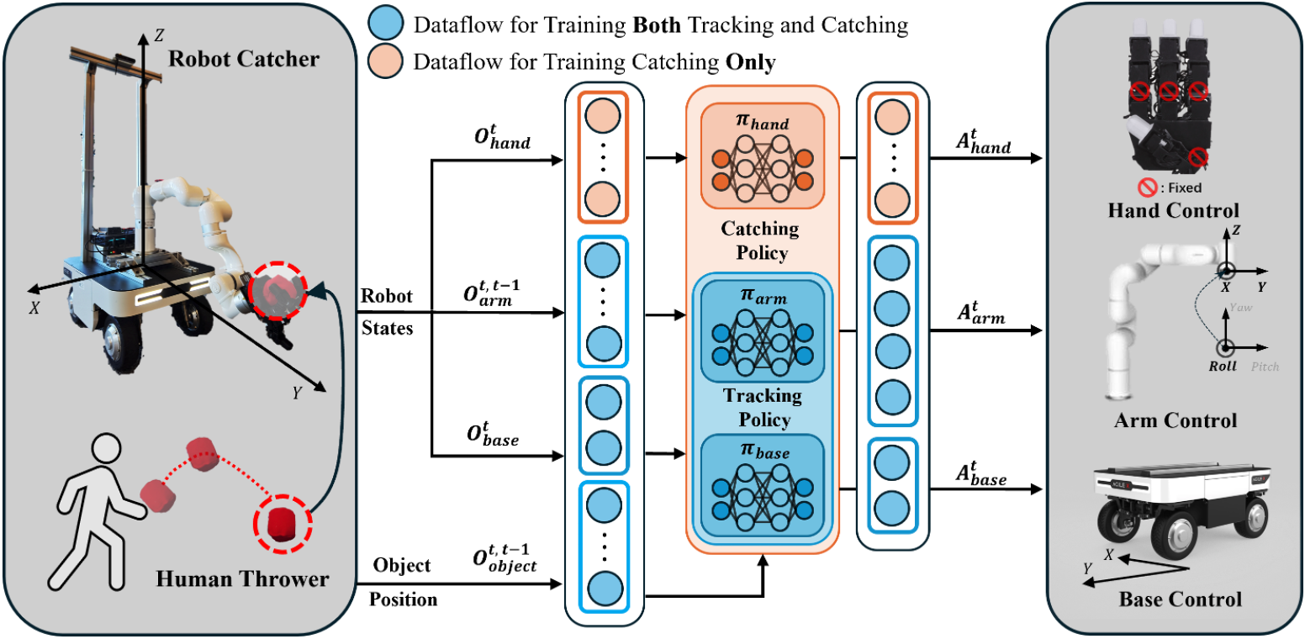
05
Two-stage Reinforcement Learning
Stage 1 · tracking
Train base + arm to reach the flying object. Keep the hand fixed while the object is distant.
Stage 2 · catching
Add the 12-DoF hand and fine-tune the base + arm for a stable grasping pose.
PPO maximizes the expected episode return in a partially observed MDP.
Notes:
这篇论文最核心的方法是两阶段强化学习。
第一阶段叫 tracking，也就是追踪阶段。这一阶段只训练移动底盘和机械臂去接近飞行中的物体，手部保持在固定的初始姿态。这样做的原因是，当物体距离还比较远时，手指动作并不能带来太大帮助，但会增加很多需要优化的自由度。
第二阶段叫 catching，也就是抓取阶段。在已经具备追踪能力的基础上，加入灵巧手的控制，同时继续微调底盘和机械臂，让它们把手送到更适合抓取的位置。
策略使用 PPO，也就是近端策略优化算法。整个问题可以看作部分可观测的马尔可夫决策过程，因为机器人只能通过摄像头和自身传感器估计物体的状态，而不能直接获得完整的环境状态。
这种训练方式的核心思想是，先让机器人学会“到达物体附近”，再让它学习“稳定地抓住物体”。
The main idea of this paper is a two-stage reinforcement learning framework.
The first stage is called tracking. In this stage, only the mobile base and the arm are trained to approach the flying object. The hand remains in a fixed neutral pose.
This design is useful because hand movements are not necessary when the object is still far away. Keeping the hand fixed reduces the number of variables that the policy needs to optimize.
The second stage is called catching. At this stage, the dexterous hand is added to the policy. The base and arm are also fine-tuned so that they can bring the hand into a better grasping position.
The authors use PPO, or Proximal Policy Optimization. The problem is modeled as a partially observable Markov decision process because the robot must estimate the object’s state from camera observations and its own sensors.
So The main idea is to first teach the robot how to reach the object, and then teach it how to hold the object stably.

Slide 6
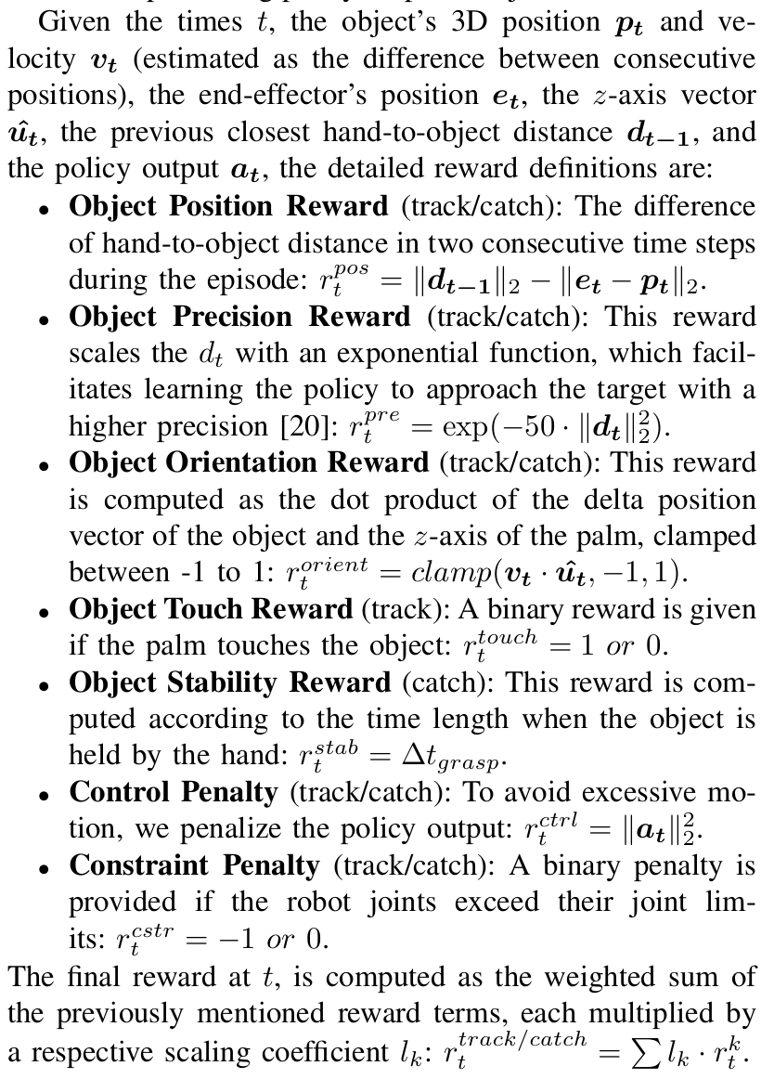
06
Reward design
The reward aligns the palm with the object, then protects stability and feasibility.
Core terms used in both tasks
• Position progress: reward reduction in hand-to-object distance
• Precision: exp(−50 · distance²) sharpens the final approach
• Orientation: palm z-axis aligned with object velocity
• Control and joint-limit penalties discourage unstable actions
Task-specific terms
Touch reward in tracking · grasp-duration reward in catching
Notes:
强化学习能不能学好，很大程度上取决于奖励函数怎么设计。
在追踪和抓取两个阶段，机器人接近物体都会获得奖励。如果手和物体之间的距离变小，奖励就会增加。距离越近，精度奖励也会越高，因此策略会逐渐学会更准确地接近物体。
另外，手掌的方向也很重要。奖励函数会鼓励手掌的方向与物体的运动方向保持合理关系，这样机器人接触物体时更容易形成稳定的接触。
在追踪阶段，手掌碰到物体可以获得触碰奖励。在抓取阶段，物体保持在手中的时间越长，稳定性奖励就越高。
同时，奖励函数会惩罚过大的控制动作和关节越界，从而避免机器人产生过于剧烈或者不可执行的动作。整体上，奖励函数让机器人同时关注接近、方向、接触、稳定性和动作约束。
The reward design is critical for successful reinforcement learning.
In both stages, the robot receives a reward when the hand moves closer to the object. The closer the hand gets, the higher the precision reward becomes.
The reward also considers the orientation of the palm. The policy is encouraged to align the palm with the object’s motion direction, which makes contact more stable.
During the tracking stage, the robot receives a touch reward when the palm contacts the object. During the catching stage, the robot receives a stability reward based on how long the object remains in the hand.
The reward function also penalizes excessive control actions and joint-limit violations. This prevents the robot from producing unstable or physically infeasible motions.
Overall, the reward function encourages the robot to approach the object accurately, align the palm correctly, make contact, and maintain a stable grasp.
Specifically,
On the right, the paper gives the mathematical definitions of the reward terms. At time \(t\), \(p_t\) is the object’s 3D position, and \(v_t\) is its velocity, estimated from two consecutive positions. \(e_t\) is the end-effector position, \(\hat{u}_t\) is the palm’s z-axis, \(d_t\) represents the hand-to-object displacement, and \(a_t\) is the policy output.
The first term is the position reward. It compares the previous hand-to-object distance with the current distance. If the robot moves closer to the object, this term becomes positive. The precision reward uses an exponential function, \(\exp(-50\|d_t\|_2^2)\). This reward becomes especially sensitive when the hand is close to the object, helping the robot refine its final approach.
The orientation reward is based on the dot product between the object’s velocity and the palm’s z-axis. The value is clamped between \(-1\) and \(1\), encouraging the palm to face the object’s motion direction at the moment of contact.
The next two terms are task-specific. In the tracking task, the touch reward is binary: the robot receives a reward when the palm touches the object. In the catching task, the stability reward is proportional to how long the object remains in the hand.
The control penalty discourages large policy outputs, which helps avoid unnecessary or abrupt movements. The constraint penalty is activated when a robot joint exceeds its limit, preventing physically infeasible actions.
Finally, the total reward is a weighted sum of all these terms. The coefficients balance the robot’s progress toward the object, final positioning accuracy, palm orientation, contact or grasp stability, motion smoothness, and joint-limit constraints. This gives the policy a complete learning signal for approaching, aligning with, contacting, and holding the object.

Slide 7
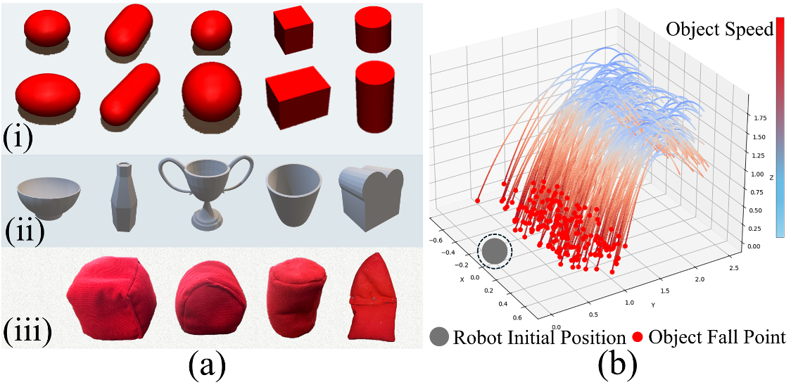
07
Experiment
Training Configuration
• 64 parallel simulation environments
• 500 Hz physics, 25 Hz policy inference
• Randomize throw position and velocity
• Randomize shape, size, mass, and damping
• Train on 5 shapes, evaluate on unseen shapes
Workspace pressure
The farthest landing point is about 1.5 m away, beyond the arm’s roughly 0.8 m reach. The mobile base is necessary.
Notes:
训练时，作者使用了 64 个并行仿真环境来收集数据。物理仿真频率是 500 Hz，策略每 25 Hz 更新一次动作。
为了提高泛化能力，训练过程中会随机改变物体的抛出位置和初始速度，也会随机改变物体的形状、大小、质量和阻尼。
训练和测试使用不同的物体形状。也就是说，机器人并不是只记住训练时见过的物体，而是要面对没有见过的物体。
这里还有一个重要观察：最远的落点大约距离机器人起始位置 1.5 米，而机械臂本身的工作范围大约只有 0.8 米。因此，移动底盘不是可有可无的组件，而是机器人能够覆盖更大空间的关键
The authors train the policy using 64 parallel simulation environments. The physics simulation runs at 500 Hz, while the policy updates its action at 25 Hz.
To improve generalization, the training process randomizes the object’s initial position and velocity. It also randomizes the object’s shape, size, mass, and damping.
The objects used for training and testing are different. This means that the robot must generalize to object shapes it has not seen during training.
Another important point is the workspace requirement. The farthest landing point is approximately 1.5 meters from the robot’s initial position, while the arm’s reach is only about 0.8 meters.
Therefore, the mobile base is essential. The robot must move its base in order to reach objects that are outside the arm’s workspace.

Slide 8
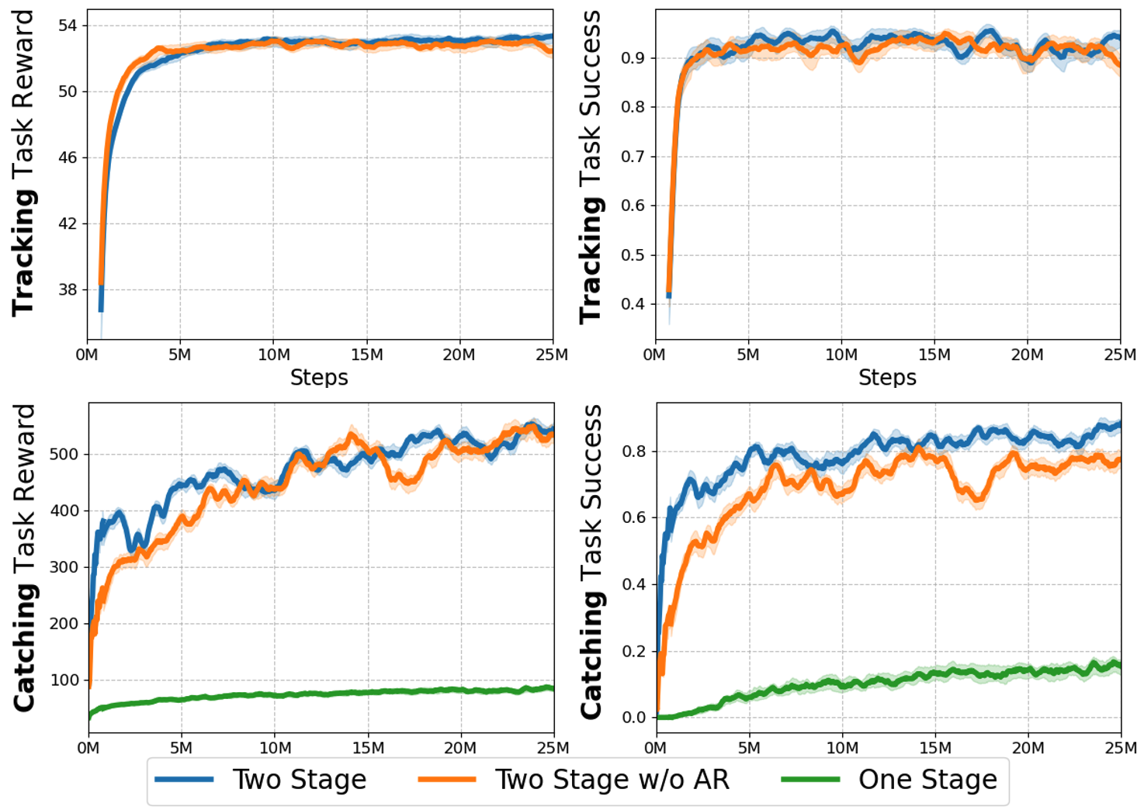
08
Simulation Results
Two-stage training reaches high tracking and catching performance faster than one-stage training.
Catch S.R. (%) | Bowls | Bottles | Win-Cups | Cups | Breads
O.S. | 22±2 | 10±3 | 6±2 | 13±2 | 15±3
T.S. w/o A.R. | 80±6 | 73±4 | 61±7 | 77±5 | 75±3
T.S. (ours) | 84±5 | 78±6 | 65±3 | 80±4 | 80±3
On unseen objects, the proposed two-stage policy is consistently around 61–84% in catching, while one-stage training remains at 6–22%.
Notes:
这一页比较了三种方法。
O.S. 表示从零开始直接进行单阶段训练。T.S. w/o A.R. 表示两阶段训练，但去掉了机械臂的 roll 动作。T.S. 表示论文提出的完整两阶段方法。
在没有见过的物体上，单阶段方法的抓取成功率只有大约 6% 到 22%。两阶段方法明显提高了性能，去掉 roll 动作时大约是 61% 到 80%，完整方法大约是 65% 到 84%。
这说明两阶段训练不只是让最终成功率更高，也让训练过程更容易收敛。机械臂的 roll 动作能够帮助调整手掌方向，因此完整方法在抓取阶段表现更好。
这里的抓取成功指的是物体被手保持到规定的 episode 结束时间，而追踪成功主要指手掌能够接触到飞行中的物体。论文原文中的 Table I给出了这些不同物体上的具体结果。
This slide compares three methods.
O.S. means one-stage training from scratch. T.S. w/o A.R. means two-stage training without the arm’s roll action. T.S. refers to the complete two-stage method proposed in the paper.
On unseen objects, the one-stage method achieves only about 6 to 22 percent catching success. The two-stage method performs much better. Without the arm’s roll action, the success rate is about 61 to 80 percent. With the complete method, it reaches about 65 to 84 percent.
This shows that two-stage training improves both training efficiency and final performance.
The arm’s roll action also helps adjust the palm orientation, which improves the catching performance.
In these experiments, tracking success means that the palm touches the flying object. Catching success means that the object remains held in the hand until the end of the evaluation episode. The detailed results are reported in Table I of the paper.

Slide 9
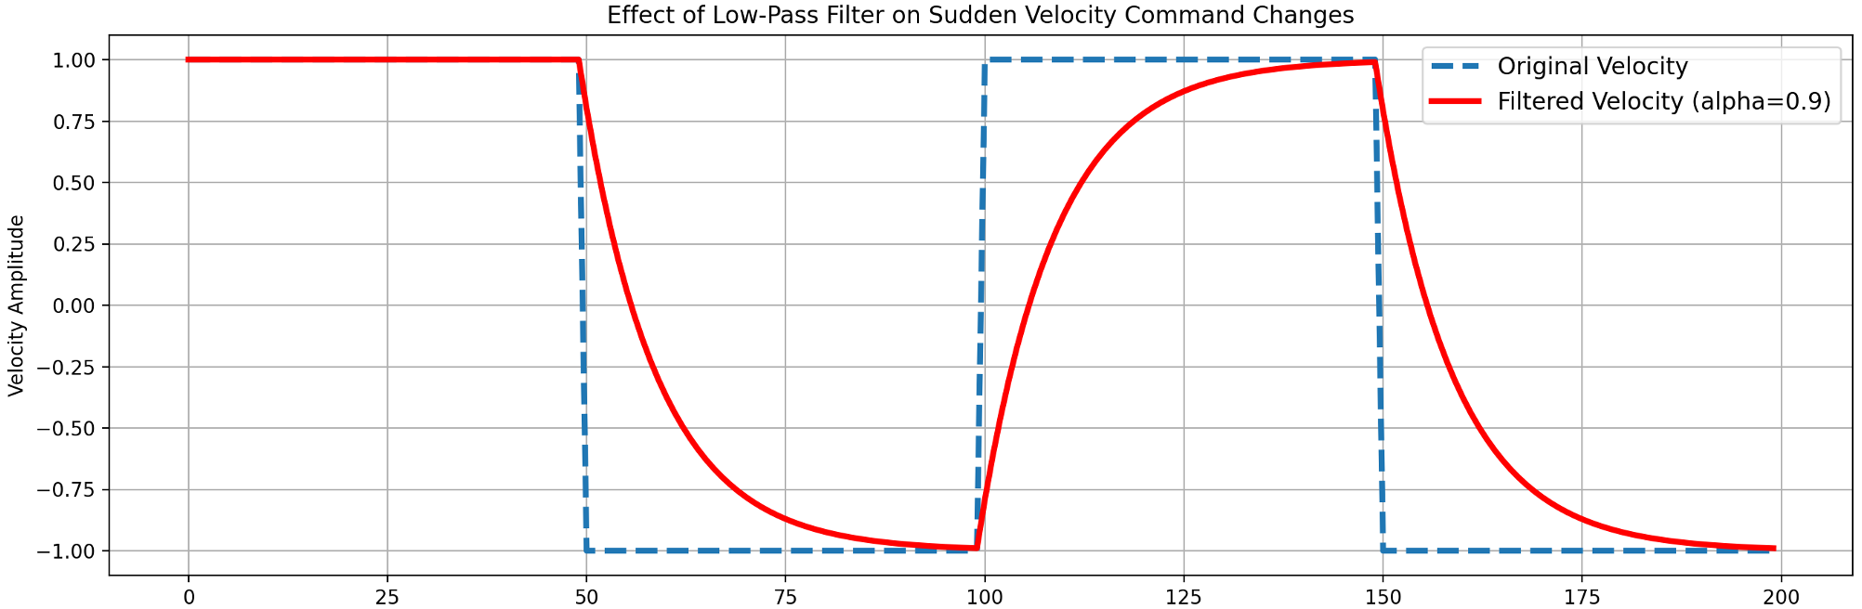
09
Sim2Real transfer
Why filter the base command?
The real base cannot change steering as abruptly as the simulator. A recursive low-pass filter (α = 0.9) turns sudden commands into executable velocity profiles.
Transfer recipe
• Low-pass filter for base commands
• System identification for PID alignment
• Domain randomization over dynamics, timing, and noise
Notes:
从仿真迁移到真实机器人时，最大的困难之一来自移动底盘。
在仿真中，底盘可以非常迅速地改变运动方向。但真实底盘的转向和动力学存在限制，如果直接执行仿真策略产生的突变指令，底盘可能会突然刹车或者无法按照预期运动。
因此，作者对底盘速度指令使用了递归低通滤波器，系数为 0.9。它可以把突变的速度指令变得更加平滑，使真实底盘更容易执行。
除此之外，作者还使用系统辨识来调整仿真和真实机器人中的 PID 控制参数，并通过域随机化模拟动力学、重力、时间、观测噪声和动作噪声等变化。
这些方法的目的都是让策略在训练时接触更多可能的误差，从而提高它在真实环境中的适应能力。
低通滤波：
在 MuJoCo 仿真中，机器人底盘可以几乎瞬间改变运动方向。但是现实中的 Ranger Mini V2 底盘受到转向机构和机械运动能力的限制，不能这样运动。所以我们希望：让强化学习输出的速度命令变化得更平滑，避免现实底盘跟不上指令。
* 低频变化：保留，例如机器人逐渐加速。
* 高频变化：抑制，例如速度突然从 +1 变成 −1。你会发现，滤波后速度不是瞬间跳到 1，而是逐渐接近 1。
One of the main challenges in sim-to-real transfer comes from the mobile base.
In simulation, the base can change its steering direction very quickly. In the real world, the base cannot always execute such abrupt commands. Sudden changes may cause braking or unstable motion.
To address this issue, the authors apply a recursive low-pass filter with a coefficient of 0.9. This smooths the velocity commands and makes them easier for the real base to execute.
The authors also use system identification to align the PID controllers in simulation and on the real robot.
In addition, they apply domain randomization to factors such as dynamics, gravity, timing, observation noise, and action noise.
The goal is to expose the policy to a range of possible errors during training so that it becomes more robust during real-world deployment.
Low-pass filtering:
In the MuJoCo simulation, the robot’s mobile base can change its direction almost instantaneously. However, the real Ranger Mini V2 base is constrained by its steering mechanism and mechanical dynamics, so it cannot move in the same way.
Therefore, we smooth the velocity commands generated by the reinforcement learning policy so that the real base can track them more reliably.
Low-frequency changes are preserved, such as gradual acceleration.
High-frequency changes are suppressed, such as a sudden switch from +1 to −1.
After filtering, the velocity does not jump to 1 immediately. Instead, it gradually approaches 1.

Slide 10
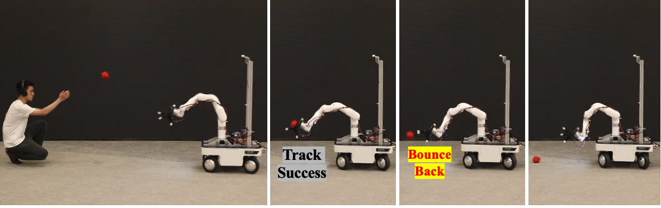
10
Real Robot Deployment
Catch S.R. (%) | Cube | Sphere | Cylinder | Irregular
w/o LPF | 0 | 0 | 0 | 5
Ours + LPF | 25 | 25 | 15 | 20
What limits catching?
• Elastic sandbags rebound on contact, unlike the simulator objects
• RGB-D tracking degrades during fast motion or hand occlusion
• The authors suggest tactile sensing and stronger global localization
With LPF, tracking reaches roughly 65–75% across four sandbag shapes. Catching reaches 15–25%.
Notes:
在真实实验中，作者使用了四种不同形状的沙袋，包括立方体、球体、圆柱体和不规则形状。
加入低通滤波之后，追踪成功率大约在 65% 到 75% 之间。具体来说，不同形状的追踪成功率约为 70%、65%、70% 和 75%。
但是，最终抓取成功率只有 15% 到 25%。相比之下，不使用低通滤波时，追踪和抓取表现都明显下降。
仿真和真实结果之间存在差距，主要有两个原因。第一，沙袋具有弹性，接触手掌之后可能会反弹，而仿真中的物体没有完全模拟这种接触行为。第二，物体运动速度较快，或者被手掌遮挡时，RGB-D 摄像头的三维定位会产生误差。
因此，机器人有时能够移动到物体附近，却无法在接触之后稳定地把它抓住。论文认为，触觉传感器和更准确的全局定位系统可能有助于解决这些问题。
For the real-world experiments, the authors use four types of sandbags: a cube, a sphere, a cylinder, and an irregular shape.
With the low-pass filter, the tracking success rate is approximately 65 to 75 percent across the four shapes. The specific tracking rates are about 70, 65, 70, and 75 percent.
However, the catching success rate is only between 15 and 25 percent. Without the low-pass filter, both tracking and catching performance decrease substantially.
There are two main reasons for the gap between simulation and reality.
First, the sandbags are elastic. They can rebound after hitting the palm, while this contact behavior is not fully modeled in simulation.
Second, the RGB-D camera becomes less reliable when the object moves quickly or is occluded by the hand.
As a result, the robot can sometimes reach the object but still fail to hold it securely after contact. The authors suggest that tactile sensing and more accurate global localization could help address these problems.

Slide 11
11
Conclusion and Limitation
Takeaway
A mobile base expands the workspace;
A dexterous hand expands the object set;
Two-stage RL makes the high-DoF policy trainable.
Boundary
• Simulation: catching success around 61–84% on unseen objects
• Real robot: tracking is around 70%, but catching stays at or below 25%
• Next step: tactile sensing for rebound-aware grasping
Notes:
Catch It! 的核心贡献可以概括为三点。第一，移动底盘扩大了机器人的工作空间。第二，灵巧手提高了机器人对不同物体形状的适应能力。第三，两阶段强化学习降低了高维控制策略的训练难度。
在仿真中，机器人对未见过物体的抓取成功率达到大约 65% 到 84%，说明这种方法具有较好的泛化能力。
在真实机器人上，追踪成功率约为 70%，但抓取成功率最高只有 25%。因此，这篇工作已经展示了一个完整的仿真到现实流程，但真实环境中的接触动力学和视觉定位仍然是主要瓶颈。
未来可以结合触觉传感器，让机器人感知物体是否发生反弹，并根据接触状态及时调整手指动作。同时，也可以使用更稳定的全局定位系统，提高高速运动和遮挡情况下的物体定位精度。
To conclude, this paper makes three main contributions.
First, the mobile base expands the robot’s workspace. Second, the dexterous hand improves the robot’s ability to handle objects with different shapes. Third, two-stage reinforcement learning makes it easier to train a high-dimensional whole-body control policy.
In simulation, the robot achieves approximately 65 to 84 percent catching success on unseen objects, which demonstrates strong generalization.
On the real robot, the tracking success rate is around 70 percent, but the catching success rate remains at or below 25 percent.
Therefore, the paper demonstrates a complete sim-to-real pipeline, but contact dynamics and visual perception remain the main bottlenecks in the real world.
Future work could add tactile sensors so that the robot can detect rebounds and adjust its grasp accordingly. A more accurate global localization system could also improve object tracking during fast motion and hand occlusion.

Slide 12
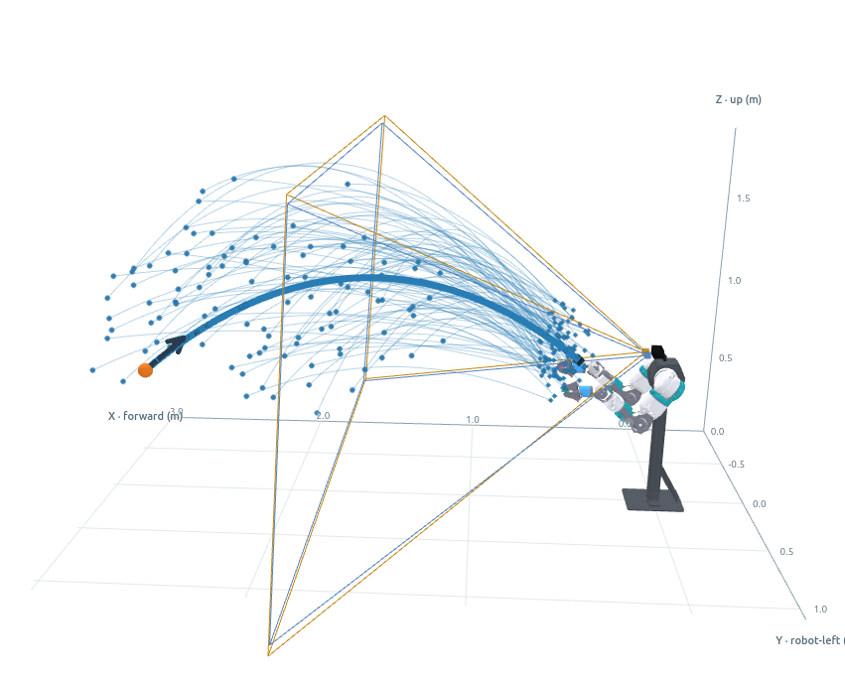
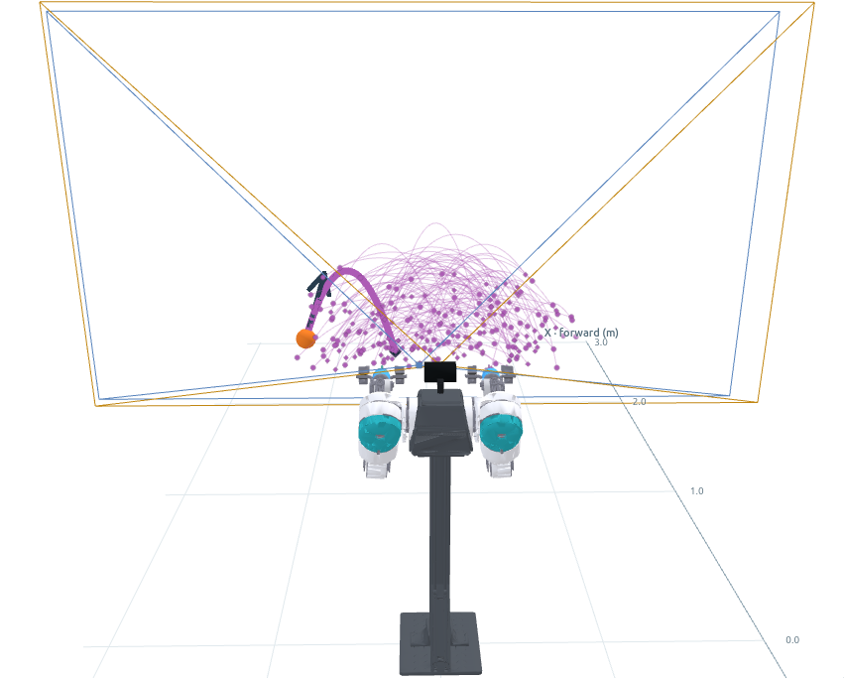
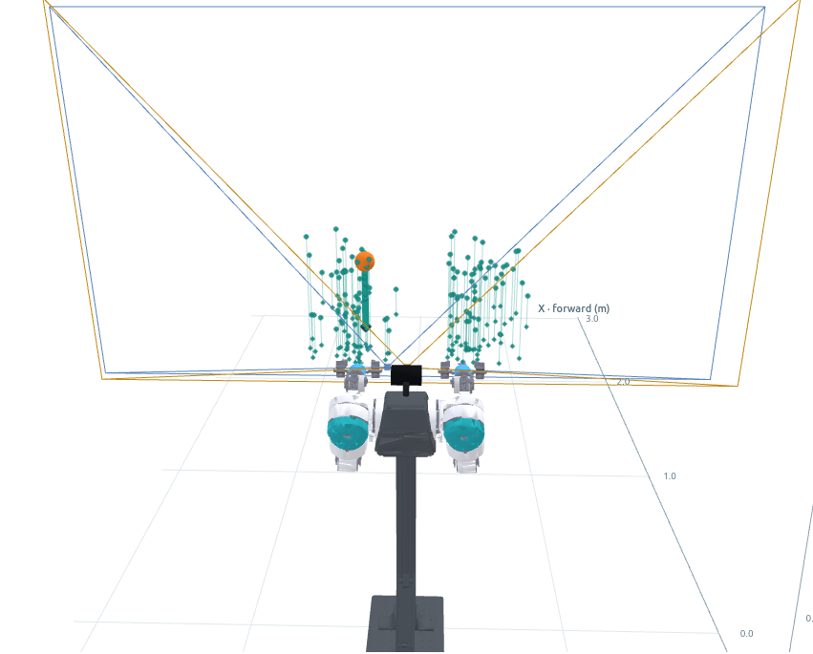
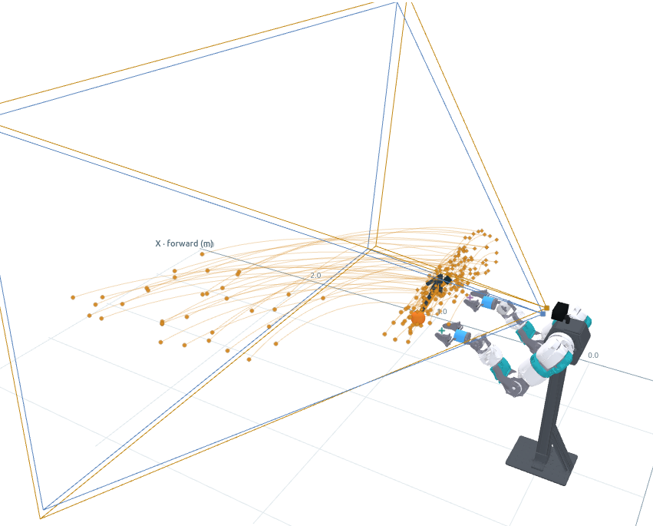
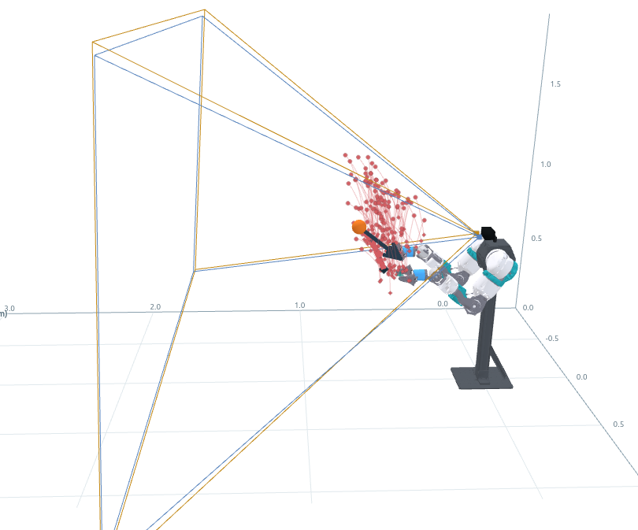
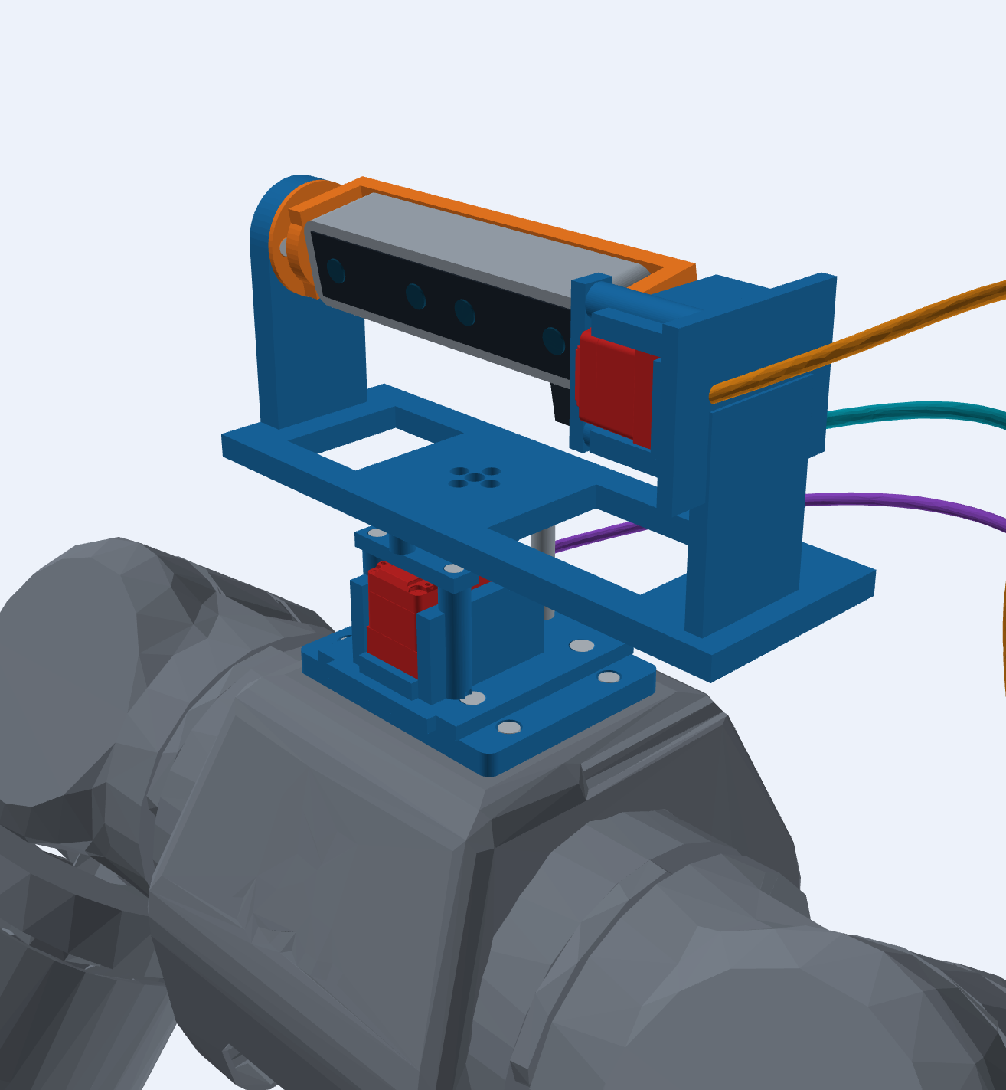
Notes:
1. Dataset: 现有的很多catching工作是把物体从机器人前方或一个集中的区域抛入可达空间，很少有测试物体从不同方向进入工作空间。所以我的一个核心观点是：机器人应该主动的去接取物体，而不是把物体抛给机器人; 我想先从纯运动轨迹数据集开始做起
所以就是可以先只管物体的运动轨迹，不管机器人的位置，机器人的位置我们可以去计算他的工作空间，然后随意挪动。所以二者是解耦的，不能基于机器人的位置去生成物体的轨迹。
2. 设计一个3D云台让openarm能主动去观察,
Dataset: Many existing catching studies throw objects from directly in front of the robot or from a concentrated region within its reachable space. Few studies test objects entering the workspace from different directions.
One of my core ideas is that the robot should actively move to catch the object, rather than having the object thrown directly toward the robot. I would like to begin with a dataset containing only object motion trajectories.
At this stage, we can focus on the object’s trajectory and ignore the robot’s position. The robot’s workspace can be calculated separately, and the robot can then be moved freely within that workspace. In other words, the two components should be decoupled. Object trajectories should not be generated based on the robot’s position.
Design a 3D gimbal: Build a 3D pan-tilt gimbal that enables OpenArm to actively observe its surroundings.

