Slide 1
Development Cycle
From Idea to Release

Slide 2
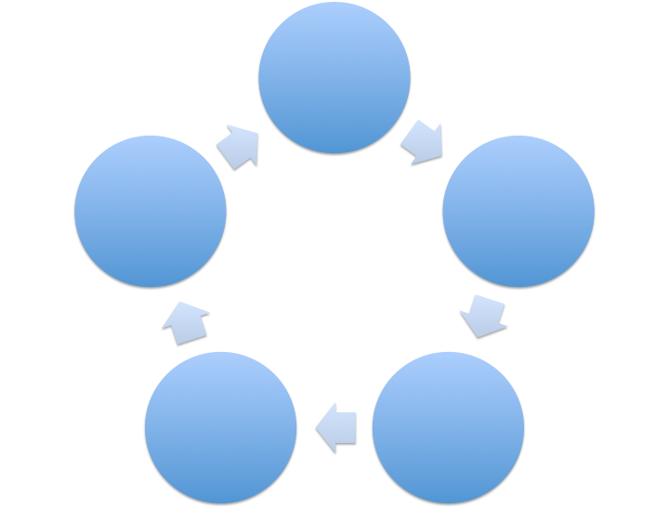
Requirements Gathering
Release
Detail/Feature Design
User Acceptance
Code/
Testing
Process
Notes:
Note that the process will be different across different companies, and the engineers may be involved in different steps across different companies. But this is the general process that most products go through.
Depending on what comes out of user testing, you may want to rebuild or even re-design certain features.
It’s a cycle because after you release, there may be future phases with new deliverables where the process starts over again.

Slide 3
Requirements Gathering
Identify your problem
Why are we building this? Who are we building this for?
Identify your stakeholders
Who are the people who have a say or who owns this feature?
Function
What does the feature need to do? Break the product down into user stories.
Form
How does the feature need to look?
Prioritize requirements and determine the minimum viable product (MVP), i.e., what are the features that this product cannot launch without.

Slide 4
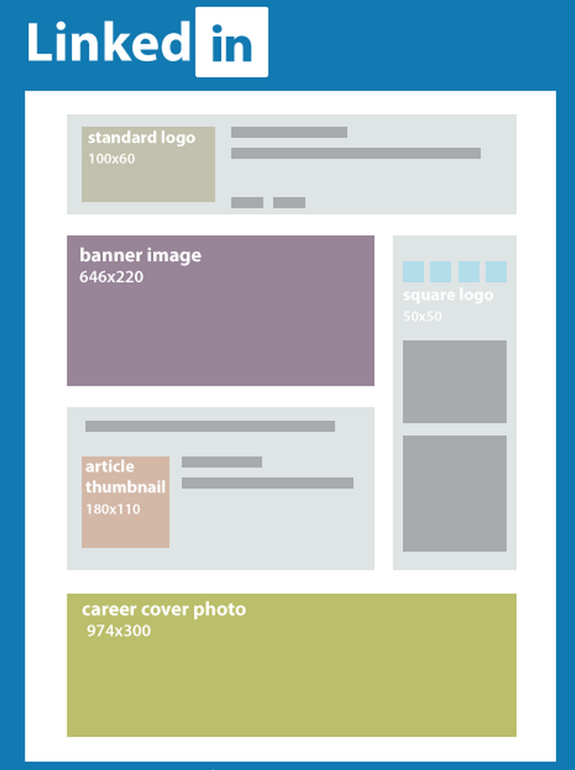
Detail & feature design
Example mockup
Form
Mocks: realistic graphic representation of what the feature will look like
Work with designers
Function
System architecture design
Proof of concept (POC): barebones version of how the feature will work
Work with engineers

Slide 5
Coding & testing
Everything we have been doing so far!
We will be covering testing tomorrow.

Slide 6
User acceptance
Getting your feature in front of the stakeholders and noting how they interact with it, their opinions and feedback, etc.
Go / no-go decision made
Have you met the requirements?

Slide 7
Release
Initial ramp
Allow a small subset of real users to test the live feature
Ramping up
Release the feature to a larger subset of real users
Test the feature against heavier traffic loads
100% ramp
Making the feature available to everyone
Notes:
Some people may simply release to everyone at the same time instead of doing an incremental ramp release.

