Slide 1
qmd-pptx-template
Here is the subtitle Author 1, Author 2

Slide 2
Section 1

Slide 3
Title and Content slide
This list of item is incremental - change to incremental: false in the YAML to turn it off
list 1
list 2
list 3

Slide 4
Speakers notes
You can add speaker notes with
::: {.notes} Speaker notes go here. :::
Notes:
Speaker notes go here.

Slide 5
Two Content slide
There can be content …
… split in different columns

Slide 6
Section 2

Slide 7
Comparison slide
Text here with image/table next to it
Sepal.Length | Sepal.Width | Petal.Length | Petal.Width | Species
5.1 | 3.5 | 1.4 | 0.2 | setosa
4.9 | 3.0 | 1.4 | 0.2 | setosa
4.7 | 3.2 | 1.3 | 0.2 | setosa
4.6 | 3.1 | 1.5 | 0.2 | setosa
5.0 | 3.6 | 1.4 | 0.2 | setosa
5.4 | 3.9 | 1.7 | 0.4 | setosa

Slide 8
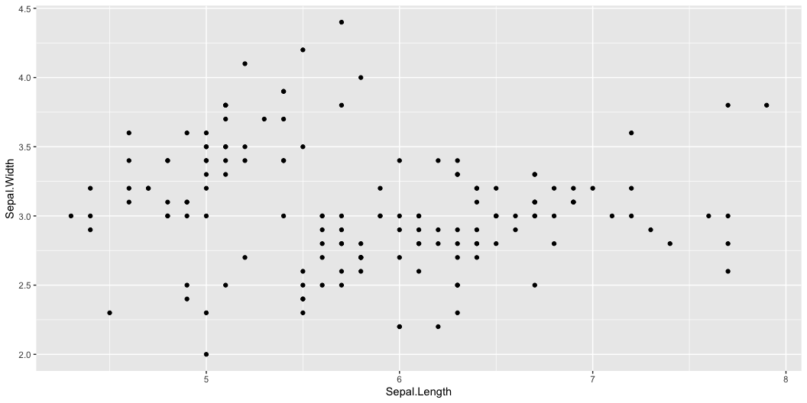
Content with Caption slide
There is text above a graph or a table

Slide 9
Notes:
Blank slide to get the final slide

